Slide 1
13주차 과제 – AC Sweep Analysis
회로도
Simulation – waveform capture & Project file(.opj)
start freq. : 1, end freq. : 100k, points : 100
simulation 결과 – x축, y축 모두 logarithmic scale

Slide 2
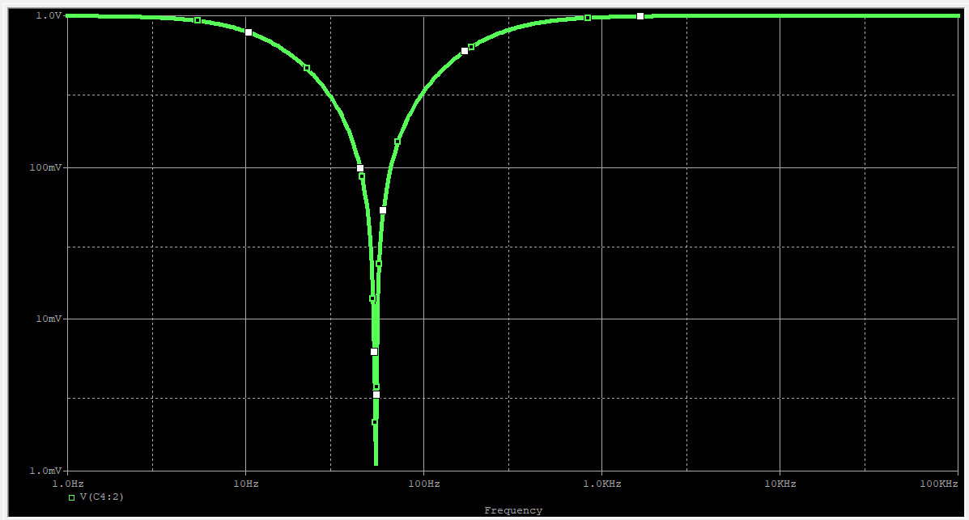
13주차 과제 – AC Sweep Analysis
결과 waveform

