Slide 1
Advanced Flying Robots
Current Progress Presentation #1 (CW3)
Geometric controller on hardware, onboard Rust trajectory execution, and motion-planning mode comparison
Crazyflie 2.1 + optical flow + planning modes 0-3

Slide 2
Main Message
The current stack has progressed from early geometric-controller tracking tests toward onboard Rust trajectory execution and a richer motion-planning comparison across modes 0-3.
The contribution is not only generating new reference trajectories.
The stack also validates references with feasibility/limits plots, closed-loop simulation, and real-flight log analysis.
The presentation compares both hardware progress and planning-mode behavior.

Slide 3
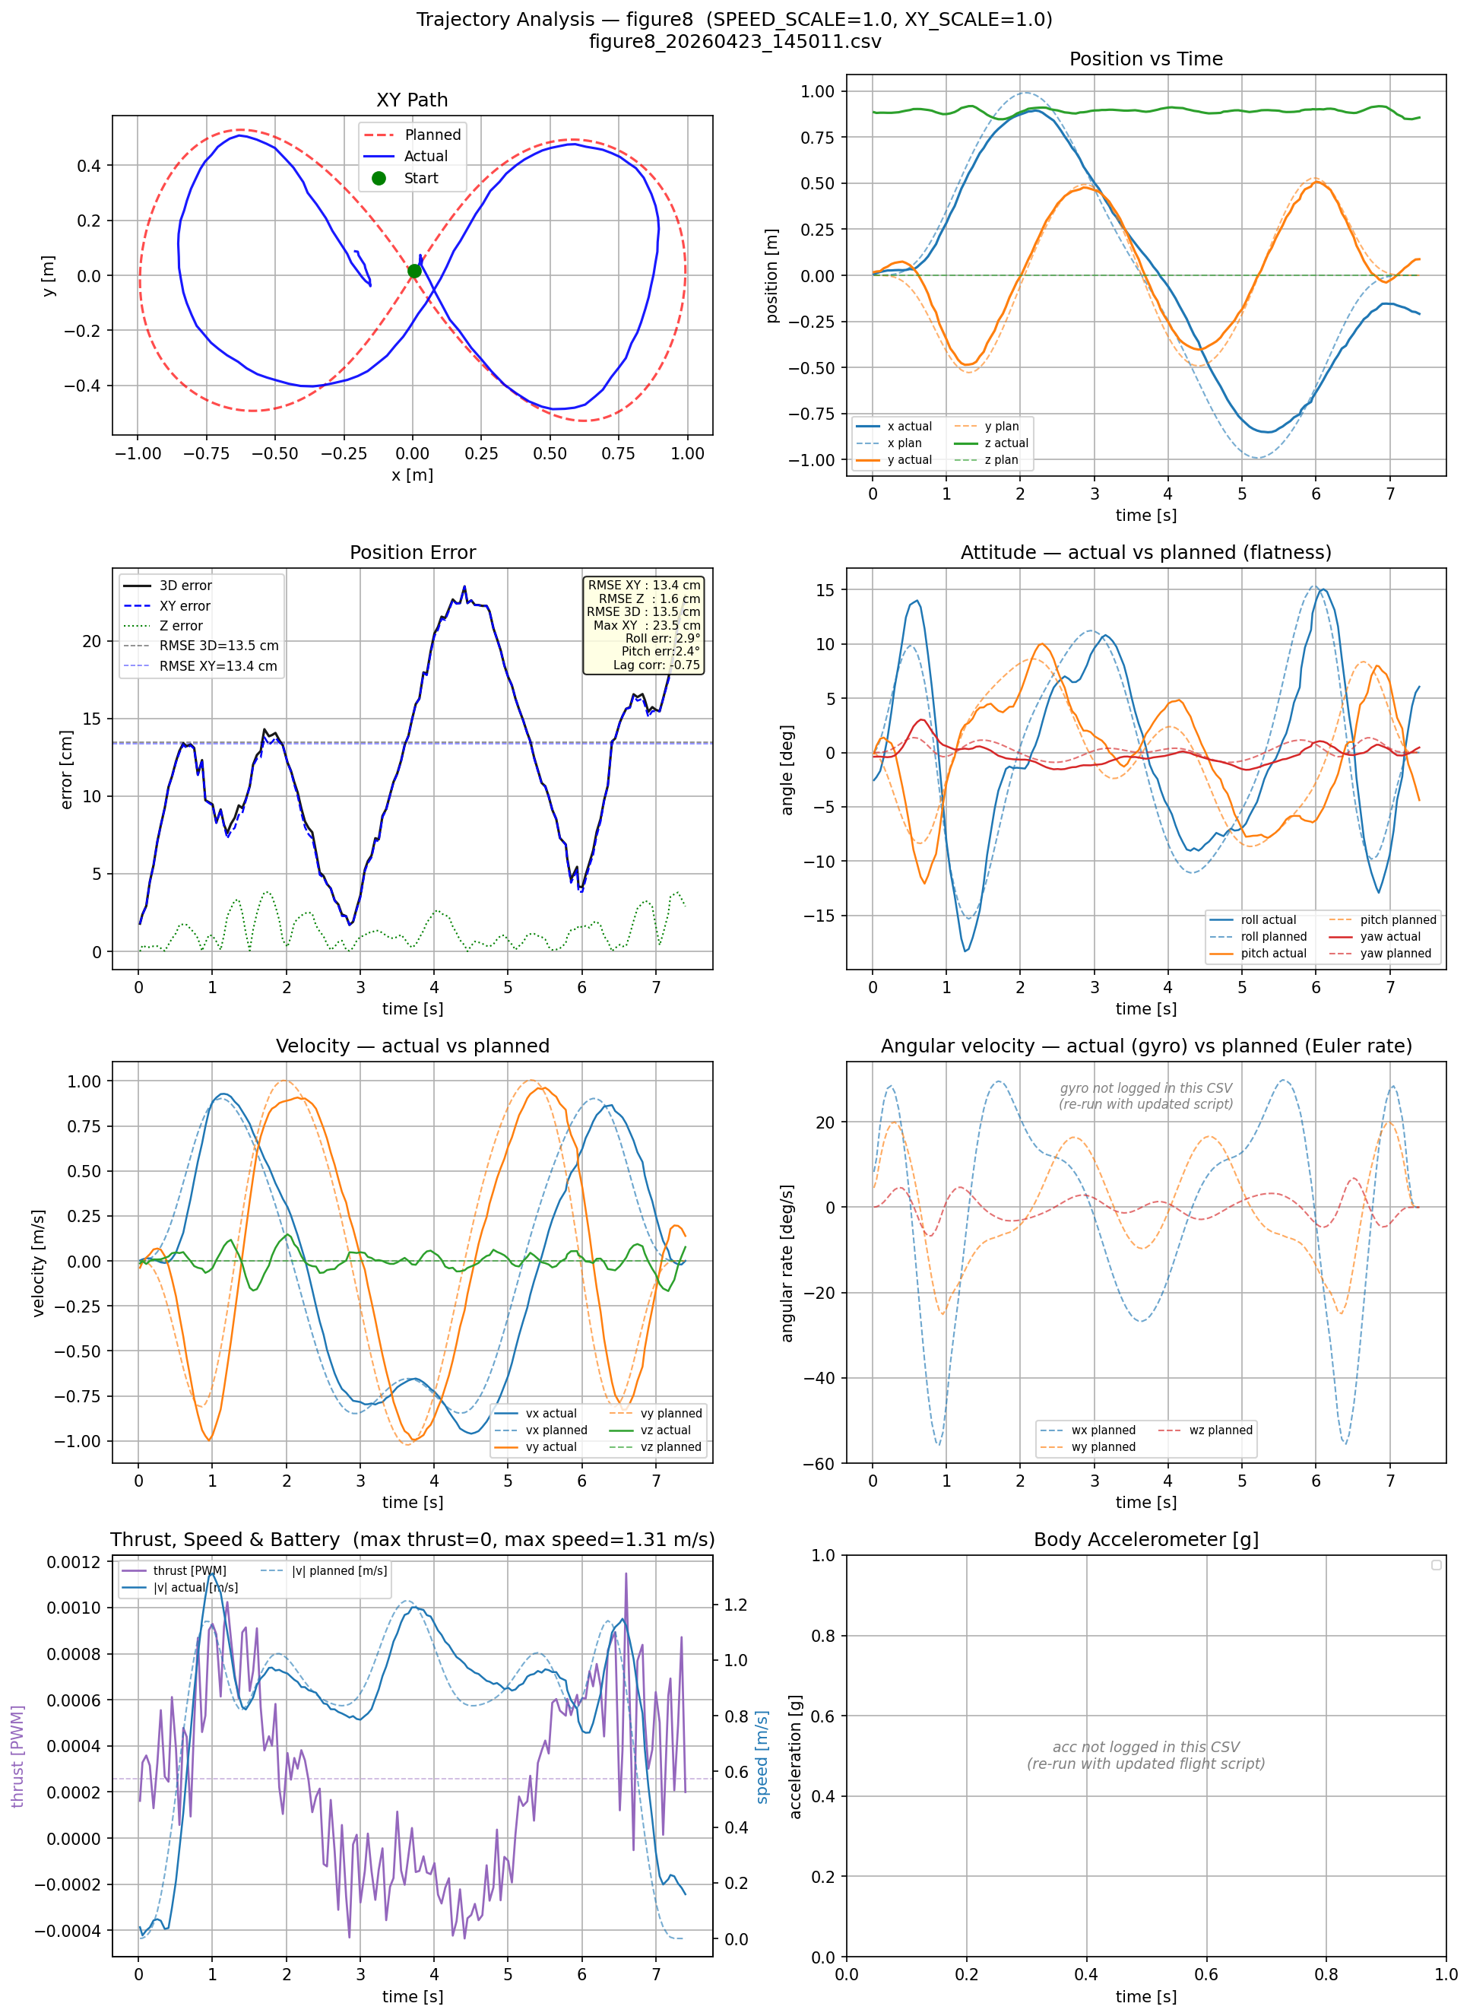
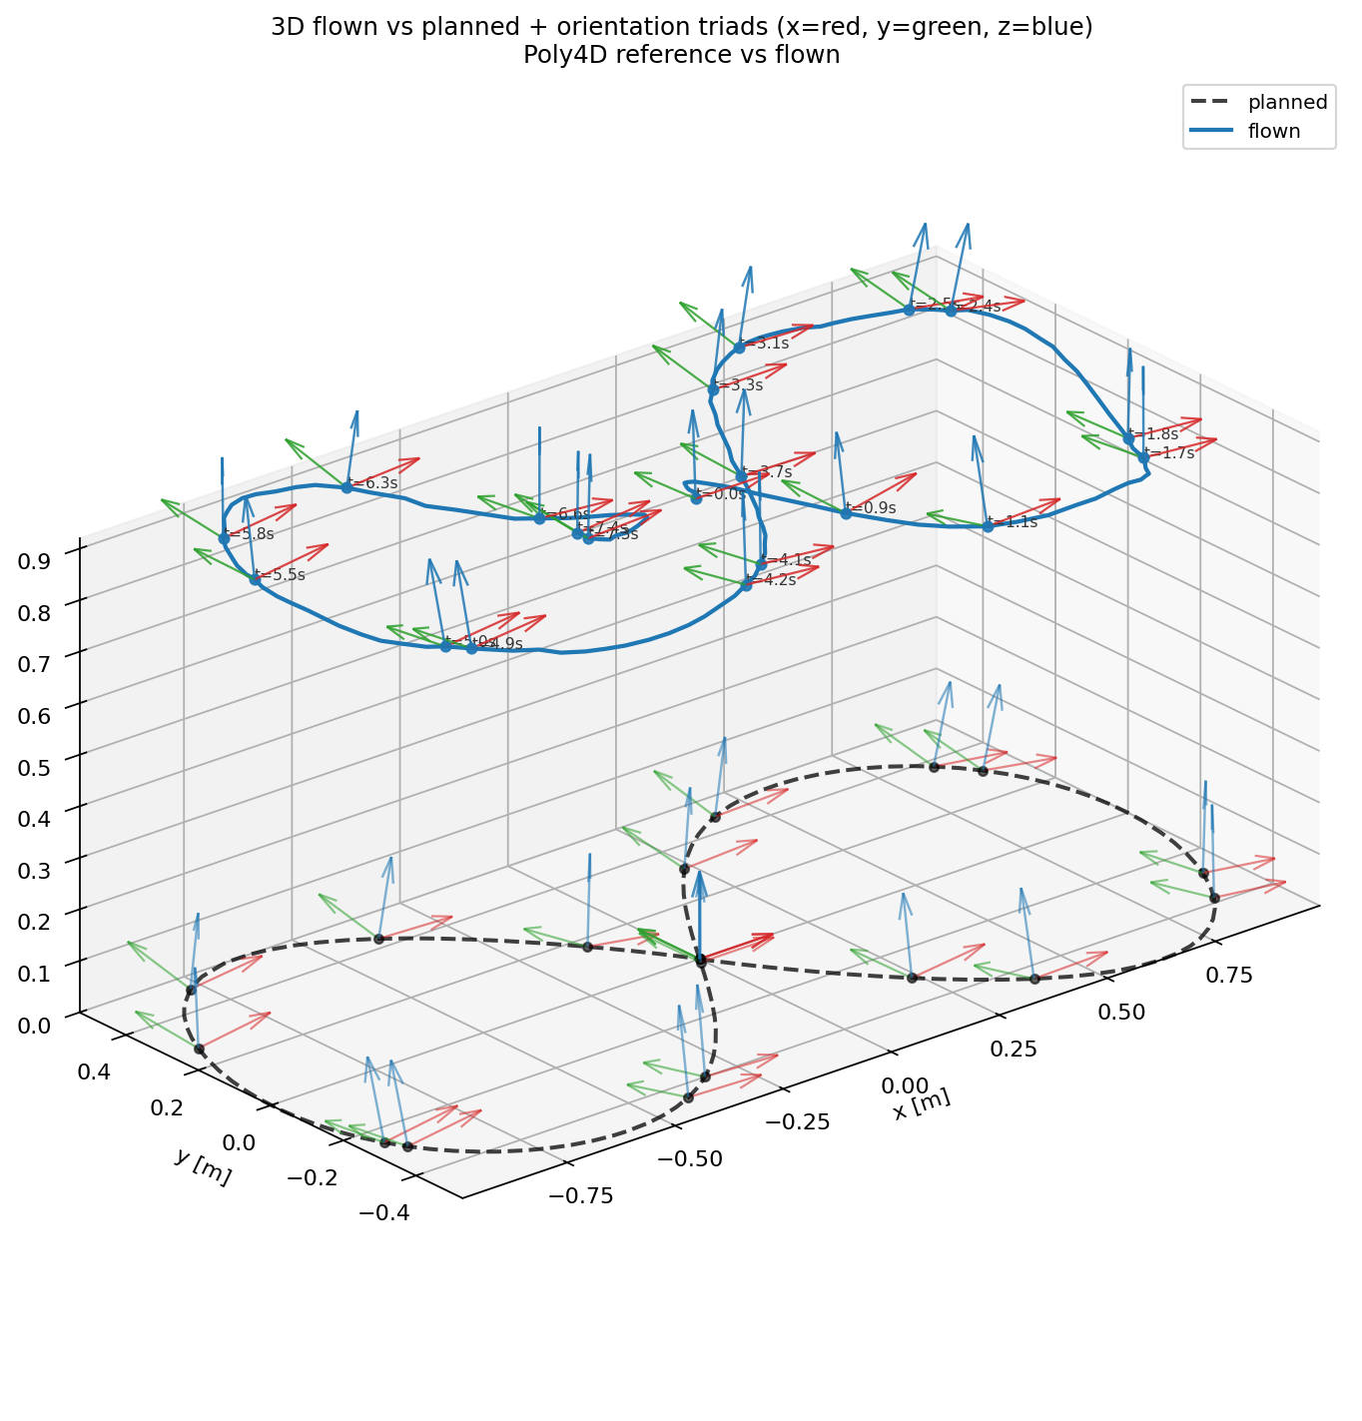
Geometric Controller On Hardware: Initial State
figure8_20260423_145011.csv
Main analysis
3D orientation

Slide 4
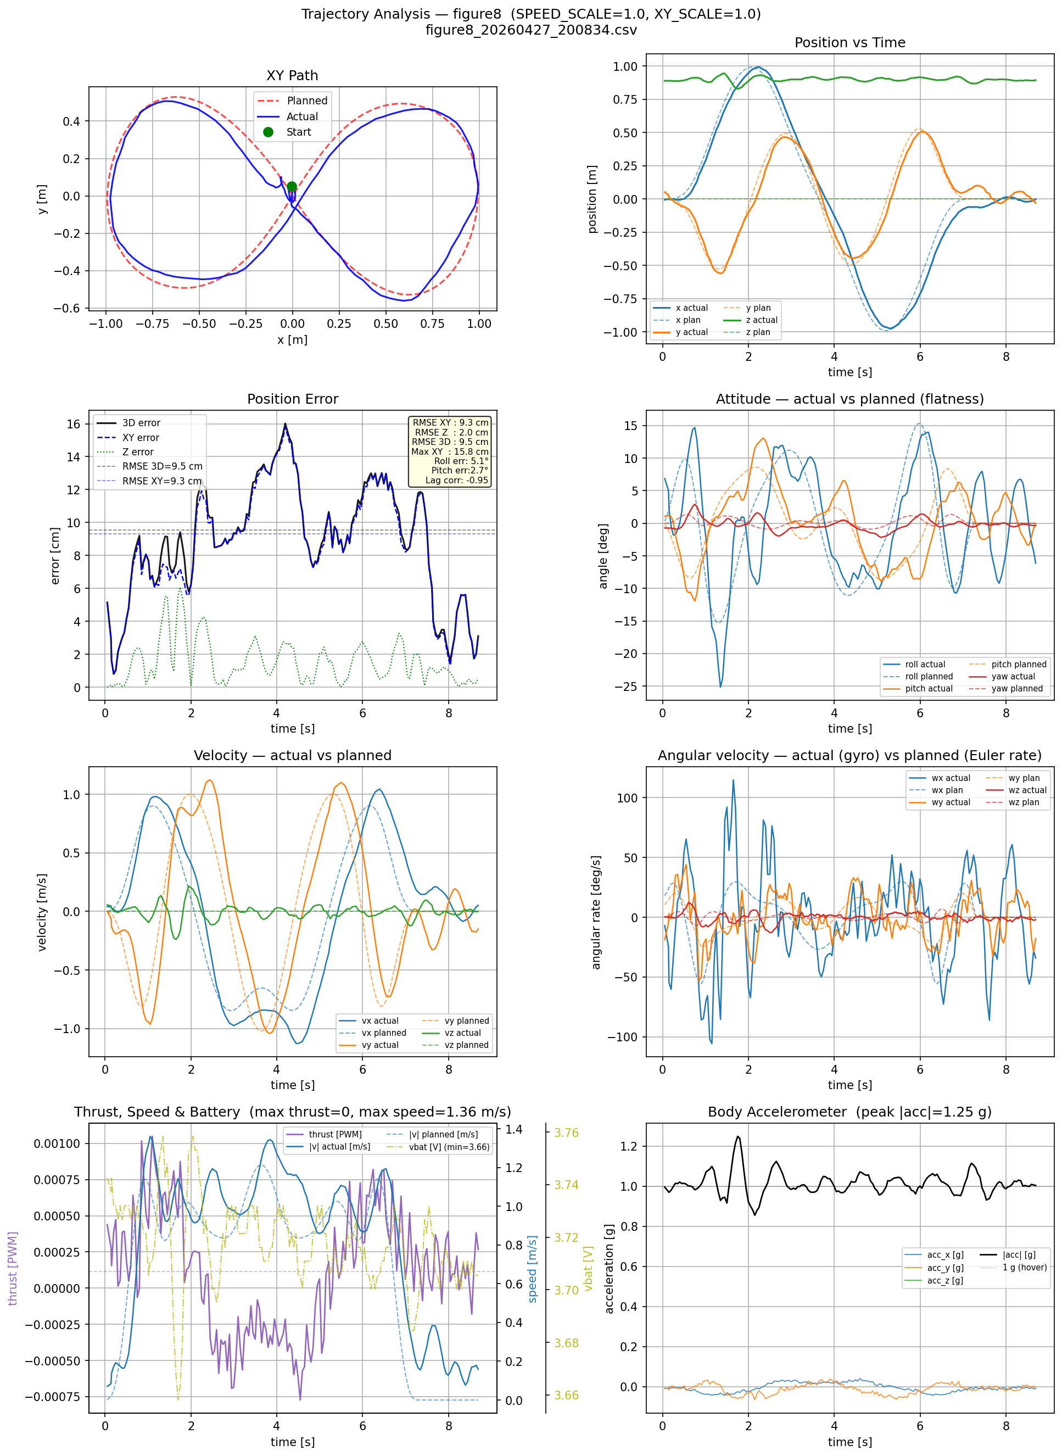
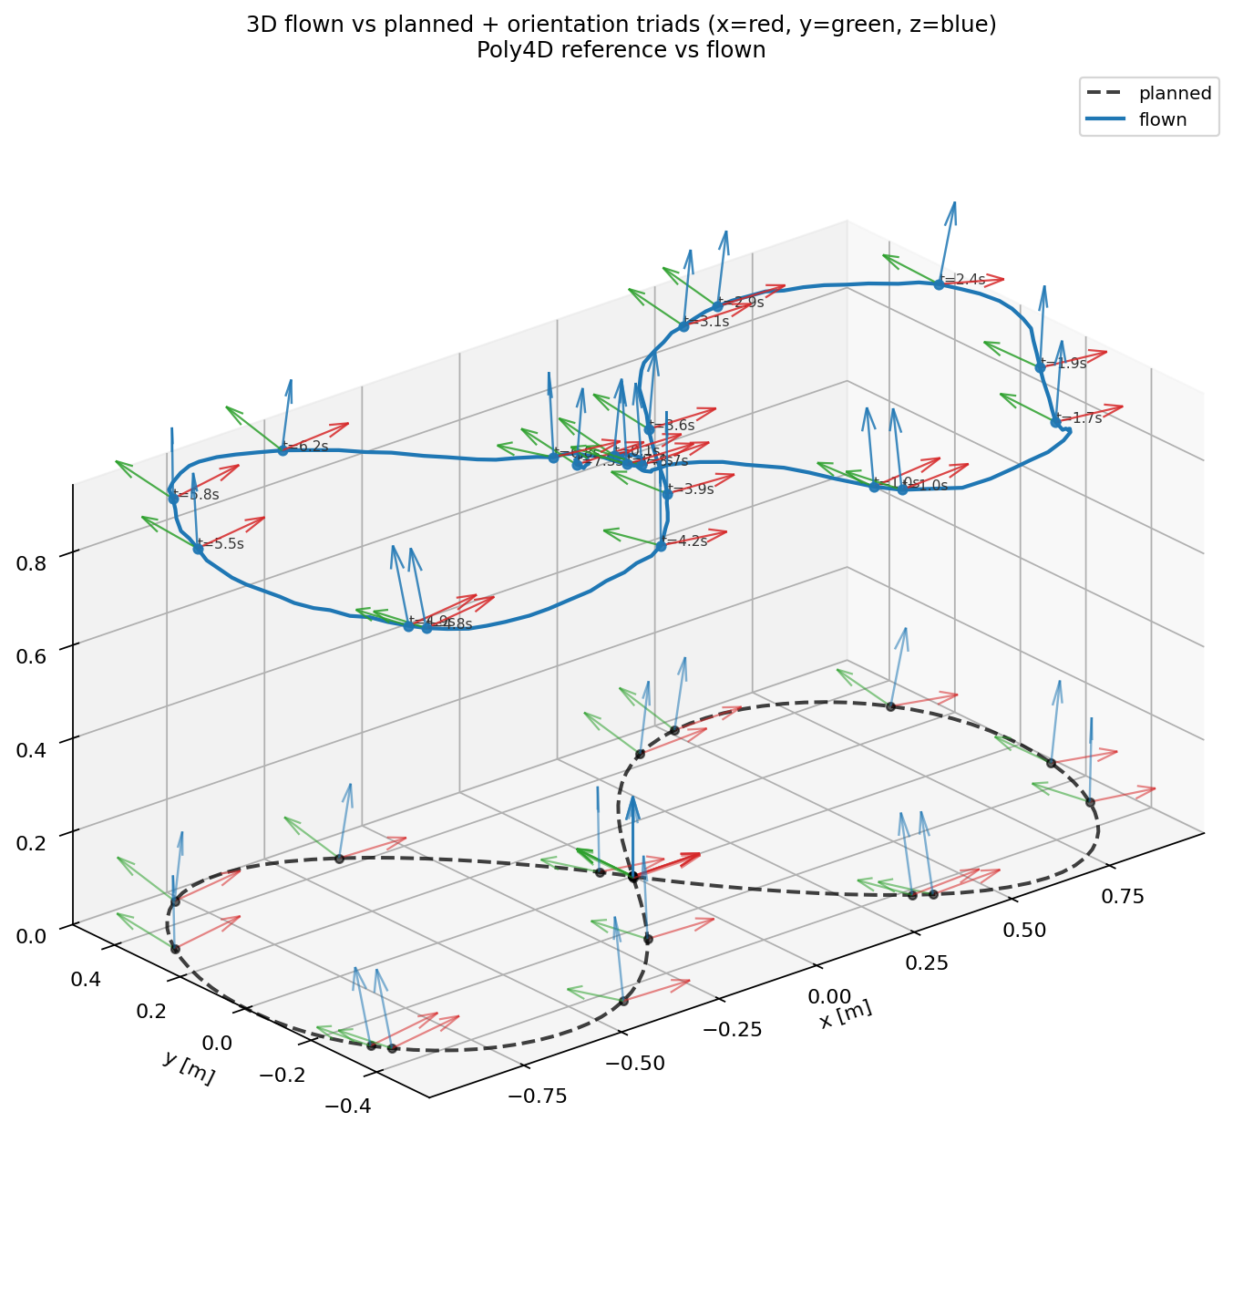
Geometric Controller On Hardware: Intermediate Improvement
figure8_20260427_200834.csv
Main analysis
3D orientation

Slide 5
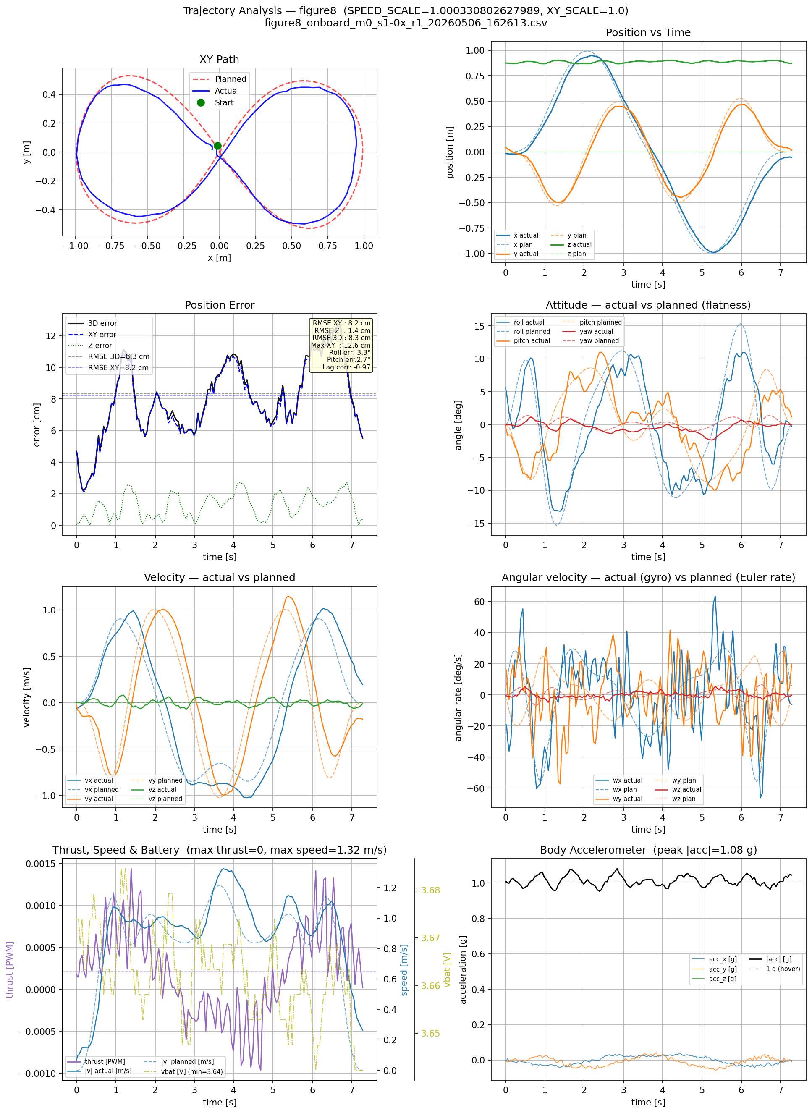
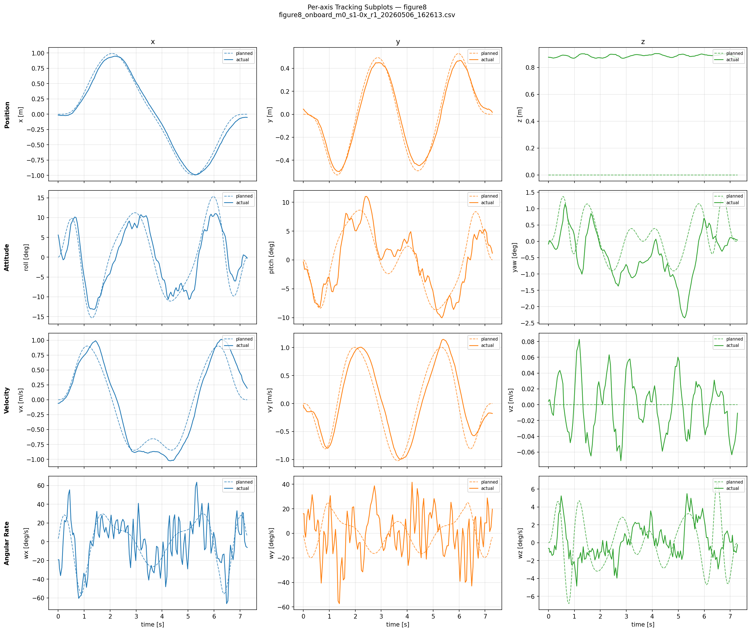
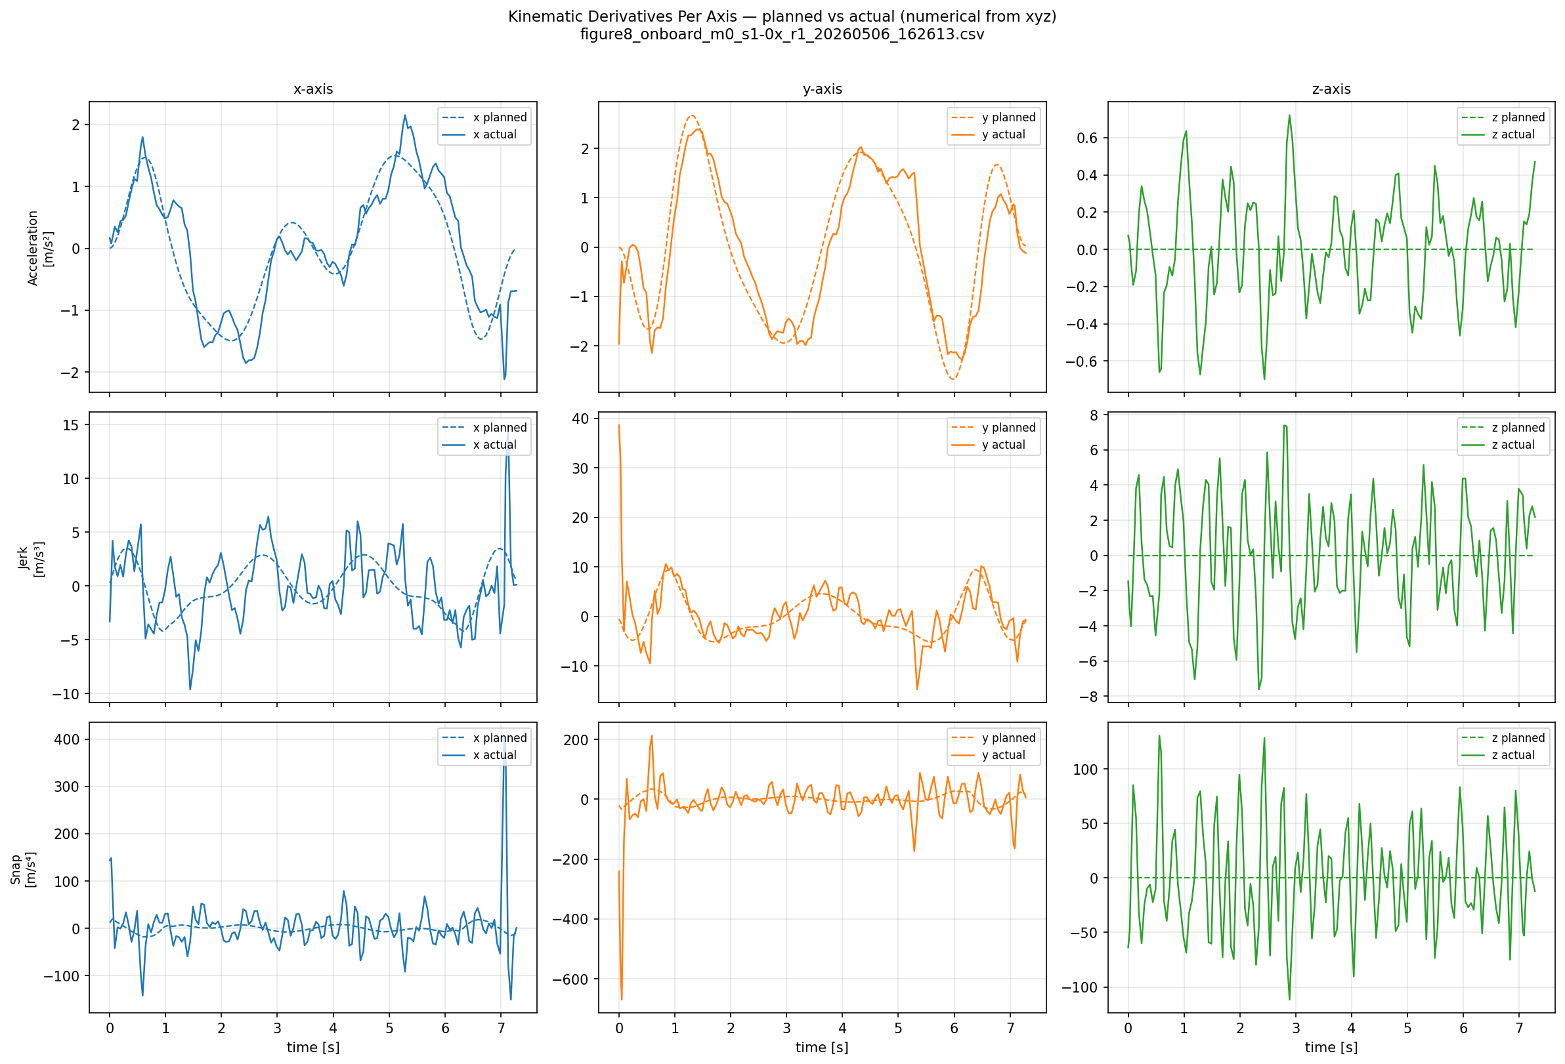
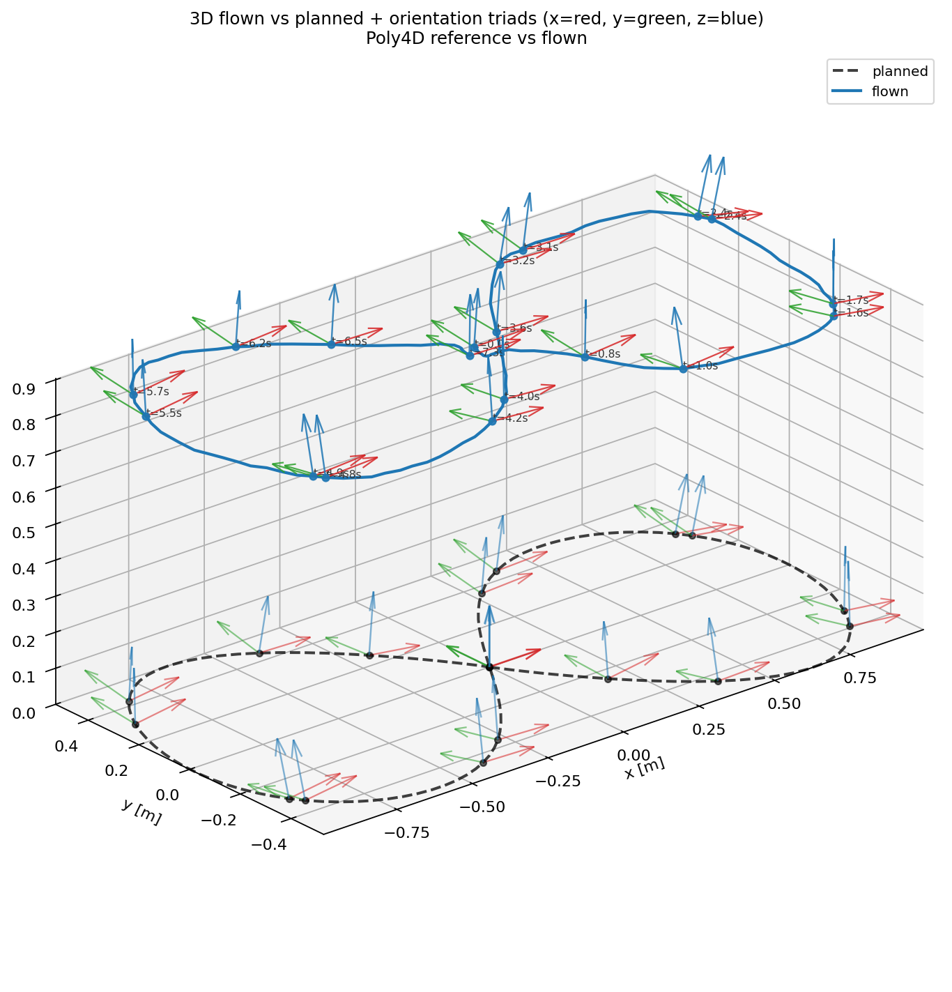
Best Current Hardware Result
Geo controller + onboard Rust: figure8_onboard_m0_s1-0x_r1_20260506_162613.csv
Main analysis
Per-axis
Kinematics
3D orientation

Slide 6
Motion Planning: Figure-8 Across Modes (0-3)
Mode | Core Idea | Attitude Source | Time Scaling | Evidence
0 | Base spline trajectory | Flatness-derived | Manual/basic | Full reference plot set
1 | Richter-like min-snap with time allocation | Flatness-derived | k_t-based | Full reference plot set
2 | Explicit SE(3): authored attitude + position | Uploaded/explicit | Richter timing + SE(3) | Full reference plot set
3 | Paper-faithful flat-output planning | Flatness-derived | Iterative/paper-style | Full reference plot set
Modes 0/1/3 share the minimum-snap spline backbone: 8th-order polynomials and per-axis QPs for x, y, z, yaw.
Cross-axis physics is handled downstream through differential flatness, controller logic, and feasibility checks.
Mode 2 keeps the position-planning stack but changes the attitude source to explicit quaternion/SO(3) interpolation.

Slide 7
Concise Implementation Notes
Per-axis QP: robust, debuggable, and fast enough for iteration.
A joint QP becomes useful only when hard coupled constraints must be enforced directly in the optimizer.
Feasibility plots are planning-side model/proxy checks; hardware saturation claims still need logs or actuator telemetry.
Mode 2 uploads explicit attitude polynomials, while modes 0/1/3 derive attitude from flatness.
Mode 1 timing
Mode 3 redistribution
v_avg = 0.5 + 1.5 sqrt(k_t) T_i = max(||p_{i+1}-p_i|| / v_avg, 0.15 s)
T_i_target = T_total J_i / sum_j J_j T_i <- T_i + 0.5 (T_i_target - T_i)

Slide 8
Latest Figure-8 k_t Scan Summary
The scan selected the largest sampled k_t values that stayed below target_utilization_max = 0.99. Values marked below_band are safe but below the tighter 0.95-0.99 target band.
Mode | Figure-8 k_t | Scan Status | Interpretation
1 | 0.3107 | below_band | Highest safe sampled Richter timing value found for Figure-8
2 | 3.9191 | below_band | Highest safe sampled SE(3) timing value found for Figure-8
3 | 0.7116 | below_band | Highest safe sampled paper-style timing value found for Figure-8

Slide 9
Common Planning Backbone: Formulation
Shared Aspect | Specific formulation / meaning
Waypoint objective | Given waypoints w_i, generate one polynomial segment between each pair and match segment endpoints.
Segment representation | p_s(t) = sum_{k=0}^{8} c_{s,k} t^k, t in [0, T_s]
Minimum-snap objective | min sum_s integral_0^{T_s} || p_s^(4)(t) ||^2 dt
Per-axis QP | min_c 1/2 c^T Q c + q^T c subject to A_eq c = b_eq
Continuity constraints | A_eq c = b_eq enforces waypoint endpoints and derivative continuity at segment boundaries.

Slide 10
Common Planning Backbone: Flatness And Feasibility
Shared Aspect | Specific formulation / meaning
Flat outputs | Planned outputs are x, y, z, yaw and derivatives; modes 0/1/3 derive attitude afterwards.
Force direction | f = m(a + g e_3), z_B = f / ||f||
Attitude construction | x_C=[cos psi, sin psi, 0]^T; y_B=(z_B x x_C)/||z_B x x_C||; x_B=y_B x z_B; R=[x_B y_B z_B]
Feasibility checking | Sample thrust, angular velocity, torque/motor proxy, state axes, kinematics, and 3D orientation.
Downstream use | All modes feed the same simulator/controller/log-analysis chain, so plots can be compared mode-by-mode.

Slide 11
What Makes Each Mode Different
Mode | What stands out | Exact / useful formulation | Plot focus
0 Spline | Baseline min-snap with fixed segment times | T_s provided directly; optimizer solves coefficients only. | Fixed timing baseline.
1 Richter | Automatic k_t timing | v_avg=0.5+1.5 sqrt(k_t); T_i=max(||p_i+1-p_i||/v_avg,0.15) | Similar path, different timing/limits.
2 SE(3) | Explicit authored attitude | q(s)=SLERP(q_i,q_i+1,s), s=t/T_i; roll/pitch polynomials fitted for upload. | 3D orientation plot matters most.
3 Paper | Iterative time redistribution | T_i_target=T_total J_i/sum J_j; T_i <- T_i+0.5(T_i_target-T_i) | Compare local kinematics/limits vs Mode 1.
Key takeaway: the modes share the smooth-polynomial planning philosophy; the main differences are timing allocation and attitude source.

Slide 12
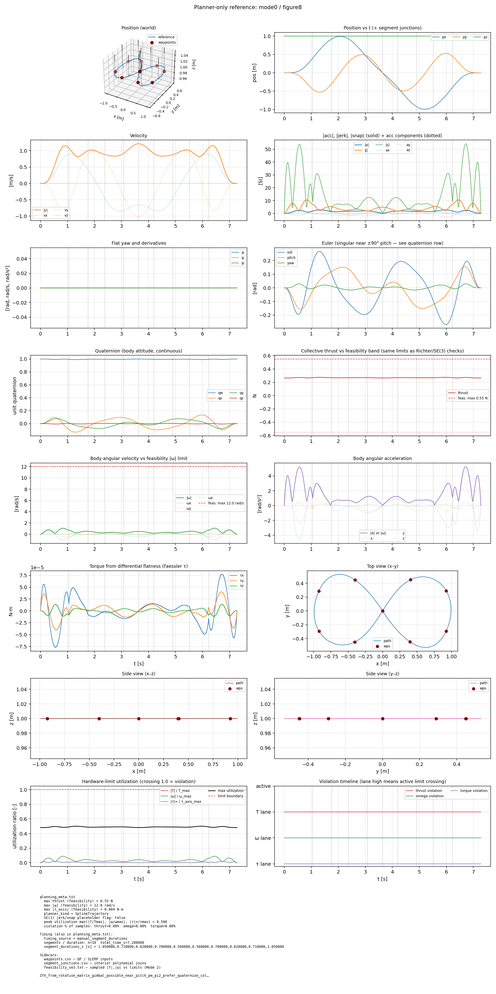
Mode 0: SplineTrajectory — Figure-8 Overview
Baseline fixed-time minimum-snap trajectory
Reference overview

Slide 13
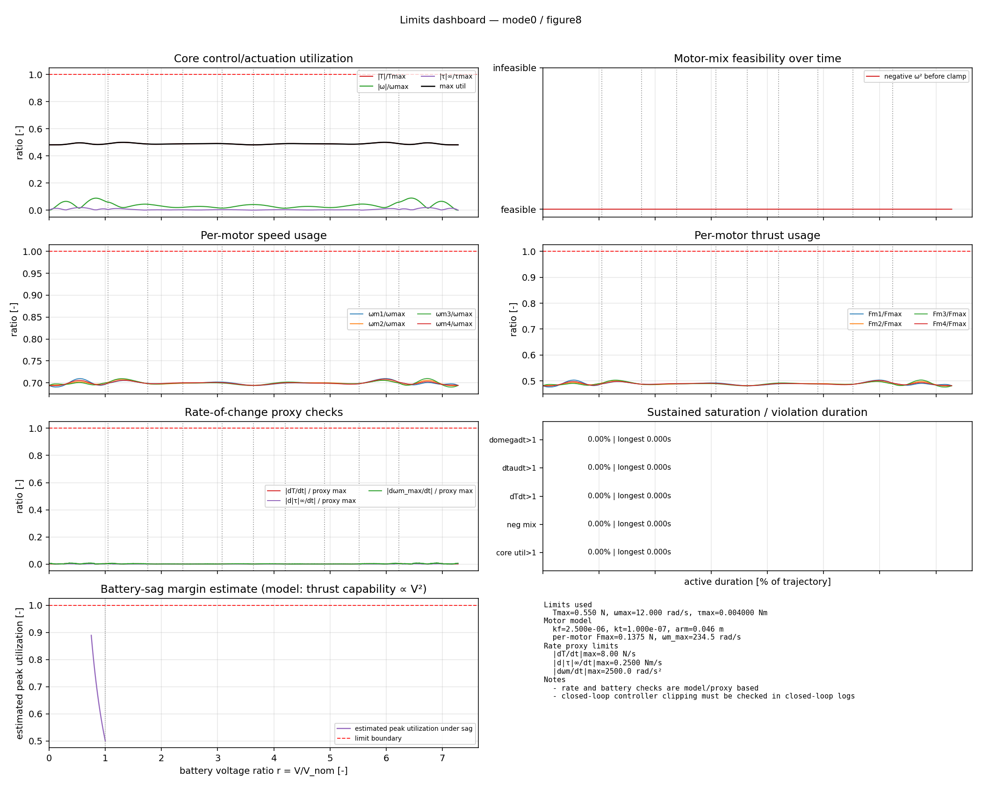
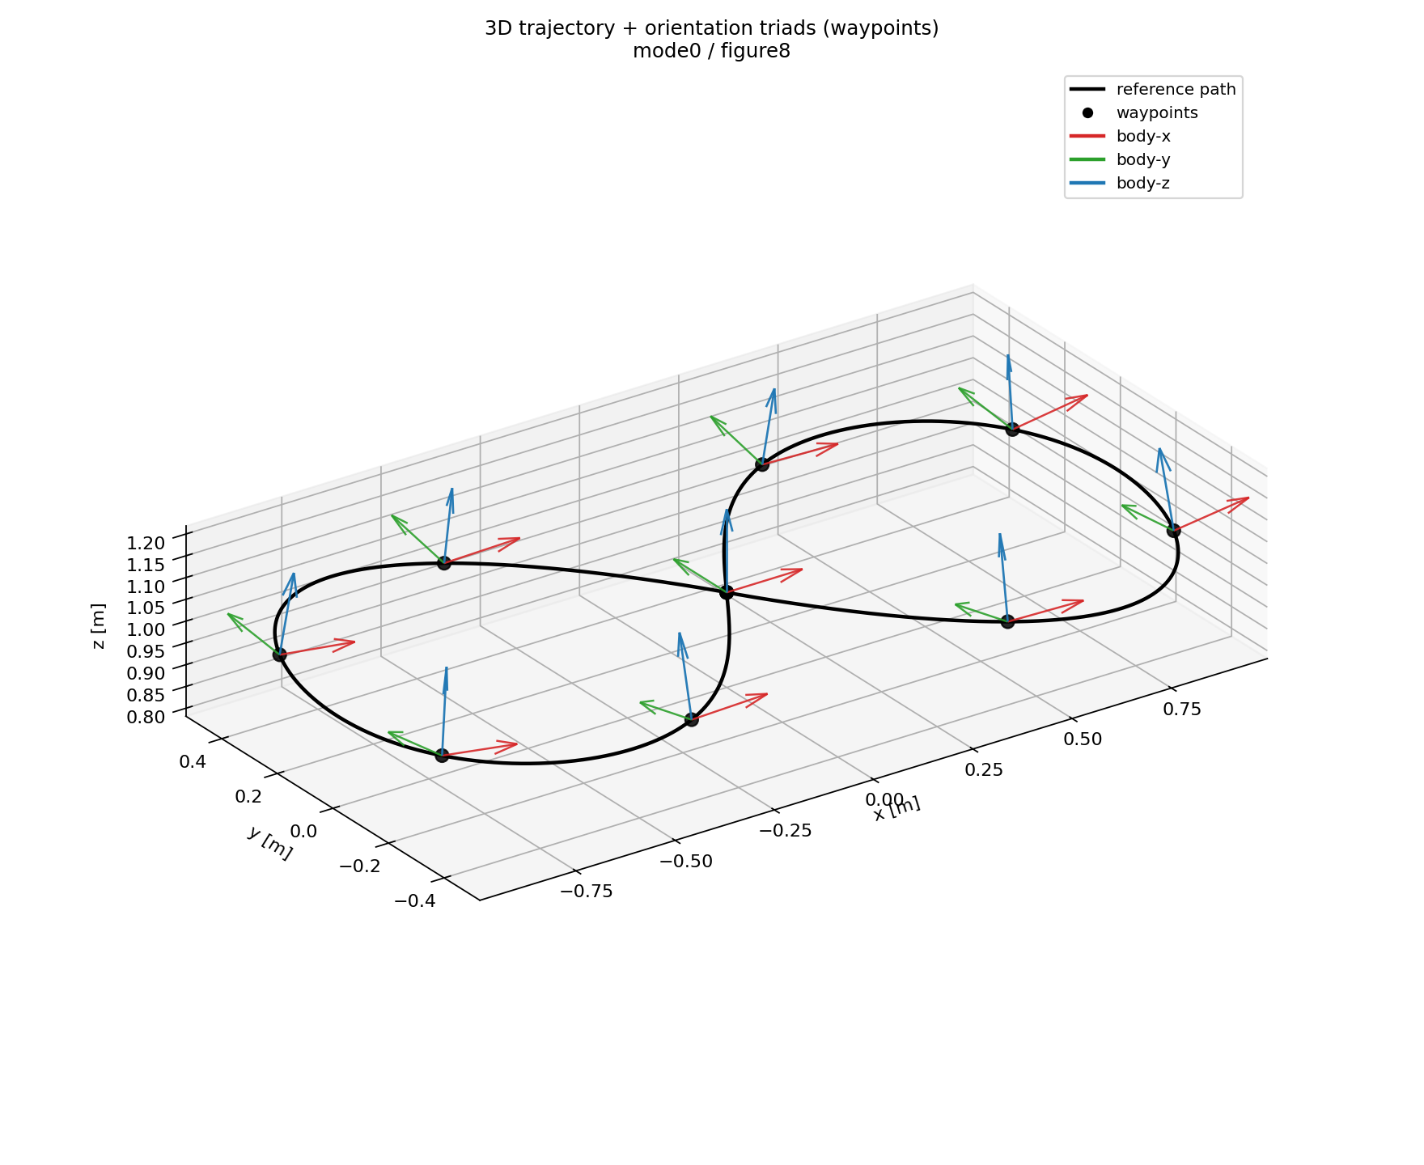
Mode 0: SplineTrajectory — Limits And 3D Orientation
Limits dashboard
3D trajectory + orientation

Slide 14
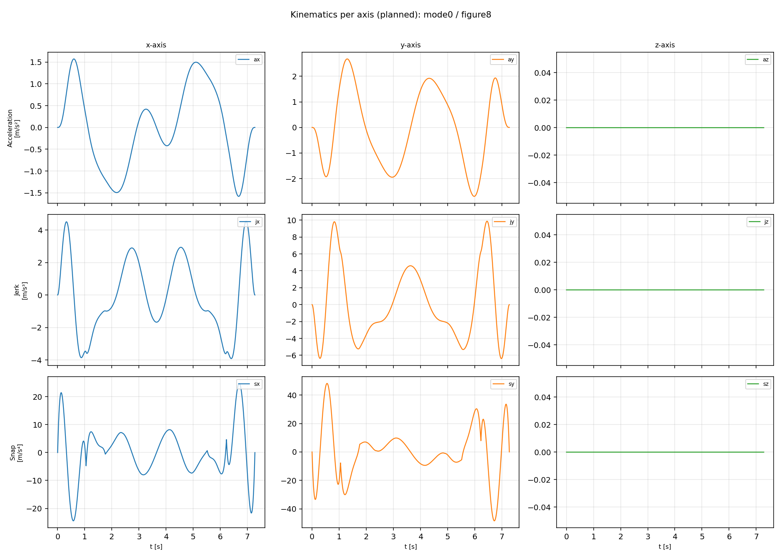
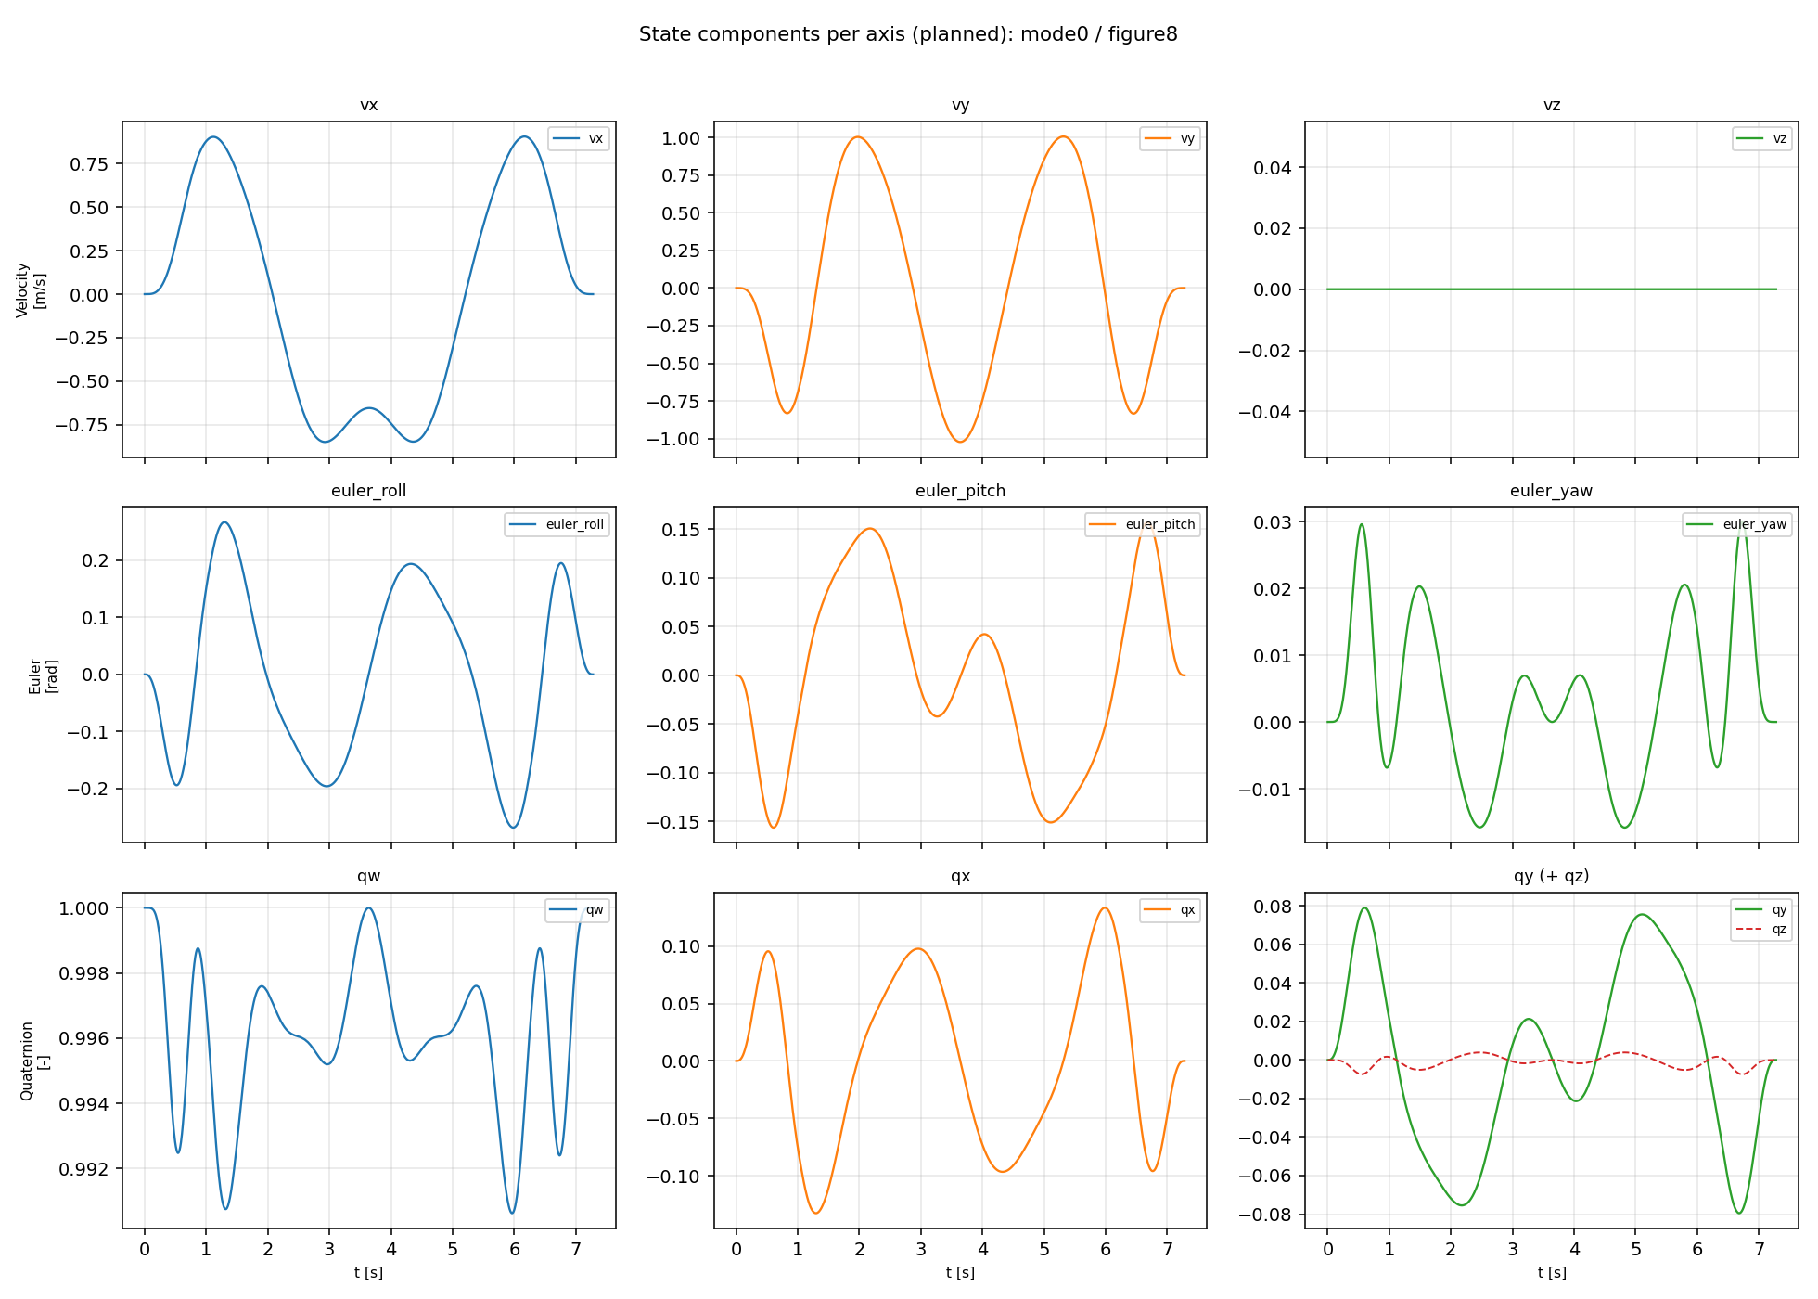
Mode 0: SplineTrajectory — Kinematics And State Axes
Kinematics axes
State axes

Slide 15
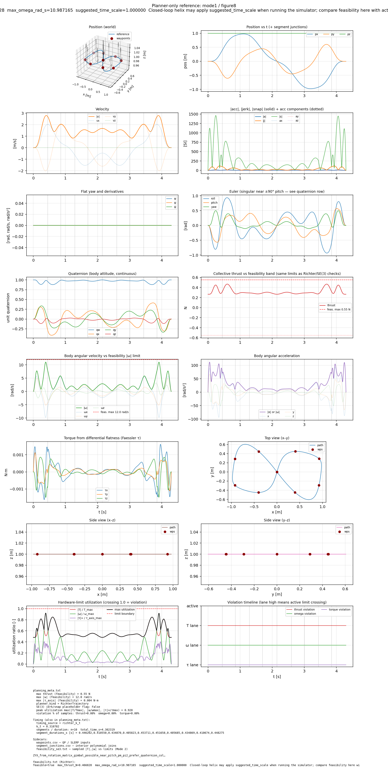
Mode 1: RichterTrajectory — Figure-8 Overview
Minimum-snap with automatic k_t timing
Reference overview

Slide 16
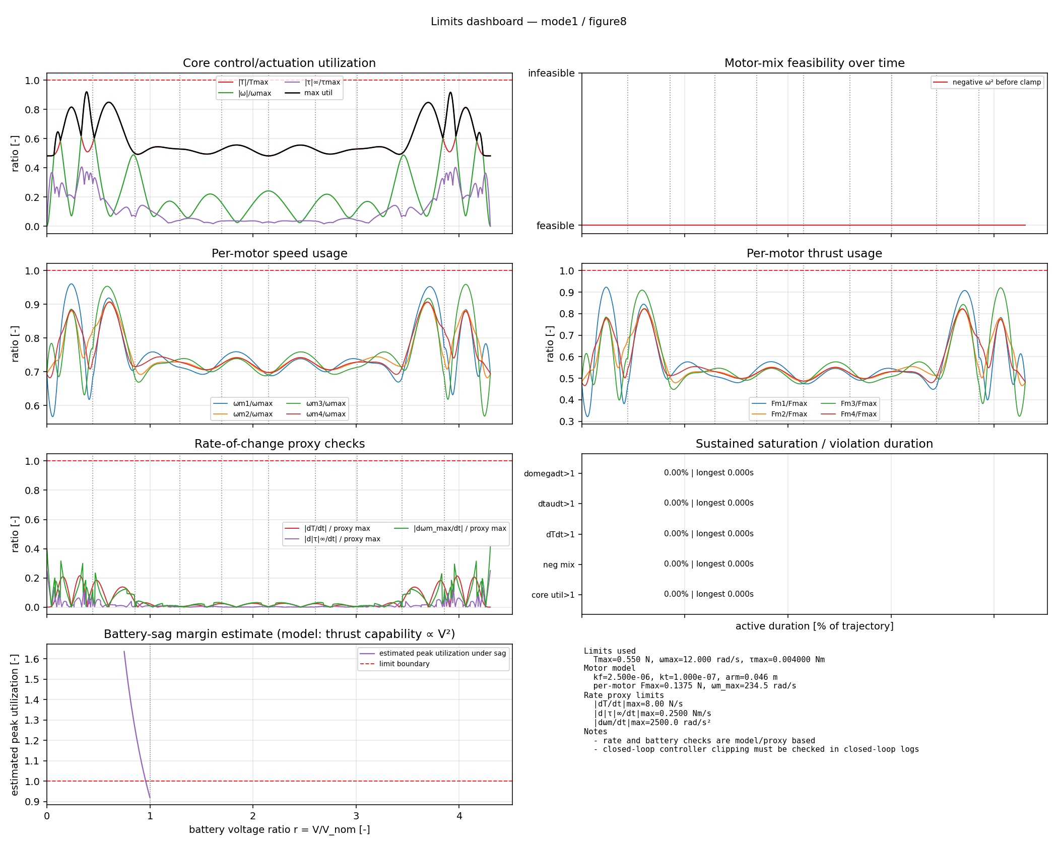
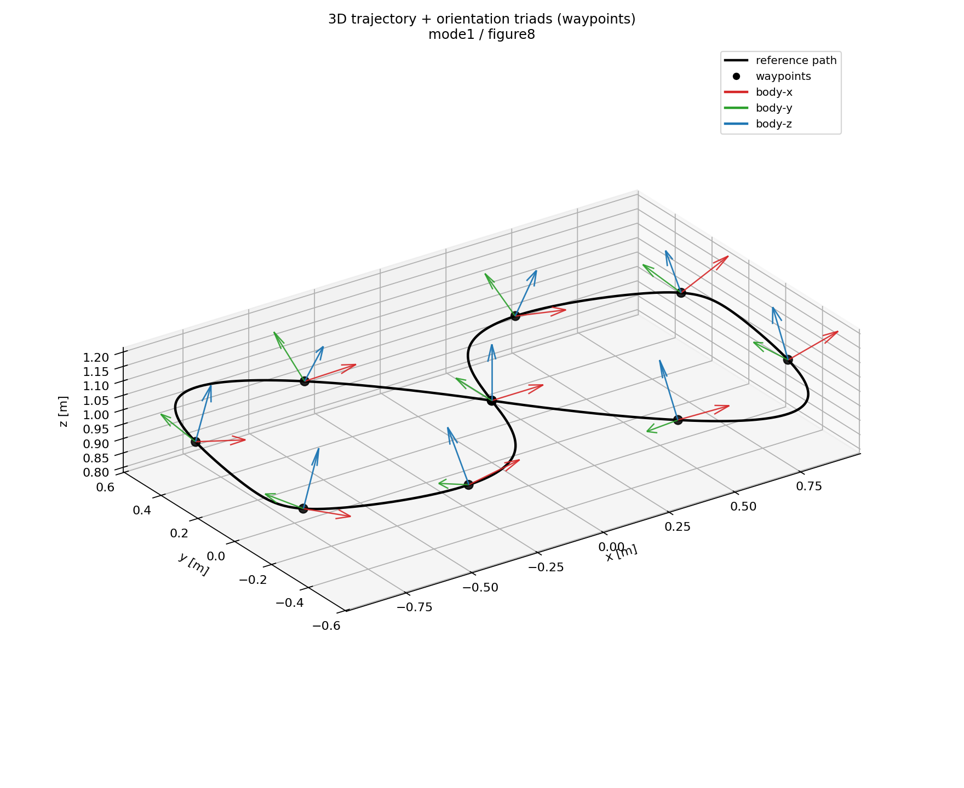
Mode 1: RichterTrajectory — Limits And 3D Orientation
Limits dashboard
3D trajectory + orientation

Slide 17
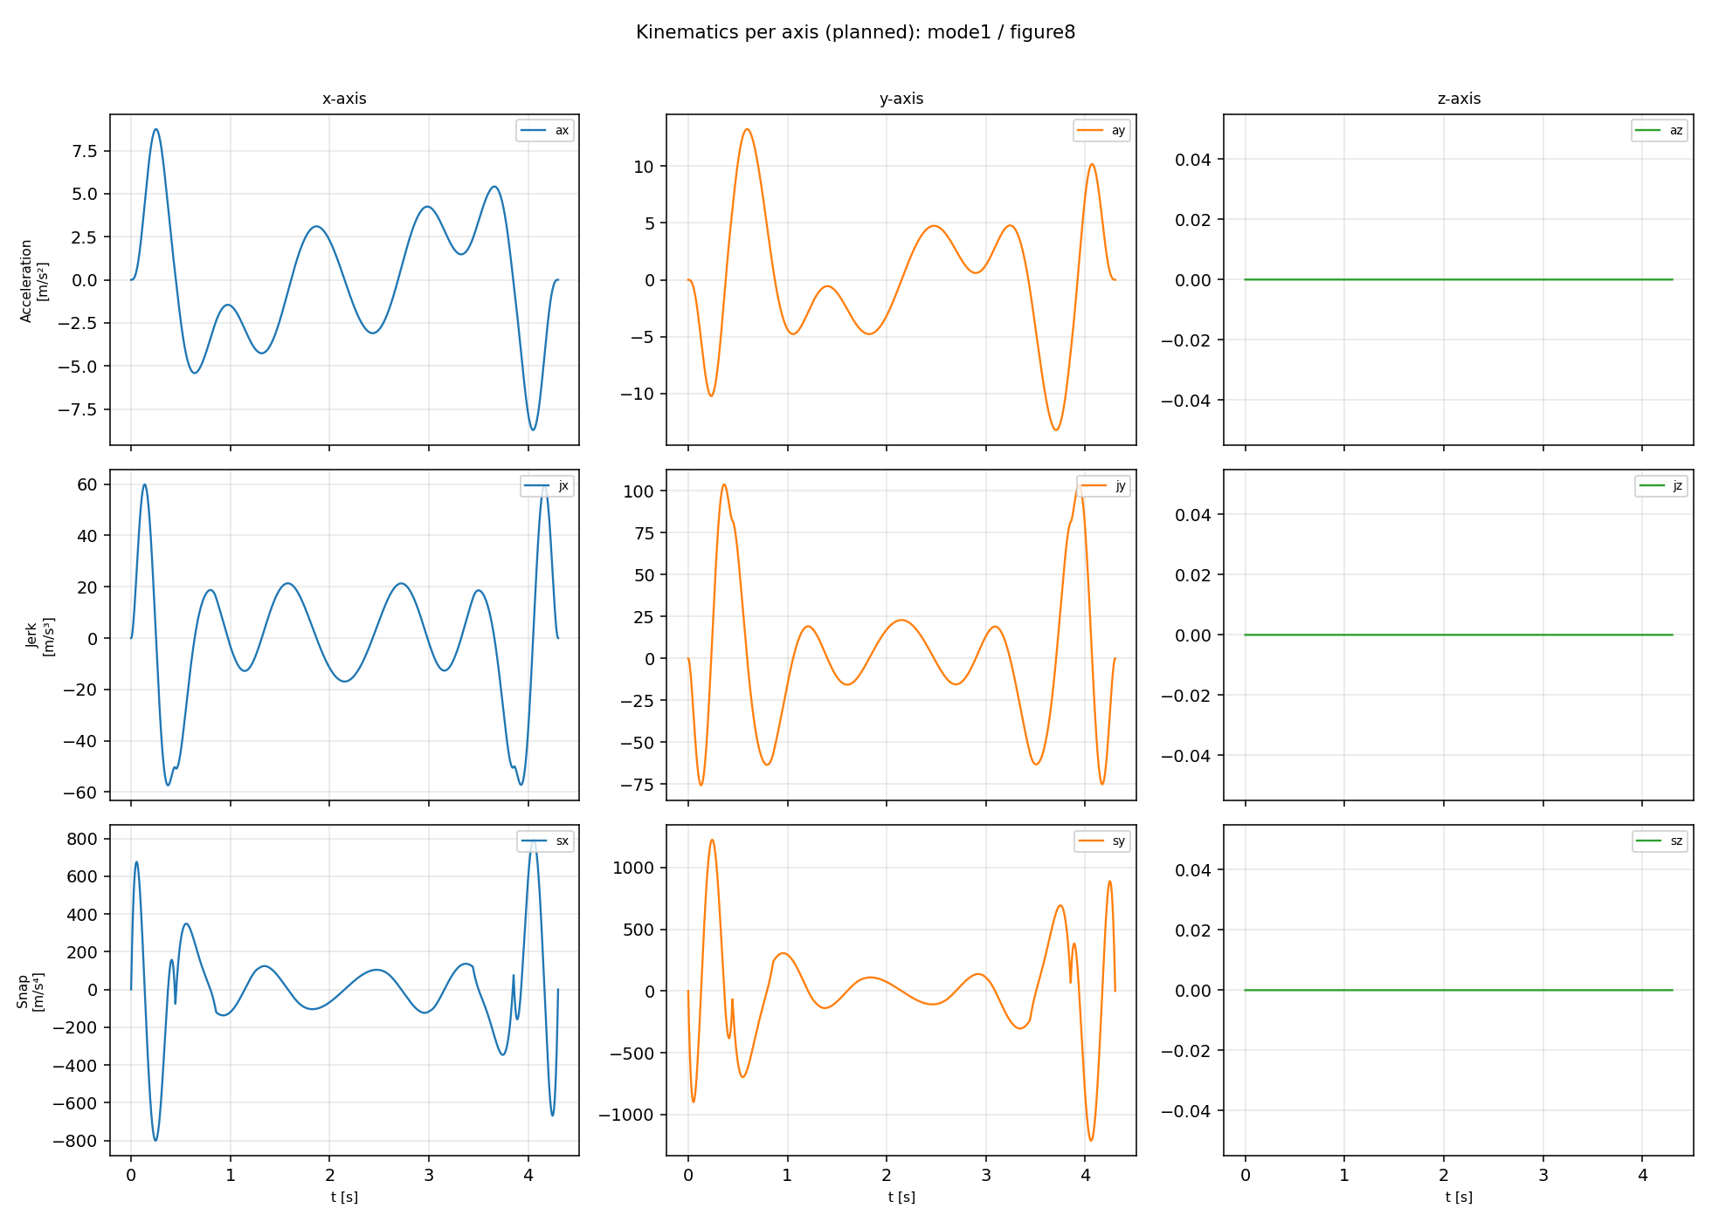
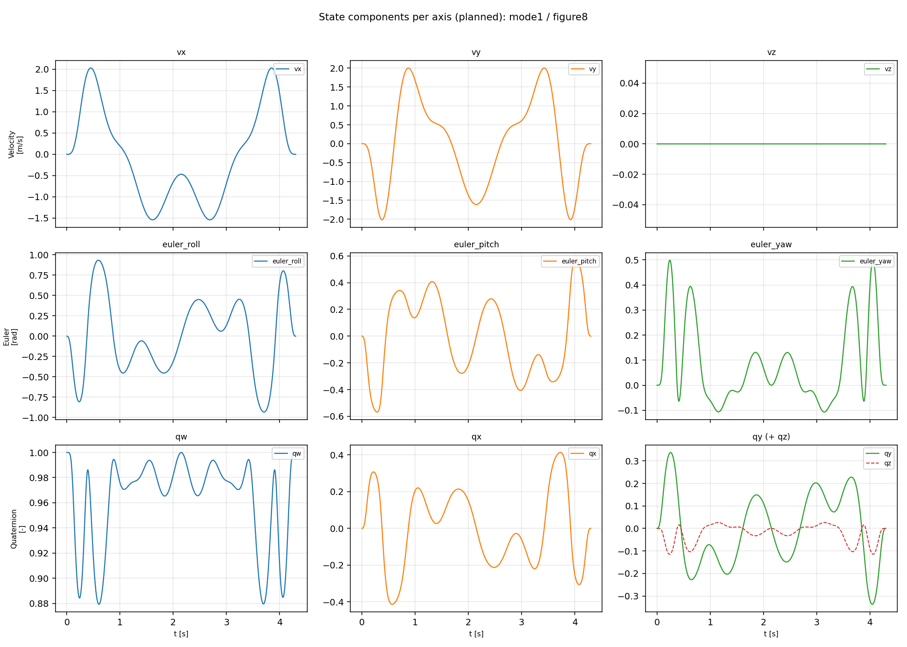
Mode 1: RichterTrajectory — Kinematics And State Axes
Kinematics axes
State axes

Slide 18
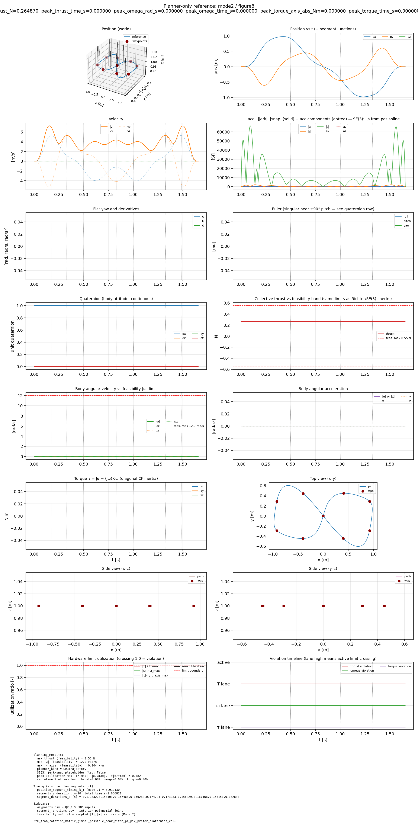
Mode 2: Se3Trajectory — Figure-8 Overview
Position planning plus explicit authored attitude
Reference overview

Slide 19
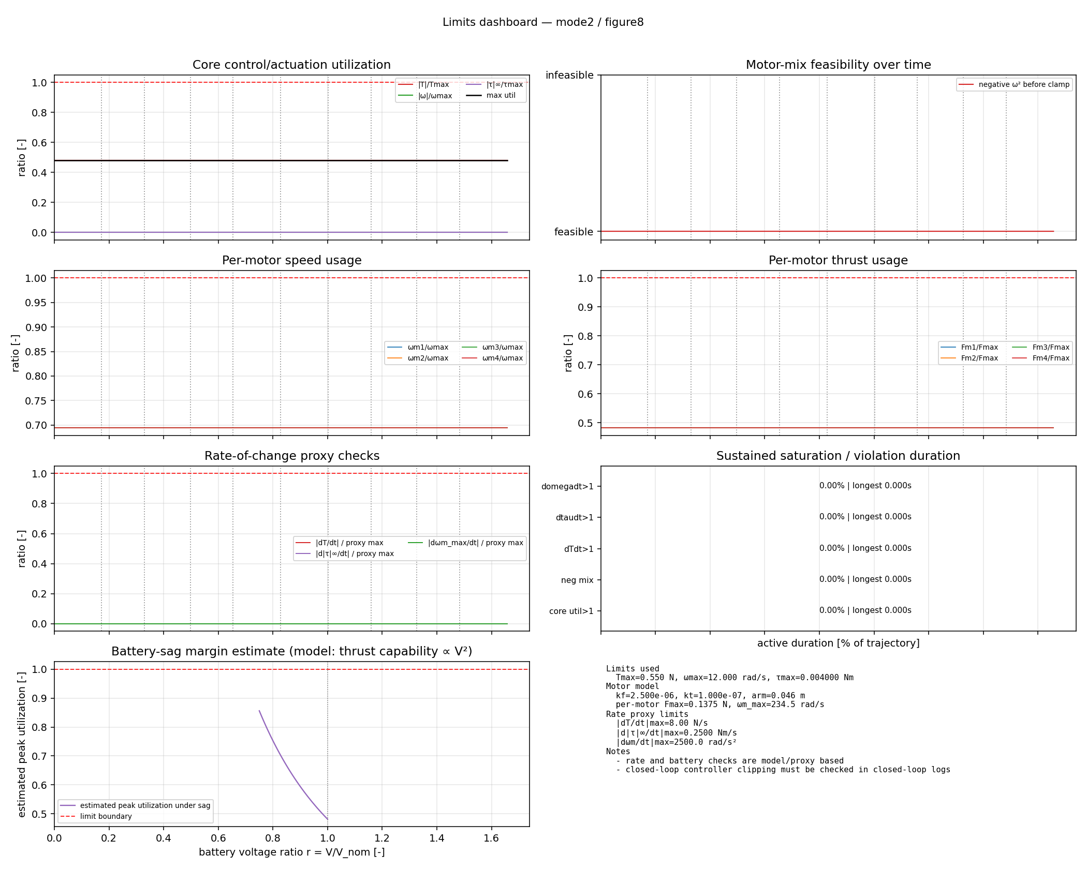
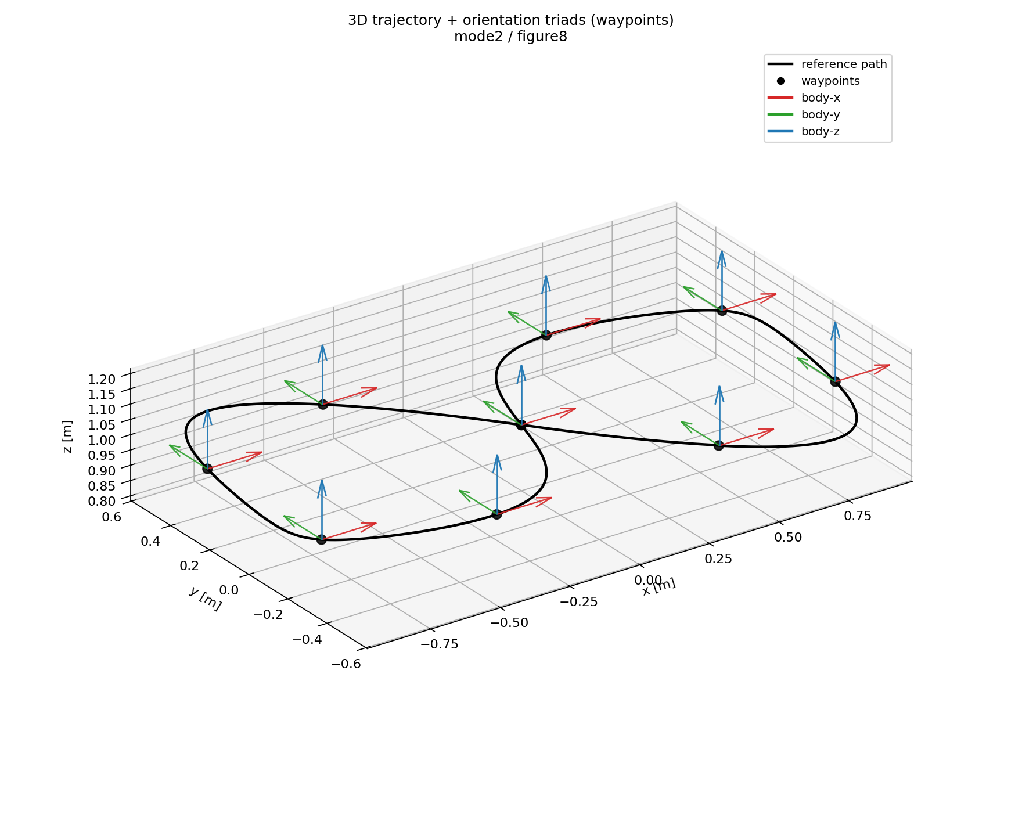
Mode 2: Se3Trajectory — Limits And 3D Orientation
Limits dashboard
3D trajectory + orientation

Slide 20
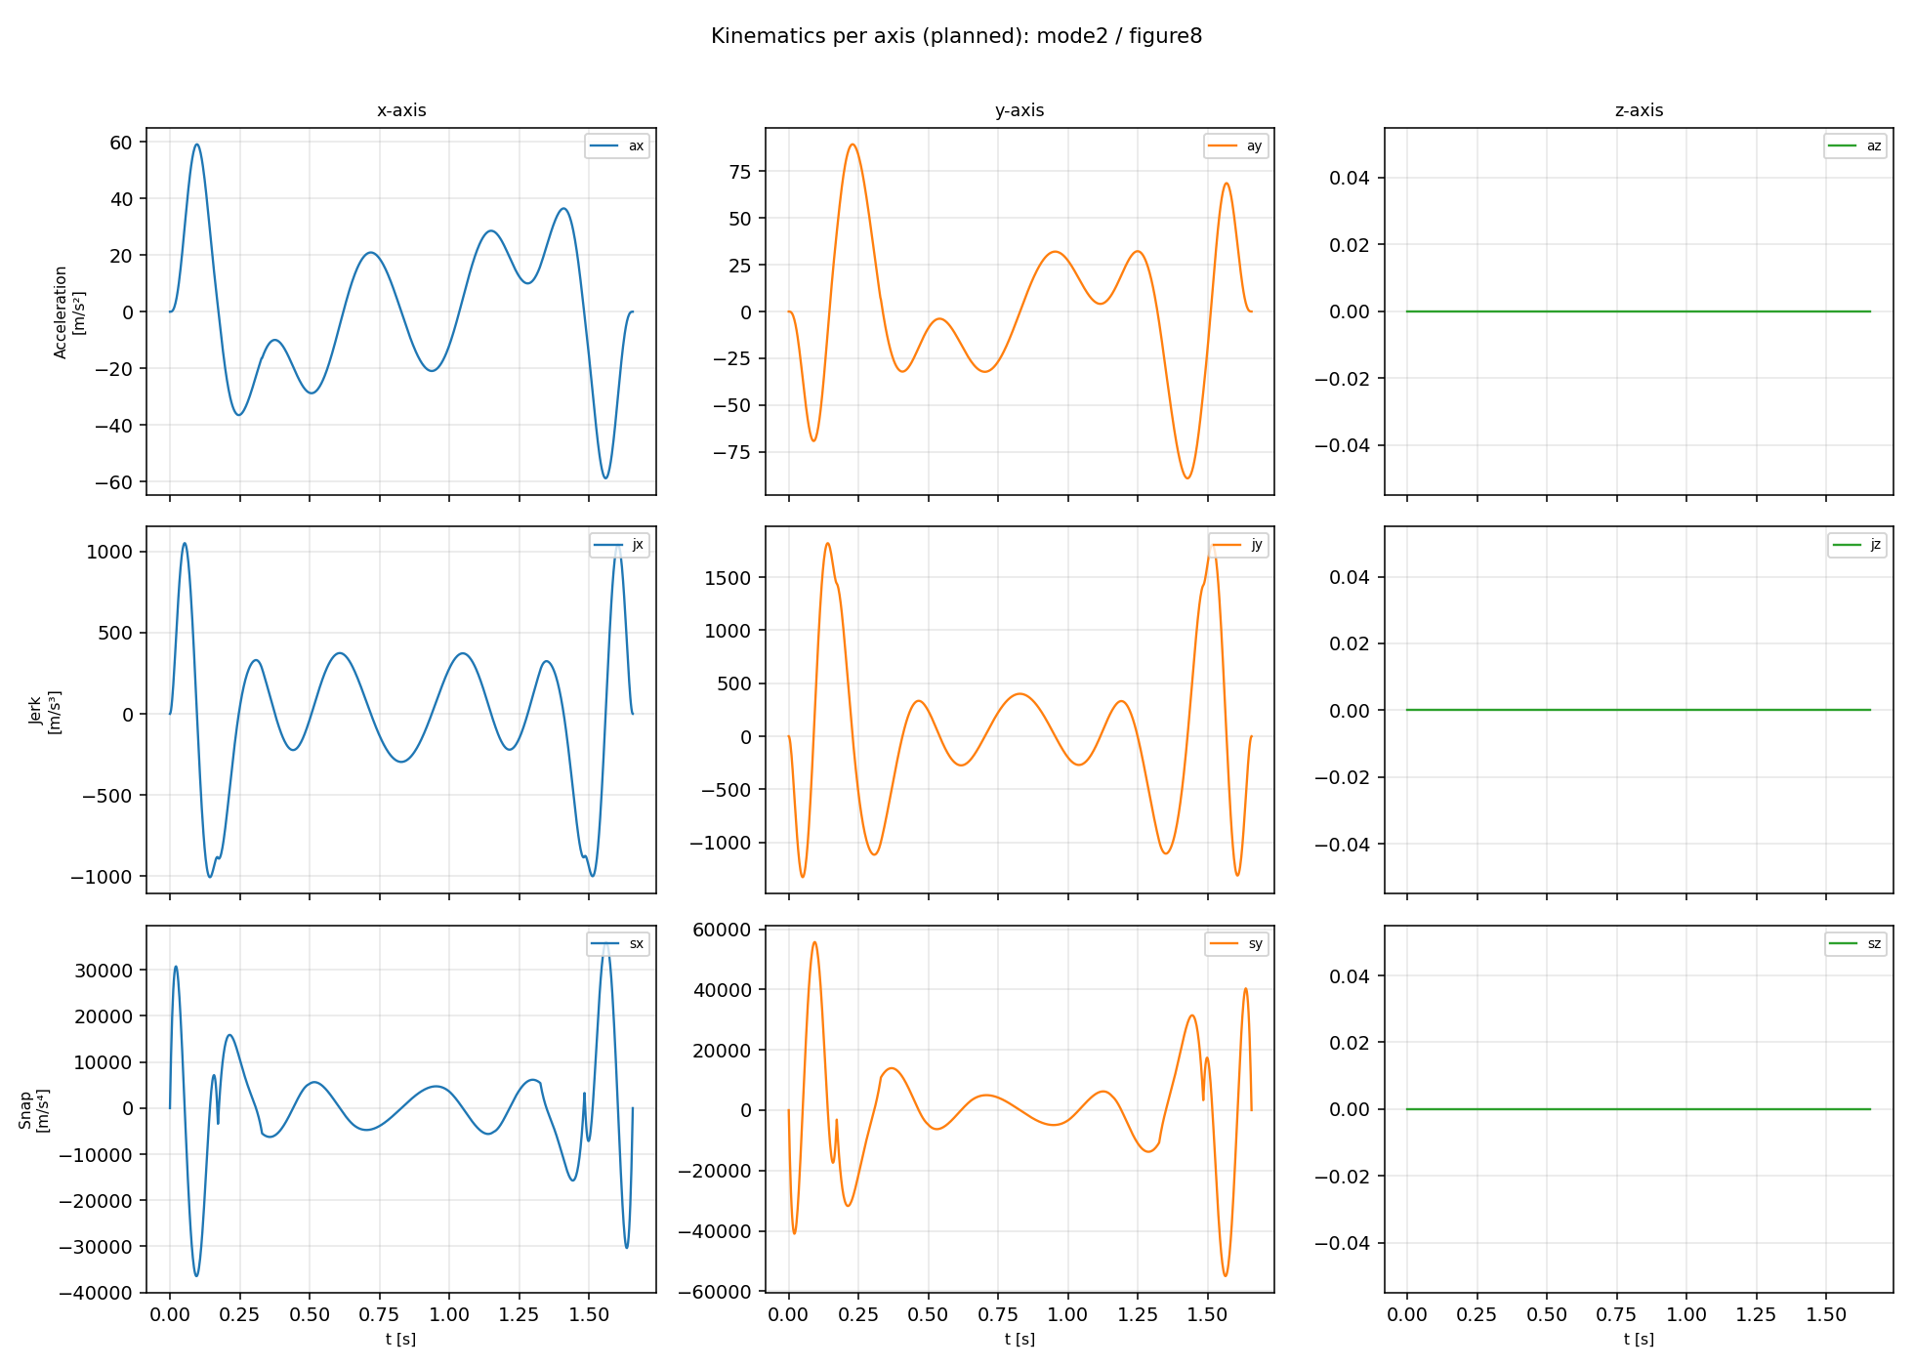
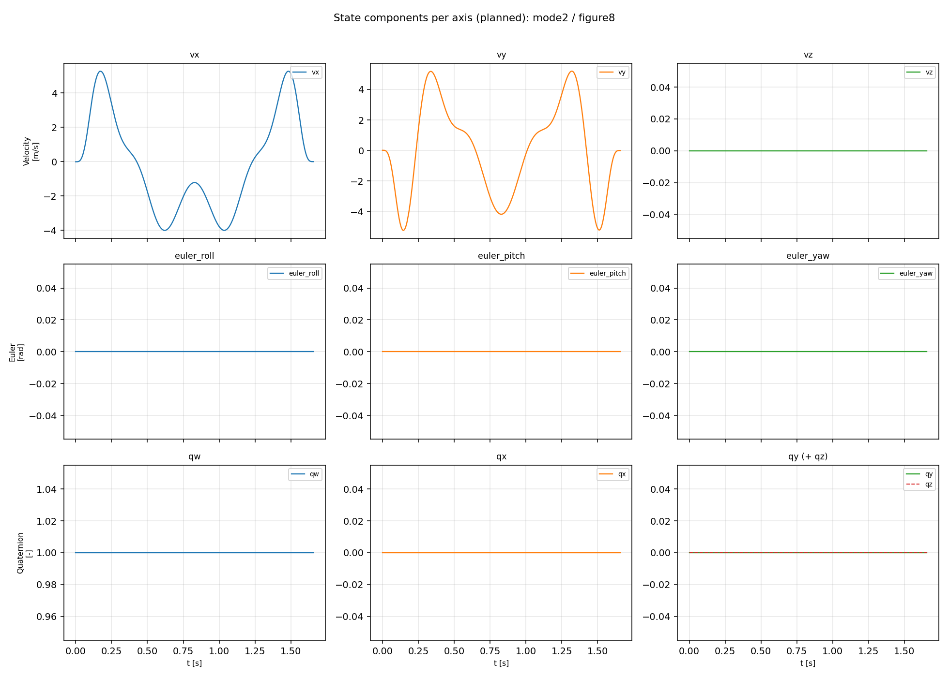
Mode 2: Se3Trajectory — Kinematics And State Axes
Kinematics axes
State axes

Slide 21
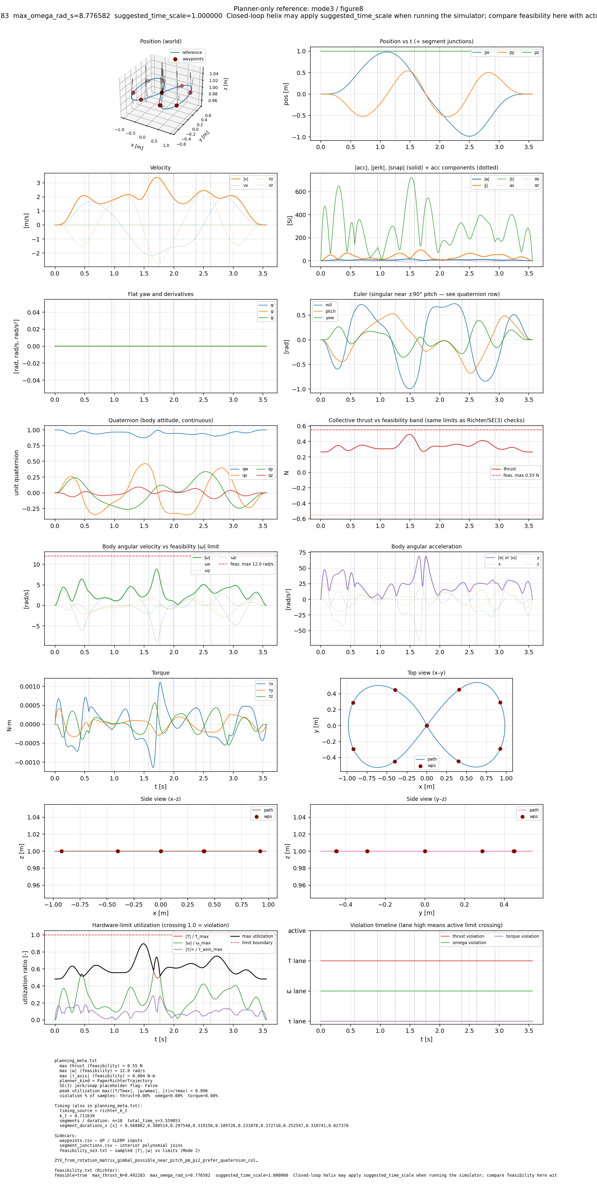
Mode 3: Paper / PaperRichterTrajectory — Figure-8 Overview
Richter-family planner plus iterative time redistribution
Reference overview

Slide 22
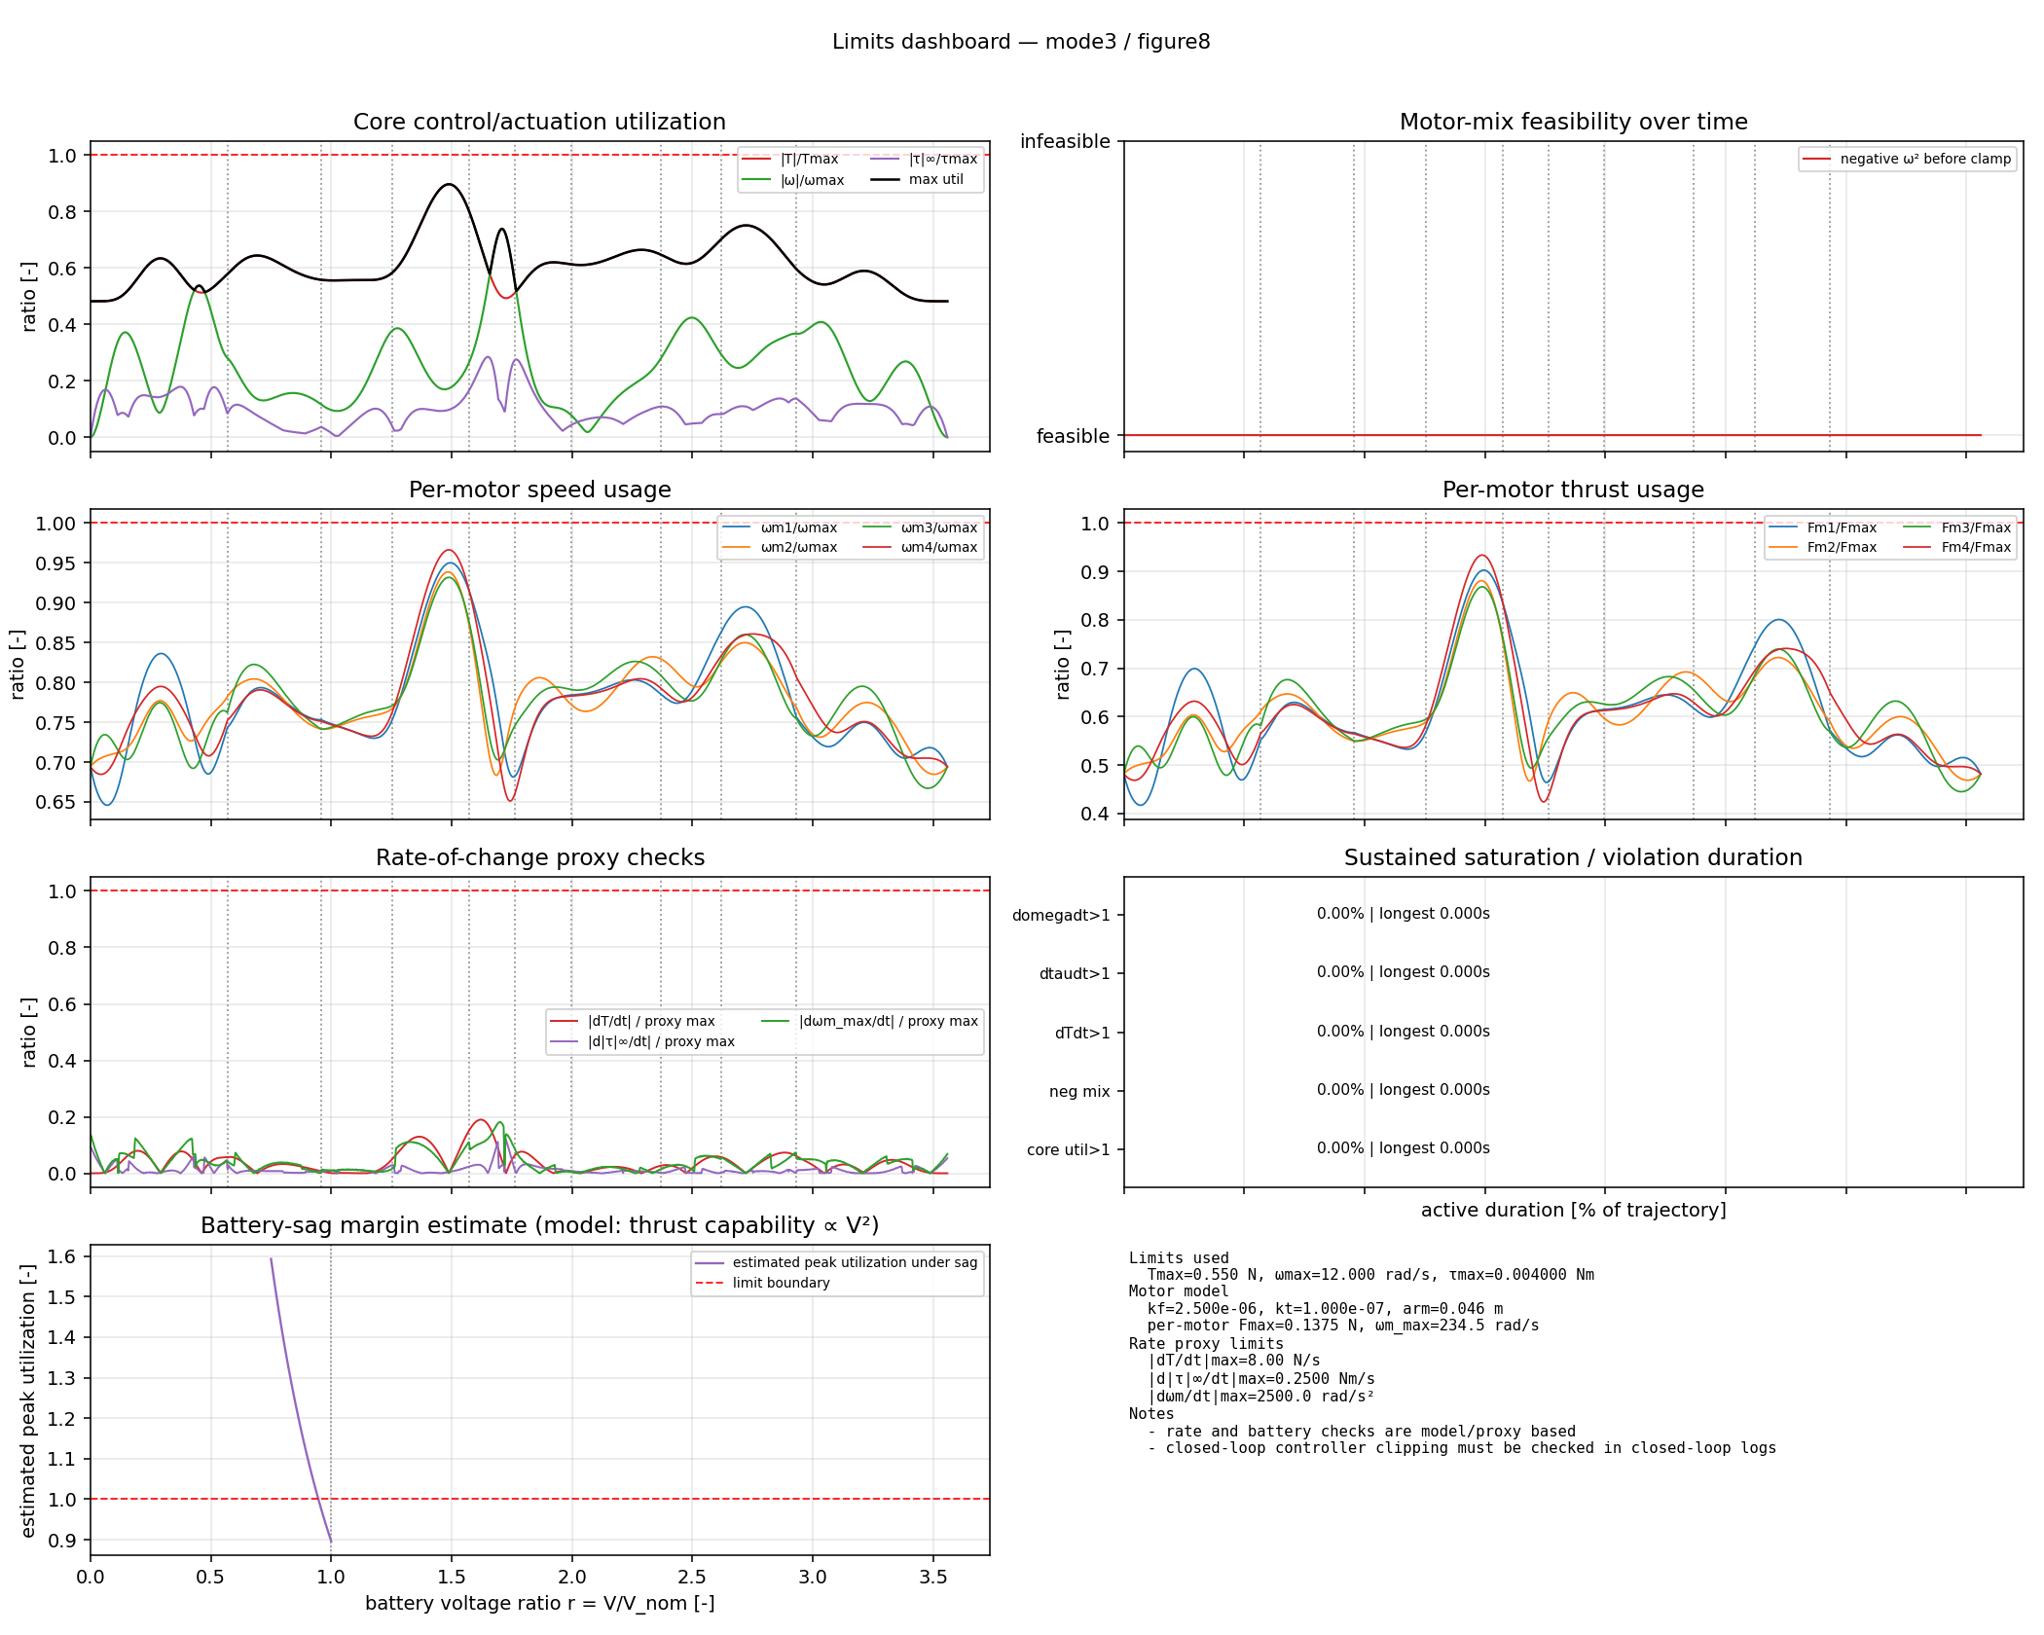
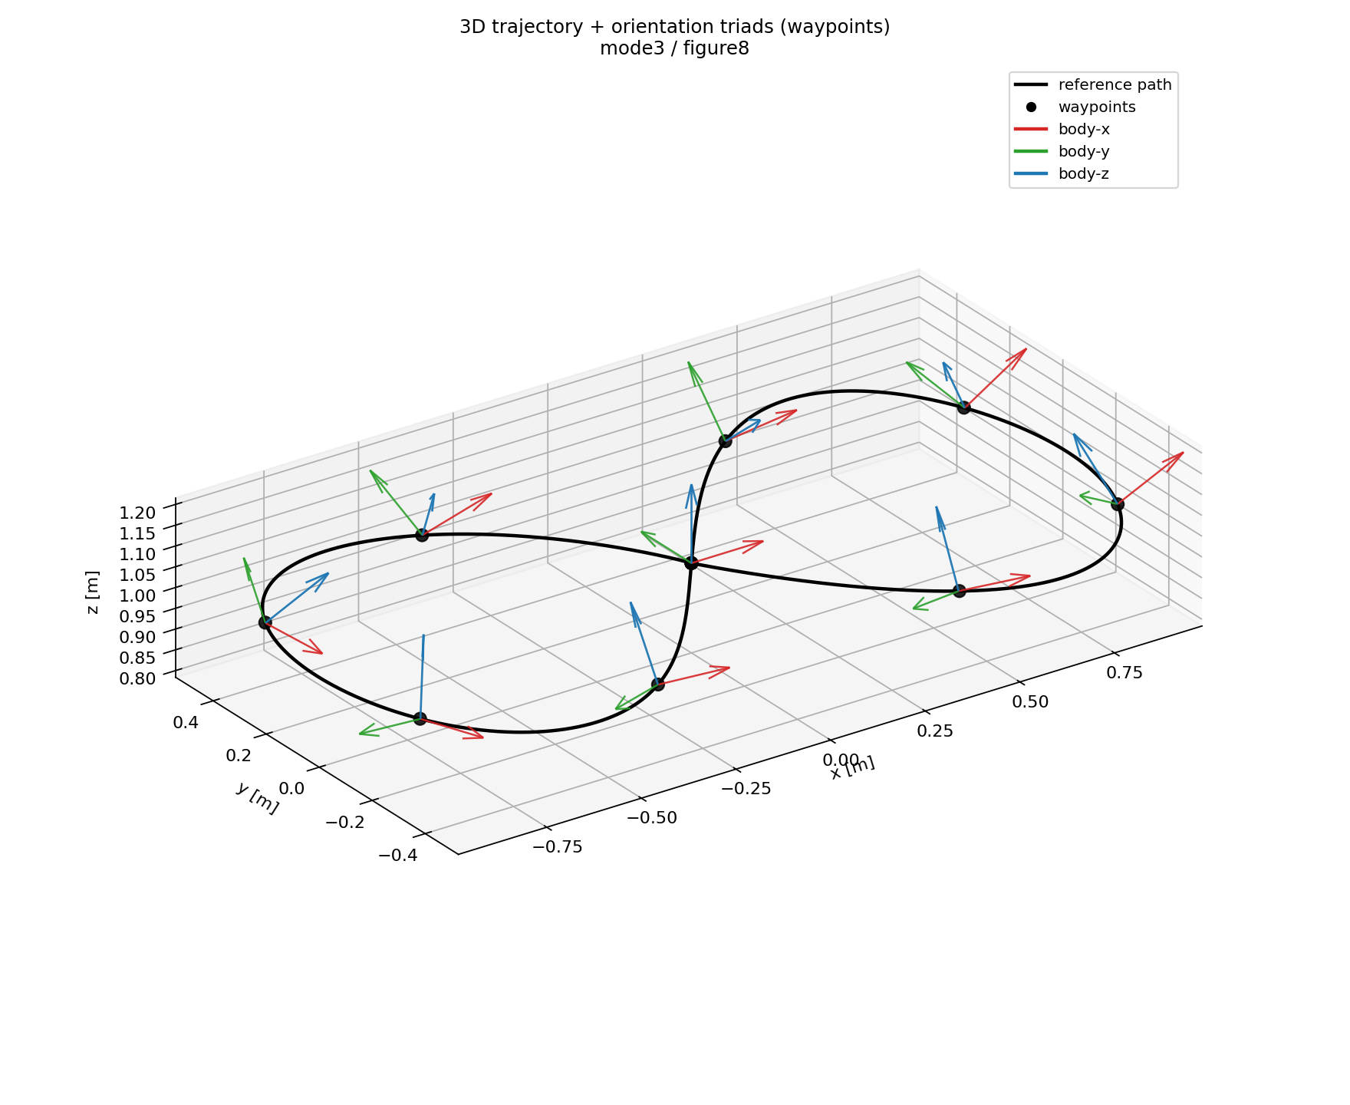
Mode 3: Paper / PaperRichterTrajectory — Limits And 3D Orientation
Limits dashboard
3D trajectory + orientation

Slide 23
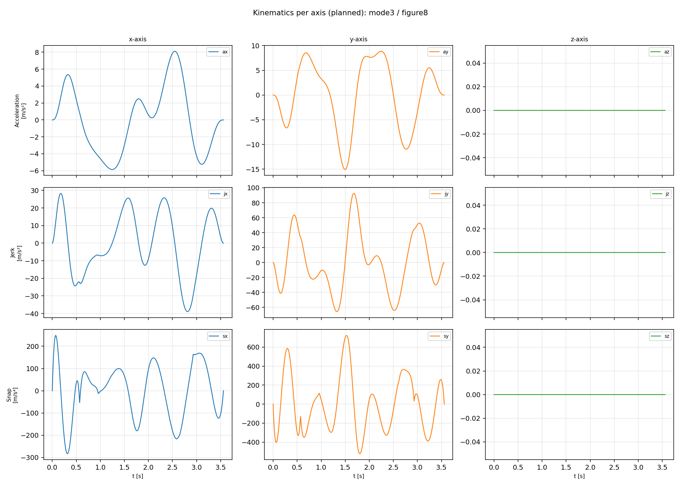
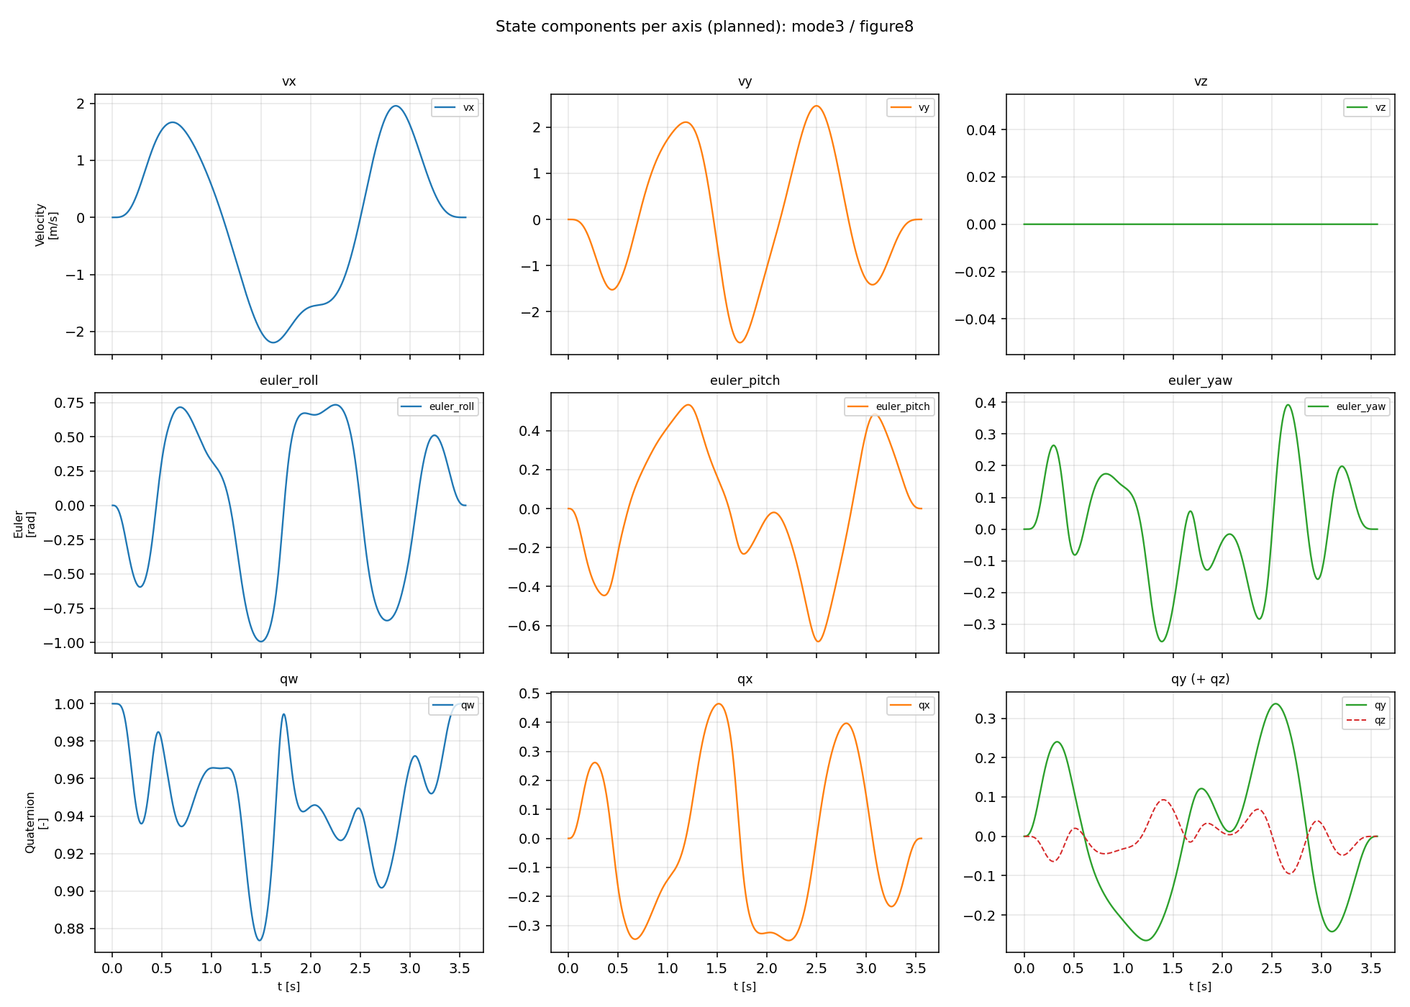
Mode 3: Paper / PaperRichterTrajectory — Kinematics And State Axes
Kinematics axes
State axes

Slide 24
Mode 0 Details
Description: baseline piecewise polynomial trajectory with fixed segment durations.
Formulation: minimum-snap polynomial solve with waypoint + continuity constraints.
QP view: solve quadratic cost over polynomial coefficients with equality constraints.
Continuity: position, velocity, acceleration, and higher derivatives remain smooth at segment boundaries.
Attitude: derived via differential flatness from x, y, z, yaw.
Core objective: min sum_s integral_0^{T_s} || d^4 p_s(t)/dt^4 ||^2 dt
Canonical QP: min_c 1/2 c^T Q c + q^T c, subject to A_eq c = b_eq

Slide 25
Mode 1 Details
Description: Richter-style minimum-snap with automatic segment timing from k_t.
Formulation: same polynomial/QP structure as Mode 0, with time allocation coupled via aggressiveness.
Time allocation: segment durations depend on geometry and k_t.
Attitude: differential-flatness-derived; no explicit attitude waypoint authoring.
Main comparison: Mode 1 is Mode 0 plus automatic timing from one aggressiveness knob.
Core objective: min sum_s integral_0^{T_s} || d^4 p_s(t)/dt^4 ||^2 dt
Canonical QP: min_c 1/2 c^T Q c + q^T c, subject to A_eq c = b_eq

Slide 26
Mode 2 Details
Description: explicit SE(3) trajectory generation with authored attitude path capability.
Formulation: position/timing baseline from Richter-like durations, then SE(3) attitude construction and derivatives.
QP view: not the same flat-only reduced QP path as modes 0/1/3; attitude is explicitly represented.
Attitude: explicit quaternion/SO(3) interpolation, then attitude polynomials for upload/evaluation.
Main comparison: path may resemble Mode 1, but body orientation is intentionally authored.
Core objective: min sum_s integral_0^{T_s} || d^4 p_s(t)/dt^4 ||^2 dt
Canonical QP: min_c 1/2 c^T Q c + q^T c, subject to A_eq c = b_eq

Slide 27
Mode 3 Details
Description: paper-faithful flat-output minimum-snap planning with stronger timing coupling behavior.
Formulation: flat-output polynomial minimum-snap with continuity/endpoint constraints and iterative timing refinement.
QP view: Richter-family constrained QP structure with paper-style timing redistribution emphasis.
Attitude: emergent from differential flatness, not explicitly authored.
Main comparison: Mode 3 is Mode 1 plus iterative segment-time redistribution based on segment snap cost.
Core objective: min sum_s integral_0^{T_s} || d^4 p_s(t)/dt^4 ||^2 dt
Canonical QP: min_c 1/2 c^T Q c + q^T c, subject to A_eq c = b_eq

Slide 28
Current Limitations And Next Steps
Planning plots are model/proxy checks; final hardware claims should be based on real flight logs and actuator telemetry where available.
Next validation step: fly selected Mode 1/2/3 Figure-8 trajectories with updated k_t values and compare against the onboard Mode 0 baseline.
INDI remains the next major control-side topic; current results mainly demonstrate geometric-controller behavior and planning-stack progress.
Use dense kinematics/state plots as backup slides for deeper technical questions.
Takeaway: same smooth-polynomial backbone, different timing and attitude choices, validated before hardware by reference, limits, simulation, and log-analysis plots.

