Slide 1
Library generation

Slide 2
Library generation
Mascot search with mascot b-fabric application
Assay Library Generation for DIA
Using protocol from specL publication
Input – list of dat
/usr/local/mascot/data/20150715/F221103.dat
/usr/local/mascot/data/20150715/F221097.dat
/usr/local/mascot/data/20150715/F221096.dat
/usr/local/mascot/data/20150715/F221095.dat
/usr/local/mascot/data/20150715/F221094.dat
topN ions
Minimum ions? Or default topN = minumum ions.

Slide 3
Open issues
Stress tests – who want’s to build libraries and can give me list’s of *.dat files (registered with b-fabric) (and is interested in looking at the output?)
Open issues :
How to assign precursors to proteins?
How to control FDR on protein level?
Precursors are selected given Mascot e-value of 0.05 approx. Mascot score of 13.
Min Mascot score as parameter?
Or fdr - on transition level as parameter? (counting decoys) -> You must use decoy databases.
There can’t be one on protein level since we do not know at this stage number of proteins generated.

Slide 4
Peptides -> Proteins
AAAITSDLLESLGR
sp|Q62009|POSTN_MOUSE sp|Q62009-2|POSTN_MOUSE sp|Q62009-3|POSTN_MOUSE sp|Q62009-4|POSTN_MOUSE sp|Q62009-5|POSTN_MOUSE
AAAQTLER
sp|P23492|PNPH_MOUSE tr|Q543K9|Q543K9_MOUSE
AADKDTCFSTEGPNLVTR
Sp|P07724|ALBU_MOUSE
AAFTECCQAADK
zz|ZZ_FGCZCont0097|

Slide 5
Solutions?
Or use precursor Protein assignment computed by search engines
Resolve this issue on genomic level.
use databases with low redundancy (without isoforms)
Only sp identifiers than -> 80% of proteotypic peptides!
Take first protein ID for each peptide
AAAEVNQEYGLDPK.2;1504.728
sp|P97807|FUMH_MOUSE sp|P97807-2|FUMH_MOUSE
not clever because of id sorting

Slide 6
Spectronaut
Runs on command line starting version 7
Need windows hardware to run it on – solution to stage data
Needs schema configured in spectronaut – not sure if can be transported and transferred to other computers
Export schema
INFERSchemaOptionsCJW
C:\Program Files (x86)\Biognosys\Spectronaut\bin>Spectronaut.exe -d "D:\FGCZ\p1000\Spectronaut\wolski_20150803_testingspecnautcommandline" -a "D:\FGCZ\p1000\Spectronaut\wolski_20150803_testingspecnautcommandline\p1503_lib_individualFiles.csv" -o "D:\FGCZ\p1000\Spectronaut\wolski_20150803_testingspecnautcommandline" –n "Secondtry" -s "OurSchemaCJW" -f ".*\.raw”

Slide 7
Redundancy in peptide protein assignment
WEW@fgcz.ethz.ch

Slide 8
Maxquant
Maxquant : given peptide identification arrive at smallest possible protein set explaining these peptides(?)
Occam’s razor : Among competing hypotheses that predict equally well, the one with the fewest assumptions should be selected
Does this implicate that a peptide is assigned only to one protein? Or can I use one peptide to quantify more than one protein?
If peptide assigned to 2 proteins split their intensities among both
i.e. a(A) b(B) c(A,B) then 0.5 I(c) -> A and 0.5 I(c) -> B

Slide 9
Explaining what ?
Are all peptides equally important?
There are long and short peptides
Are longer peptides not more informative?
Do rare amino acid sequences don’t have higher evidence of a protein than more common sequences?
Are we looking for protein hypothesis explaining peptides or AA sequences?
And what about protein coverage?
a5(A), a7(A,B), c6(C,B), d4(C) => protein B does not have proteotypic peptide but has higher AA coverage:
B -> 13, A->12, C->10

Slide 10
How to use peptide intensities
Is sequence evidence enough?
What if not prototypic peptides cluster together given intensity?
a(A,B) , b(C,B) , c(A), d(C)
Naïve : A(a,c) , C(b,d)
But assume cor(a,b) >> c(a,c) and cor(b,d)
Isn’t there enough evidence for Protein B -> A(c), C(d) , B(a,b) ?

Slide 11
Algorithms
Greedy algorithm ->
Find protein with most peptides
Remove all peptides assigned to it
Find next protein with most peptides
Arrive at smallest protein set but with respect to? is it the best set?

Slide 12
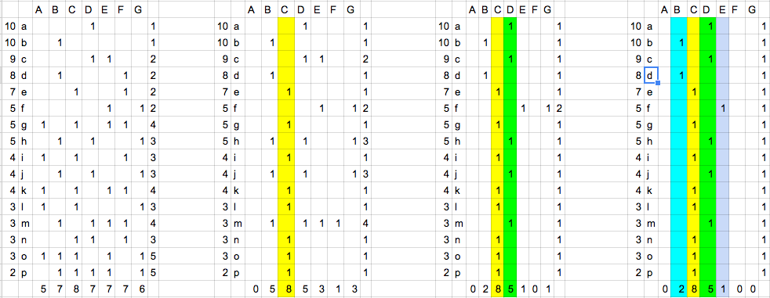
Example

Slide 13
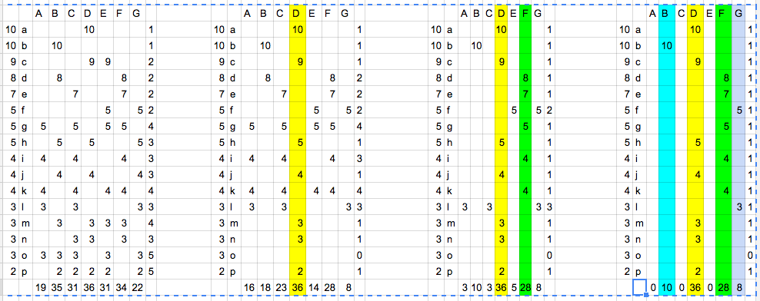
Highest Protein takes all

