Slide 1

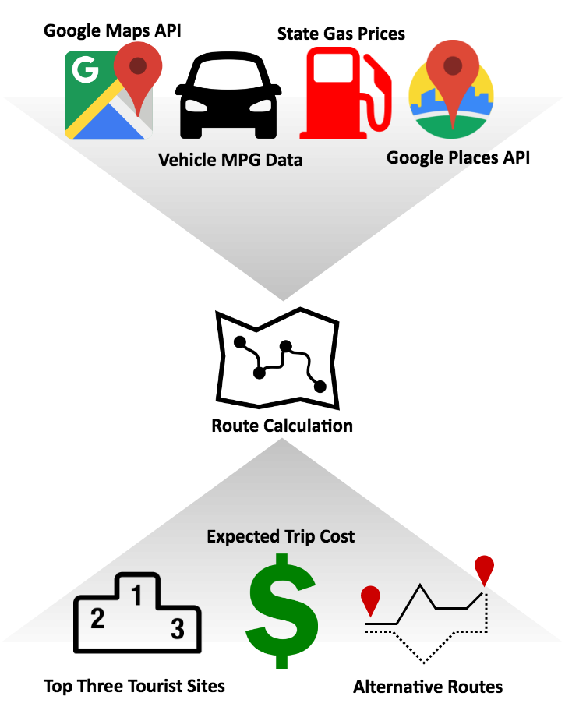
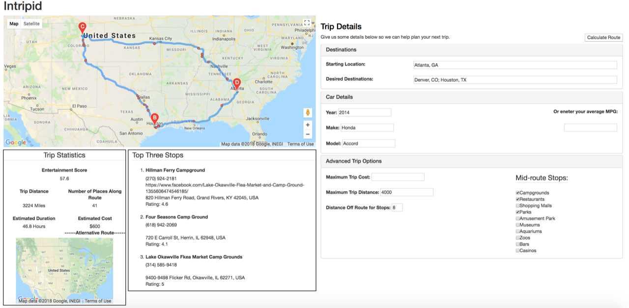
Intripid: Interactive Road Trip Optimizer
Sarah Carpenter, Nicholas Hardy, Will Olsson
Motivation/Introduction
Intripid is a system that provides the user with the optimal road trip route, combining user interaction and data visualization to optimize time, cost, and enjoyment. Intripid is useful for anyone planning a road trip – reducing time spent trip planning, reducing gas costs, and providing the user with enjoyment.
Approach
Intripid partitions the route into manageable blocks – recommending sites and calculating gas prices in each block. We provide a quantitative score to compare road trip routes, increasing trip planning efficiency. No other extensive trip optimizer combines the visualization of a trip with gas expenditure as a constraint and scales it to the entire US.
(Left) Intripid combines resources from Google's APIs and vehicle and gas information to calculate the optimal route, outputting the top three sites, expected trip cost, and alternative route suggestions. (Right) The UI combines a map overview, user inputs for route calculation, advanced trip options, and a simplistic overview of the route details. The quantitative details about each route allow the user to efficiently and effectively compare multiple road trips.
Data
Intripid utilizes the Google Maps API for route navigation and the Google Places API for querying sites along the route. We scraped state gas price data from AAA. We used OpenRefine to clean over 50,000 rows of car gas mileage data.
Experiments and Results
Over forty users assessed algorithm validity and user interface, determining Intripid to be effective in suggesting tourist sites, easy to navigate, and efficient in managing trip cost. It is fast, scalable to the entire US, and provides access to petabytes of data available with Google APIs.

