Slide 1

Godzilla Case study
Piotr Wolszakiewicz Demant

Slide 2

Bio
Software engineer with over 10 years of experience in development, designing and architecting.
With hands on experience in Azure Cloud since 2017 Currently in Demant
Piotr Wolszakiewicz
wolszakiewicz.piotr@gmail.com https://www.linkedin.com/in/piotr-wolszakiewicz/
Notes:
Ask question how many of you has an experience working with azure?
Who of you learn better by seeing things?
Do you have already a question coming here?
Is there anything that you want to leave this room with?

Slide 3
Godzilla journey
1. What is Godzilla and how it evolves (Big Picture)
2. First iteration – store unknown amount of data (2017)
3. Second iteration – event hub (2017)
4. Third iteration – costs of a data lake (2018)
5. Fifth iteration: App want their data (2018)
6. Sixth iteration - events compression (2019- 2020)
8. Lessons learned

Slide 4
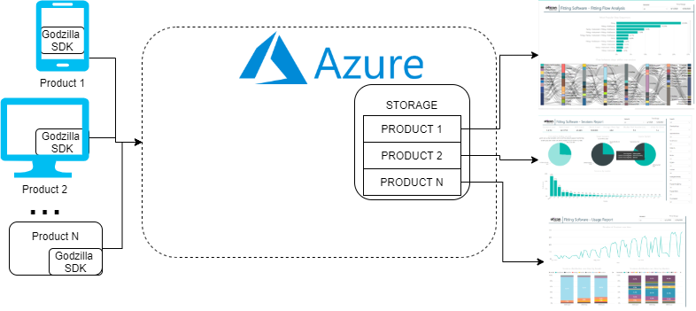
1. Godzilla

Slide 5


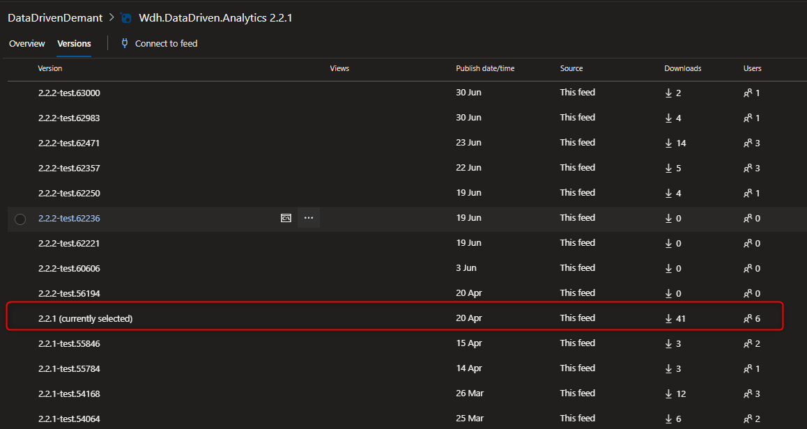
1. Godzilla
Godzilla SDK
Godzilla backend

Slide 6


2. Requirement: collect big? huge?... data
Receive data from different sources: windows app/android/ios/xamarin etc.
Be prepared for huge amount of data
Ready for high traffic
Can’t lose data
Possible to do analysis on a data later
Storage

Slide 7




2. Different sources of data
Why?
Flexibility
Global scale with high availability “Scale up or out manually or automatically”
Security IP Address restrictions
REST API
App Service

Slide 8

2. Unknown amount of data
Storage for BigData solution
Why?
No limits: any size, type and ingestion speed
Designed to enable analytics on stored data
Compatible with Hadoop (HDFS)
DataLake Store v1
Why not?
Only locally-redundant

Slide 9
2. Ready for high traffic
AppService
DataLakeStore
?
Analysis e.g. Hadoop
DataLakeAnalytics

Slide 10

2. Ready for high traffic
Why?
Designed to event ingestion – on ramp for BigData
Auto Inflate (Throughput units) 1TU - ingress up to 1MB/sec or 1000events 1TU - egress 2MB per second or 4096 events Max 20TU -Soft limit
7 days retention
Consumer groups (max 20)
AppService
Event Hub

Slide 11
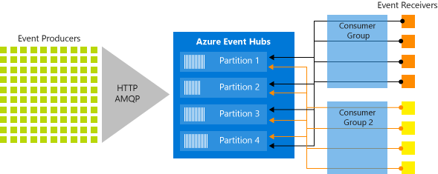
2. Ready for high traffic
Event Hub

Slide 12
2. Join EventHub with DataLake store
AppService
EventHub
DataLake
?
Analysis e.g. Hadoop
DataLakeAnalytics

Slide 13

2. Join EventHub with DataLake store
Why?
Function App
Easy to implement
Integration with Event Hub
Auto Scaling in Consumption Plan
Cheap Execution Time $0.000016 /GB-s Total Executions $0.20 per million Free grant per month 400,000 GB-s 1 million executions

Slide 14
2. First version of Godzilla
AppService
EventHub
Function App
DataLake

Slide 15
3. Second iteration
Event hub scales better than AppService
Backward compatibility for 2 years
In high traffic paying twice: AppService and EventHub TU

Slide 16
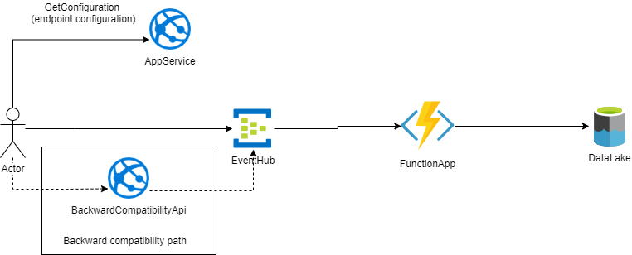
3. Second iteration - solution
Notes:
- REST Interface

Slide 17
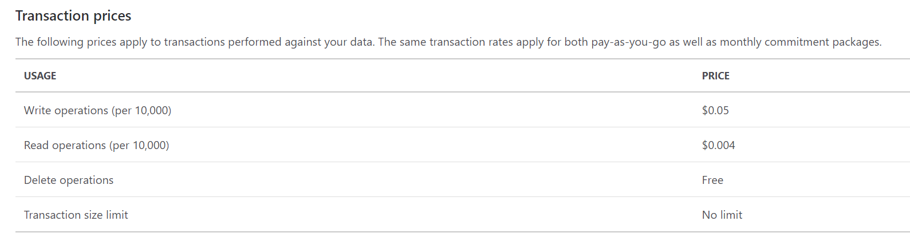
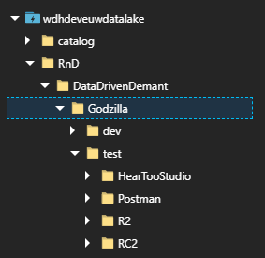
4. Third iteration - requirements
Function is bad! Why? ☺ To many write transactions on a DataLake storage
Data Lake storage Transaction prices
Partition data per ApplicationName – new feature
Godzilla -> HearToo
-> HearingFitness
-> etc.

Slide 18

4. Third iteration – StreamAnalytics Job POC
AppService
EventHub
StreamAnalytics Job
DataLake
SDK

Slide 19
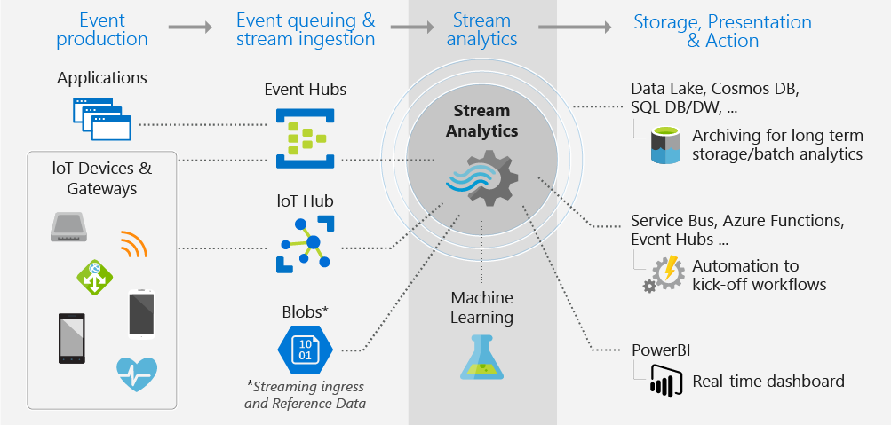
4. Third iteration – StreamAnalytics Job
Event-processing engine
Real time analytics
SQL like query language –USQL
Input/Output

Slide 20
4. StreamAnalytics POC results
Pros
Cons
Simple
Process gzip messages out-of-the-box
No autoscaling
With SU% < 20% not realtime
Dynamic output only for Blob
Need to renew authorization (Right now work using MSI)
Price Streaming unit – $0.12/hour -> € 87.6/Month For 10k events/s ~24SU

Slide 21

4. StreamAnalytics POC results
Pros
Cons
Simple
Process gzip messages out-of-the-box
No autoscaling
With SU% < 20% not realtime
Dynamic output only for Blob
Need to renew authorization (Right now work using MSI)
Price Streaming unit – €0.102/hour -> € 67.72/Month For 10k events/s ~24SU

Slide 22

4. Third iteration – offline processing
Store data in temp storage for e.g. 1hour/1day….
Move partitioned data into DataLake Store periodically
AppService
Temp Blob
Storage
EventHub
DataLake
SDK
Partitioned

Slide 23


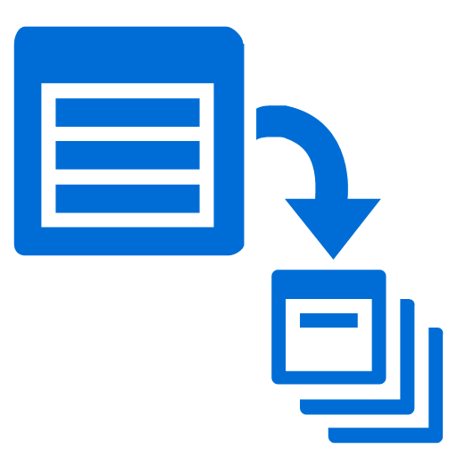
4. Offline processing– POC propositions
EventHub
+ Capture
Azure Data Factory
DataLake Analytics
Blob
DataLake
Azure Data Factory
Copy
EventHub
Function App
Blob
DataLake

Slide 24
4. Offline processing – POC results
EventHub Capture
FunctionApp
+ Inbuilt in EventHub + Very fast + Auto scaling
- Price EventHub cost -> $21.90 per TU EventHubCapture -> $73 per TU - Static partitioning – need something extra for partitioning {Namespace}/{EventHub}/{PartitionId}/{Year}/{Month}/{Day}/{Hour}/{Minute}/{Second} - Only Avro format
+ Our code – flexible partitioning + Auto scaling

Slide 25
4. Offline processing – POC results
EHC: Azure Data Lake Analytics
FA: Blob
+ Easy to write a query
- No dynamic output. But...
- Expensive -> €1.687/hour per AU
+ Cheaper than DataLake - Maximum request rate per storage
Maximum request rate per storage account | 20,000 requests per second²
Azure Data Factory
- v2 in Preview
- Copy activity without “*” in paths
What with copied files -> remove?
Notes:
Blob

Slide 26
4. Offline processing – POC results
EHC: Azure Data Lake Analytics
FA: Blob
+ Easy to write a query
- No dynamic output. But...
- Expensive -> €1.687/hour per AU
+ Cheaper than DataLake - Maximum request rate per storage
Maximum request rate per storage account | 20,000 requests per second²
Azure Data Factory
- v2 in Preview
- Copy activity without “*” in paths
What with copied files -> remove?

Slide 27

4. Online processing with FunctionApp – POC
Function App Timer
AppService
Redis Cache
EventHub
Function App
DataLake
SDK
Notes:
From redis to DataLake

Slide 28
4. Online processing with FunctionApp – POC results
+ Complexity
+ Best statistics on a Writing Operation on the DataLake
+ Flexible partitioning possibilities
+ Auto scaling
+ Near real time
- Acceptable but static cost of Redis – $40.15 (was €84.95) for C1 -1024MB

Slide 29

4. Online processing with FunctionApp – POC results
+ Complexity
+ Best statistics on a Writing Opeartion on the DataLake
+ Flexible partitioning possibilities
+ Auto scaling
+ Near real time
- Acceptable but static cost of Redis - €84.95 for C1 -1024MB

Slide 30
5. Application want their data
Publisher policy in EventHub gives you option to process messages in order (taken from Jeff Hollan)
1TU gives you 1MB/sec or 1000 events on ingress and 2MB/sec or 4096 egress
AppService
Redis cache
Function App
EventHub
Function App
DataLake
ConsumerGroup 1
SDK
Events Forwarder
App EventHub
Consumer Group 2
Notes:
Redis cace to datalak

Slide 31
6. Event compression
Need to handle events that comes in compressed form
Easy right? -> We got FunctionApp so we can put custom logic
Add custom header to mark compressed messages
AppService gives us option – for content negotiation (possibly split handling uncompressed and compressed messages)
REQUEST: Give me endpoint with Content-Type handling compression
AppService
SDK
RESPONSE: Endpoint with all handled Conent-Types by them
SDK needs to verify if requested Content-Type is in returned Content-Types

Slide 32
6. Event compression
AppService
Redis cache
Function App
EventHub
Function App
DataLake
ConsumerGroup 1
SDK
Decompression Logic
ConsumerGroup 2
Events Forwarder
App EventHub
Notes:
Redis cace to datalak

Slide 33
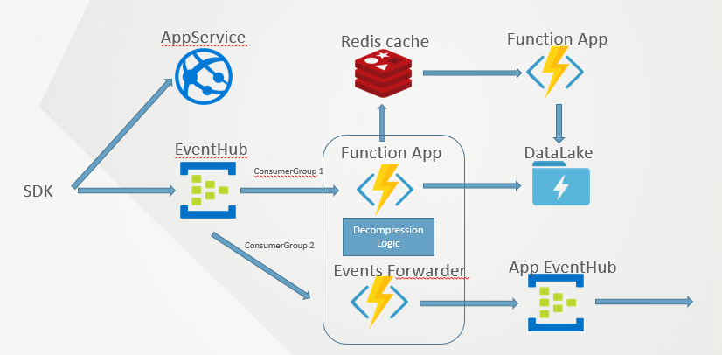
6. Event compression - outcome
Redis got hiccup when it 10MB at once
We start to lose messages
Load tests showed 30% of duplicates
Easy right?

Slide 34
6. Event compression - outcome
Redis got hiccup when it 10MB at once
We start to lose messages
Load tests showed 30% of duplicates
Easy right?

Slide 35

6. Event compression with ServiceBus
AppService
Function App Subscriber
EventHub
Function App
ServiceBus
DataLake
ConsumerGroup 1
SDK
Decompression Logic
ConsumerGroup 2
Events Forwarder
App EventHub
Notes:
Redis cace to datalak

Slide 36
6. Event compression with ServiceBus - outcome
Week on production flawless but then....
1day -stoppage on processing „hot” session but then start work again
Release app make incomming traffic goes to 15k/second
EventHub give us breath to work on solution (7days retention)
Start to work with with MS to solve that.
Need a workaroud... to not lose data

Slide 37
6. Event compression with ServiceBus
AppService
Function App Subscriber
EventHub
Function App
ServiceBus
DataLake
ConsumerGroup 1
SDK
Decompression Logic
ConsumerGroup 2
Events Forwarder
App EventHub

Slide 38
6. Event compression – only with function
AppService
EventHub
Function App
DataLake
ConsumerGroup 1
SDK
Decompression Logic
ConsumerGroup 2
App EventHub
Events Forwarder
Notes:
Redis cace to datalak

Slide 39
6. Event compression only with function - outome
Because of high traffic we don’t need to buffer data
Simple and work
To not lose data on production: We release this and configure to use production EventHub with separate ConsumerGroup (thank you EventHub for ConsumerGroups)

Slide 40
6. Event compression – back to basic
AppService
EventHub
Function App
DataLake
ConsumerGroup 1
SDK
Decompression Logic
ConsumerGroup 2
App EventHub
Events Forwarder
Notes:
Redis cace to datalak

Slide 41
7. Lessons learned
Do a proof of concept.
Check prices for low/high load.
Solution good for now
Contact with community – Facebook, product teams,….
You have impact about future changes. -> https://feedback.azure.com
More components – harder to diagnose.
Use automation – ARM?
Multiple factors: price, complexity, time, product updates, …

Slide 42
Lessons learned c.d.
Contract very important
RODO – possibility to remove user/consent data
MS Support - it take time to goes to MS TechExpert They need time to work on your issue
Message size is important 1kB <> 1MB
Automatic tests to verify your load and give you important metrics: procesingTime, numberOfSends and received messages, number of duplicates, batchSize etc.
Give your solution stabilization phase. (LoadTests that are longer than 10minutes) ☺

Slide 43
Questions?
?
Feedback please: https://forms.gle/Ue8u5HPxav8AVqzSA
Notes:
https://forms.gle/Ue8u5HPxav8AVqzSA

Slide 44

Demant is hiring. Who?
Senior cloud engineer hello@demant-technology.com

