Slide 1

Automation with Gulp
By Piotr Wolszakiewicz
Wolszkaiewicz.Piotr@gmail.com

Slide 2
Journey with Gulp
Introduction of me
Grunt vs Gulp
Gulp Api
Installation
Play with Gulp
Summary
Resources

Slide 3
Small introduction about me
I am working with angularjs 2,5 years
In our project we use grunt
I am lazy – what? I don’t like repeat my work.
I like do things simple.
I am fan of tests and automation everything that is possible.
I am from Poland

Slide 4

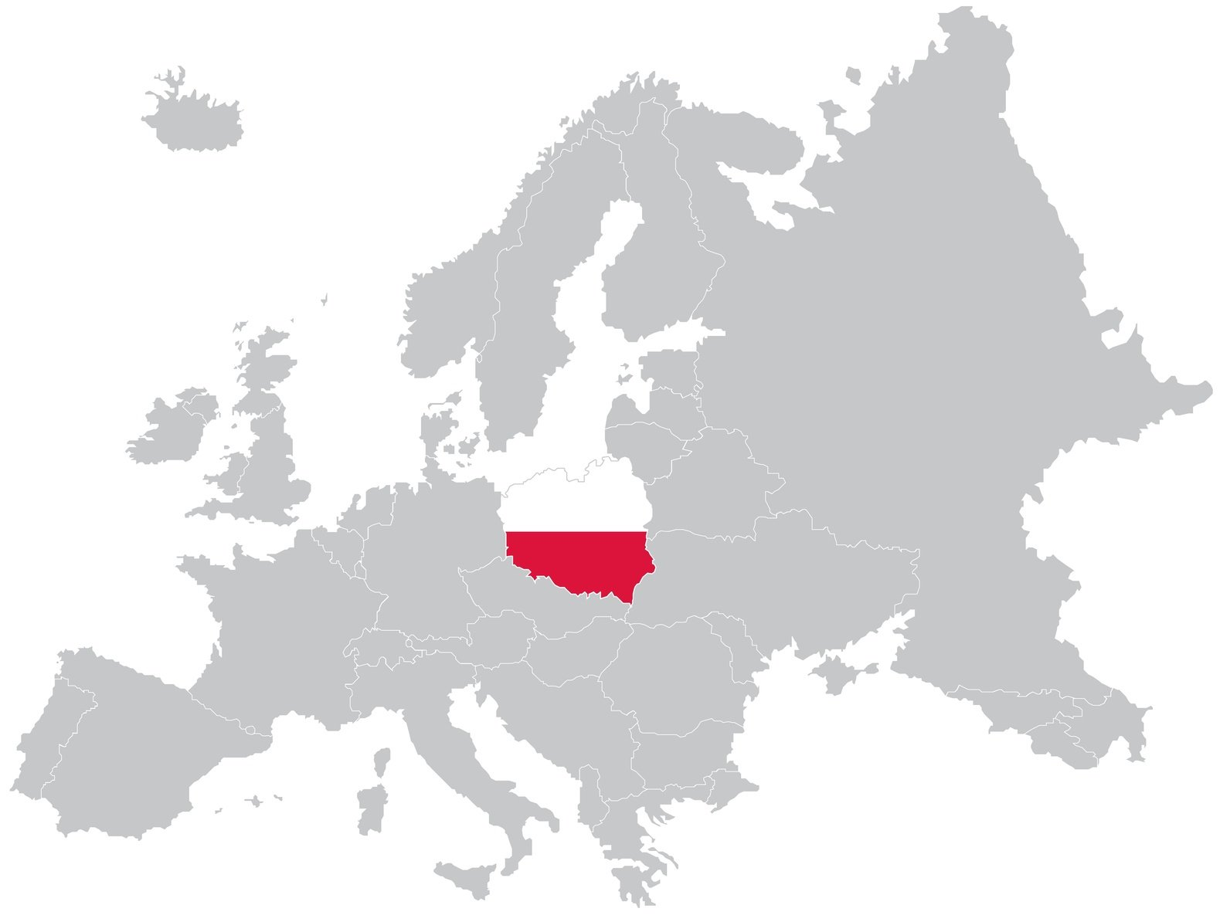
Where is Poland?

Slide 5
Why Gulp if I use Grunt
I like do things easy and I am lazy
Every time I want to change something in grunt it is painfull.
That is why I start looking replacement for grunt
I start my jurney with gulp and this is my short experience with it

Slide 6

Grunt vs Gulp
Grunt
------------------------------------------------------------
Configuration over code
File based
5683+ plugins
Gulp
------------------------------------------------------------
Code over configuration
Stream based
2368+ plugins

Slide 7
Why task runner?
Minify
Concat
Vendor prefixes
Less to css compilation
Injecting files into HTML
Angular Template Cache
Testing
Code Analysis

Slide 8
Gulp Api – simple?
gulp.task – define a task
gulp.src – read files
gulp.dest – write files
gulp.watch – watch files

Slide 9
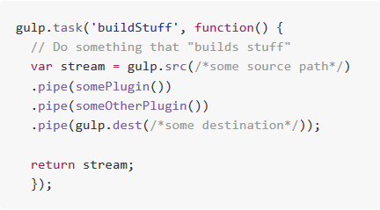
gulp.task
gulp.task(name [, deps, fn])
Define a task
Dependencies run first before task runs
Dependencies run in parallel

Slide 10

gulp.src
gulp.src(globs[, options])
take a file system set of files
emits files that match
optionally specify options to apply on a glob

Slide 11
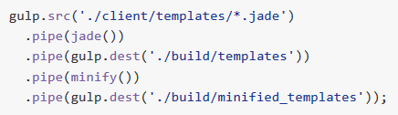
gulp.dest
gulp.dest(path[, options])
Piped files are written to file system
Can be re-piped
Options to apply on a output folder

Slide 12
gulp.watch
gulp.watch(glob [, opts], tasks) or gulp.watch(glob [, opts, cb])
run one or more tasks when file matched by glob changed
cb(event) - event { type: ’’, path: ’’}

Slide 13
Installation
npm install -g gulp
Lets play with some examples
npm install -g yo bower npm install -g generator-gulp-angular yo gulp-angular

Slide 14
Play with gulp
Gulp is javascript – foo (task)
Play with src
How pipe works – (src + pipe + dest)
How to debug
Events and error handling
Task dependency
Make your plugin’s life easier
Pass parameters to your tasks
Conditionally run code
How to watch

Slide 15
Gulp + Angular
Caching Html templates for Angular (angular-templatecache)
Many Html templates = many http cals
Cache the HTML
Reduce HTTP requests
Angular $templateCache service
Html minification
Minify Angular scripts (ng-annotate)
Mangling code change variables
Angular uses variable names for dependency injection
Manual injection solve this but automated injection provide security blanket
Ng-annotate seraches for dependency injection and add injection code if not found

Slide 16
Summary
Where is Poland ☺
Motivation
Drink vs Wild pig
Installation
Gulp api
Play with gulp

Slide 17
Thank you very much.
Link to book a flight - Book a flight

Slide 18
Resources
John Papa presentation on Pluralsight https://www.pluralsight.com/courses/javascript-build-automation-gulpjs
Gulp https://github.com/gulpjs/gulp
Yeoman http://yeoman.io/

