Slide 1
Variational Autoencoder-aided
Rumor Classifier
with Sentiment Analysis
Yuhang Lu
Zechen Ha
Zehao Huang

Slide 2
Index
1
Introduction
2
Data Acquisition
3
Implementation
4
Conclusion

Slide 3
01
Introduction

Slide 4


Rumor on Twitter
“An item of circulating information
whose veracity status is yet to be
verified at the time of posting.”

Slide 5
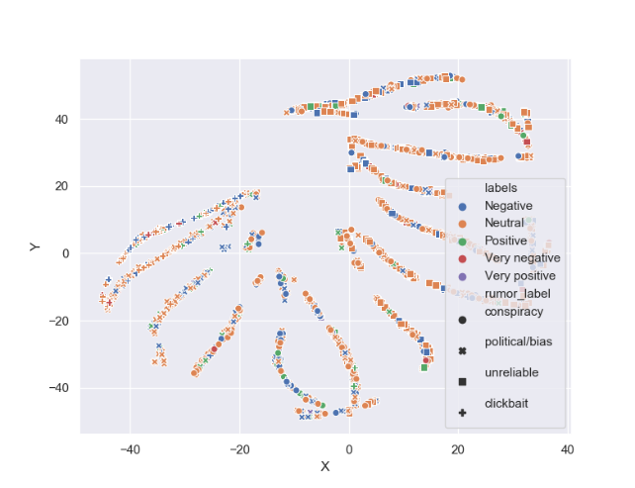
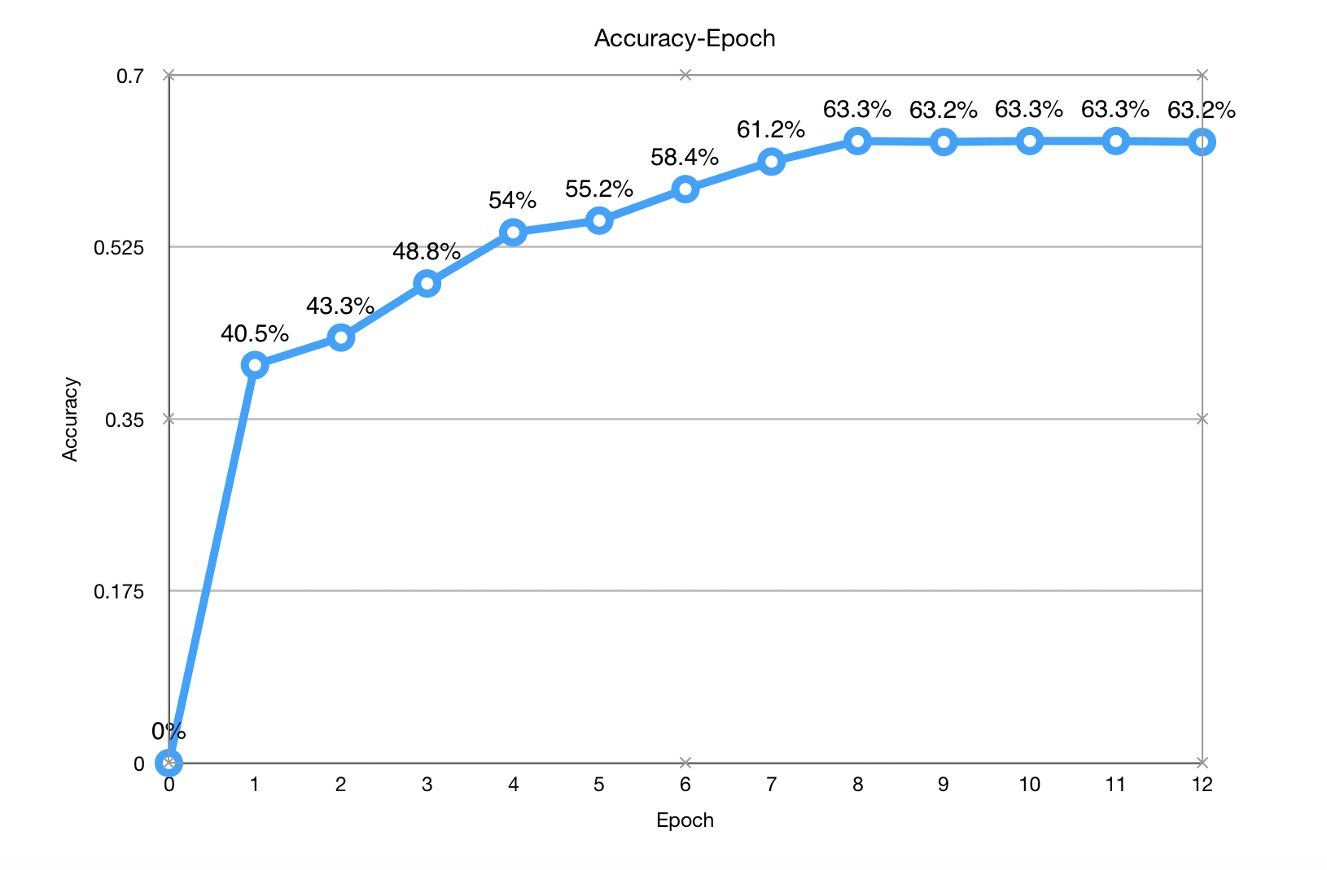
Outline
40-D
Vectors
2-D
Vectors
T-SNE
TokenTextEncoder
Rumor
Sentences
Visualization
Bert
VAE
Encoder
40-D
Vectors
GloVe
Predictions
FCNN
Embedding
Sentiment
Classification

Slide 6
02
Data Acquisition

Slide 7

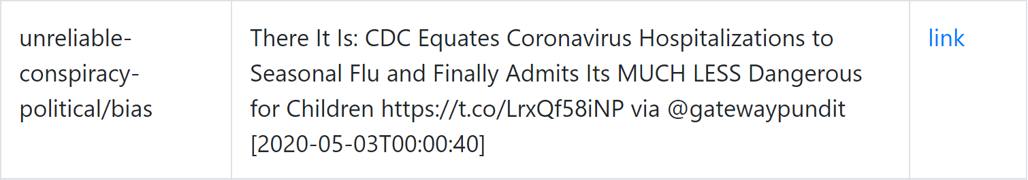
Data Acquisition
Rumors shared on Twitter about Coronavirus from 2020-03-01 - 2020-05-03
Collected by
We use a Web Crawler to acquire these data:
Rumor
Label
multiple label is allowed
Source
Time
Citing:
https://usc-melady.github.io/COVID-19-Tweet-Analysis/misinfo.html

Slide 8
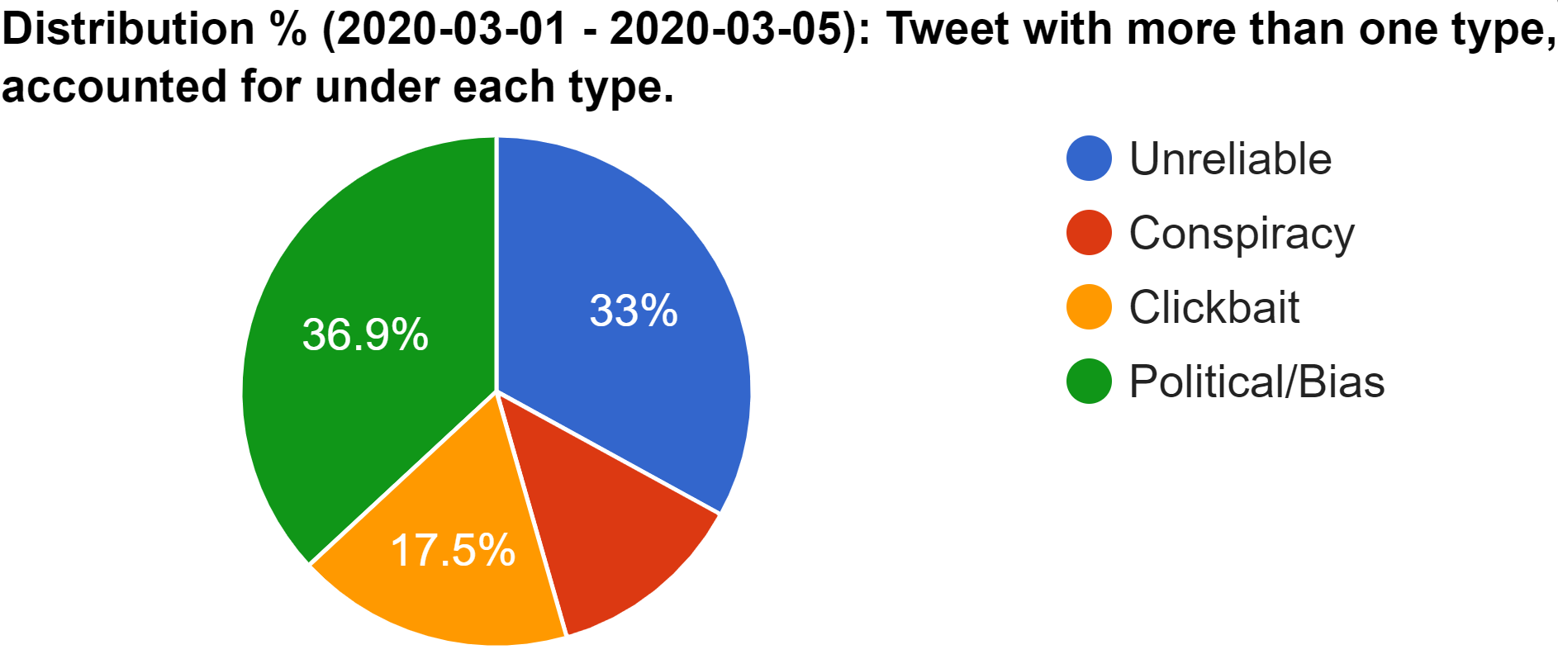
Class
12.6%
Citing:
https://usc-melady.github.io/COVID-19-Tweet-Analysis/misinfo.html

Slide 9
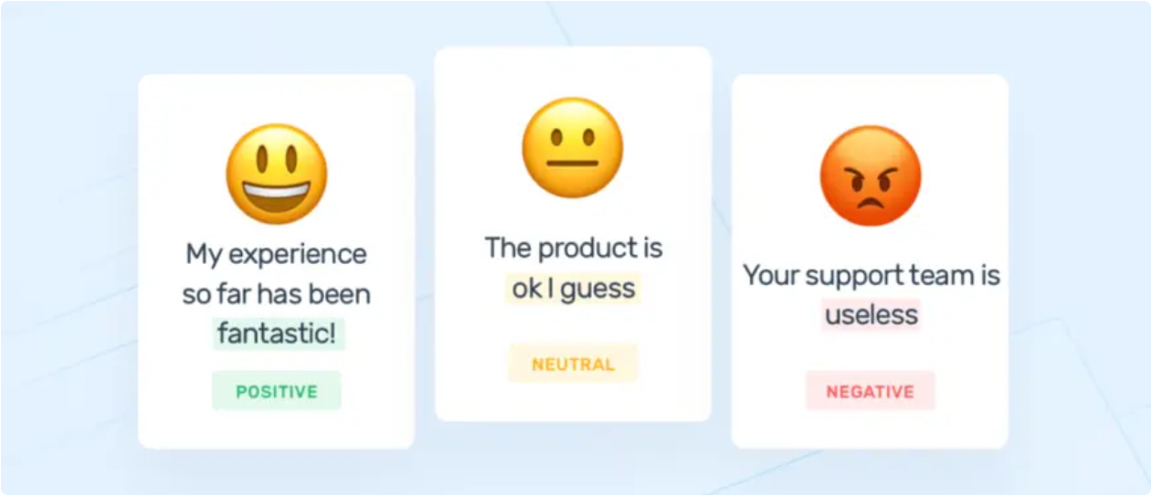
Sentiment Labels
We manually labeled 1630 rumors
Emotions
Happiness
Sadness
Surprise
Positive
Very Positive
Facial Expressions
Neutral
Fear
Neutral
Disgust
Anger
Negative
Very Negative
Citing:
https://monkeylearn.com/sentiment-analysis/，https://people.ece.cornell.edu/land/OldStudentProjects/cs490-95to96/HJKIM/emotions.html

Slide 10
03
Implementation

Slide 11
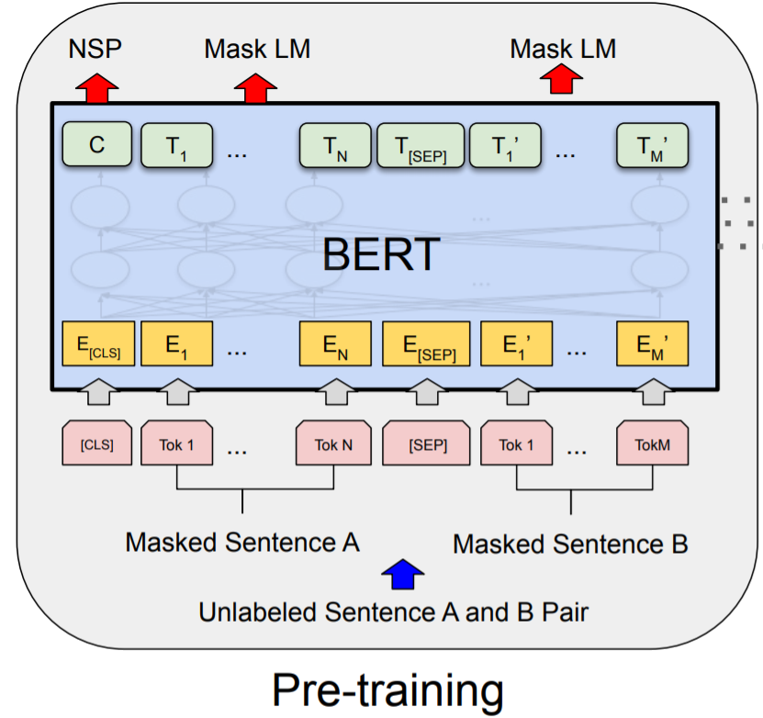
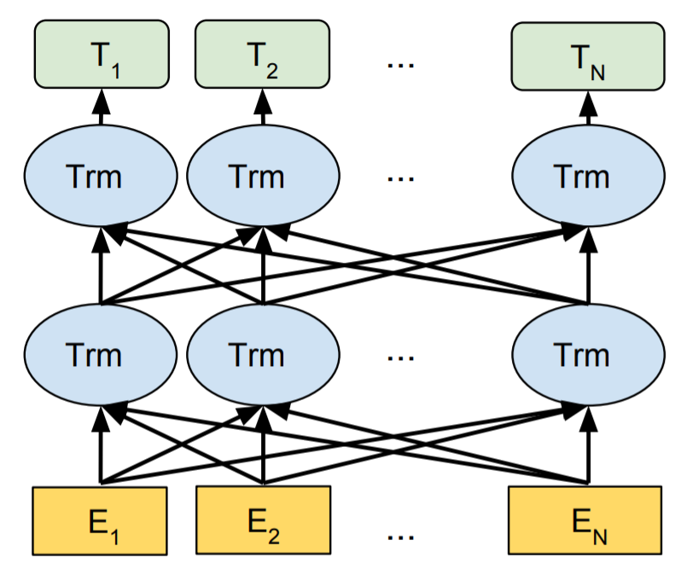
BERT
We use BERT to do word embedding
Bidirectional Encoder
to capture
bidirectional context
Pre-trained by large number of data
Citing:
Devlin J, Chang MW, Lee K, Toutanova K. Bert: Pre-training of deep bidirectional transformers for language understanding. arXiv preprint arXiv:1810.04805. 2018 Oct 11

Slide 12



bert-as-service
We use bert-as-service to extract feature vectors
Server
The bert-as-service
encapsulates feature extraction parts of BERT and offers useful APIs
Feature Vectors
Client
Citing:
https://github.com/google-research/bert ，https://github.com/hanxiao/bert-as-service

Slide 13
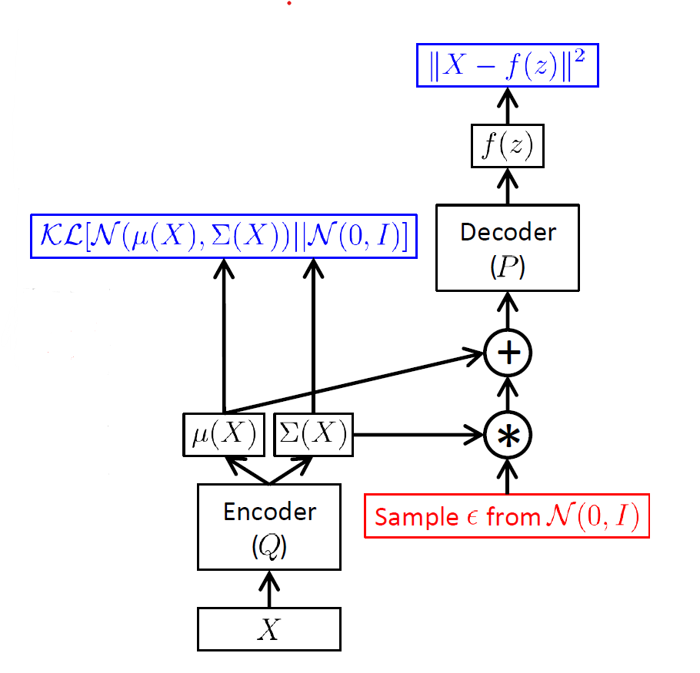
Variational Autoencoders
Decoder
Maximum likelihood
Loss function:
KL divergence
Euclidean distance
Citing:
Doersch, C. (2016). Tutorial on Variational Autoencoders. ArXiv, abs/1606.05908.

Slide 14
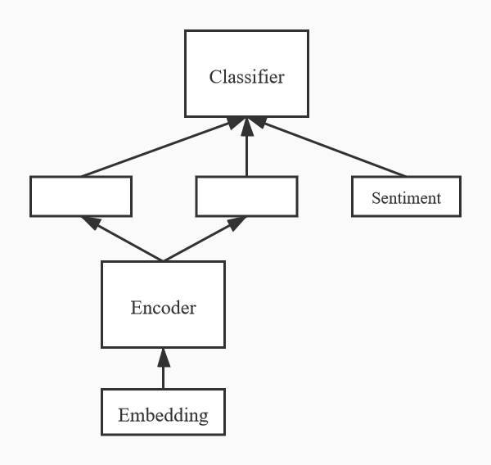


Variational Autoencoders
Citing:
Doersch, C. (2016). Tutorial on Variational Autoencoders. ArXiv, abs/1606.05908.

Slide 15
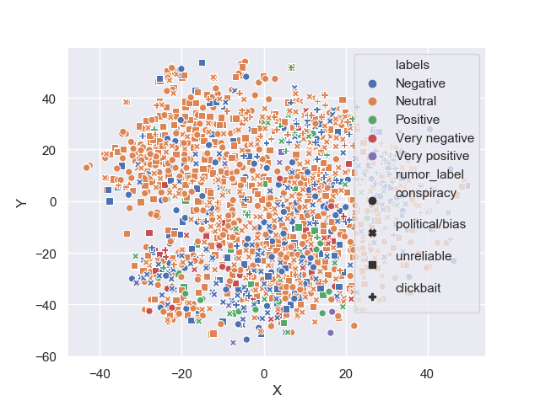
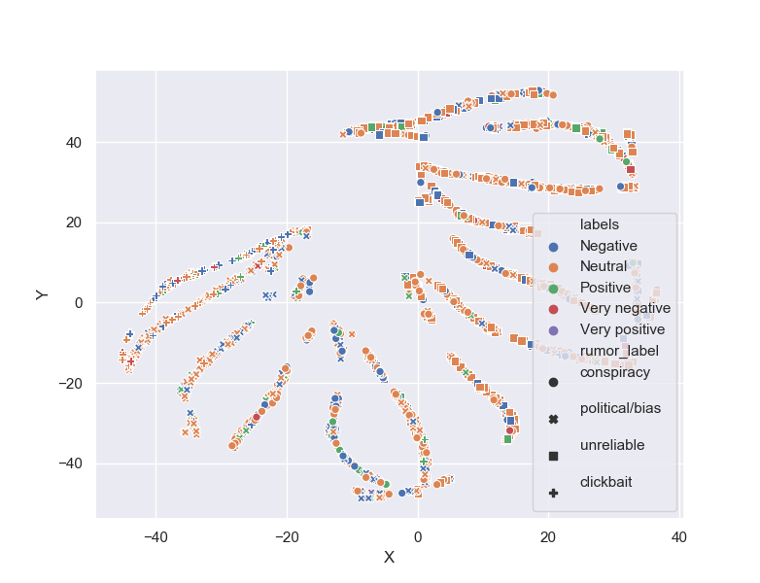
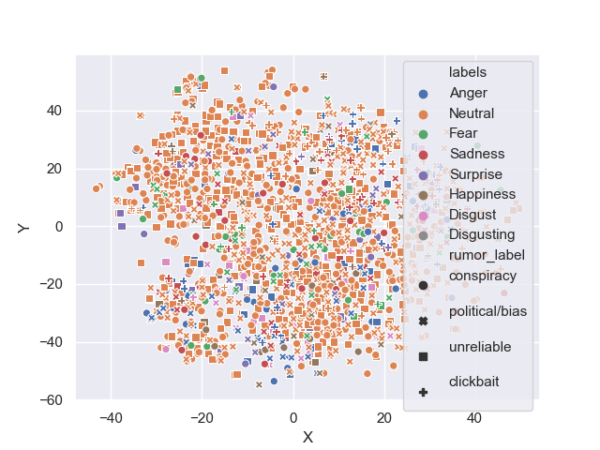
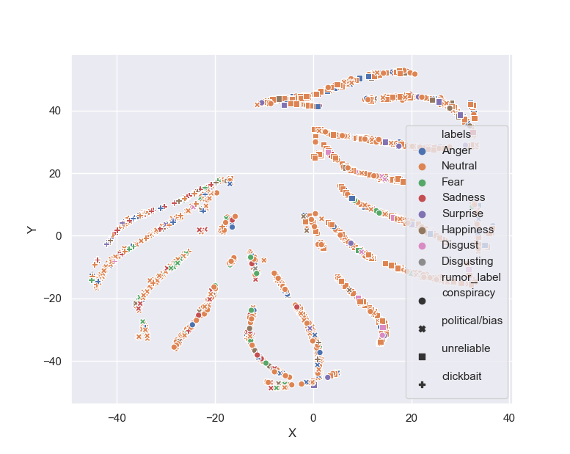
T-SNE
Emotion
BERT
VAE
Facial Expression

Slide 16
Implement VAE using C++
Using the PYTORCH C++ frontend.
The C++ frontend exposes a pure C++11 API that extends this underlying C++ codebase with tools required for machine learning training and inference.
Based on our Python version of VAE, we convert Python API to C++ API.
Citing:
https://pytorch.org/tutorials/advanced/cpp_frontend.html ， https://www.tensorflow.org/tutorials/generative/cvae

Slide 17
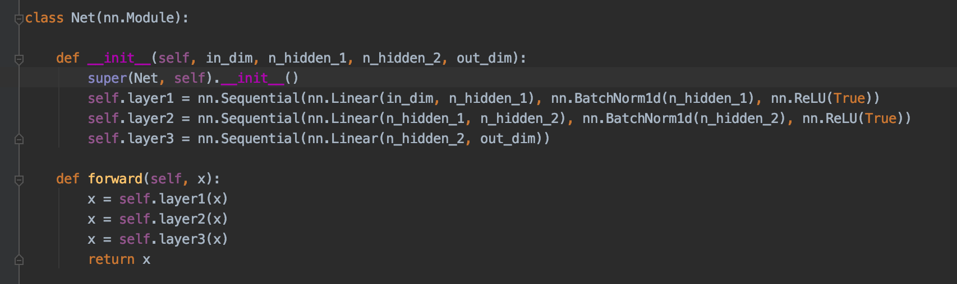
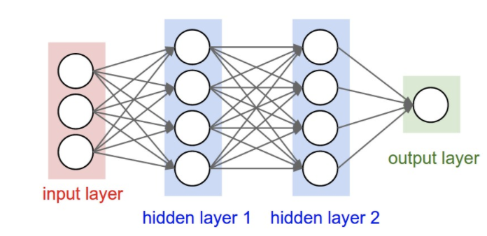
FCNNs Classification
Build fully connected neural network.
Citing:
https://github.com/liamlycoder/PyTorch_Primer/blob/master/PyTorch_Primer/04FConMNIST/net.py ，https://cs231n.github.io/convolutional-networks/

Slide 18
04
Conclusion

Slide 19
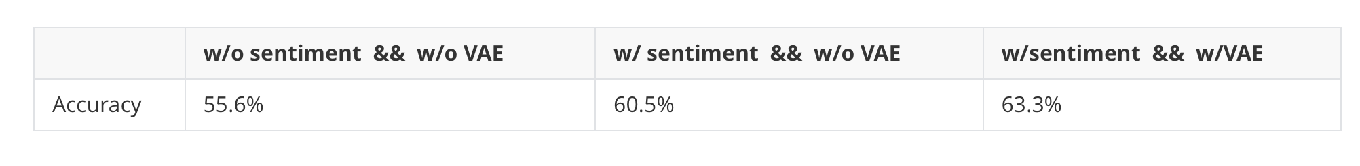
Bert-VAE-FCNNs model Results
As shown in the chart, the introduction of sentiment analysis did improve the accuracy of this model.
Based on Bert’s feature vector

Slide 20
Analysis
1.Dataset:
veracity: the majority of these twitters about COVID-19 are negative
label: facial emotions labels are not that suitable for annotating twitters
size: larger datasets
2. Models:
Bert: improve this model through a preceding multi-task fine-tuning
VAE: Semi-supervised Sequential Variational Autoencoder
Classification: build different models to compare results
Citing:
Xu W, Sun H, Deng C, et al. Variational autoencoder for semi-supervised text classification[C]//Thirty-First AAAI Conference on Artificial Intelligence. 2017.

Slide 21
THANKS!

