Slide 1
Variational Autoencoder-aided
Rumor Classifier
with Sentiments Analysis
Yuhang Lu
Zechen Ha
Zehao Huang

Slide 2
Index
1
Introduction
2
Data Acquisition
3
Implementation
4
Conclusion

Slide 3
01
Introduction

Slide 4


Rumor on Twitter
“An item of circulating information
whose veracity status is yet to be
verified at the time of posting.”

Slide 5
Outline

Slide 6
02
Data Acquisition

Slide 7

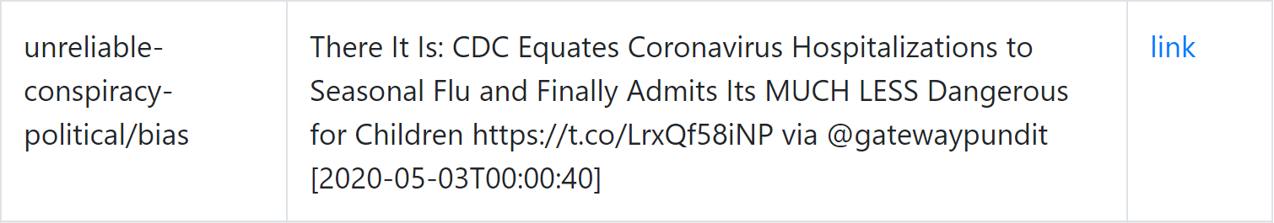
Data Acquisition
Rumors shared on Twitter about Coronavirus from 2020-03-01 - 2020-05-03
Collected by
We use a Web Crawler to acquire these data:
Rumor
Label
multiple label is allowed
Source
Time

Slide 8
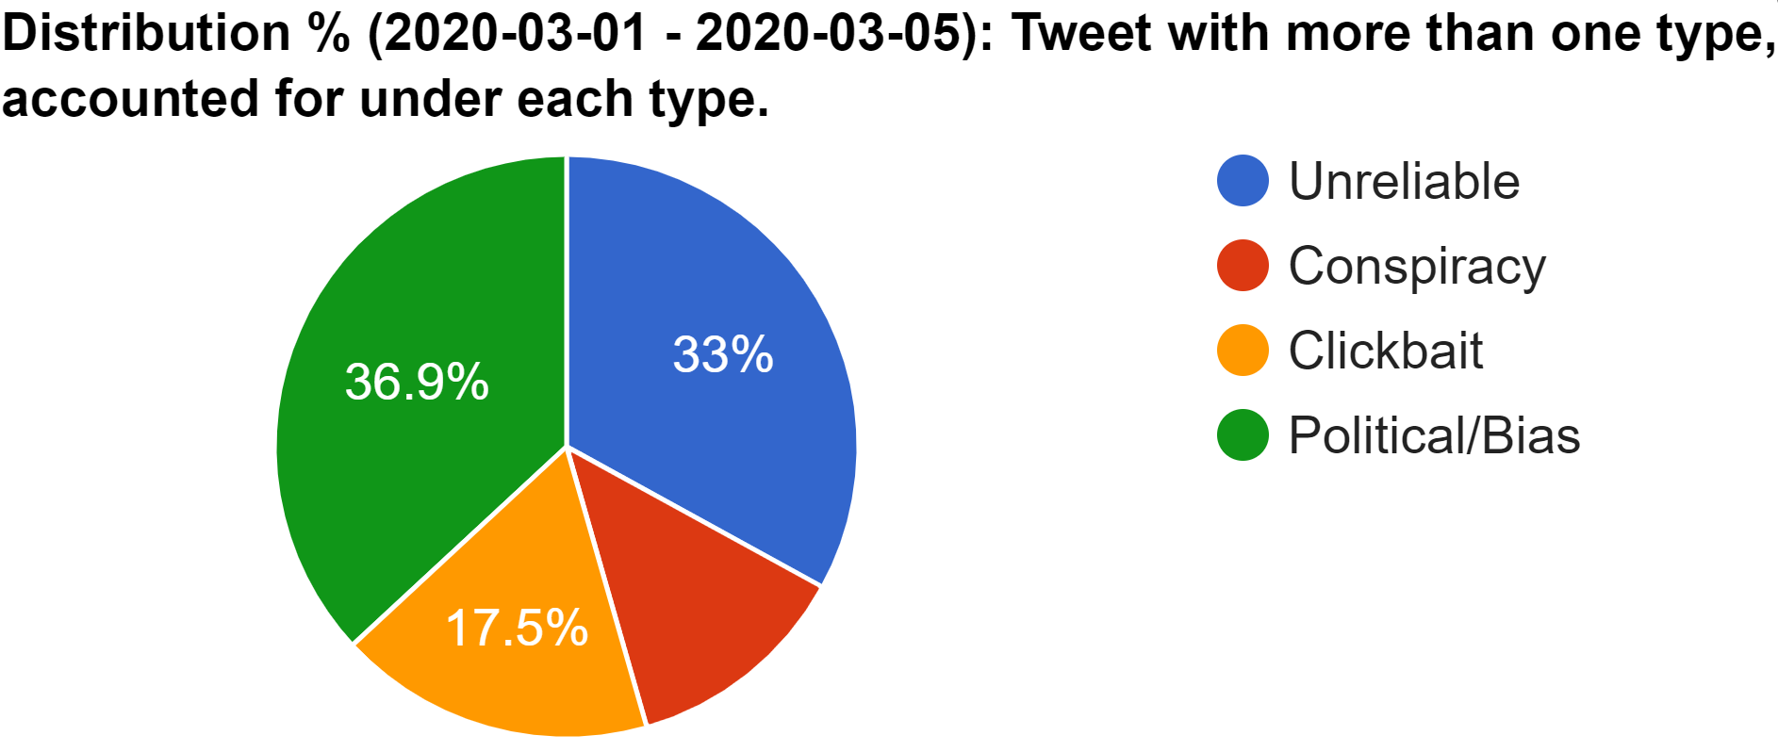
Class
12.6%

Slide 9

Sentiment Labels
We manually labeled 1630 rumors
Happiness
Sadness
Surprise
Positive
Very Positive
Neutral
Facial Expressions
Fear
Neutral
Disgust
Anger
Negative
Very Negative

Slide 10
03
Implementation

Slide 11
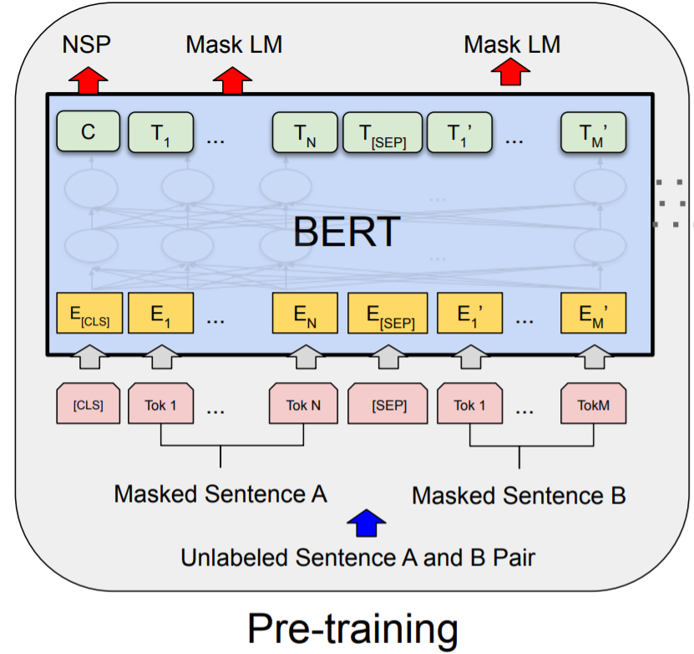
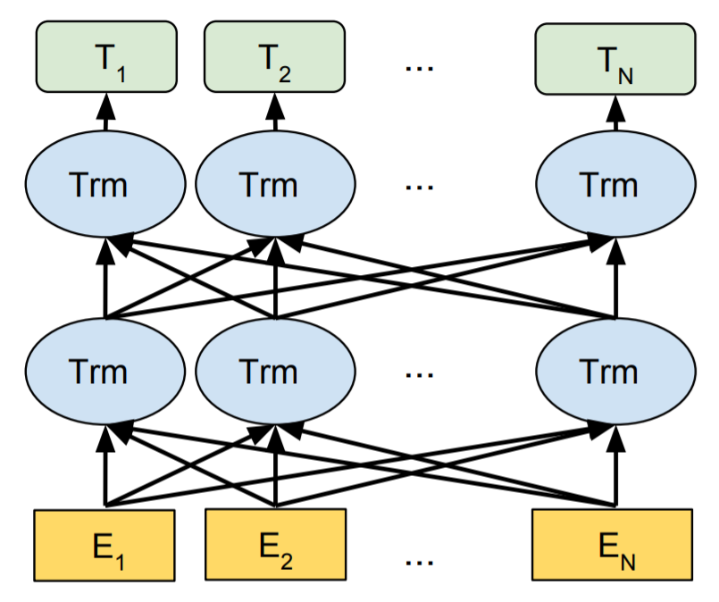
BERT
We use BERT to do word embedding
Bidirectional Encoder
to capture
bidirectional context
Pre-trained by large number of data

Slide 12



bert-as-service
We use bert-as-service to extract feature vectors
Server
The bert-as-service
encapsulates feature extraction parts of BERT and offers useful APIs
Feature Vectors
Client

Slide 13
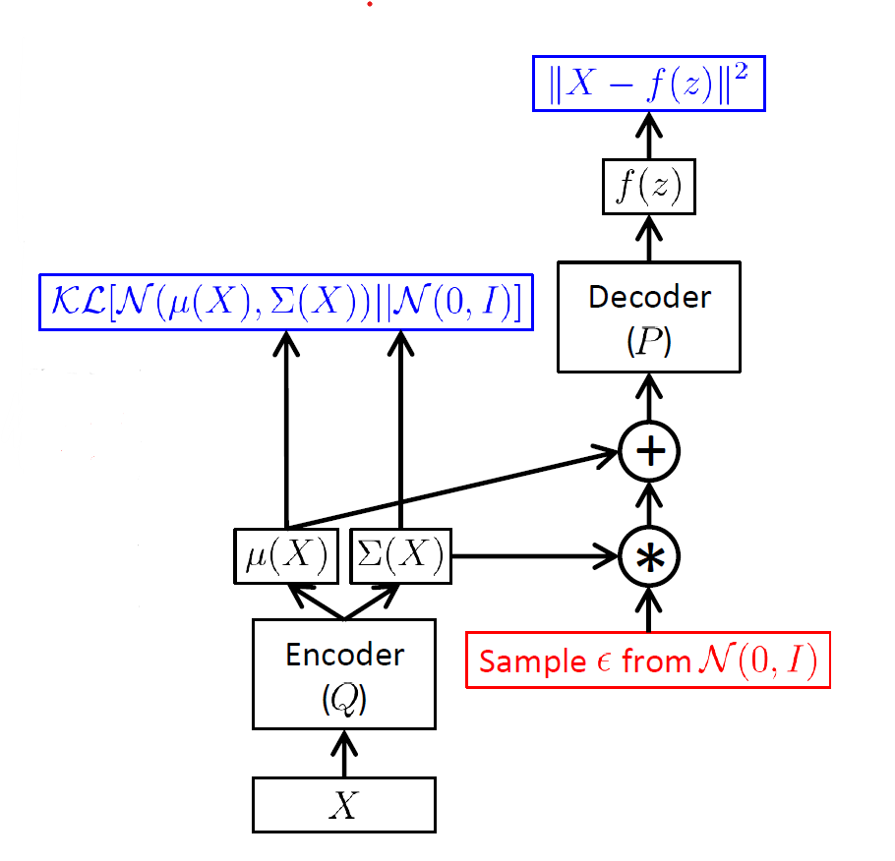
Variational Autoencoders
Decoder
Maximum likelihood
Loss function:
KL divergence
Euclidean distance
Citing: Doersch, C. (2016). Tutorial on Variational Autoencoders. ArXiv, abs/1606.05908.

Slide 14
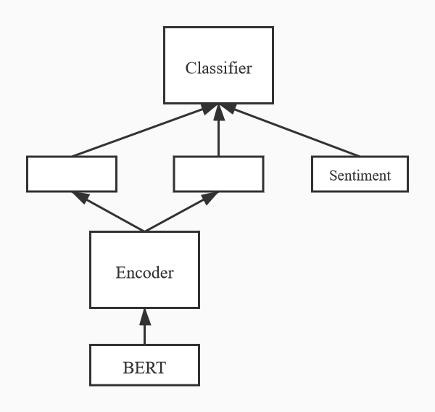


Variational Autoencoders

Slide 15
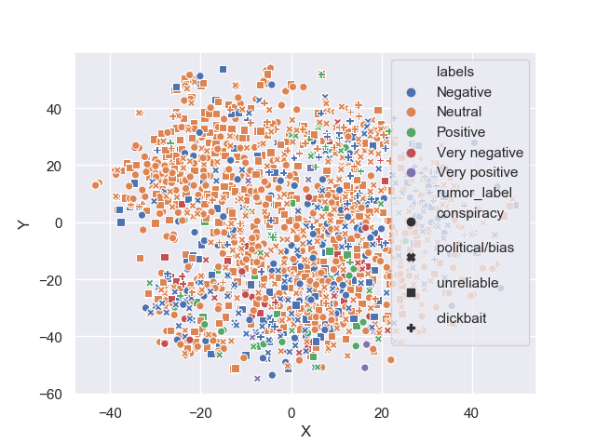
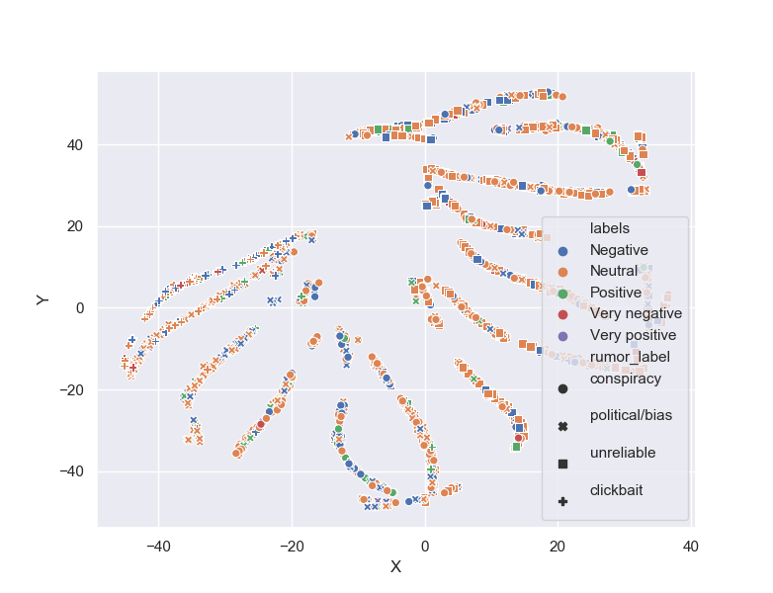
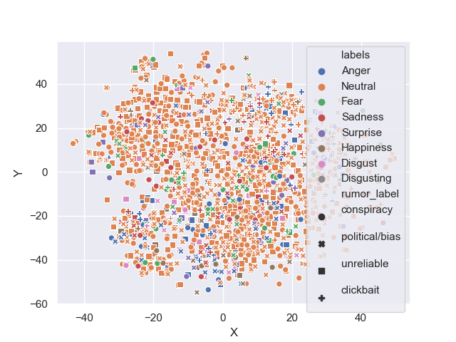
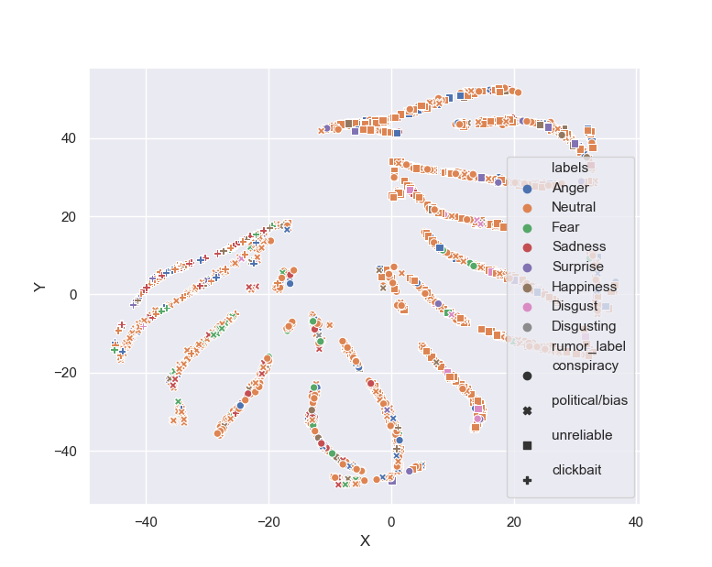
T-SNE
Emotion
BERT
VAE
Facial Expression

Slide 16
04
Conclusion

Slide 18
THANKS!

