Slide 1
Quantum NLP with Lambeq
Ramachandran Sekanipuram Srikanthan

Slide 2
Womanium Quantum Hackathon 2022
Old Team Name : Harekrishna
Team Name : HareKrishna_new
Team Member : Ramachandran SS
Discord ID : Ramachandran SS#0280
Email : ramachandranss22@gmail.com, rsekani@ncsu.edu
Github ID : https://github.com/RamAIbot
Pitch Presenter : Ramachandran SS
Name of Challenge : Quantum Natural Language Processing with lambeq --> by Quantinuum

Slide 3

Problem statement

Slide 4
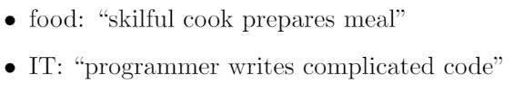
The problem
Write, train and test a QNLP model which when given two sentences can detect whether the sentences fit into the same category or not.
Here we have two categories food and IT. If the two sentences have a subject related only to food or IT, they are classified to same category.

Slide 5

The solution
Text is parsed into circuits.
A QNLP model using IOPAnsatz.
Trained for 100 epochs with batch size 30 with SPSA optimizer.

Slide 6
Solution - contd.
The sentences are taken from original dataset and made into separate train,evaluation and test dataset with each sentence being manually labelled as food and IT (food as 0 and IT as 1).
Instead of passing both the sentences to the model we train the model to classify whether the given sentence can belong to food or IT class.
Finally the sentences in test set are also being passed separately and classified as food or IT. Now for each pair of classification results, if both are same they belong to same class else they are different.

Slide 7
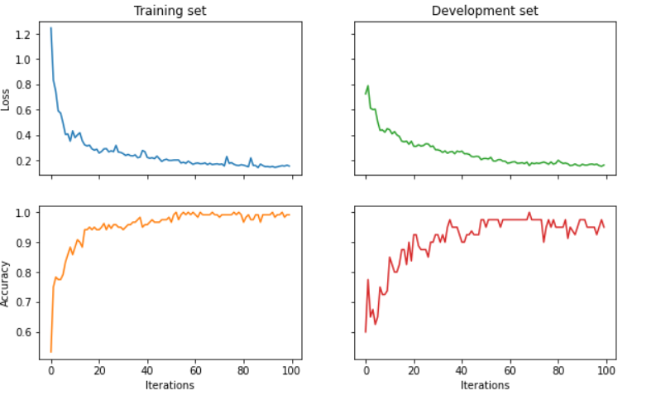
Results
Train Acc: 0.9833
Eval Acc: 0.9500
Test Acc: 0.95

Slide 8
Implementation & Scaling

Slide 9
Implementation
Using DiscoCat algorithm the sentences and the grammatical relations are represented using graphical structures.
These structures are converted to quantum circuits and encoded into Qubits.
It automatically establishes meanings to phrase and sentences.
Provide representation of sentence meanings that would be independent of the grammatical structure.

Slide 10
Scaling
Other plausible uses for QNLP include language generalization and summarization.
As quantum hardware becomes more powerful, we scale up the size of meaning spaces and the complexity of tasks.
Instead of single sentences, we can start processing larger chunks of text as indicated in this article- https://arxiv.org/abs/1203.6242
QNLP technology puts us on the cusp of ongoing quantum tech revolution-pointing us towards quantum native hardware implementation

Slide 11
Thank you!

