Slide 1


Intent detection using deep learning techniques
Paul Kiyambu mvula
pmvul089@uottawa.ca
300169684

Slide 2

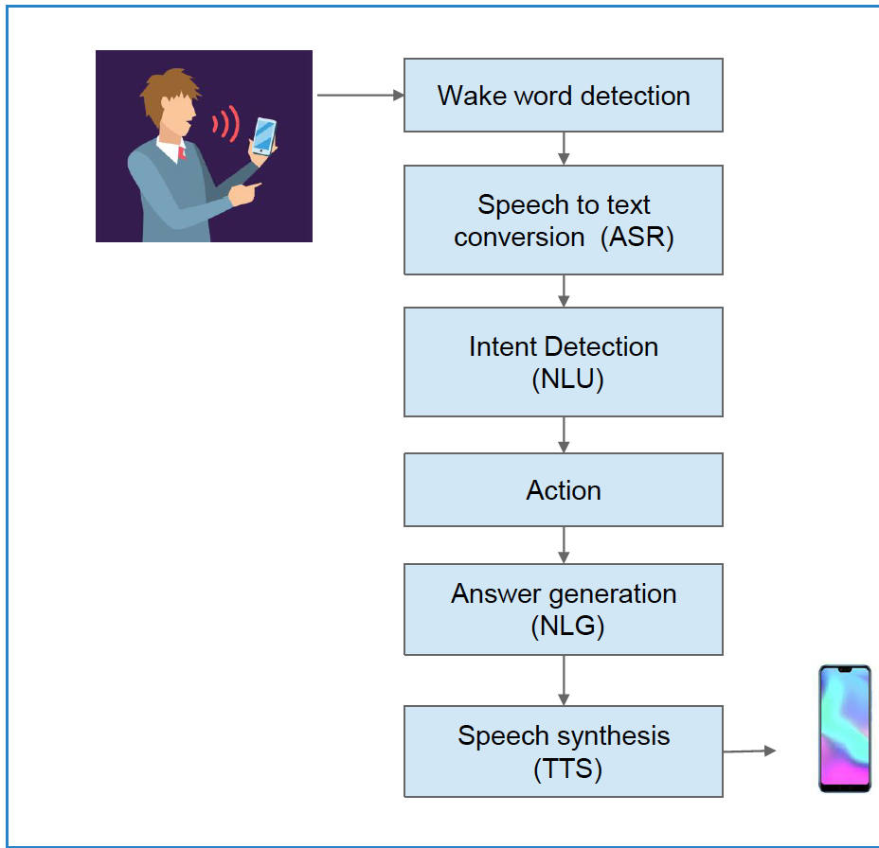
INTENT DETECTION
In IPAs, it is the step after the Speech has been converted to Text (ASR)
An important step determining what the user “intends” to do after initiating the command.
Three data sets, three models, attempting to reproduce [1].
Basic architecture of VA
Notes:
In this project we focus on intent detection (classification), which as you can see on the right, is the step coming after the STT conversion,
So here we assume that the speech has been correctly transcribed to text and is ready for intent classification.
Once the intent has been correctly classified, the next operations can then take place.
We used three data sets, therefore built three models, in addition to a written report detailing the experiments are on GItHub.

Slide 3
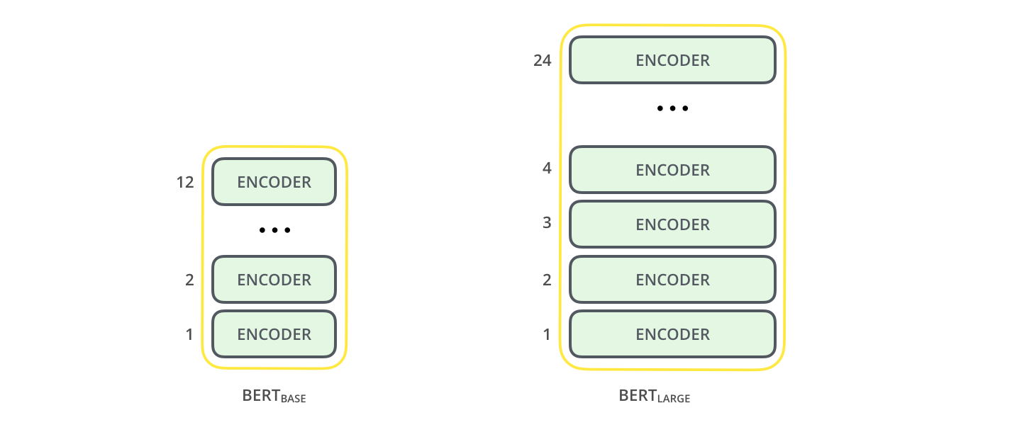
Methodology
Three data sets: ChatBot, AskUbuntu and WebApp (2, 5, 8 intents) [6].
BERT [2] – Bidirectional Encoder Representations from Transformers – to extract features (embeddings) for the sentences in our data sets.
Deep Learning layers to classify the features vectors to corresponding intents.
Notes:
In this project, we have used BERT embeddings for classifying intents in the three data sets: chatbot, askubuntu and webapps.
The chatbot corpus consists of questions gathered by a Telegram chatbot answering questions about public transport connections and
the StackExchange Corpus consists of data from the ask ubuntu platform and Web Ap-plications platform.
BERT (bidirectional encoder representations from transformers) introduced by Google AI.
We used BERT to extract features 768 features from the samples in data sets before doing the classification. BERT is a pre-trained Transformer Encoder stack, that was trained on Wikipedia and the Book Corpus data set, a data set containing +10,000 books of different genres. This neural-based technique demonstrates state-of-the-art performance on a wide range of NLP tasks, including chatbot
technology. BERT embeddings are robust to disambiguation problems as homonyms are represented by different word vectors based on their context.
For this project, we used the base (smaller) and uncased (only lower case letters) version. It is a model that contains 12 layers, 768 hidden units (number of features), 12 heads and 110 million parameters that was trained on lower-cased English text.
Word embeddings are useful when there is less training data.

Slide 4
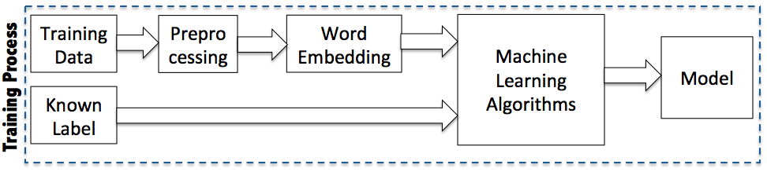
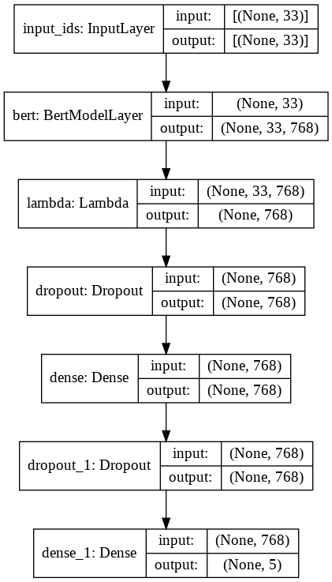
Methodology Cont’d
Python – PyTorch, TensorFlow and Keras – classes and functions to preprocess the raw data.
1st fine-tuning on the three data sets.
2nd fine-tuning on the WebApps data set (8 intents).
Notes:
Topic and Intent Classifier from Scratch | by Himang Sharatun | SkyshiDigital | Medium
Here is are the steps that were taken for training, except that the ML step here are NN layers.
For example, after tuning the model for the AskUbuntu data set, here are the layers

Slide 5

Activity table
Activity | Why | Time Taken | Deliverable
Read and summarize[1] | Get understanding of the problem to be solved. | 3h | -
Explore the three data sets | To get a better understanding of the contents and distribution of each data set. | 1h | -
Preprocess and extract features from the data sets with BERT | Before extracting features with BERT, the data sets were preprocessed, and features were extracted from the data with BERT. | 5h | Uploaded the preprocessed data sets and extracted features uploaded to GitHub (CSV) [5]
Develop baseline models | The models we compared to and improved for better results (i.e., accuracy) | 3h | Uploaded notebook on GitHub (.IPYNB)
Fine tune algorithms | We fined tuned the baseline model with different hyperparameters combinations and layers to get the best accuracies on the tasks. | 4h | Uploaded on GitHub
Perform feature selection and explore literature. | To improve the classification accuracy on the WebApps data set, we found, in the literature, that attention masks as input for the BERT model has a good impact on the classification accuracy. [3] | 3h | Uploaded notebook on GitHub (.IPYNB)
Retrain with the new feature set and compare | In order to see how the new model with the new feature set will compare to the baseline | 4h | -
Prepare a presentation to demonstrate the work and progress | To demonstrate the implementation and experiments carried out. | 3h | Video (.mp4 or .mkv) accompanied by the PowerPoint file
Write a final report | To explain and give further details about the work briefly shown in the presentation. | 5h | Uploaded on Brightspace and Github in the form of a research article in a portable document format (PDF).
Notes:
It took on average 30 hours but was split on different days because we also have other classes.

Slide 6
Challenges
Not enough training data, imbalanced classes
Not enough computational resources => Not enough time
Notes:
As shown in the submitted report, these three data sets do not contain enough training data for good generalization:
Chatbot- 100 for 2 intents
Webapps: 30 for 8 intents
AskUbuntu: 53 for 5 intents

Slide 7
Results
Data set | Test Accuracy
Askubuntu (5 intents) – 1st tuning | 89.91%
ChatBot (2 intents) – 1st tuning | 98.11%
WebApps (8 intents) – 2nd tuning | 67.79%

Slide 8
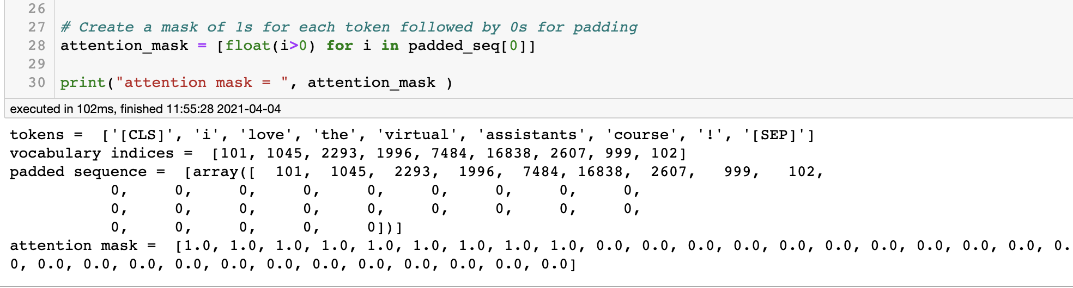
preprocessing Outputs

Slide 9
Lessons learned
How to use BERT for feature extraction and Sequence classification => intent detection (classification)
Preprocessing the raw sentences and attention masks are useful in case vocabulary indices are not sufficient for good generalization.
FastText embeddings [4] and Hyperas [7] for fast hyperparameter optimization.
Notes:
Currently testing the hypothesis on the other data sets (chatbot and askubuntu)

Slide 10
Conclusion - Current/Future works
Try attention Masks for the ChatBot and AskUbuntu Data sets and observe the results;
01
Experiment with FastText embeddings as in [1] and compare the performance to BERT embeddings.
02
Use Hyperas for fast hyperparameter optimization and attempt to develop better models for better accuracy.
03
Test with different ML algorithms (SVM, DTC, XGB, ...) and observe the performance
04
Notes:
This project is an attempt to implement the idea in [1], we have learned to use BERT embeddings and the BERT model for sequence classification for the intent detection problem that is the step after the ASR in VAs

Slide 11
references
J. Kapočiūtė-Dzikienė, K. Balodis, and R. Skadiņš, “Intent Detection Problem Solving via Automatic DNN Hyperparameter Optimization,” Applied Sciences, vol. 10, no. 21, Art. no. 21, Jan. 2020, doi: 10.3390/app10217426.
J. Devlin, M.-W. Chang, K. Lee, and K. Toutanova, “BERT: Pre-training of Deep Bidirectional Transformers for Language Understanding,” arXiv:1810.04805 [cs], May 2019, Accessed: Apr. 03, 2021. [Online]. Available: http://arxiv.org/abs/1810.04805.
A. Vaswani et al., “Attention Is All You Need,” arXiv:1706.03762 [cs], Dec. 2017, Accessed: Apr. 03, 2021. [Online]. Available: http://arxiv.org/abs/1706.03762.
K. Balodis and D. Deksne, “FastText-Based Intent Detection for Inflected Languages,” Information, vol. 10, no. 5, Art. no. 5, May 2019, doi: 10.3390/info10050161.
P. Mvula, womega/CSI5180_Project. 2021.
D. Braun, A. Hernandez Mendez, F. Matthes, and M. Langen, “Evaluating Natural Language Understanding Services for Conversational Question Answering Systems,” in Proceedings of the 18th Annual SIGdial Meeting on Discourse and Dialogue, Saarbrücken, Germany, Aug. 2017, pp. 174–185, doi: 10.18653/v1/W17-5522.
M. Pumperla, maxpumperla/hyperas. 2021.

Slide 12
INTERESTING ?
THANK YOU …
Paul Kiyambu mvula
pmvul089@uottawa.ca
300169684

