Slide 1


Machine Learning based covid-19 phishing domains detection
Paul Kiyambu mvula
pmvul089@uottawa.ca

Slide 2
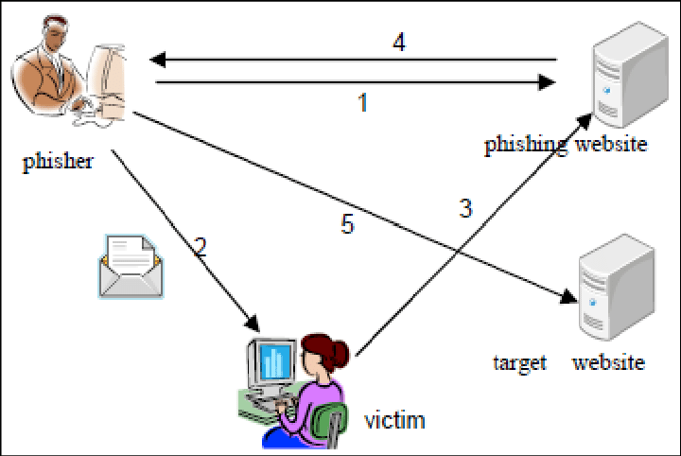
What is phishing ?
Phishing is a fraudulent attempt to trick users into revealing sensitive information (personal information, banking/credit card details, …)
Typically carried out through URLs sent via emails/social media
It is the most used social engineering and cyber attack.
Two main categories:
Spear phishing (targeted)
Clone phishing (generalized)
Notes:
Spear phishing: Phishing attempts directed at specific individuals or companies is known as spear phishing (focus on credibility)
Generalized: no specific target, to increase their probability of success, reach, attackers use the same phishing attack on many users (focuses on increasing reach)

Slide 3


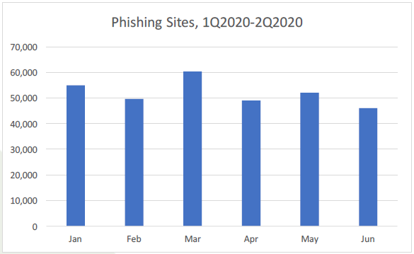
Phishing during the covid-19 pandemic
What is COVID-19 ?
Cybercriminals use natural disasters, health crisis, …, as basis to launch phishing campaigns^{[1]}.
APWG reported over 60000 unique phishing website detected in March, from 40 thousand in February.
APWG Phishing Activity Trend Report Second Quarter, 2020
Notes:
The novel corona virus disease or COVID-19 in short, is a contagious respiratory and vascular disease caused by being infected with the Severe Acute Respiratory Syndrome coronavirus 2 (SARS-Cov-2). The earliest onset of symptoms has been reported by WHO officials on December 8th, 2019 and the outbreak has been declared a pandemic on Mach 11.
APWG’s contributing members report phishing URLs into APWG and study the ever-evolving nature and techniques of cybercrime.
Indicates that cybercriminals have become highly active by taking advantage of the massive increase of online activity caused by the pandemic.

Slide 4
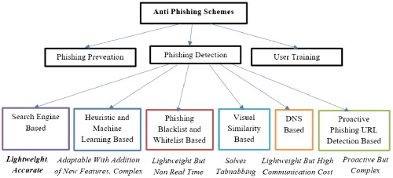
What can we do ?
We can:
Prevent
Educate users
Detect
Notes:
Prevent: prevention directions include case studies of phishing attacks within organizations and universities. They also include investigations into technical security measures as phishing attacks also exploit weakness in current web security.
Educate: education include legislation, user training, and public awareness. Where users are trained to recognize and report phishing attack
Detection: can be divided in three categories visual similarity-based detection systems, list-based detection systems and Machine Learning based detection systems
Although user education and prevention are crucial, end-users are always vulnerable to attacks as attackers can use new techniques and exploit those vulnerabilities to trick them into opening links and releasing their personal information.

Slide 5

Phishing detection Systems
Three categories:
Visual similarity-based detection systems
List-based detection systems
Machine learning-based detection systems
Notes:
Visual similarity: as the name states, they visually compare a suspected phishing page with a legitimate one; their weaknesses are that they are very complex in nature and they have high processing costs because prior knowledge about the websites or large databases of images need to be stored.
List-based: In these systems, there are two types of lists: a list containing malicious domains, the blacklist and another one containing legitimate domains, the whitelist
ML build a model where the phishing detection is simply a classification task classifying phishing domains from legitimate ones with weights generated from the features and data set (garbage in, garbage out)
In a real-time environment, the detection of a phishing attack should be effective and very fast. List-based approaches are fast, but they are not able to detect zero-hour (new) phishing attacks. On the other hand, visual similarity-based approaches are time consuming, require a lot of memory, and fail to detect zero-hour attacks.; therefore ML has been proven to be the most effective of these systems.

Slide 6

objective
The objective of this project is to propose a ML model that classifies COVID-19 related domains between phishing and legitimate. We apply different models to the data set then their performances are compared and the model with the best performance is selected.
Image Source: VERISIGN^{[3]}
Notes:
One thing we should pay attention to is that we are classifying from DOMAIN NAME (sub-domain, domain name and suffix) and not from the entire URL.

Slide 7
Data set
First, we collected legitimate and confirmed phishing domains with COVID-19 related keywords from publicly available data to construct our own data set..
Legitimate domains were obtained from search engines (Google, Baidu, Yandex and Bing)
Malicious domains were obtained from opensource services: DomainTools^{[4]} and Phishlab^{[5]}.
Notes:
keywords = ['covid' , 'ncov', 'wuhan', 'chinavirus', 'ncov-19', 'virus', 'covid-19', 'covid19', 'sars', 'wuhanvirus', 'novelvirus’]
Whitelist: we obtained more than 5000 domains this way.
Malicious: More than 60000 domains were collected.
After that, we extract useful features from the generated data set and then move on to the model construction and algorithm tuning

Slide 8

features
Length
Hyphen ?
Entropy
Tranco Rank (web-traffic) ?
Longest word ratio
Typos ?
Freenom Top Level Domain ? (.cf, .gq, .ml, .tk, .ga)
Numbers other than 19 ?
Number of subdomain levels (benchmark)
Notes:
As mentioned earlier, we need to be able to be fast while extracting features and classifying domains, that is the reason why we have extracted a set of lexical features successfully used in literature and not time consuming to extract.
Entropy: Shannon entropy allows to estimate the average minimum number of bits needed to encode a string of symbols based on the alphabet size and the frequency of the symbols, we notice we need less bits to encode legitimate domains than malicious domains on average.
Tranco rank: like Alexa Rank, checks whether the domain is on the 1m most visited website list
Freenom: This feature checks whether the TLD belongs to Freenom2. Freenom provides free domain names on \.cf", \.gq",\.ml", \.tk" and \.ga" TLD
Subdoms: The last feature is a benchmark because most of the domains in the legitimate list have more than one subdomains, we have decided not to use it to avoid biasing our model.

Slide 9
ML Models and evaluation
Algorithm | F-1 | Precision | Accuracy | Sensitivity | Specificity
Decision Tree | 95.9391 | 97.6139 | 93.7534 | 94.4982 | 90.7719
Random Forest | 97.8558 | 97.6436 | 96.6004 | 98.1199 | 90.5206
XGBoost | 97.9467 | 97.3351 | 96.7108 | 98.5889 | 89.1976
GBC | 97.4743 | 95.5708 | 9.58767 | 99.4557 | 81.5609
MLP | 97.7228 | 96.1286 | 96.2954 | 99.3719 | 83.9893
SVM | 97.6162 | 95.6964 | 96.1078 | 99.6148 | 82.0800
The baseline XGBoost is the best model as it has the best performance compared to the other algorithms. It is saved for further works.
Notes:
The algorithms used in this project are:
Decision Tree (DT)
Random Forests (RF)
Extreme Gradient Boosting (XGBoost)
Gradient Boosting (GBC)
Multilayer Perceptrons (MLP)
Support Vector Machine (SVM)
Here are the average scores under 10-fold cross-validation with legitimate domains making ¼ of the malicious domains (undersampled), untuned algorithms.

Slide 10
Current/Future works
Tune algorithms the algorithms in previous slide for best parameters;
01
The best model could be deployed as a browser extension to predict unseen cases;
02
Develop an online learner that would constantly be updated as instances arrive, and more malicious / legitimate domains are created.
03

Slide 11
INTERESTING ?
THANK YOU …
Paul Kiyambu mvula
pmvul089@uottawa.ca

Slide 12
references
Verma, R., Crane, D., & Gnawali, O. (2018). Phishing During and After Disaster: Hurricane Harvey. 2018 Resilience Week (RWS) (pp. 88-94). IEEE.
Anti-Phishing Working Group (APWG), Phishing Activity Trend Report Second Quarter, 2020 http://docs.apwg.org/reports/apwg_trends_report_q2_2020.pdf
VERISIGN: What Is A URL? Find Out What A URL Stands For and Its Meaning – Verisign
Free COVID-19 Threat List - Domain Risk Assessments for Coronavirus Threats (domaintools.com)
COVID-19 Threat Intelligence | PhishLabs

