Slide 1
Data Mining Principles
Final Project
by
Jason Lyn, Won Woo Seo, Ran Pang

Slide 2
Overview
Data Preprocessing
Model Building
Model Comparison
Interpretation
Future Steps
Appendix

Slide 3

1.1 Data Overview & Case Description
Case Description
The goal of this project to apply machine learning algorithms to predict the probability that a customer will default a loan also known as Probability of Default(PD). This is a classification model. Historically, Banks and Credit Card companies have used Logistic (Probit) Regression models to predict loan defaults. We will utilizing various Loan attributes and Customer attributes including FICO scores to build classification models using various machine learning algorithms (Logistic Regression, SVM, Decision Tree, Random Forest, Gradient Boosting, and XG Boosting). There are total of 4 original data tables about 12 gigabytes, with over 300 columns.
Loan
Origination
Credit
Application
Customer
Behavior
Payment
History
Equifax
Credit Bureau
External
Data

Slide 4
1.2 Data Description
Loan
Origination
Payment
History
Credit
Application
Equifax
Credit Bureau
Customer
Behavior
External
Data
Loan dimension tables has records of origination information of each Loan.
The dataset includes 10.8 million loan records originated in 2018.
The record includes origination balance, type of loan, terms of the loan, and basic customer information
Payment History of the loan will show which loans are delinquent in payments.
This is also part of the customer behavior. Customers who have good payment history are likely to receive high line increases.
Credit Application data includes a snapshot of the customer data at the time of the application.
It will include FICO score, LTV, Debt to Income at the time of the application.
Credit Bureau data comes in 20 to 100 pages long XML format.
The data includes previous employments, past credit history / delinquencies, known alias, etc.
For the purpose of this project, we only used employment length and FICO score.
Internal customer data which shows customer records within the company in the past
BLS Unemployment Rates based on time and region.
S&P Index Open & Close Value.
10 Year Treasury Rate.
Federal Reserves Quarterly GDP estimate.
Consumer Confidence Index.

Slide 5
1.3 Fundamentals of Credit Risk Modeling
Banks, credit unions and other lenders utilizes various Credit Risk Models to estimate the loan losses based on their underwriting policy and portfolio analysis
Banks use FICO scores, external vendor data (Experian, TransUnion, Equifax) and their internal customer behavior information. Typical features include:
Length of Employment | Credit Line Usage
Number of Delinquencies | Number of Credit Lines
Debt to Income | Number of Inquires
Loan to Value (LTV) for Secured Loans | ……
PD
EAD
LGD
Loan Loss

Slide 6




1.4 Point in Time vs Through the Cycle
There are two different types of Probability of Default (PD) Modeling
Point in Time
Through the Cycle
Model considers external factors such as Interest Rate, Unemployment Rate, S&P Index, etc. For our PD models, we will utilize time-series modeling and include external factors (10 year Treasury rate, S&P Index, GDP, Unemployment Rate) to determine if there are associations of increase/decrease in default rates based on external economic factors.
Through the cycle doesn’t utilize time-series modeling. It looks at the entire population without regard to specific time period or external factors. ‘ALLL’ Allowance for Loans and Leases uses Through the Cycle methodology. However, most banks and financial institutions are adopting to a Point in Time method in order to comply with CECL (Current Expected Credit Loss).

Slide 7
Overview
Data Preprocessing
Model Building
Model Comparison
Interpretation
Future Steps
Appendix

Slide 8
2.1 Data Preprocessing – Data Import
CURO table (Default Info) and FICO table (Customer Info) are merged using the Customer Key
CURO (internal)
FICO (external)
The table has over 5 million observations and 112 columns
3 columns are selected:
Write-off amount indicates whether a customer defaults a loan
‘Is Internet’ shows whether a customer used online application
‘CustomerKey’ will be used for joint
The table has over 7 million observations and 49 columns
Customers location information is dropped because the model will be used within a specific region
FICO scores are aggregated at the customer level
Customer Key
Notes:
The prediction goal: identify good customer at the point of pre-approval

Slide 9
2.2.1 Data Preprocessing – Categorical Handling
Categorical variables handling consists of 2 parts: missing value handling & category encoding
Missing Value Handling
Most values in the first 3 variables are missing, so these variables will be dropped
Missing values and ' ' in 'GENDER' will be recategorized as 'other’
Missing values in 'ACH_STATUS' will be dropped
CHK_CASHING_FEE | 518579
HOW_REF_OBSOLETE | 900318
INET_APPROVED | 307704
GENDER | 5
ACH_STATUS | 1
*Based on 20% sample data
Notes:
'GENDER' is very unbalanced: there are a lot more females than males. The reason might be males do not like to fill our their gender information, but this can be seen as a typical type, which is labeled as 'other'.

Slide 10
2.2.2 Data Preprocessing – Categorical Handling
Categorical variables handling consists of 2 parts: missing value handling & category encoding
Encoding (regression)
Categorical variables are converted into dummies using pd.get_dummies
def create_dummy(dataframe, todummy_list):
for x in todummy_list:
dummies = pd.get_dummies(df[x], prefix=x, dummy_na=False, drop_first=True)
dataframe = dataframe.drop(x, 1)
dataframe = pd.concat([dataframe, dummies], axis=1)
return dataframe
Before vs After Transformation
 | GENDER
1 | F
2 | M
3 | other
 | GENDER_F | GENDER_M
1 | 1 | 0
2 | 0 | 1
3 | 0 | 0
Notes:
After dummy transformation, the observations with 0 value will cause that variable’s coefficient to have no role in influencing the dependent variable. And this will allow regression equations to handle categorical variables correctly.

Slide 11
2.2.3 Data Preprocessing – Categorical Handling
Categorical variables handling consists of 2 parts: missing value handling & category encoding
Encoding (tree-based)
Dummy variables present 2 problems that are more particular to tree-based models:
The resulting sparsity virtually ensures that continuous variables are assigned higher feature importance.
A single level of a categorical variable must meet a very high bar in order to be selected for splitting early in the tree building. This can degrade predictive performance.
Features that have many levels are recategorized into fewer levels
Variable 'Is Internet' has 2 unique categories
Variable 'SPOUSE_DIR_DEP' has 2 unique categories
Variable 'GENDER' has 3 unique categories
Variable 'BOUNCED' has 2 unique categories
Variable 'NEW_CUST_REF' has 1 unique categories
Variable 'PAY_CYCLE' has 8 unique categories
Variable 'ACH_STATUS' has 2 unique categories
Variable 'OwnRentOther' has 4 unique categories
Variable 'ACCT_BLOCKED' has 2 unique categories
Variable 'COURTESY_CALL_NUM' has 3 unique categories
Variable 'ACTIVE_MILITARY' has 1 unique categories
Variable 'CC_BLOCK' has 2 unique categories
Variable 'MARITAL_STATUS' has 4 unique categories
PAY_CYCLE | Frequencies
B | 245405
M | 141354
W | 90772
T | 57772
other | 2201
recategorize
*Based on 20% sample data
Notes:
For large number of levels you should proceed with caution. Too much levels can be translated in low predictive power. So maybe a grouping of the levels gives more than use directly the variable.
(https://stats.stackexchange.com/questions/152433/will-decision-trees-perform-splitting-of-nodes-by-converting-categorical-values)

Slide 12
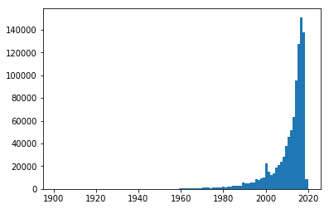
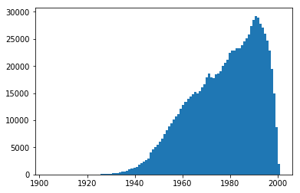
2.3.1 Data Preprocessing – Numerical Handling
Numerical variables handling consists of 2 parts: missing value handling & standardization
Missing value handling
If most data in one feature are missing, that feature will be dropped
If a small number of data is missing, missing values will be imputed.
KNN imputation will be used instead of direct imputation, because of the distributions of data (for example: ResidenceSince & DOB)
ResidenceSince
DOB
Notes:
In k-NN regression, the output is the property value for the object. This value is the average of the values of its k nearest neighbors. Nearest neighbor imputations which weights samples using the mean squared difference on features for which 2 rows both have observed data.
The best choice of k depends upon the data; generally, larger values of k reduces effect of the noise, but make boundaries between classes less distinct.
The reason why choosing KNN instead of other methods:
1. No assumptions about data — useful, for example, for nonlinear data
2. Simple algorithm

Slide 13
2.3.2 Data Preprocessing – Numerical Handling
Numerical variables handling consists of 2 parts: missing value handling & standardization
Missing value handling
KNN imputation will be used instead of direct imputation
The assumption behind using KNN for missing values is that a point value can be approximated by the values of the points that are closest to it, based on other variables.
def knn_impute:
# Dependency: sklearn.neighbors
# Create a dataframe that does not have nan for training and sample the dataframe
# Create a dataframe of missing values for prediction
# Train k-Nearest Neighbor Classifier
# Predict missing values
# Concatenate predicted missing values with original dataframe that does not have nan
Because of the size of our data, package fancyimpute was not used for KNN imputation
Instead, knn_impute was self-defined to improve efficiency
(Pseudo code for demonstration; see .ipynb for actual codes)
Notes:
Why not fancyimpute: computationally expensive — because the algorithm stores all of the training data

Slide 14
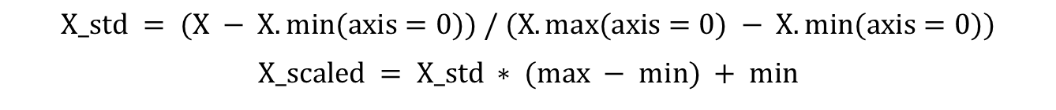
2.3.3 Data Preprocessing – Numerical Handling
Numerical handling consists of 2 parts: missing value handling & nondimensionalization
Standardization
MinMaxScaler is used to standardize numerical data for non tree-based model
The transformation is given by:
$$X_std = (X − X.min(axis=0)) / (X.max(axis=0) − X.min(axis=0))$$
$$X_scaled = X_std ∗ (max − min) + min$$
BEFORE
AFTER
 | DEPENDENTS | RI_BALANCE
mean | 0.000220 | 475.935610
std | 0.023466 | 981.630035
min | 0.000000 | -1200.000000
max | 6.000000 | 32678.070000
 | DEPENDENTS | RI_BALANCE
mean | 0.000037 | 0.049470
std | 0.003911 | 0.028975
min | 0.000000 | 0.000000
max | 1.000000 | 1.000000
*Based on 20% sample data
Notes:
Why using MinMaxScaler:
Standardscaler:
Assumes that data has normally distributed features and will scale them to zero mean and 1 standard deviation.
After applying the scaler all features will be of same scale .
Minmaxscaler :
This shrinks your data within the range of -1 to 1(if there are negative values).
This is used when distribution is not Gaussian, responds well if standard deviation is small.

Slide 15
2.4 Data Preprocessing – Feature Engineering
2 way interaction terms created for all features/between categorical and numerical features
Among All Features
Categorical * Numerical
def add_interactions_all:
# Dependencies: itertools, sklearn.preprocessing
# Select categorical and numerical columns
# Use combinations from itertools to create names
# Create interaction using PolynomialFeatures
def add_interactions:
# Dependencies: itertools, sklearn.preprocessing
# Select categorical and numerical columns
# Create a loop to loop through each categorical and numerical features
for cat in categorical_column:
for num in numerical_column:
# Use combinations from itertools to create names
# Create interaction using PolynomialFeatures
Number of features increases from 32 to 330 after interactions
Number of features increases from 32 to 116 after interactions

Slide 16
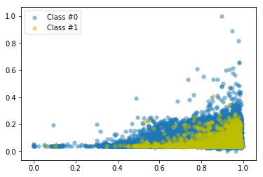
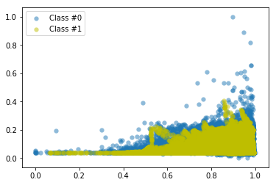
2.5 Data Preprocessing – Target Balancing
Both SMOTE and self-defined undersampling + oversampling are tried and tested for balancing
SMOTE
Target variable is very unbalanced:
 | COUNTS | %
0 | 527136 | 98.07
1 | 10367 | 1.93
TOTAL | 537503 | 100.00
UNDER + OVER SAMPLING
Target balancing will be performed on training data set only
def upsampling_downsamling:
# Upsampling minority category (1s) by a certain amount
# Downsampling majority category (0s) by a certain amount
# Concatenate two dataframes
(Pseudo code for demonstration; see .ipynb for actual codes)
*Based on 20% sample data

Slide 17
2.6.1 Data Preprocessing – Feature Reduction
Features will be selected based on a vote, using Filter, Wrapper, and Embedded methods
Filter (Pearson, Chi-Squared, and Mutual Information), Wrapper (RFE), and Embedded (LightGBM) methods are all used to rank the features.
A vote is conducted to obtain the final comprehensive results.
Filter
70 BEST FEATURES
Pearson, Chi-Squared, and MI
FEATURE WITH MOST VOTES WILL STAY (IN THIS CASE 4 or 5 VOTES)
Wrapper
70 BEST FEATURES
RFE Logistic
Embedded
154 BEST FEATURES
LightGBM
Notes:
Filters:
Methods: measure feature relevance; usually order features; use statistical tests as assessment
Results: robust against overfitting; may fail to select the most “useful” features
Pearson: for numerical variables
Chi-Squared: for categorical variables
MI: the mutual information (MI) of two random variables is a measure of the mutual dependence between the two variables.
Wrappers:
Methods: measure feature subset’s usefulness; search the space of all feature subsets; use cross-validation as assessment
Results: can find the most useful features to a certain algorithm, but prone to overfitting
Embedded:
Methods: measure feature subset’s usefulness; search guided by the learning process; use cross-validation as assessment
Results: can find the most useful features to a certain algorithm, less computationally intensive than wrapper methods, and less prone to overfitting
Light GBM is a fast, distributed, high-performance gradient boosting framework based on decision tree algorithm, used for ranking, classification and many other machine learning tasks.
Since it is based on decision tree algorithms, it splits the tree leaf wise with the best fit whereas other boosting algorithms split the tree depth wise or level wise rather than leaf-wise. So when growing on the same leaf in Light GBM, the leaf-wise algorithm can reduce more loss than the level-wise algorithm and hence results in much better accuracy which can rarely be achieved by any of the existing boosting algorithms.
(http://clopinet.com/isabelle/Projects/ETH/lecture9.pdf)
(https://www.analyticsvidhya.com/blog/2017/06/which-algorithm-takes-the-crown-light-gbm-vs-xgboost/)
(https://www.quora.com/What-is-the-wrapper-and-embedded-method-How-is-the-feature-selection-done-by-using-it)

Slide 18
2.6.2 Data Preprocessing – Feature Reduction
Features will be selected based on a vote, using Filter, Wrapper, and Embedded methods
def feature_selection_voting(x, y, num_features=70, threshold=4):
cor_support = cor_selector(x, y, num_features)
chi_support = chi_selector(x, y, num_features)
info_support = mutual_info_selector(x, y, num_features)
rfe_support = rfe_logistic_selector(x, y, num_features)
embeded_lgb_support = lgbc_selector(x, y)
feature_selection_df = pd.DataFrame({'Feature’: x.columns.tolist(),
'Pearson’: cor_support,
'Chi-2’: chi_support,
'Mutual Information’: info_support,
'RFE (Logistic)’: rfe_support,
'LightGBM’: embeded_lgb_support})
# Count the selected times for each feature
feature_selection_df['Total'] = np.sum(feature_selection_df, axis=1)
# Display
feature_selection_df = feature_selection_df.sort_values(['Total’, 'Feature'] , ascending=False)
feature_selection_df.index = range(1, len(feature_selection_df)+1)
return feature_selection_df.loc[feature_selection_df['Total'] >= threshold]
Notes:
Filters:
Methods: measure feature relevance; usually order features; use statistical tests as assessment
Results: robust against overfitting; may fail to select the most “useful” features
Pearson: for numerical variables
Chi-Squared: for categorical variables
MI: the mutual information (MI) of two random variables is a measure of the mutual dependence between the two variables.
Wrappers:
Methods: measure feature subset’s usefulness; search the space of all feature subsets; use cross-validation as assessment
Results: can find the most useful features to a certain algorithm, but prone to overfitting
Embedded:
Methods: measure feature subset’s usefulness; search guided by the learning process; use cross-validation as assessment
Results: can find the most useful features to a certain algorithm, less computationally intensive than wrapper methods, and less prone to overfitting
Light GBM is a fast, distributed, high-performance gradient boosting framework based on decision tree algorithm, used for ranking, classification and many other machine learning tasks.
Since it is based on decision tree algorithms, it splits the tree leaf wise with the best fit whereas other boosting algorithms split the tree depth wise or level wise rather than leaf-wise. So when growing on the same leaf in Light GBM, the leaf-wise algorithm can reduce more loss than the level-wise algorithm and hence results in much better accuracy which can rarely be achieved by any of the existing boosting algorithms.
(http://clopinet.com/isabelle/Projects/ETH/lecture9.pdf)
(https://www.analyticsvidhya.com/blog/2017/06/which-algorithm-takes-the-crown-light-gbm-vs-xgboost/)
(https://www.quora.com/What-is-the-wrapper-and-embedded-method-How-is-the-feature-selection-done-by-using-it)

Slide 19
2.6.3 Data Preprocessing – Feature Reduction
Features will be selected based on a vote, using Filter, Wrapper, and Embedded methods
Feature | Pearson | Chi-2 | MI | RFE (Logistic) | LightGBM | Total
ResidenceSince*BOUNCED_1 | TRUE | TRUE | TRUE | TRUE | TRUE | 5
PAY_CYCLE_M | TRUE | TRUE | TRUE | TRUE | TRUE | 5
OwnRentOther_2*COURTESY_CALL_NUM_C | TRUE | TRUE | TRUE | TRUE | TRUE | 5
Is Internet_1*MARITAL_STATUS_1 | TRUE | TRUE | TRUE | TRUE | TRUE | 5
Is Internet_1*GENDER_other | TRUE | TRUE | TRUE | TRUE | TRUE | 5
Is Internet_1*BOUNCED_1 | TRUE | TRUE | TRUE | TRUE | TRUE | 5
BOUNCED_1 | TRUE | TRUE | TRUE | FALSE | TRUE | 4
DOB*PAY_CYCLE_W | True | True | True | False | True | 4
PAY_CYCLE_I | TRUE | TRUE | FALSE | TRUE | TRUE | 4
Is Internet_1 | TRUE | FALSE | TRUE | TRUE | TRUE | 4
Number of features: 32 -> 330 -> 40

Slide 20
Overview
Data Preprocessing
Model Building
Model Comparison
Interpretation
Future Steps
Appendix

Slide 21
3.1 Model Building – Pipeline
6 different models are used for prediction: non tree-based model + tree-based model
Model Fitting
Cross Validation
Model Testing
Non Tree-Based Model
Logistic Regression
SVM* (VERY SLOW)
Bootstrap Aggregating
Tree-Based Model
Decision Tree
Random Forest
Gradient Boosting
XGBoost
5-fold Cross Validation
Area under ROC curve
Type I Error & Type II Error
Train/Test Split is 7:3
Test set is in the same format as training set and is not balanced

Slide 22
3.2 Model Building – Threshold Optimization
Build an exhaustive search algorithm to find the optimal probability threshold for each model
Objective Function: Minimize the Sum of Type I + Type II Error
Choose the Threshold that Minimize the Objective Func.
Probability
Output
Threshold
Value
Binary
Classification
Point Estimate of
Type I & Type II
Every Threshold Tested?
Y
N
Optimal Threshold (Cutoff) for Logistic Regression is: 0.58
*Based on 20% sample data

Slide 23
Overview
Data Preprocessing
Model Building
Model Comparison
Interpretation
Future Steps
Appendix

Slide 24
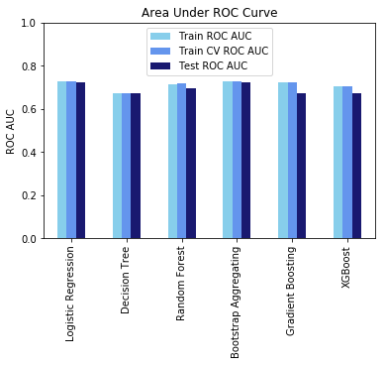
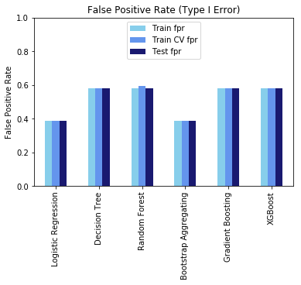
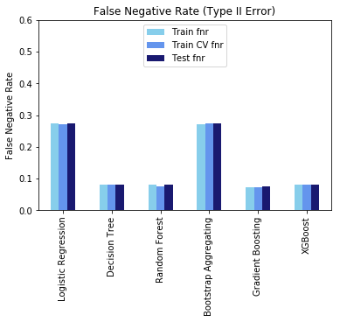
4.1 Model Comparison – Performance Measures
Models will be compared based on their AUC under ROC and Type I and Type II error
AUC under ROC is about 70% for all models
Logistic Regression and Bootstrap Aggregating (Logistic) have low Type I error
Decision Tree, Random Forest, Gradient Boosting, and XGBoost have low Type II error
*Based on 20% sample data

Slide 25
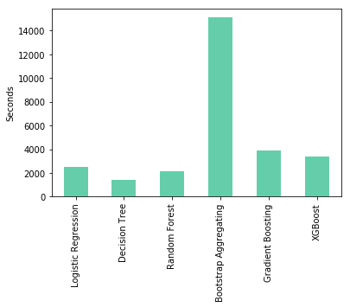
4.2 Model Comparison – Time Complexity
Bootstrap Aggregating is the most time consuming algorithm, but it is highly parallelizable
Logistic Regression and Decision Tree are very efficient
The speeds of Random Forest, Gradient Boosting, and XGBoost are similar, but gradient boosting is difficult to parallelize
*Based on 20% sample data

Slide 26
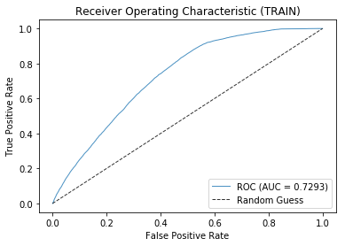
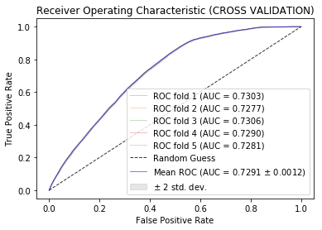
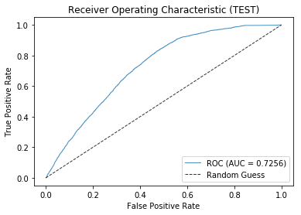
4.3 Model Comparison – Model Choice
Logistic Regression or Bootstrap Aggregating (Logistic) will be used for prediction
The company does not want to be either too “aggressive” or “conservative” on loan approvals
The company will find a good balance between Type II and Type I error
Logistic regression is time efficient; bootstrap aggregating (logistic) is highly parallelizable
Logistic Regression
 | Processed Time | Train ROC AUC | Train CV ROC AUC | Test ROC AUC | Train FPR | Train CV FPR | Test FPR | Train FNR | Train CV FNR | Test FNR
Logistic Regression | 2520.3511 | 0.7293 | 0.7291 | 0.7256 | 0.3870 | 0.3873 | 0.3873 | 0.2734 | 0.2729 | 0.2747
*Based on 20% sample data

Slide 27
Overview
Data Preprocessing
Model Building
Model Comparison
Interpretation
Future Steps
Appendix

Slide 28
5.1 Interpreting Results – Sensitivity vs Specificity
In Credit Risk Modeling, there is a greater focus in Sensitivity (Type II Error), which is failure to detect bad loans.
Accuracy rate will typically be in the +95% because most banks and lending institutions generally have loan defaults between 1~12% (unbalanced data).
For example, if you build a model using a loan portfolio with 5% default rate, you will generally have an accuracy score of 95%. However, these models will have failed to detect any defaults (Low Sensitivity).
A good credit risk model will have low Type II error (High Sensitivity) without sacrificing Type 1 error (Specificity).
Logistic Regression
Sensitivity – Booking bad loans
WHY?
Generally, in a prime loan portfolio, the lender will earn between 4% to 15% for an unsecured loan (i.e. Credit Card Balances). This roughly translates to an average profit margin of 7%.
Example: $10,000 loan x 7% = $700 profit
However, if a lender books a bad unsecured loan, the lender will only recover approximately 20% of the loan balance, which is ~80% loss.
Example: $10,000 loan x 80% loss = ($8,000) loss.
1 Bad Loan can wipe out the profit of 11 Good Loans.
Lenders can go out of business by failing to detect bad loans (i.e. Having Type II error rate greater than 10% can shut down the bank)
1-Specificity – Losing good loans

Slide 29
5.2 Interpreting Results – Financial Impact
By using average loan amount and profit margin, we can estimate the impact of each error rate.
Type 1 Error is turning away good loans and Type 3 error is booking bad loans.
Logistic Regression
 |  | Predicted
 |  | 0 | 1 | TOTAL |  | Type 1 Error Loss: | 20%
Actual | 0 | 61.7% | 36.8% | 98% |  | Type 2 Error Loss: | 7%
 | 1 | 0.5% | 1% | 2% |  | Total Error Loss: | 26%
 | TOTAL: | 62% | 38% | 100%
Decision Tree
 |  | Predicted
 |  | 0 | 1 | TOTAL |  | Type 1 Error Loss: | 22%
Actual | 0 | 52.3% | 45.7% | 98% |  | Type 2 Error Loss: | 6%
 | 1 | 0.5% | 2% | 2% |  | Total Error Loss: | 28%
 | TOTAL: | 53% | 47% | 100%
Random Forest
 |  | Predicted
 |  | 0 | 1 | TOTAL |  | Type 1 Error Loss: | 38%
Actual | 0 | 24.9% | 74.3% | 99% |  | Type 2 Error Loss: | 0%
 | 1 | 0.0% | 0.7% | 1% |  | Total Error Loss: | 39%
Bootstrap Aggregating
 |  | Predicted
 |  | 0 | 1 | TOTAL |  | Type 1 Error Loss: | 21%
Actual | 0 | 55.2% | 42.8% | 98% |  | Type 2 Error Loss: | 5%
 | 1 | 0.4% | 2% | 2% |  | Total Error Loss: | 26%
 | TOTAL: | 56% | 44% | 100%
Gradient Boosting
 |  | Predicted
 |  | 0 | 1 | TOTAL |  | Type 1 Error Loss: | 26%
Actual | 0 | 47.0% | 51.3% | 98% |  | Type 2 Error Loss: | 3%
 | 1 | 0.3% | 1% | 2% |  | Total Error Loss: | 29%
 | TOTAL: | 47% | 53% | 100%
XG Boosting
 |  | Predicted |  |  |  | Type 1 Error Loss: | 24%
 |  | 0 | 1 | TOTAL |  | Type 2 Error Loss: | 4%
Actual | 0 | 49.3% | 49.0% | 98% |  | Total Error Loss: | 28%
 | 1 | 0.3% | 1% | 2%
 | TOTAL: | 50% | 50% | 100%

Slide 30
Overview
Data Preprocessing
Model Building
Model Comparison
Interpretation
Future Steps
Appendix

Slide 31
6.1 Future Steps
Build a credit scoring process and a model training schedule
REALTIME FEEDBACK
Accept
Loan
Reach Cutoff Score?
Future Customer
Extract Internal and External data
Machine Learning Prediction
Reject
Loan
Model training and update:
Run on a weekly basis
Create sub models for different customer segmentations

Slide 32
Overview
Data Preprocessing
Model Building
Model Comparison
Interpretation
Future Steps
Appendix

Slide 33


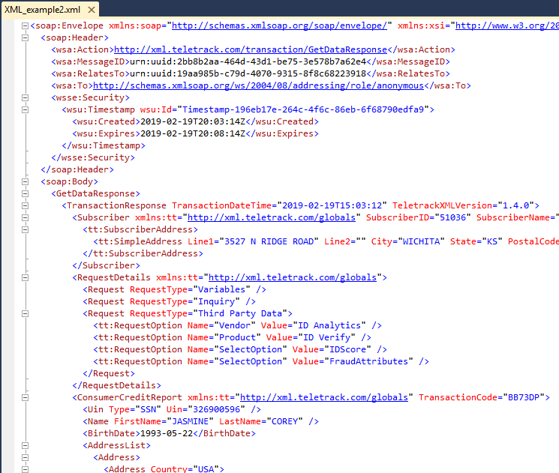
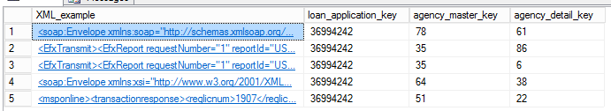
7.1 XML Parsing Using Azure SQL
For every loan application (approximately 3 million applications per month), company receives credit reports from multiple Credit Bureaus (Experian, TransUnion & Equifax).
Credit reports are sent as XML documents (20 to 100 pages).
These XML files are parsed and the records are stored in FACT/Dimension SQL Tables in Azure Data-Warehouse.
Raw XML format stored in Data-Warehouse
Utilizing Parsing Function in SQL, we can extract key fields such as FICO Score, Outstanding Debt, Number of Inquiries, etc.

Slide 34
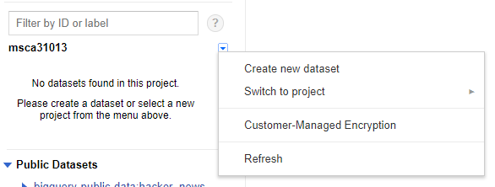
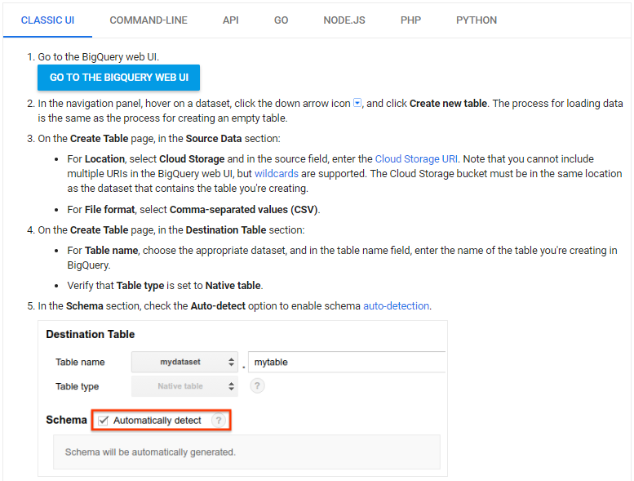
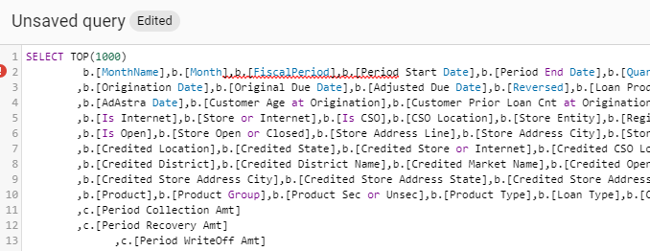
7.2.1 Google Big Query
Using the same CSV file that’s loaded in Google Cloud Storage, the data can loaded into Google BigQuery
https://cloud.google.com/bigquery/docs/loading-data-cloud-storage-csv
1
Create a new Dataset using your stored CSV in the Cloud
2
You can use Auto Detection to define your data type
3
Create a new query using SQL

Slide 35
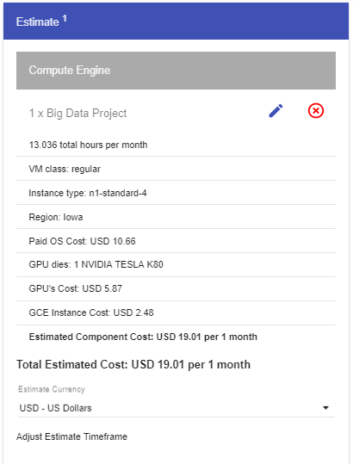


7.2.2 Google Big Query
BigQuery Cost
There are two different types of pricing ON-DEMAND & FLAT-RATE
You can estimate the cost using the Google Cloud Platform Pricing Calculator
Approximately $.60 per day
Unlike the Google DataProc, BigQuery allows you to add additional resources
“Remove the headache of planning for data warehouse capacity and reach for infinity with elastic capacity scaling that has no limit. BigQuery meets the challenges of real-time analytics by leveraging Google’s serverless infrastructure that uses automatic scaling and high-performance streaming ingestion to load data. BigQuery’s managed columnar storage, massively parallel execution, and automatic performance optimizations make it possible for all your users to quickly and simultaneously analyze data regardless of the number of users or the size of the data.”
https://cloud.google.com/bigquery/

Slide 36
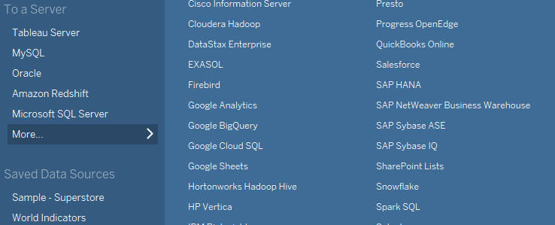
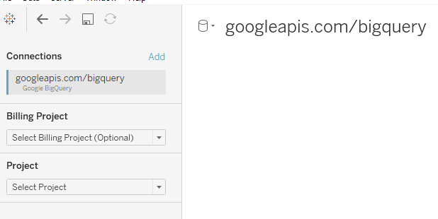

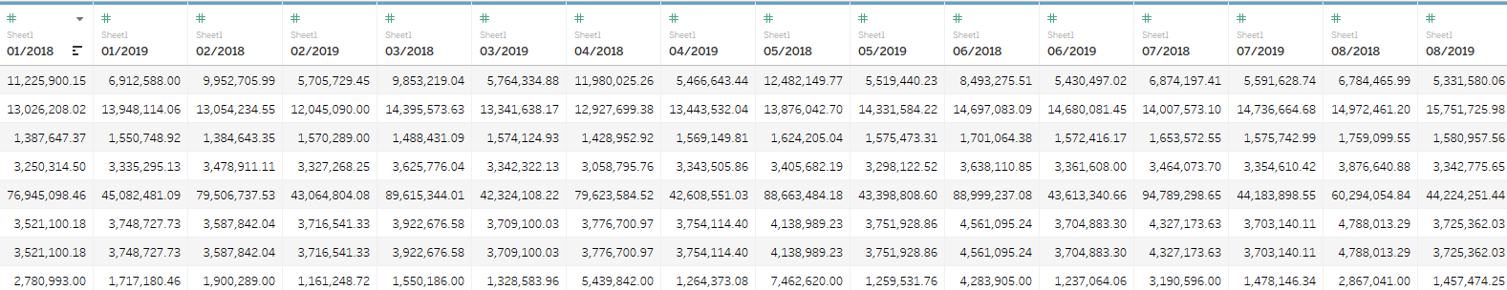
7.3.1 Big Data Visualization Using Tableau

Slide 37
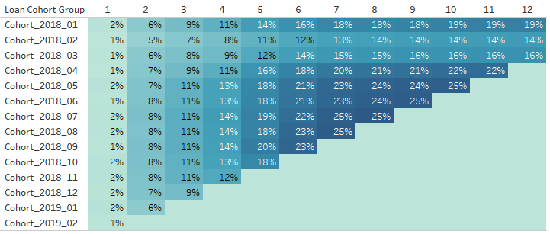
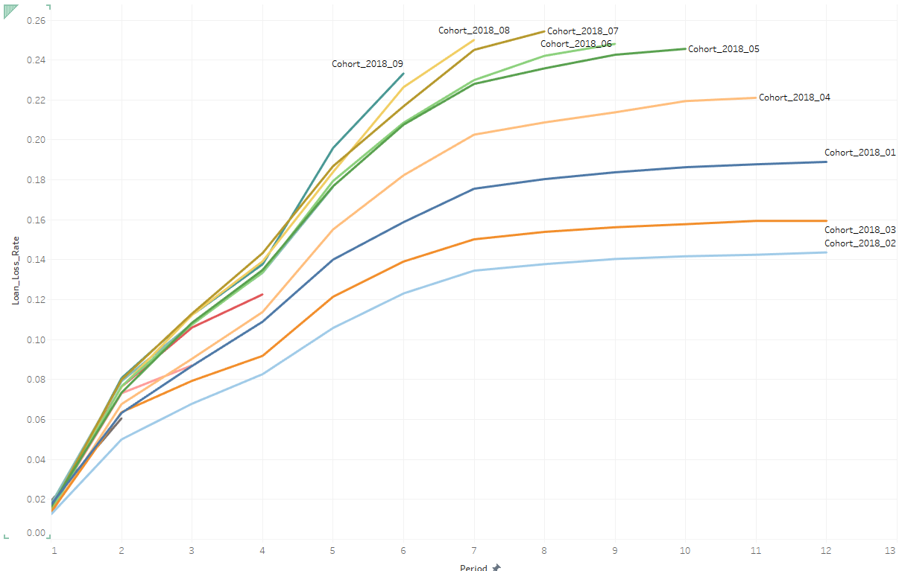
7.3.2 Big Data Visualization Using Tableau
Tableau allows to connect to various Cloud platform including Google Cloud SQL and Google Big-Query.
1 Billion Maximum Records and 5,000 columns utilizing Google Big Query.
11 million rows with 75 columns took approximately 25 minutes to process.
Once the data grouped and loaded as TBE format (tableau compression) in memory, each dashboards take less than 10 seconds to process.
Create Loan Vintage Loss Curve (CECL Requirement) – Grouping 11 million loan records into loan vintages

Slide 38
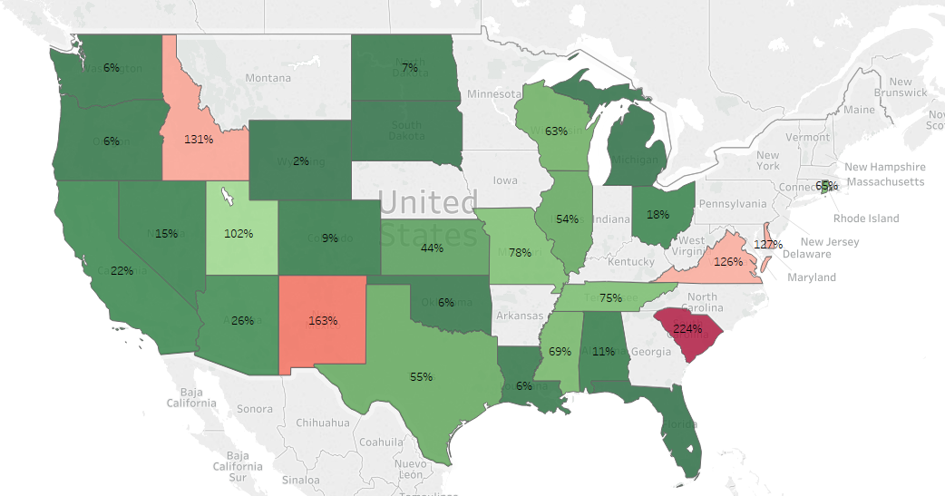
7.3.3 Big Data Visualization Using Tableau
Visualize which state has the highest loan loss rate

