Slide 1
Predictive Analytics on Credit Card Defaults
Matthew Tate
Cameron Wonchoba

Slide 2
Business Problem
To determine financial risk the company is exposed to in the form of customers failing to pay their credit card bills and therefore defaulting. A model should be developed that allows us to predict which customers will default on their next monthly payment.

Slide 3


What are default payments?
Default payments are when people fail to make a payment on debt before the due date.
Impacts of default often land mostly on the customer, however the bank is often required to take action in order to get their money back (action = costs).

Slide 4

Actionable Outcome
Each customer will be split into two categories:
Will default [represented as : 1]
Will not default [represented as : 0]
Splitting up customers into these two classes will allow Credit Card companies to identify "high risk" individuals and intervene in a strategic way.

Slide 5
Data
The data set contains demographic and financial information on Taiwanese credit card customers for April 2005 - September 2005.
Features :
LIMIT_BAL : Amount of credit (in NT dollars) provided to a customer.
SEX : Denoted whether customer is male or female.
EDUCATION : Denotes customer education level.
MARRIAGE : Denotes customer marital status.
AGE : Denotes customer age.
PAY_*X* : Denotes payment status (delayed or payed) for a given month.
BILL_AMT*X* : Denotes bill statement amount for a given month.
PAY_AMT*X* : Denotes payment amount for a given month.
Target:
Default.payment.next.month : States whether the customer defaulted the month following the most recent month.

Slide 6
Exploratory Data Analysis
Things to note:
Our target variable is skewed (~1.34).
There are a significant correlation between multiple variables.
Data set is clean (no missing values/no NAN values).
The data in its original form appears to require some human understanding key relationships between variables.
More to see in the Jupyter Notebook...

Slide 7
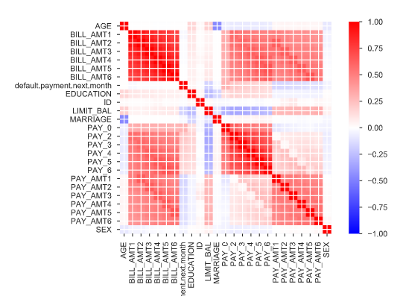
Correlation Matrix
Original

Slide 8
Feature Engineering
The features that were given to us were used to create better features that capture the hidden “signal” better.
Example Features:
Rate of change of Payment over each month and average.
Rate of change of Bill over each month and average..
Percentage of bill paid
The number of delays each customer had in the last six months.
One-Hot-Encoding
Education
Marital Status
Sex
Bucketing
Credit Limit
Age

Slide 9
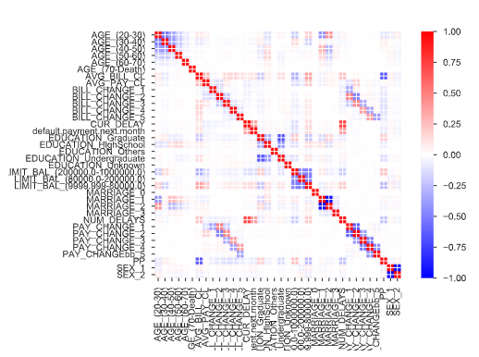
Correlation Matrix Comparison
Engineered
Original

Slide 10
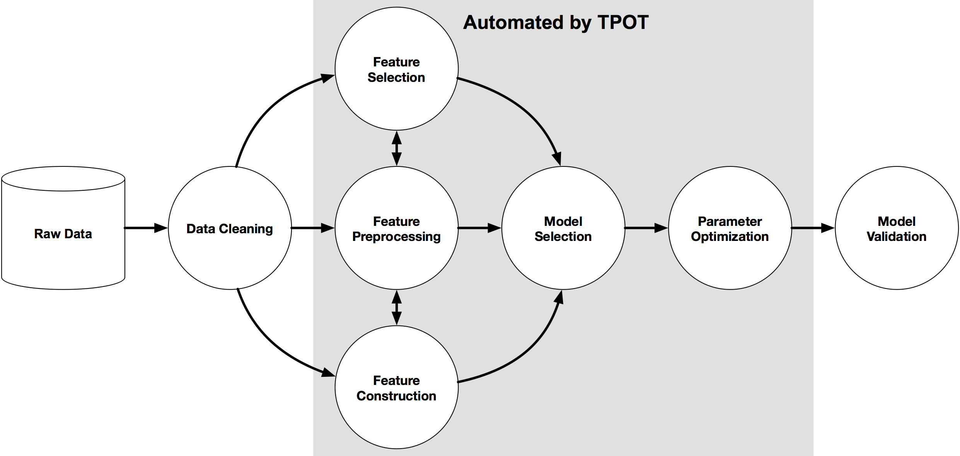
Modeling Selection
Model Selection was dominantly driven by the “Data Scientist’s Assistant” TPOT.
TPOT is a Tree Based Python Automated Machine Learning Tool that optimizes machine learning pipelines using genetic programming. (epistasis lab)
Image from : https://epistasislab.github.io/tpot/

Slide 11
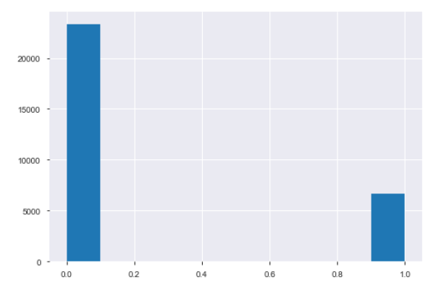
Model Tuning
The target is imbalanced.
Negative >> Positive
Ways to combat this:
Undersampling
Oversampling
SMOTE

Slide 12
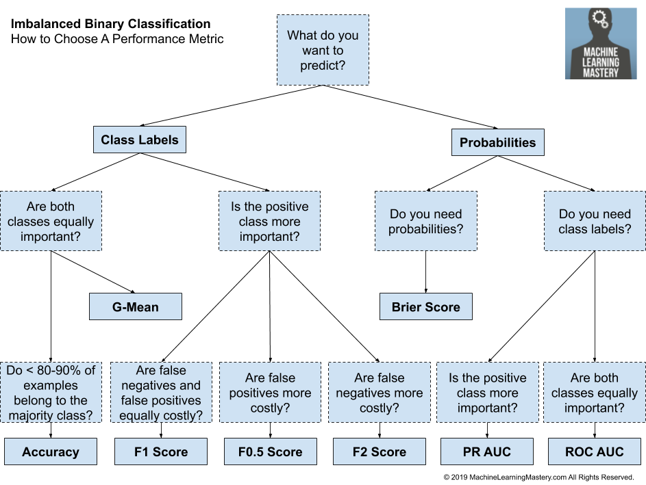
Evaluation
F score
Accuracy
AUC
Precision
Recall
Image from: https://machinelearningmastery.com/tour-of-evaluation-metrics-for-imbalanced-classification/

Slide 13
Results (Validation)
Very similar results.
Metric Importance (in order):
F1
AUC
Accuracy
XGBoost wins.
Model | Sampling Method | AUC | F1 | Accuracy
XGBoost | Over Sample | 0.77 | 0.514 | 0.76
Random Forest | Over Sample | 0.75 | 0.513 | 0.78
Logistic Regression | Under Sample | 0.75 | 0.511 | 0.77
Extra Trees | Over Sample | 0.76 | 0.510 | 0.77
MLP | Under Sample | 0.75 | 0.50 | 0.74

Slide 14
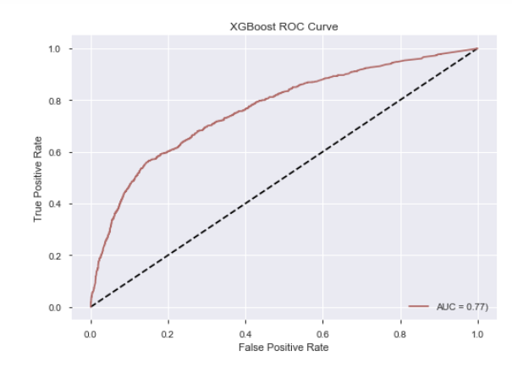
Final Results on Engineered Test Data
AUC | 0.77
F1 | 0.54
Accuracy | 0.79
Confusion Matrix
TP: 565 | FN: 449
FP: 501 | TN: 2985
Generalizes well.
Identifies more than half of defaults (precision).

Slide 15
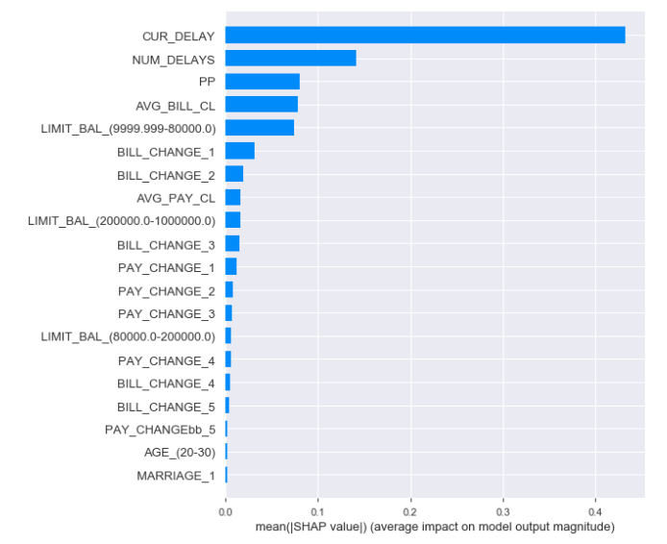
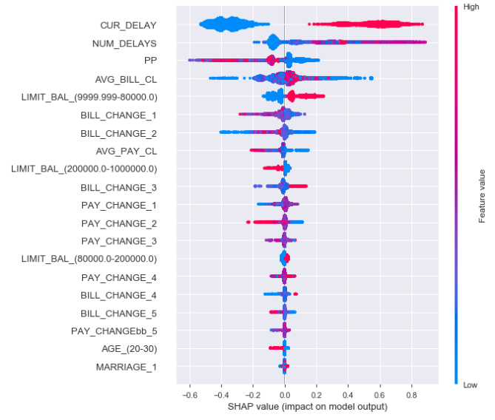
Feature Importance
SHAP (SHapley Additive exPlanations)
Original Paper: https://papers.nips.cc/paper/7062-a-unified-approach-to-interpreting-model-predictions.pdf
Quantifies the contribution that each feature brings to the prediction.

Slide 16

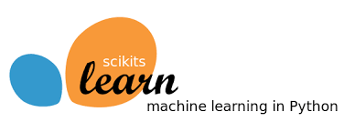

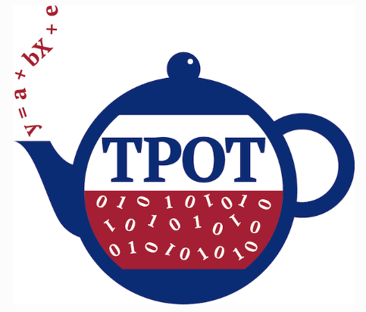
Conclusions
Model Choice:
XGBoost
Oversampling
AUC: 0.77
F1: 0.54
Accuracy: 0.79
Machine Learning Techniques/Tools:
Pandas Profiling
Feature Engineering
TPOT
Sci-kit learn
Combating Imbalanced data
Evaluation methods matter
SHAP identifies important features
Characteristics of Clients who Default (from SHAP):
They're in a current delay
They have a lot of previous delays.
They don't pay their bills in the past.
They spend more of their credit limit
They have a credit limit between 9,999-80,000
Using engineered features, we were able to build a model that generalizes and performs well.
Relevant Links:
https://xgboost.readthedocs.io/en/latest/
https://epistasislab.github.io/tpot/
https://shap.readthedocs.io/en/latest/
https://scikit-learn.org/stable/
https://pandas-profiling.github.io/pandas-profiling/docs/

