Slide 1

AR/VR Workshop Boolean geometric operations
Phillip G. Bradford
University of Connecticut

Slide 2

Module demo highlights: Intersection
Sphere-in-cube

Slide 3
Outline
A-frame scenes
Basic A-frame geometric objects
New web tab:
https://www.w3schools.com/colors/colors_picker.asp
https://www.w3schools.com/colors/colors_wheels.asp

Slide 4
Colors in A-frame
RGB for screens – additive colors since pixels are additive
CMYK for physical color printing like paper –subtractive
Cyan – absorbs red and reflects green and blue
color=“#00FFFF”
Magenta – absorbs green and reflects red and blue
color=“#FF00FF”
Yellow – absorbs blue and reflects red and green
color=“#FFFF00”

Slide 5
Compliments/Intersections with colors
00 00 00
FF FF FF

Slide 6
Several geometric components: classic
<a-box position="-1 0.5 -3" rotation="0 45 0" color=“red"></a-box>
<a-sphere position="0 1.25 -5" radius="1.25" color=“blue“></a-sphere>
<a-plane position="0 0 -4" {2,3,4}-planes-intersecting.html
rotation="-90 0 0"
width="4"
height="4"
color=“3cb371"></a-plane>

Slide 7
Famous: Several geometric components
<a-box position="-1 0.5 -3" rotation="0 45 0" color=“red">
</a-box>
<a-sphere position="0 1.25 -5" radius="1.25" color=“blue“>
</a-sphere>
<a-cylinder position="1 0.75 -3" radius="0.5" height="1.5" color=“purple">
</a-cylinder>
<a-plane position="0 0 -4" rotation="-90 0 0" width="4" height="4" color=“3cb371"></a-plane>
<a-sky color="#e9f7ff "></a-sky>

Slide 8
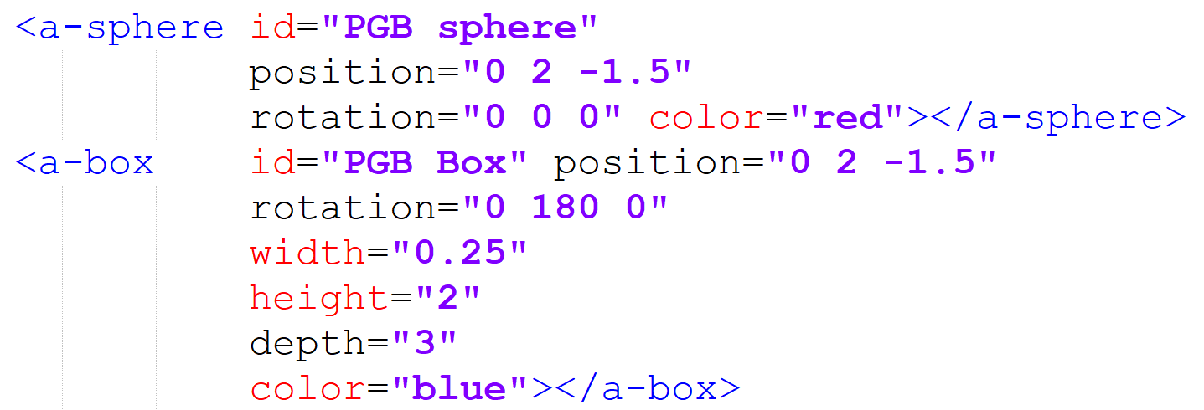
Union
Same position

Slide 9
HTML/A-frame attributes
transparent="true"
opacity= "0.25"
blending="additive"
none, normal, additive, subtractive, or multiply

Slide 10

Intersection

