Slide 1
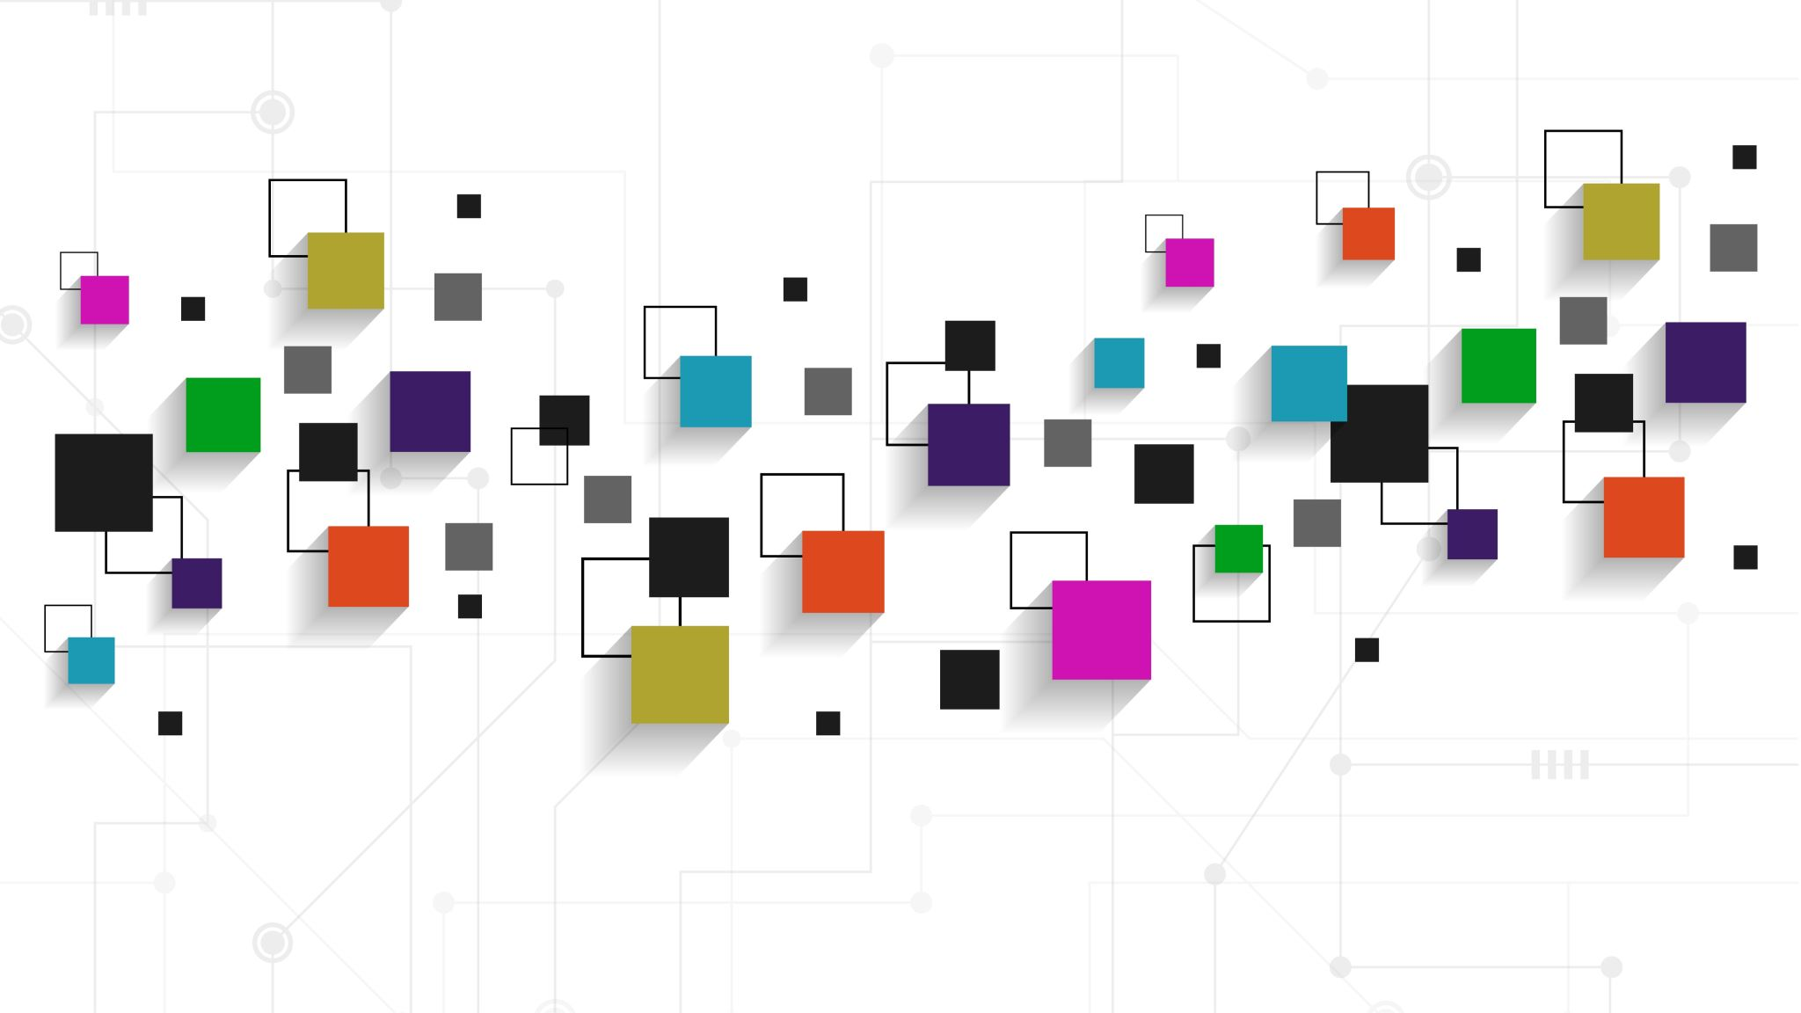
AR/VR Workshop Basic geometric objects
Phillip G. Bradford
University of Connecticut

Slide 2
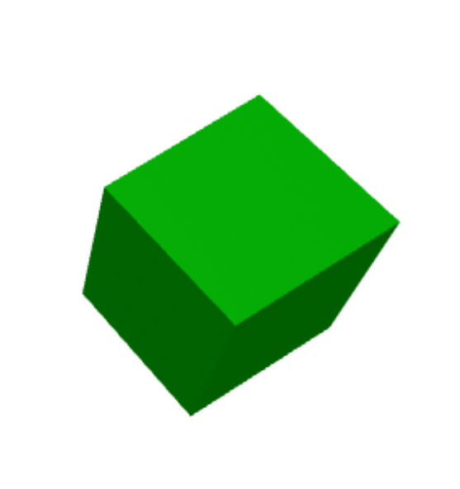
Module demo highlights: 3D geometric shapes

Slide 3
Outline
A-frame scenes
Basic A-frame geometric objects
New web tab:
https://www.w3schools.com/colors/colors_picker.asp

Slide 4
3D images
2D images most common
https://en.wikipedia.org/wiki/VR_photography

Slide 5
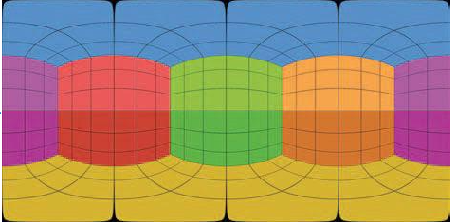
VR Images

Slide 6
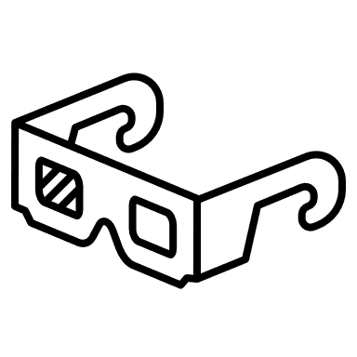
Viewing VR Images
Field-of-vision intersection 60º
Field-of-vision = 110º left 110º right – 60º intersection

Slide 7
Scenes and geometric objects
Primitive | What | Link
a-scene | Global root object contains all entities | https://aframe.io/docs/1.4.0/core/scene.html
a-text | Text | https://aframe.io/docs/1.4.0/primitives/a-text.html
a-box | 3D Box | https://aframe.io/docs/1.4.0/primitives/a-box.html
a-cylinder | 3D cylinder | https://aframe.io/docs/1.5.0/primitives/a-cylinder.html
a-plane | 2D plane | https://aframe.io/docs/1.5.0/primitives/a-plane.html
a-sphere | 3D Sphere | https://aframe.io/docs/1.4.0/primitives/a-sphere.html

Slide 8
Geometric terms
Mesh or geometry
Vertices, edges and faces defining a 3D object
Texture
Color and appearance of a surface
Full representation: mesh and texture

Slide 9
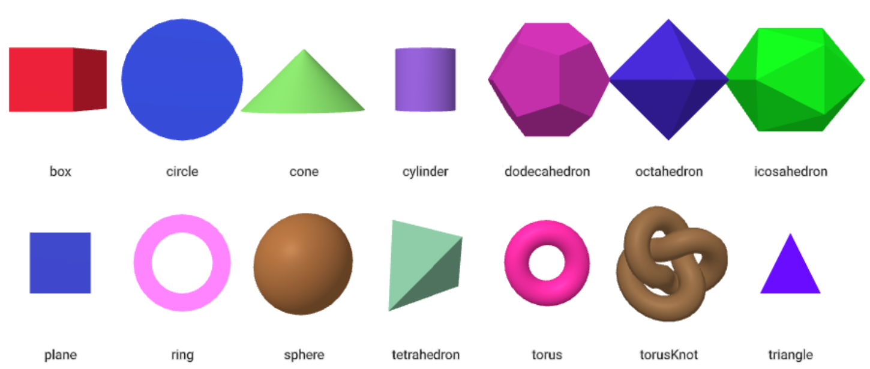
Pre-defined A-Frame geometries
Notes:
https://aframe.io/docs/1.5.0/components/geometry.html

Slide 10
Textures
Another tab
https://github.com/aframevr/sample-assets/tree/master/assets/images
Make our own src=“…”

Slide 11



A-box – in a scene
$$y$$
<a-box position="1.5 1 -2.0">
</a-box>
x: pitch
y: yaw
z: roll
a-box.html
$$z$$
$$x$$

Slide 12
A-box
<html>
<head>
<script src="https://aframe.io/releases/1.4.1/aframe.min.js"></script>
</head>
<body>
<a-scene>
<a-box position="1.5 1 -2.0" color=“red"></a-box>
</a-scene>
</body>
</html>

Slide 13
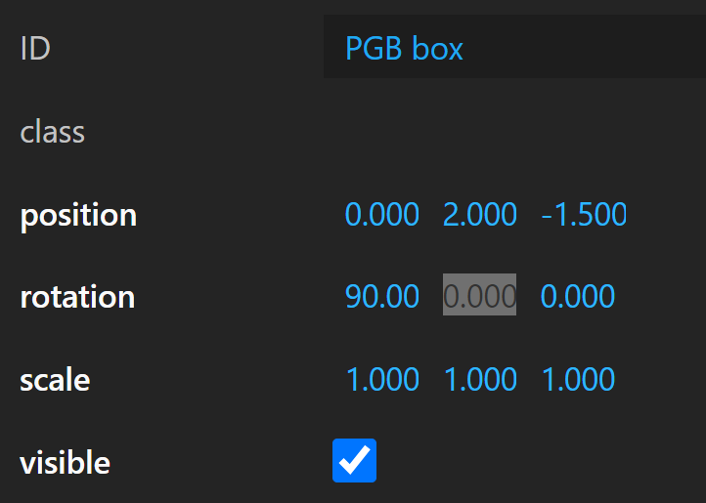
Design/debug
CTRL-ALT-I in browser for debugging

Slide 14
Full visual representation = mesh + texture
https://www.shadedrelief.com/natural3/pages/textures.html
a-sphere.html
<a-scene>
<a-sphere position="0 3 -5" src="./IMAGES/waternormals.jpg" radius="1">
</a-sphere>
</a-scene>
Notes:
src="./waternormals.jpg”
src="./1_earth_8k.jpg"
https://github.com/aframevr/sample-assets
https://www.shadedrelief.com/natural3/pages/textures.html

Slide 15
Full visual representation = mesh + texture
A-box
<a-scene>
<a-assets>
<img id="boxTexture" src="https://i.imgur.com/mYmmbrp.jpg"
</a-assets>
<a-box position="0 3 -5" src= “#boxTexture" radius="1"></a-box>
</a-scene>
Notes:
src="./waternormals.jpg”
src="./1_earth_8k.jpg"
https://github.com/aframevr/sample-assets
https://www.shadedrelief.com/natural3/pages/textures.html

Slide 16
Several geometric components
<a-box position="-1 0.5 -3" rotation="0 45 0" color=“red"></a-box>
<a-sphere position="0 1.25 -5" radius="1.25" color=“blue“></a-sphere>
<a-sky color="#e9f7ff "></a-sky>

Slide 17
Famous: Several geometric components
<a-box position="-1 0.5 -3" rotation="0 45 0" color=“red">
</a-box>
<a-sphere position="0 1.25 -5" radius="1.25" color=“blue“>
</a-sphere>
<a-cylinder position="1 0.75 -3" radius="0.5" height="1.5" color=“purple">
</a-cylinder>
<a-plane position="0 0 -4" rotation="-90 0 0" width="4" height="4" color=“3cb371"></a-plane>
<a-sky color="#e9f7ff "></a-sky>

