Slide 1

AR/VR Workshop Introduction
Phillip G. Bradford
University of Connecticut

Slide 2
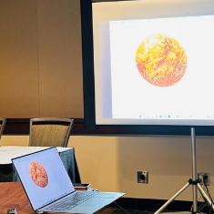
Full select demo – how you can do …
Basic-Mars-Landing

Slide 3
Learning plan
Introduction | Description
Overview Demo | Where you will be when you finish this module
Foundations
A-frame components
Three.JS and A-frame
Entity component architecture (ECA)
A-frame and planets
A-frame and animations
Conclusion

Slide 4
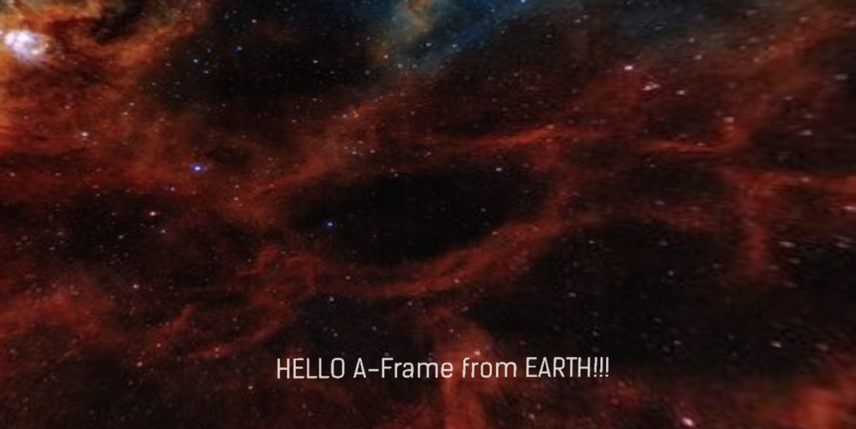
Module demo highlights: 3D image

Slide 5

Outline
Overview
No installations needed
Glitch
What is Glitch.com?
Get an account in Glitch.com
Our first VR/AR examples

Slide 6
High level view and learning path
Web components
OpenGL
WebXR
Three.JS
A-Frame

Slide 7
A-frame
3D virtual reality system built by Mozilla
A-frame is a component system built on Three.js
Three.js is built on WebXL which is built on WebGL
A-frame is HTML that uses web-components
Declarative – tell it what you want to see,
it figures out how to do it

Slide 8
No installation VR
Nothing installed
You may use Python3
To get started, get a free account on Glitch.com

Slide 9
What is glitch?
Cloud-based development environment
Fast development
Gives you a URL for each project
A-Frame is run through the on-line glitch environment

Slide 10
Glitch.com Overview
Computer
Mobile phone
Glitch.com
Glitch.com

Slide 11
Sign up for glitch
Glitch can stand alone or can be hooked to via google
Once you signed up on glitch the same account can be simultaneously on your laptop and your phone
Changes in glitch on your laptop will be seen on your phone

Slide 12
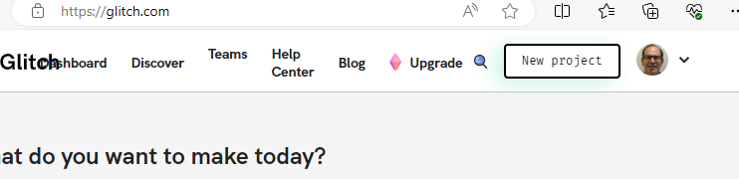
Using A-frame in glitch
Once you create a glitch.com account
access A-frame as a new project
New Project

Slide 13
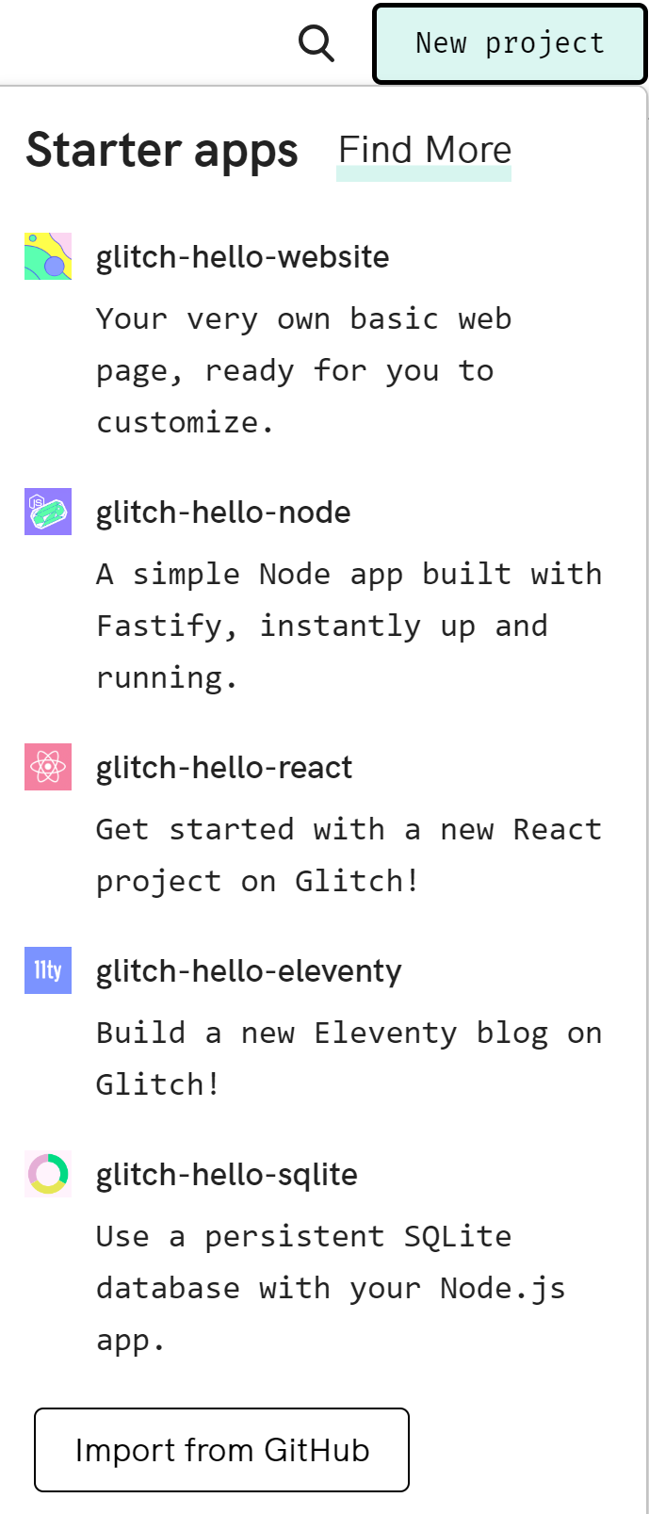
Glitch Hello Website
Select
Select glitch-hello-website
New project

Slide 14
Basic HTML
<html>
<head>
</head>
<body>
</body>
</html>

Slide 15
Working with Glitch
Replace the original index.html in Glitch with
The contents of not-index.html in p01
Find the same project on your phone name as Glitch shows on your laptop
Put your Virtual Reality Glasses on you phone and look through them
You should see HELLO A-Frame!!! on a dark blue background
All that work and we end up with a blue background!
How can we improve the background?

Slide 16
Replace index.html with not-index.html
<a-scene>
<a-sky color="#0000EE“>
</a-sky>
<a-text
font="kelsonsans"
color = "#FFFFFF"
value="HELLO A-Frame!!!"
width="6"
position="0 -1 -5"
></a-text>
</a-scene>
<html>
<head>
<meta charset="utf-8">
<title>Hello A-Frame Example</title>
<script src="https://aframe.io/releases/1.4.1/aframe.min.js"></script>
</head>
<body>
<a-scene>
<a-sky color="#0000EE"></a-sky>
<a-text
font="kelsonsans"
color = "#FFFFFF"
value="HELLO A-Frame!!!"
width="6"
position="0 -1 -5"
></a-text>
</a-scene>
</body>
</html>

Slide 17
VR glasses steps
Login to your glitch account on your phone to synchronize it with your laptop
On your phone go to your Dashboard
Go to Projects
Select the same project you are working on in your laptop
Use VR glasses to view the project on your phone

Slide 18



simple-sky.html
$$y$$
<a-scene>
<a-sky color="#0105EF"> Select a color at https://www.w3schools.com/colors/colors_picker.asp
</a-sky>
<a-text
font="kelsonsans"
color = "#FFFFFF"
value="HELLO A-Frame!!!"
width="6"
position="0 -1 -5“ Note: x-horizontal, y-vertical, and z-depth*
></a-text>
</a-scene>
*this translates to 1 meter below the origin and 5 meters into the page
$$z$$
$$x$$

Slide 19
simple-sky.html: changing the view
<a-scene>
<a-sky color="#0105EF">
</a-sky>
<a-text
font="kelsonsans"
color = "#FFFFFF"
value="HELLO A-Frame!!!"
width="6"
position="0 -1 -5"
></a-text>
</a-scene>
Replace the current index.html on glitch
with Simple-sky.html
← a-scene now looks like this

Slide 20
How to upload a picture into glitch
To use a photo (Moving_Forest_1050_700.webp in p01/IMAGES) as a background upload it into glitch this way
Make sure to copy the new URL something like
<a-sky
src="https://cdn.glitch.global/4cb2dafe-67a2-4c7f-b424-b5ef32487f34/Moving_Forest_1050_700.webp?v=1696984169228">
</a-sky>

Slide 21
Adding a picture to simple-sky.html
<html>
<head>
<script src="https://aframe.io/releases/1.4.1/aframe.min.js"></script>
</head>
<body>
<a-scene>
<a-sky
src="https://cdn.glitch.global/4cb2dafe-67a2-4c7f-b424-b5ef32487f34/Moving_Forest_1050_700.webp?v=1696984169228"
>
</a-sky>
<a-text
font="kelsonsans"
value="HELLO A-Frame from Earth!!!"
width="6"
position="-2.5 0.25 -1.5"
></a-text>
</a-scene>
</body>
</html>

Slide 22
Putting it all together
You have now created virtual reality text on a 3D background
We can also
Change background – to the nebula
What if it doesn’t work? TROUBLESHOOTING!
2. Move text around in the nebula
What if it doesn’t work? TROUBLESHOOTING!

Slide 24
Getting a-frame from aframe.io
<head>
<script src="https://aframe.io/releases/1.4.1/aframe.min.js">
</script>
</head>
Or to run outside of Glitch.com to help TROUBLE SHOOTING
<body>
<script src="js/aframe.io_releases_1.4.1_aframe.min.js"></script>

Slide 25
TROUBLESHOOTING!
CTRL-ALT-I in browser for a-frame debugging
SHIFT-CTRL-J in browser for Chrome/FireFox debugging
CTRL-O in browser to load a file

