Slide 1
Basic Clarity Foundations
Phillip G. Bradford

Slide 2
Agenda
Engineering & Applied Science
Paradigms
Examples
History

Slide 3

History
Smart contracts

Slide 4
Church-Turing Thesis
Lambda Calculus
Turing Machine
Correspondence Problem
Recursive Functions
Alonzo Church
Alan Turing
Emil Post
Hartley Rogers

Slide 5
A closer look
Church’s Lambda Calculus, 1930s
John McCarthy implementing Lisp, 1950s
A very early high-level programming language
Common Lisp (early 1990s), Scheme Lisp 1970s

Slide 6

Engineering & Applied Science Paradigms
Programming approaches

Slide 7


Programming language paradigms
Object oriented
Data oriented
Functional
Procedural
Imperative
Declarative

Slide 8
The essence of a contract
What should a smart contract be?
What should it not be?
How should it run?

Slide 9
New perspectives
A contract as a program
Execution is on a machine
Questions of validity and verification
Statutes – laws
Regulations – examples, edge cases
Case law – validity/verification

Slide 10
Examples
Smart contracts

Slide 11
Cloud or native
Cloud
https://platform.hiro.so/
Native
Assume Windows

Slide 12
Native: Setting up your machine
Clarinet
Windows installer
Windows> winget install clarinet

Slide 13
Something to work with
https://github.com/wonder-phil/ClarityWorkshop3

Slide 14
Native - Creating projects
clarinet new proj002
cd proj002
clarinet contract new c2

Slide 15
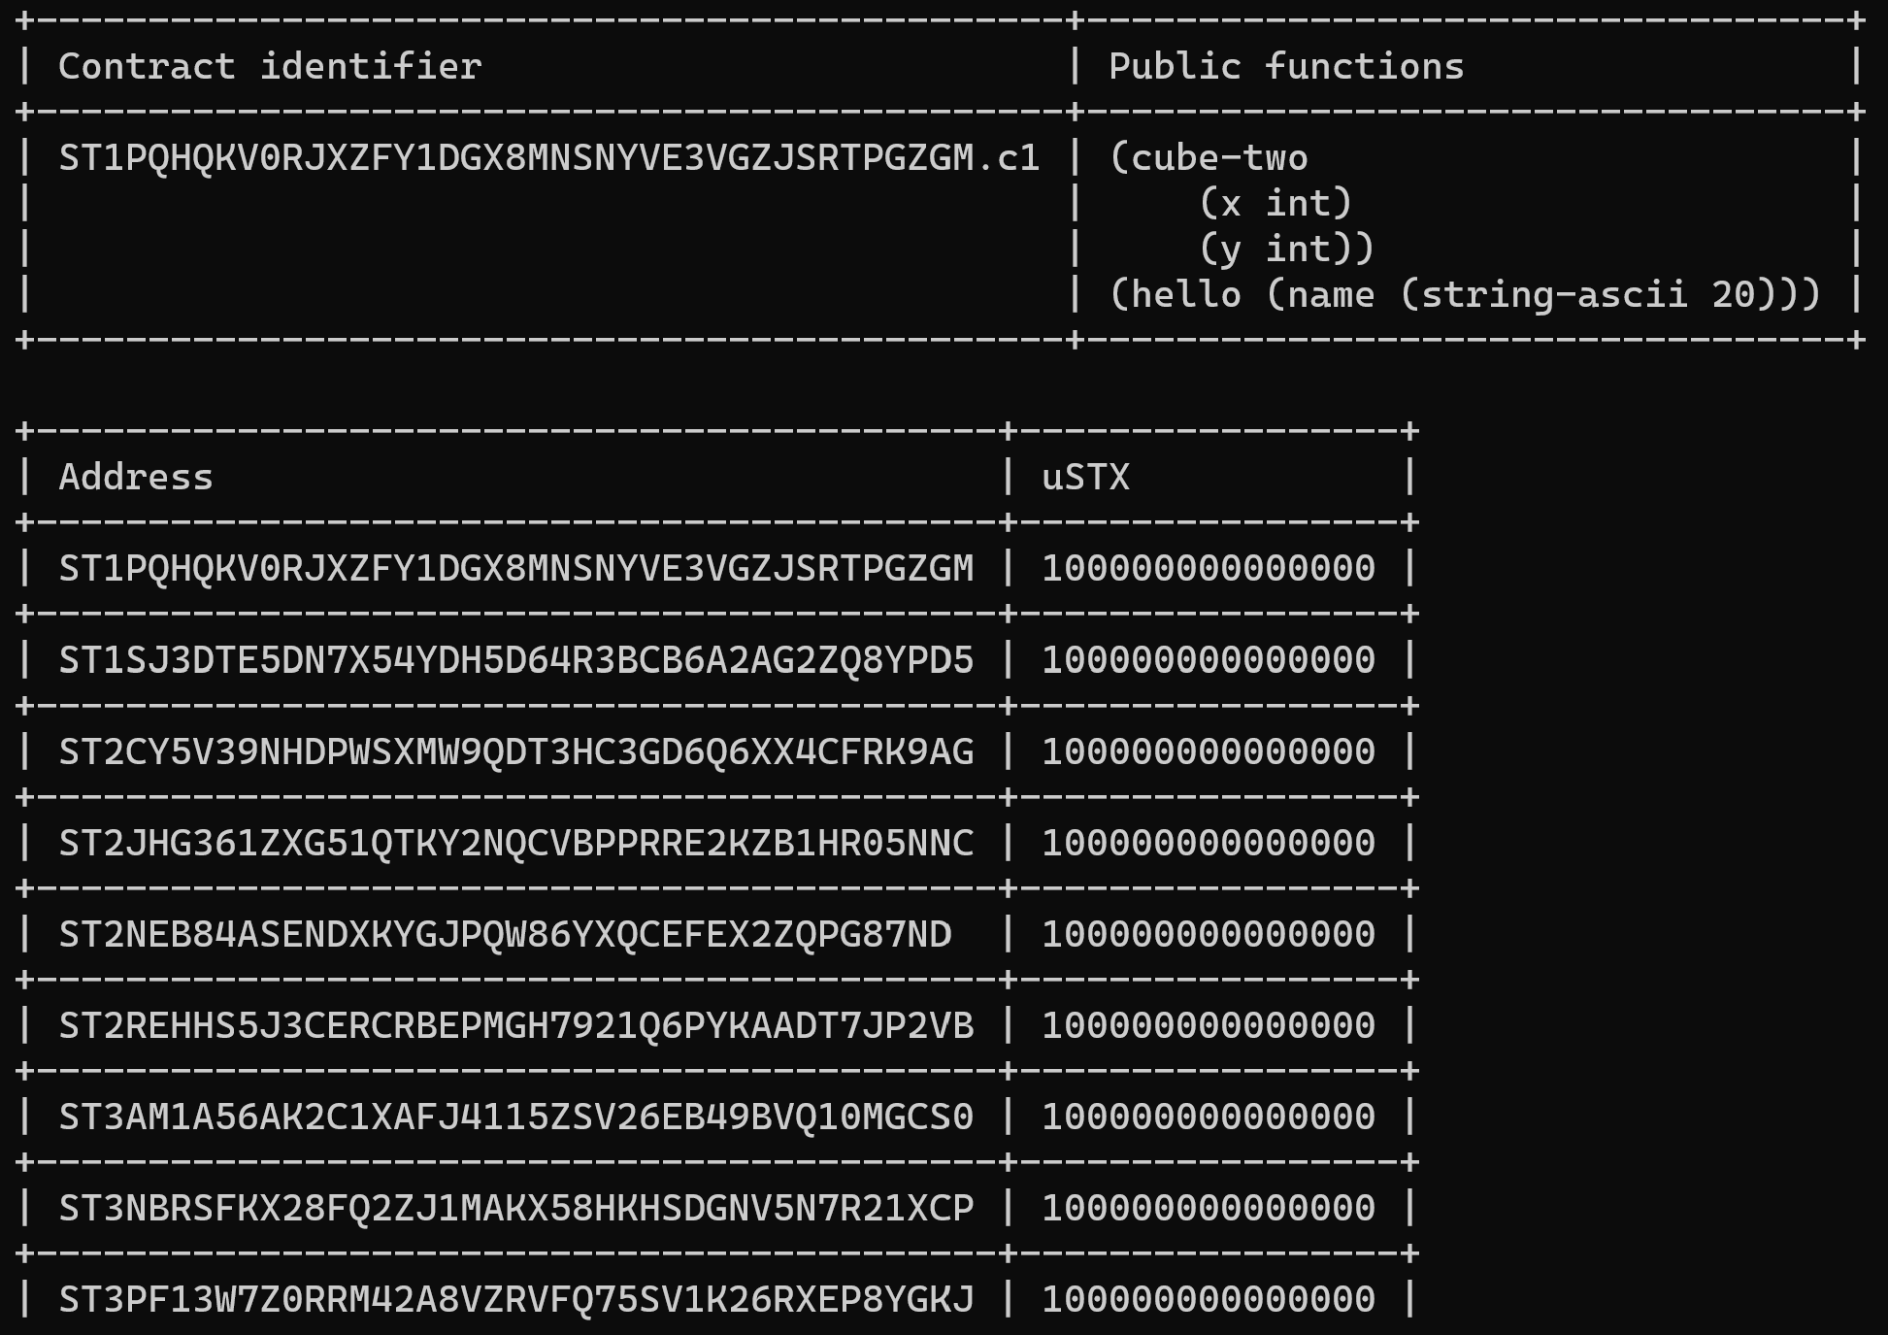
Console

Slide 16
Prefix notation
https://github.com/clarity-lang/reference/blob/master/reference.md
>> (+ 1 2 3)
6
>> (+ 1 (+ 2 3) (/ 4 2))
8
>> (pow 2 3)
8
>> (+ 1 (pow 2 3) (- 3 1))
11

Slide 17
Clarity Reference
https://github.com/clarity-lang/reference/blob/master/reference.md
(define-public (hello) (ok "hello"))
(define-public (hello (name (string-ascii 10) ) )
(ok (concat "hello " name))

Slide 18
(define-public (hello (name (string-ascii 10) ))
(ok (concat "hello" name))
Try Alan Turing
(contract-call? .c1 hello “Alan Turing”)
What happens?

Slide 19
Working with public functions
Primitive types
int and uint
(define-public (cube (x int))
(ok (* x x x )))
(define-public (tenth-power (x int))
(ok (* x (cube (cube x))))

Slide 20
Working with int and uints
Primitive types
int and uint
(define-public (cube (x int))
(ok (* x x x )))
Two arguments?
Private example

Slide 21
Lists Variables
(define-public (join-lists)
(ok (concat (list 1 2) (list 3 4))))
(define-data-var my-number uint u0)

Slide 22
Lists Variables
(map-set balances tx-sender u500)
Map-name: balances
[key value]: tx-sender u500

Slide 23

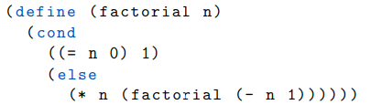
Scheme Lisp example
Factorials
0! = 0, 1! = 1, 2! = 2(1!) = 2, 3! = 3(2!) = 6, 4! = 4(3!) = 24
Recursive !

Slide 24
Clarity exercise
Factorials
0! = 0, 1! = 1, 2! = 2(1!) = 2, 3! = 3(2!) = 6, 4! = 4(3!) = 24
Let’s look at fold:
https://docs.stacks.co/docs/clarity/language-functions
Recursion is illegal
2. Looping only via map, filter, or fold
Not Recursive !

Slide 25

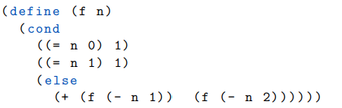
Fibonacci numbers
1, 1, 2, 3, 5, 8, 13, 21, 33, · · ·

