Slide 1
Building the time locked contract
Phillip G. Bradford

Slide 2
Agenda
Contract model
Examples
Background

Slide 3

Motivation
Smart contracts

Slide 4
Book example
https://book.clarity-lang.org/ch08-01-time-locked-wallet.html

Slide 5
Decidability and verifiability
Clarity is decidable
Clarity guards against overflow and underflows
Composition over inheritance
Notes:
https://docs.stacks.co/docs/clarity

Slide 6

Contract model
Programming approaches

Slide 7
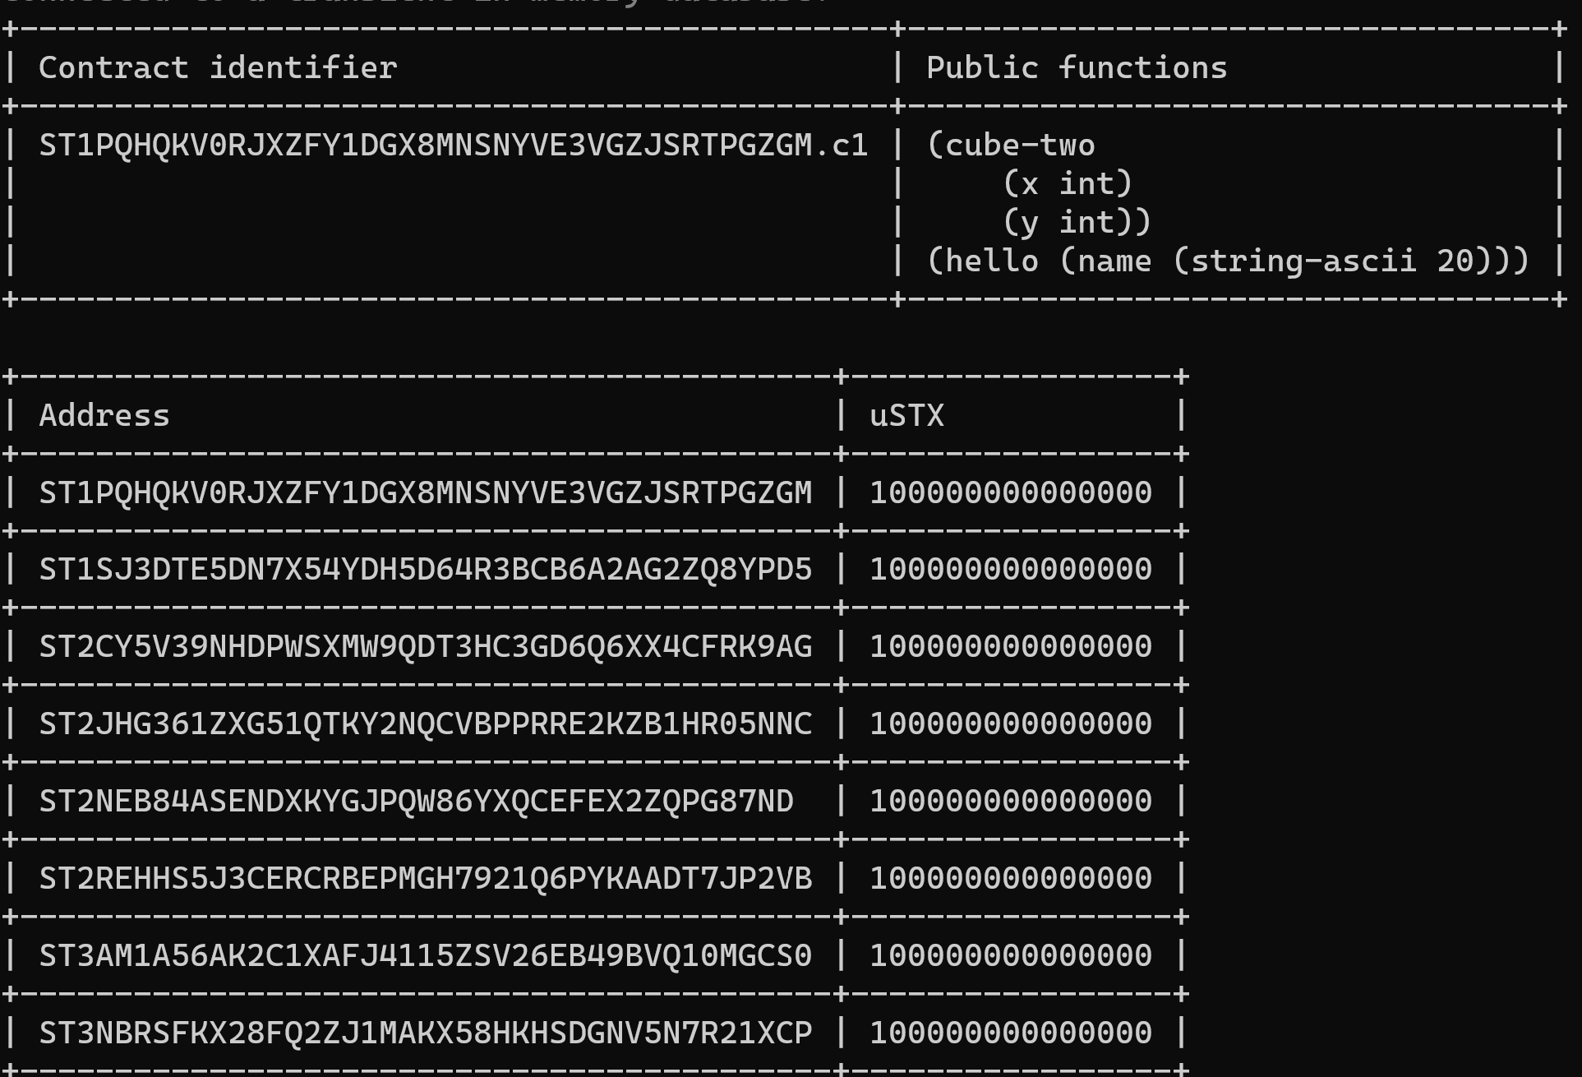
Clarinet console

Slide 8
Principals
Addresses on the Stacks chain
Contract principals – contracts at an address

Slide 9
STX and Bitcoin
S
S
S
S
S
S
S
S
S
Block 1+x
BTC
Block 2+x
BTC
Block 3+x
BTC

Slide 10
Example
Clarity of Mind Contract

Slide 11
Fold, map, filter
(define-public (sum-list
(numbers (list 10 uint)))
(ok (fold add-numbers numbers u0)))
(contract-call? .c1 sum-list (list u1 u2 u3))

Slide 12
Fold, map, filter
(define-private (is-even (num uint))
(is-eq (mod num u2) u0))
(define-public (filter-even-numbers (numbers (list 10 uint)))
(ok (filter is-even numbers)))
(contract-call? .c1 filter-even-numbers (list u1 u2 u3 u4 u5))

Slide 13
STX transfers
(stx-get-balance <principal>)
(stx-transfer?
(amount uint)
(sender principal)
(recipient principal))

Slide 14
STX transfers
https://github.com/clarity-lang/reference/blob/master/reference.md
(define-public (transfer-if-even
(recipient principal)
(amount uint))
(if (is-eq (mod amount u2) u0)
(stx-transfer? amount tx-sender recipient)
(err u400)))

Slide 15
Clarity maps
;; constants
;;
(define-constant contract-owner tx-sender)
(define-constant err-invalid-caller (err u1))
;; data maps
;;
(define-map recipients principal uint)

Slide 16
Clarity console functions
Change block height
::advance_chain_tip 10
::set_tx_sender ST1J4G6R…

Slide 17
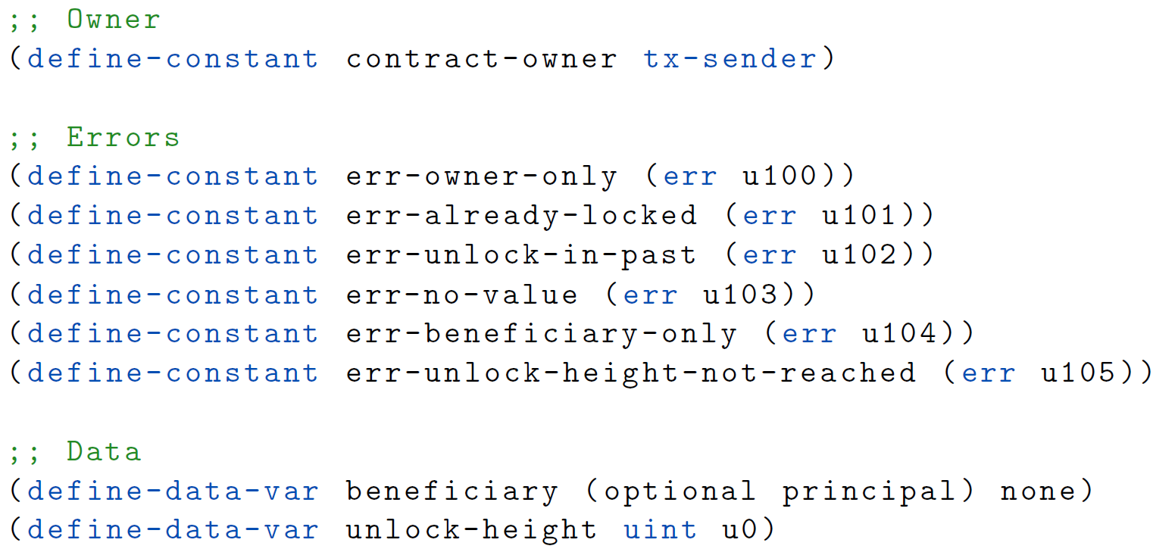
Errors

Slide 18
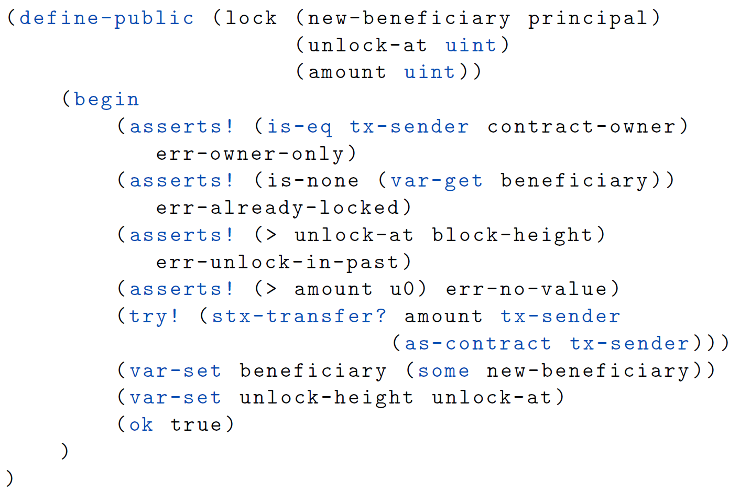
Lock

Slide 19
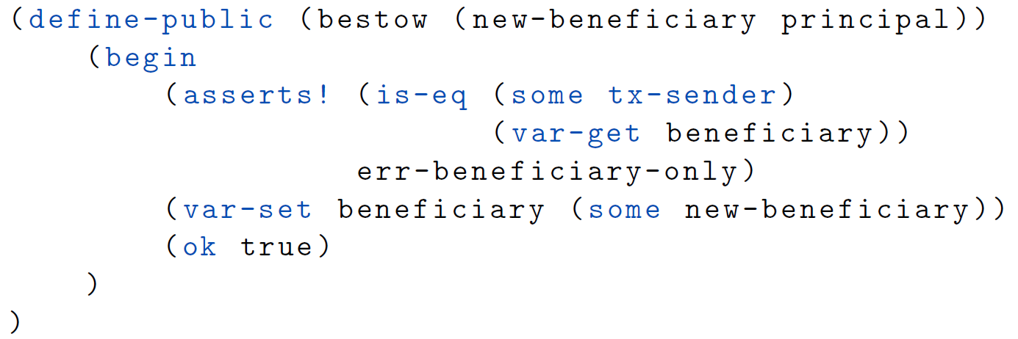
Bestow

Slide 20
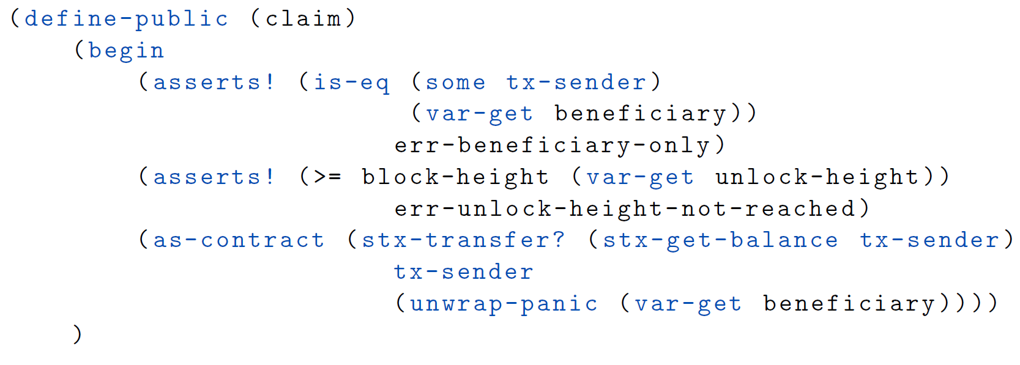
Claim

