Slide 1

Introduction to Clarity
Agenda

Slide 2
Style
Hands on
We will work together
Interactive
Questions are always welcome
Low/No IDE help
Github repo
https://github.com/wonder-phil/ClarityWorkshop3

Slide 3
Assumptions
Familiar with basic blockchains, block height
New to Clarity

Slide 4
Goal
Gain understanding of a basic Clarity contract
Our contract is from “Clarity of Mind” book
Time Locked Wallet - Clarity Book (clarity-lang.org)

Slide 5
Github repo structure
Textbook time-locked-wallet Clarity smart contract
Several PDF documents
Slide PDFs which drive the workshop

Slide 6
Agenda
Motivating the time-locked contract
Basic foundations of Clarity
Building the time-locked contract

Slide 7
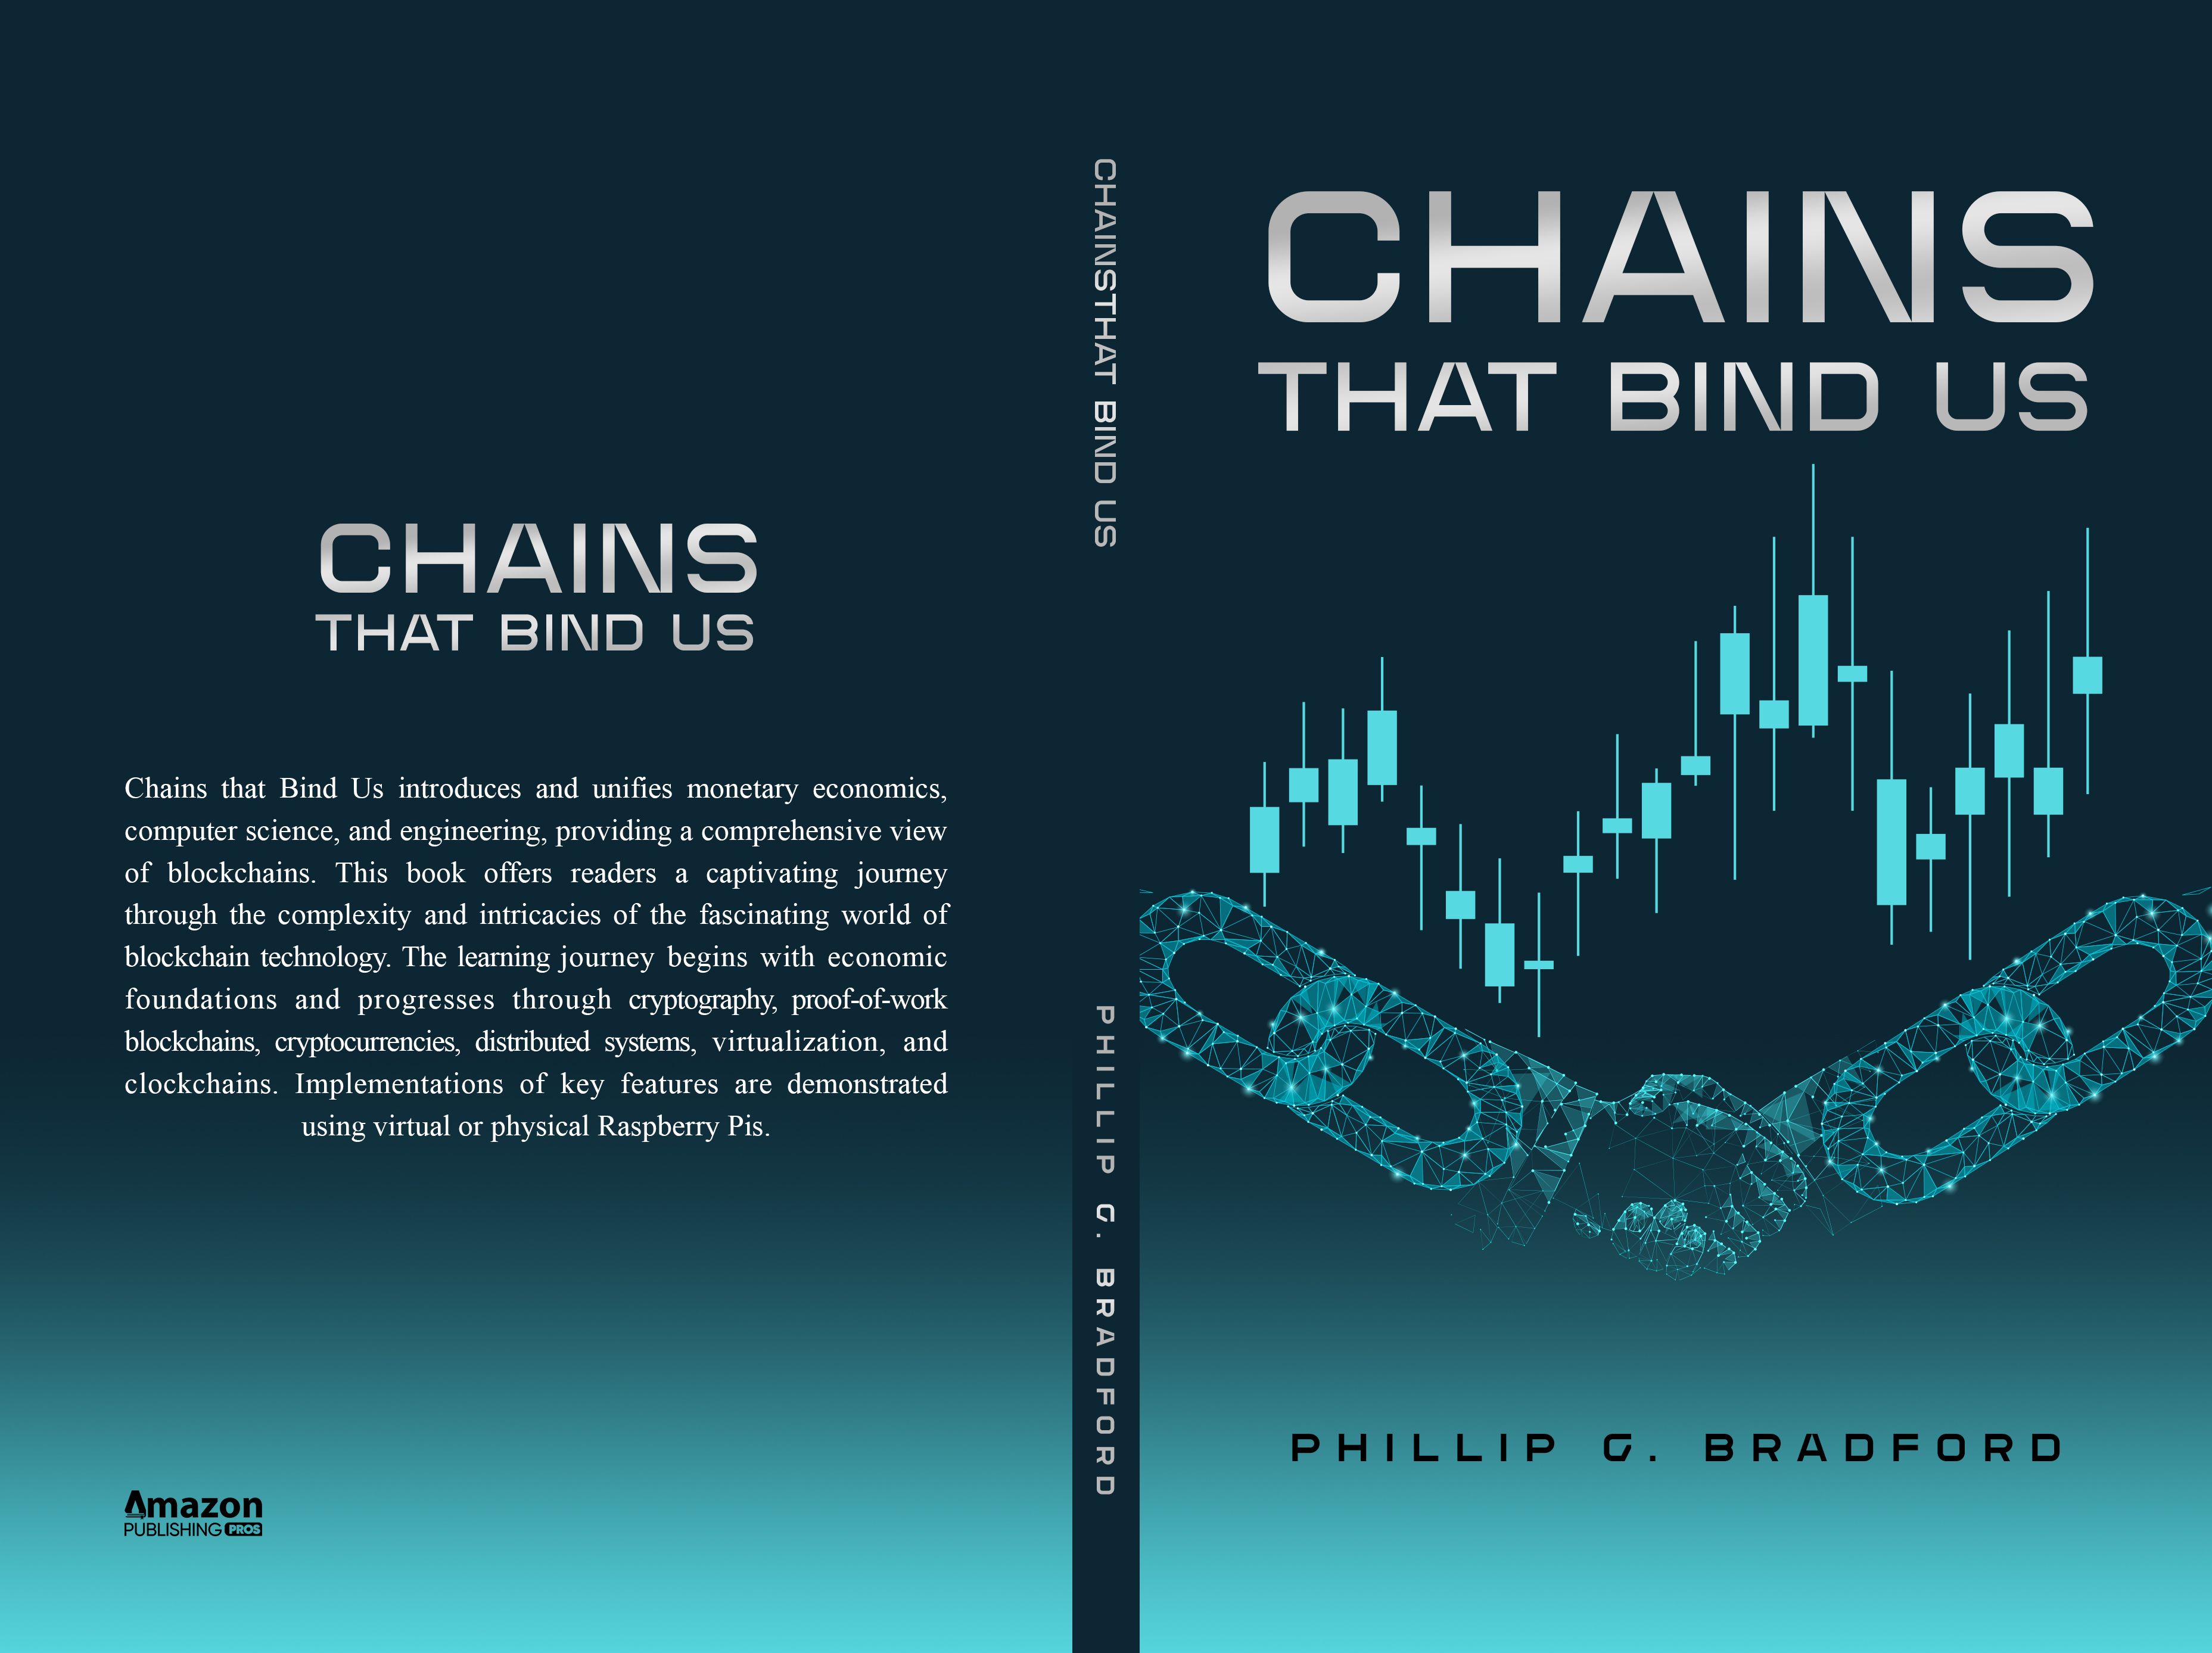
Sponsor

