Slide 1
Proof of Transfer
Phillip G. Bradford

Slide 2
Agenda
Layer 2
Motivation
Examples

Slide 3
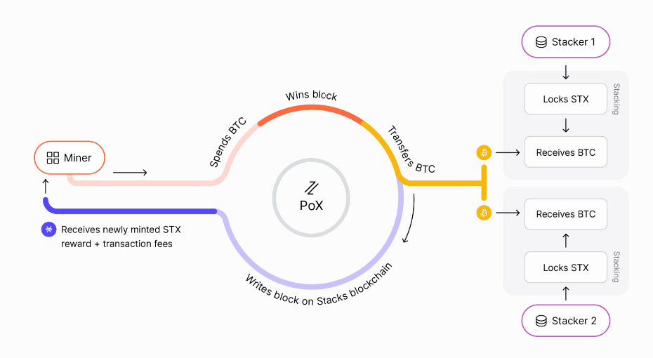
Proof-of-Transfer

Slide 4
Double peg
BTC to STX
STX to BTC

Slide 5
What keeps the stackers engaged?
Stacks miners only work for STX
Mini sBTC voluntarily maintain the sBTC peg

Slide 6

Motivation
Smart contracts

Slide 7
Traditional contract properties
Fair and transparent
Terms/conditions: measurable inputs and outputs, schedules
Legally enforceable
Immutable - settles once contract is executed
Accomplish a goal

Slide 8
Smart contracts on proof of work Blockchains
Fair and transparent – no trusted third party
Terms/conditions: measurable inputs and outputs, schedules
Distributed consensus - agree a contract’s terms/conditions are met
Immutability
Programmatically (legally) enforceable
Accomplishes goals with crypto currency or tokens

Slide 9
Foundations – from blockchains
Immutability – necessary for contracts
Programs as smart contracts must be careful
Distributed consensus - agree a contract’s terms/conditions are met
Transfer
Tokens – representation, abstraction
Cryptocurrency – settlement

Slide 10

Introduction to Smart Contracts
Clarity Smart contracts

Slide 11


Introduction to smart contracts
Digital contracts
Beyond digital signatures
On a blockchain
Automatic consensus contract evaluation
Proposed by Nick Szabo
Notes:
Beyond

Slide 12
New perspectives
A contract as a program –
Execution is on a machine
Questions of validity and verification
Statutes – laws
Regulations – examples, edge cases
Case law – validity/verification

Slide 13
Examples
Smart contracts

Slide 14


Programming language paradigms
Object oriented
Data oriented
Functional
Procedural
Imperative
Declarative

Slide 15
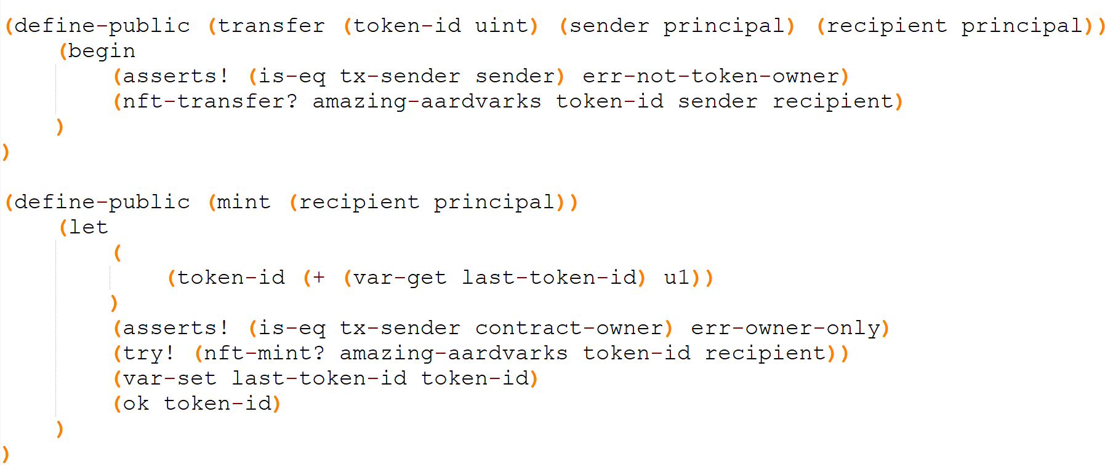
Clarity

Slide 16
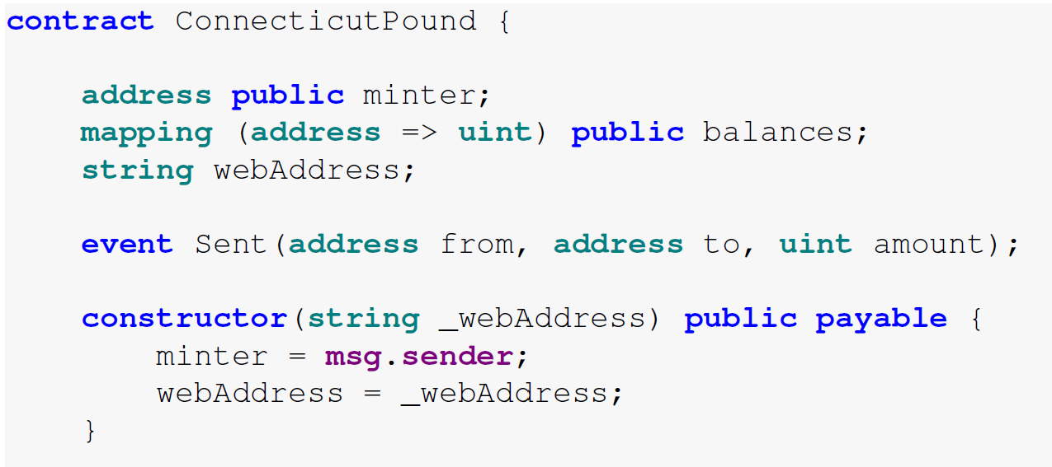
Solidity

Slide 17
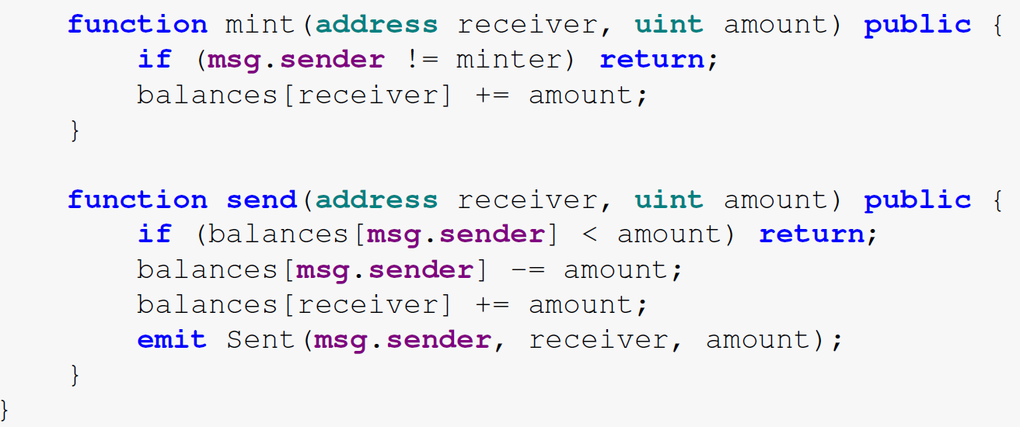
Solidity

