Slide 1
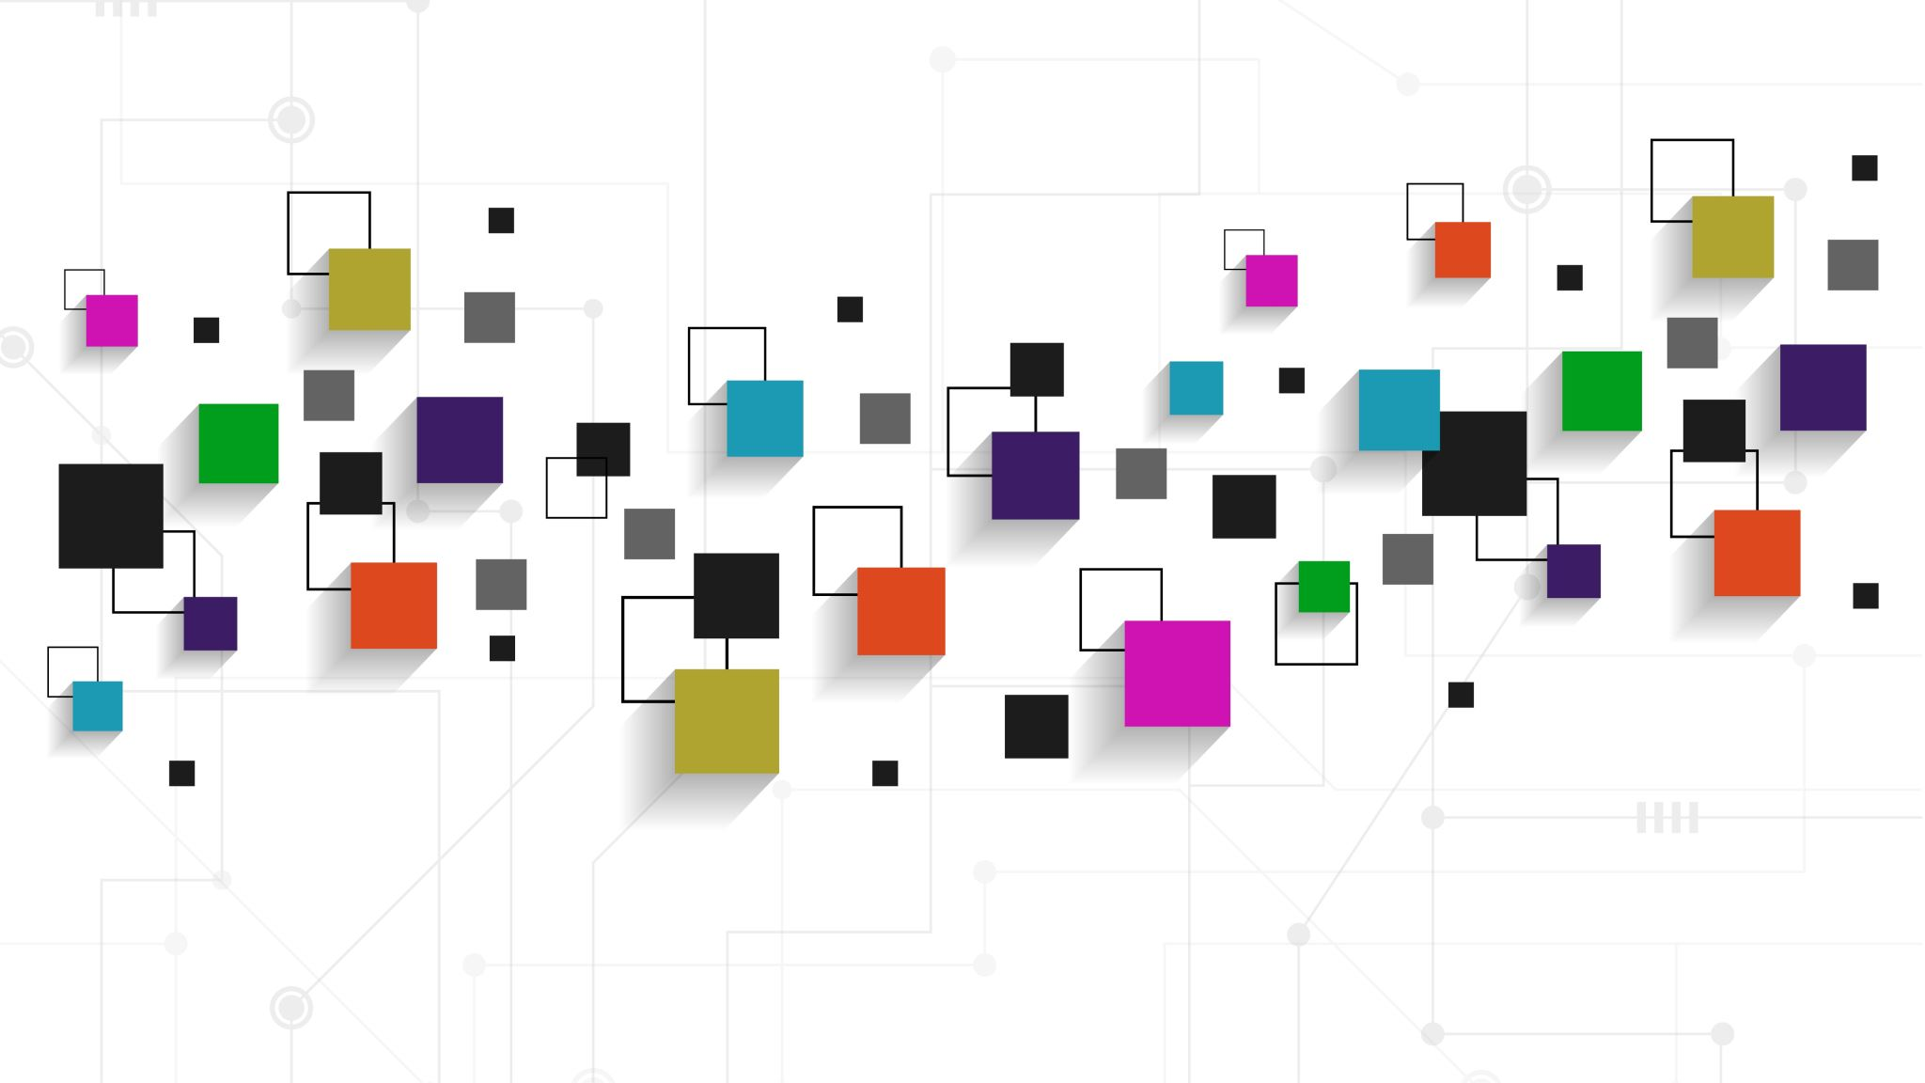
AR/VR Workshop
Moving geometric objects
Phillip G. Bradford
University of Connecticut

Slide 2
Outline
Translation
Spinning
Rotation
Linear movement

Slide 3
A-box - https://aframe.io/docs/1.7.0/components/animation.html
<html>
<head>
<script src="https://aframe.io/releases/1.7.1/aframe.min.js"></script>
</head>
<body>
<a-scene>
<a-box position="0 1 -2.0" color="red"></a-box>
</a-scene>
</body>
</html>

Slide 4
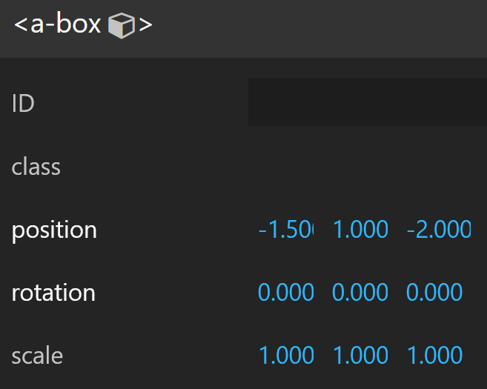



A-box
$$y$$
<a-box position="-1.5 1 -2.0">
</a-box>
A-frame Inspector: <CTRL>-<ALT>-I
$$z$$
-2.0
1
-1.5
$$x$$

Slide 5
A-box static rotation – a-Platonic-solids
$$y$$
<a-box position=" -4 1 -2.5 "
rotation=“45 45 45" >
</a-box>
x pitch
y yaw
z roll
$$z$$
$$x$$

Slide 6
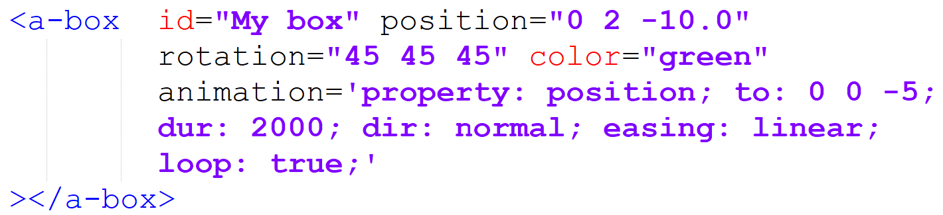
Translation

Slide 7
Platonic solids
<a-box position="-4.0 1 -2.5" color="green"></a-box> <!-- cube -->
<a-entity position="-2.0 1 -2.5" geometry="primitive: tetrahedron; radius: 1">
</a-entity>
<a-entity position="0 1 -2.5" geometry="primitive: dodecahedron; radius: 1">
</a-entity>
<a-entity position="2.0 1 -2.5" geometry="primitive: octahedron; radius: 1">
</a-entity>
<a-entity position="4.0 1 -2.5" geometry="primitive: icosahedron">
</a-entity>

Slide 8
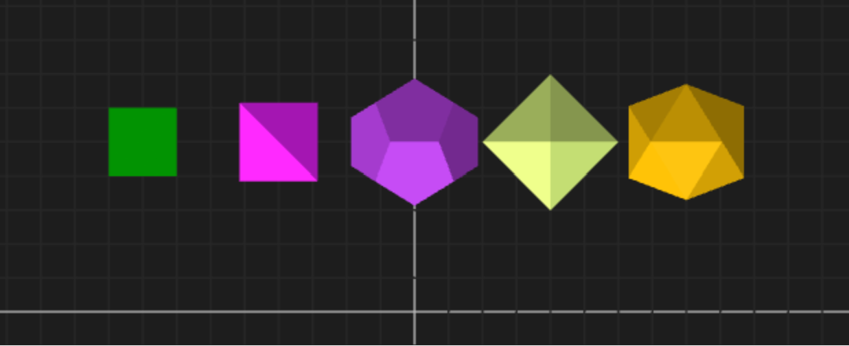
Other views
A-frame Inspector: Top View

Slide 9
Basic animation
<a-box position="0 2 -2.5" rotation="45 45 45"
color="green"
animation= "property: rotation;
dur: 10000;
from: 0 0 0;
to: 0 360 0; rotates around the y-axis
dir: normal;
easing: linear;
loop: true;"
></a-box>

Slide 10
A-box dynamic rotation
$$y$$
animation= "property: rotation;
dur: 10000;
from: 0 0 0;
to: 0 360 0; "
rotates around the y-axis
$$z$$
$$x$$

Slide 11
Basic animation – rotation in place
<a-box id="PGB box" position="0 2 -2.5" rotation="45 45 45" color="green"
animation= "property: rotation; position, color,…
dur: 10000; entire transform in 10,000 milliseconds
from: 45 45 45;
to: 0 360 0;
dir: normal;
easing: linear; between runs
loop: true;"
></a-box>

Slide 12
How to create orbits?
a-sphere-mars-spin-narrow.html
a-sphere-mars-spin-wide.html

Slide 13


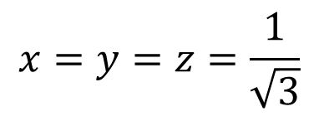

Cube in a sphere
$$x,y,z$$
$$d$$
$$d=1=\sqrt{x^{2}+y^{2}+z^{2}}$$
$$x=y=z=\frac{1}{\sqrt{3}}$$
0,0,0

Slide 14
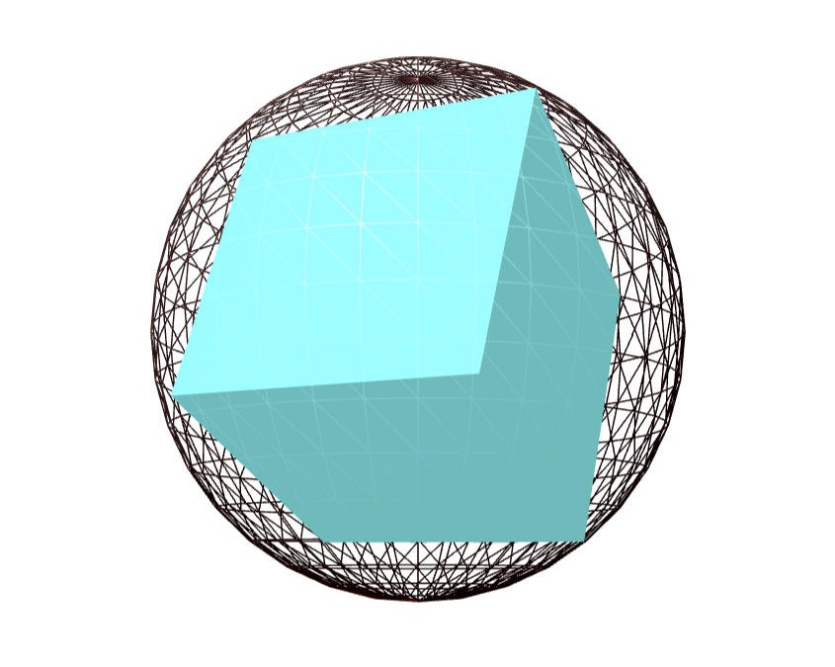
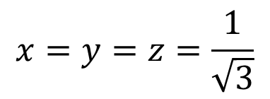

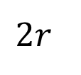
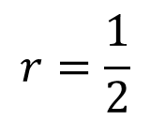
Cube in a sphere
$$d=1=\sqrt{x^{2}+y^{2}+z^{2}}$$
$$2r$$
$$x=y=z=\frac{1}{\sqrt{3}}$$
$$r=\frac{1}{2}$$

Slide 15
Orbits – frame of reference
0,0,-2 → 0,0, -7
<a-entity position="0 0 -5"
animation="property: rotation;
to: 0 360 0; rotates around the y-axis
loop: true; dur:10000 ">
<a-sphere position="0 0 -2" src="#mars"
rotation="0 0 0" >
</a-sphere>
</a-entity>
0,0,-5
0,0,-2
a-sphere-mars-rotates.html

Slide 16
Colors a-box-change-colors.html
<a-box id="My box"
position="0 2 -5"
rotation="45 45 45"
animation= "property: color; from: #FFFFFF; to: #FF0000;
dur: 5000; dir: normal; easing: linear;
loop: true;"
></a-box>

Slide 17
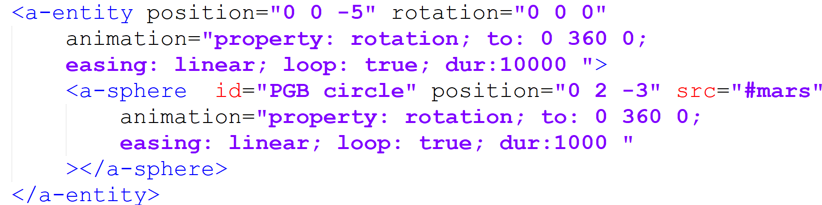
Several animations – frame of reference

Slide 18
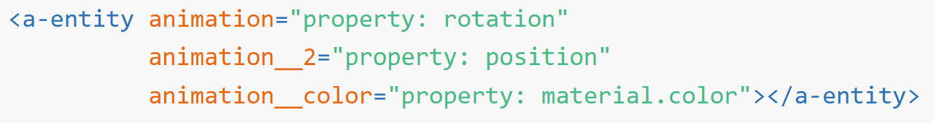
Several animations at the same time
spin
translate

Slide 19
Multi animations
<a-sphere src="#mars" radius="0.5" position="0 0.5 0" segments-height="53"
animation='property: position; dur: 5000; from: -2 0.5 0; to: 2 0.5 0; dir: alternate; easing: linear; loop: true;'
animation__2='property: rotation; dur: 1000; from: 0 0 0; to: 0 360 0; dir: normal; easing: linear; loop: true;'
animation__3='property: scale; dur: 1000; from: 1 1 1; to: 2 2 2; dir: alternate; easing: linear; loop: true;'>
</a-sphere>
Animations can change any property with a numeric / vector / color value

