Slide 1
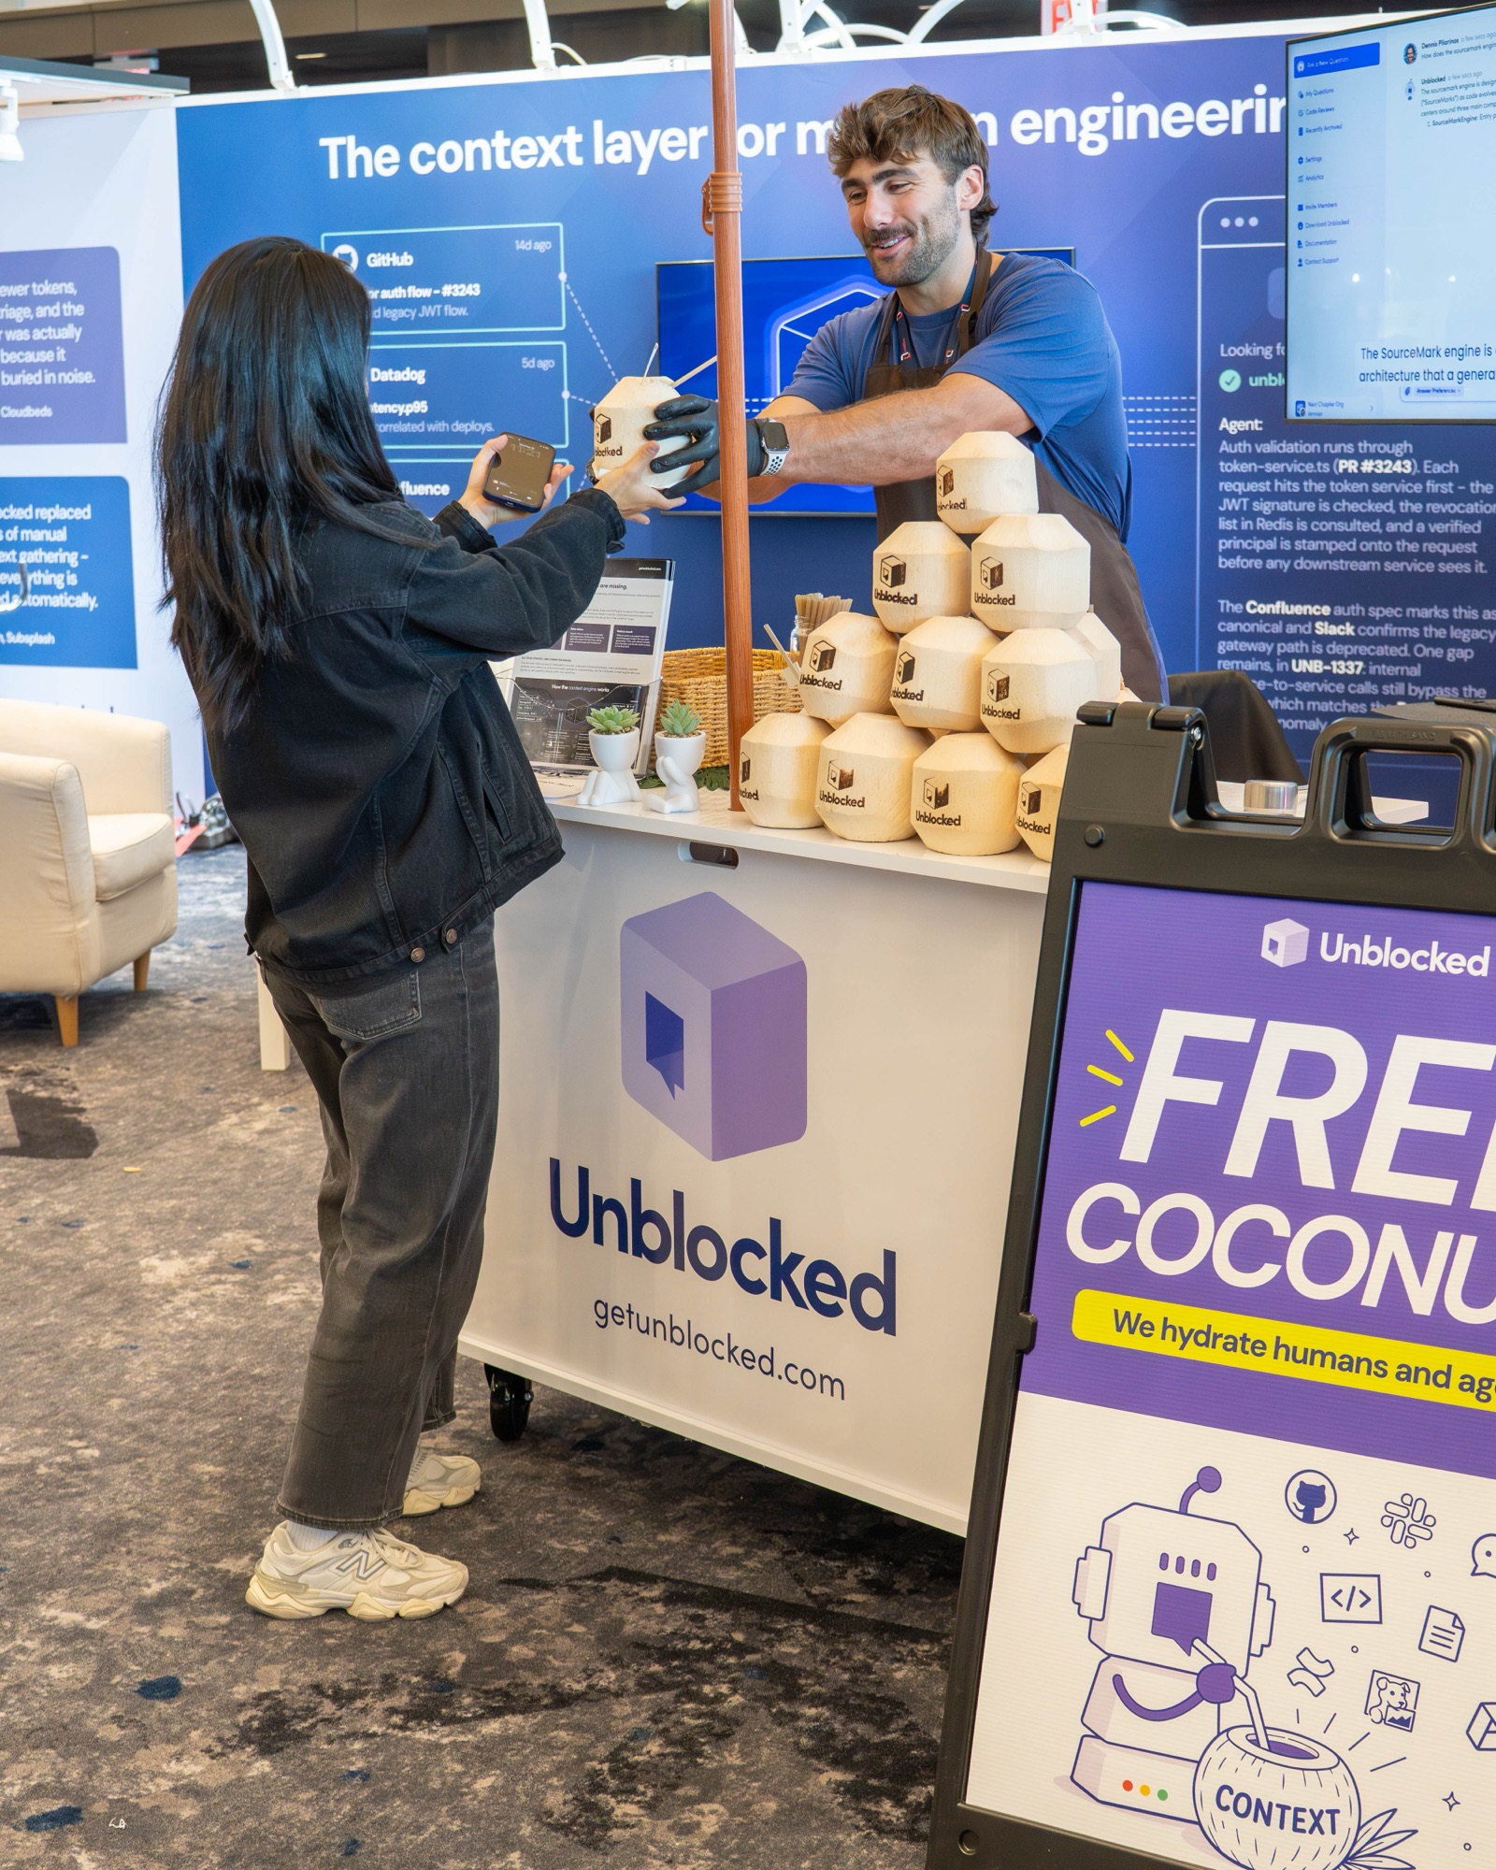
We train your team to build AI systems in-house.
One day at your office. Three days over Zoom. Eight weeks to production.

Slide 2
Why AI stalls inside companies
Tools get bought. Nothing changes.
A consultant builds it, then leaves.
Nobody inside can build the roadmap.

Slide 3
The fix is a team inside your company
01
Four to eight of your people, trained to build and own AI systems.
02
They know the business, so they build the right thing first.
03
They stay, so the systems get maintained and the next one gets built.

Slide 4
Three ways to work with us
Your team builds. We teach, review, and support it after.
1 DAY
3 DAYS, 4 HOURS PER DAY
8 WEEKS
One-day workshop
Three-day intensive
Eight-week cohort
In person, at your office
Remote, over Zoom
On site or remote
Map your operations, pick the first three systems worth building, and leave with a plan and a working prototype of one.
Build a working AI system against your real data: LLM APIs, integrations, human handoff, and deployment.
One system shipped to production inside your company, owned and understood by the people who built it.
$15,000
$7,500
$50,000

Slide 5
What your team can do after
01
Build on LLM APIs with structured outputs and tool use
02
Connect AI to your CRM, email, and operations systems
03
Design human handoff, alerts, and audit trails
04
Test, monitor, and track the cost of a system in production
05
Scope and ship the next project without outside help

Slide 6
Built for clients, running today
$6M+
10
10K+
200+
Client revenue supported by systems we built
Client systems in production
Customer conversations handled by AI agents we deployed
Hours of manual work removed per month across clients
CLIENTS
Wonderfly · Windansea Coconuts · WD Capital · Hologram Pilates (Proto) · Applegate Ventures

Slide 7
A customer service agent that answers texts around the clock
WONDERFLY
PROBLEM
Customers text evenings and weekends. Staff replied Monday. Bookings were lost.
WHAT WE BUILT
An SMS agent on the venue's phone lines that answers from live data and hands off to a human when unsure.
RESULT
Replies in seconds, any hour. Staff only touch the conversations it flags.

Slide 8
Event operations with no retyping
WINDANSEA COCONUTS
PROBLEM
Every closed deal was copied by hand into tasks, intake forms, and crew run sheets.
WHAT WE BUILT
Webhooks from the CRM create the event, send the intake, and write a daily Run of Show with Claude.
RESULT
A closed deal becomes a staffed event with a current run sheet, with nobody retyping it.

Slide 9
A lead pipeline that replaced Zapier
WD CAPITAL
PROBLEM
Property leads arrived through a chain of Zapier steps that duplicated records and failed silently.
WHAT WE BUILT
One pipeline that scores, dedupes, and pushes leads to HubSpot, with a dashboard and replay.
RESULT
Zapier is gone. Every lead has an audit trail. Million-dollar transactions run on it.

Slide 10
Fixed fees. No per-seat charges.
One-day workshop
Three-day intensive
Eight-week cohort
1 day · In person, at your office
3 days, 4 hours per day · Remote, over Zoom
8 weeks · On site or remote
$15,000
$7,500
$50,000
Tell us the one workflow in your company that wastes the most human time.
millhausenjordan@gmail.com
aitrainingforcompanies.com

