Slide 1
#Iron Legion -AI For Censorship of Textual Data..
Team Members
Sai Vamsi Y
Harika Pavani G
Anjali Priya P

Slide 2
#Problem Statement Description...
Online Censorship is becoming a big issue in recent years.
In some cases people's life gets affected that they even committe Sucides..!!
Especially incase of Social Media where people can post what ever they want.
It is the organization's responsibility to make sure that posts won't affect the rest users.

Slide 3
#Problem Statement Description...
In the present situation, we have AI to censor the data before a post was uploaded but it isn't that effective
Since most of the people tend to use their own local language words often besides texting in English Language.
The Current AI used for censorship couldn't censor the local language's Offensive words.

Slide 4
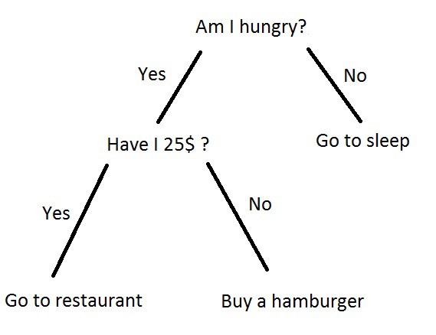
#Our Approach to the Problem
In a Nutshell, we gonna Build a Machine Learning Model which censors the textual data Effectively.
Which can even recognize Offensive words of our Local Languages.
Since, this comes under a Classification Task we gonna make use of Machine Learning algorithms like “Decision Tree”,“Random Forest”,”SVM” & “KNN”.

Slide 5
#Solution..
We choose to build a ML model where a developer can add his/her own Training Data
Dynamically, so that it can easily integrated to an app of any platform
( Using Firebase,ML kit )
First we had Label Encoded each & every letter in all the words we got.
So that the encoded words can either classified as a Polite or an Offensive
word..
Then we had trained those Four models based on the Training Dataset which
we had created manually( including Data Augmentation step ).
At last the developer can select his/her preferable model
(Based on the accuracy metrics)

Slide 6
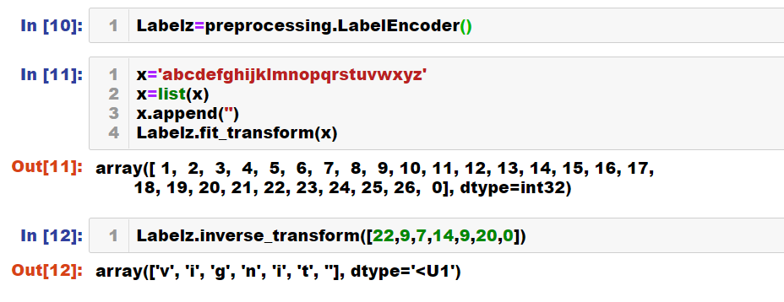
#DataPreProcessing..

Slide 7
#Use Cases..
Our Model can be used to Censor even audio/video format of the data
(Just by using Speech Recoginition APIs or Existing Deep Learning Models)
Our model can even perform tasks like “Sentiment Analysis” with the
appropriate Training Dataset.
With help of our model, people will now able to identify curse words of even
unknown languages..!!
Can be implemented in Online Shows/Movies Censorship (For Subtitles)
Can be implemented in Communication base apps like
Gmail,Twitter,Facebook,Whatsapp,Instagram & Snapchat...

Slide 8
#Thank You...!!

