Slide 1
Named Entity and Rare Word Recognition
Wang Dezhao, Liu Wenjing, Wei Jian

Slide 2
Background
U.N. I-ORG
official O
Ekeus I-PER
heads O
for O
Baghdad I-LOC
. . O
Why NER?
Question Answering
Textual Entailment
Coreference Resolution
Computational Semantics
…
word
named entity tag

Slide 3
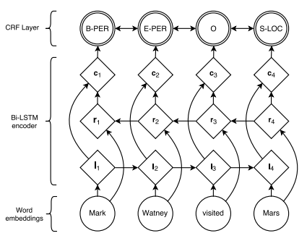
Model Construction
Word embeddings + LSTM + CRF

Slide 4
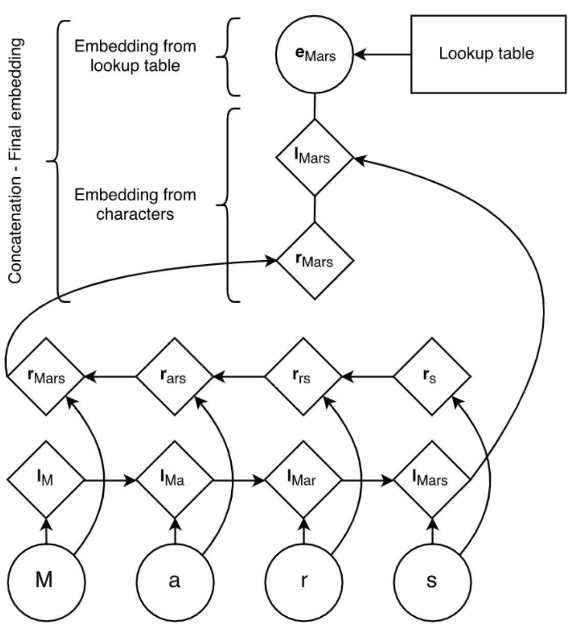
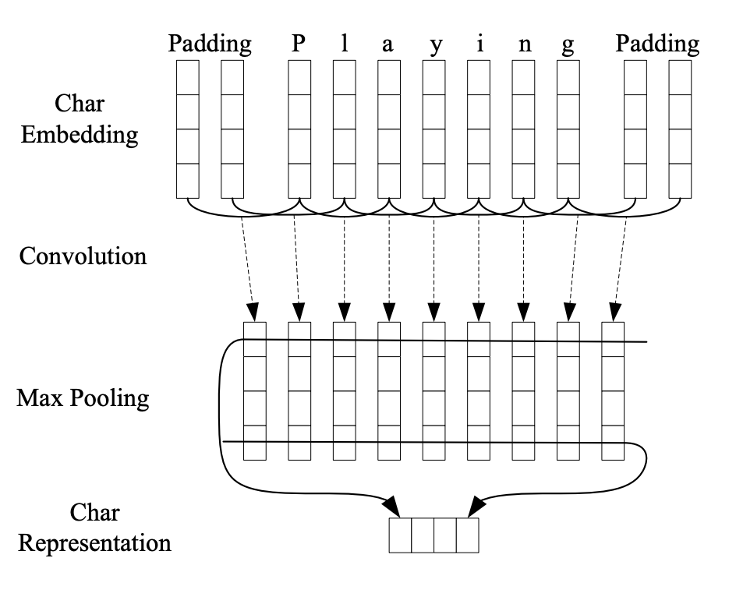
Model Construction
Word embeddings + LSTM
Word embeddings + CNN

Slide 5

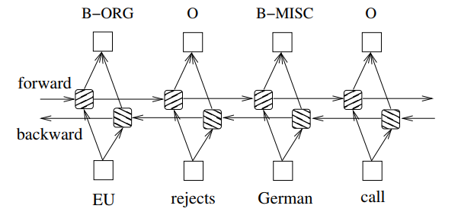
Model Construction
LSTM
Input: a given sentence
is represented as a d-dimensional vector
An LSTM(forward LSTM) computes a representation of the left context of the sentence at every word t
A second LSTM(backward) that reads the same sequence in reverse computes the right context
The representation of a word using this model is obtained by concatenating its left and right context representations

Slide 6
NER Data
Kaggle Dataset
Annotated Corpus for Named Entity Recognition using GMB(Groningen Meaning Bank) corpus for entity classification with enhanced and popular features by Natural Language Processing applied to the data set.
Lab Dataset
This is the extract from financial news and articles, annotated and built specifically to train the classifier to predict named entities such as organization, location, person, etc.

Slide 7
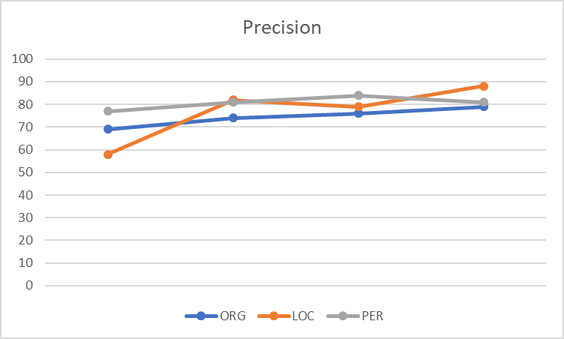
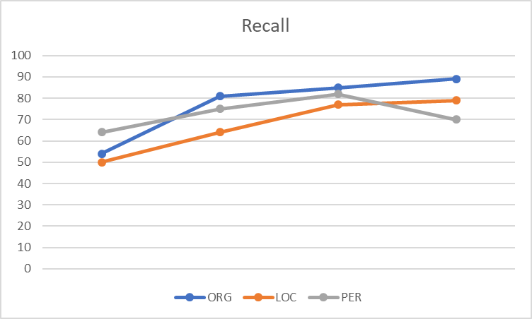
Model Evaluation on LSTM-CRF
Kaggle data | Lab data | Evaluation | ORG | LOC | PER
10000 | 0 | precision | 69 | 58 | 77
 |  | recall | 54 | 50 | 64
9000 | 1000 | precision | 74 | 82 | 81
 |  | recall | 81 | 64 | 75
8000 | 2000 | precision | 76 | 79 | 84
 |  | recall | 85 | 77 | 82
7000 | 3000 | precision | 79 | 88 | 81
 |  | recall | 89 | 79 | 70

Slide 8
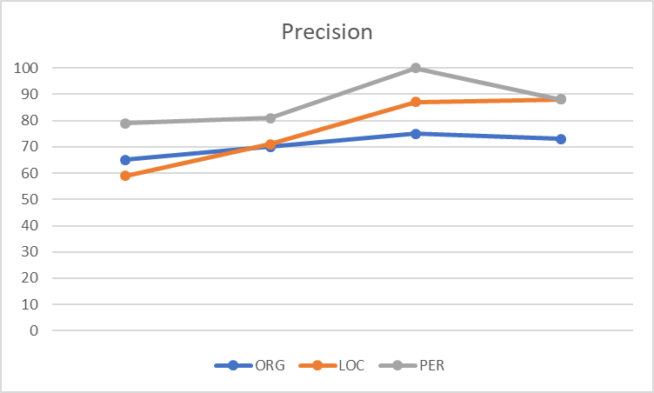
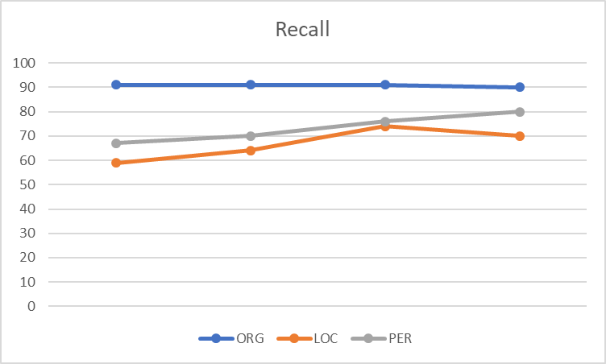
Model Evaluation on Char-LSTM-LSTM-CRF
Kaggle data | Lab data | Evaluation | ORG | LOC | PER
10000 | 0 | precision | 65 | 59 | 79
 |  | recall | 91 | 59 | 67
9000 | 1000 | precision | 70 | 71 | 81
 |  | recall | 91 | 64 | 70
8000 | 2000 | precision | 75 | 87 | 100
 |  | recall | 91 | 74 | 76
7000 | 3000 | precision | 73 | 88 | 88
 |  | recall | 90 | 70 | 80

Slide 9
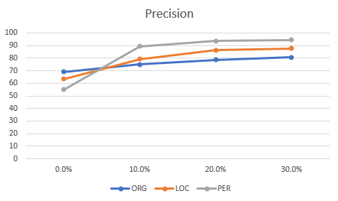
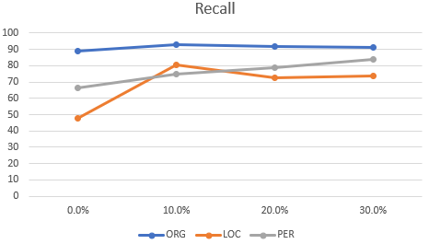
Model Evaluation on Char-Conv-LSTM-CRF
Kaggle data | Lab data | Evaluation | ORG | LOC | PER
10000 | 0 | precision | 69 | 63 | 55
 |  | recall | 89 | 48 | 66
9000 | 1000 | precision | 75 | 79 | 89
 |  | recall | 93 | 80 | 75
8000 | 2000 | precision | 78 | 86 | 93
 |  | recall | 92 | 72 | 79
7000 | 3000 | precision | 80 | 87 | 94
 |  | recall | 91 | 74 | 83

Slide 10
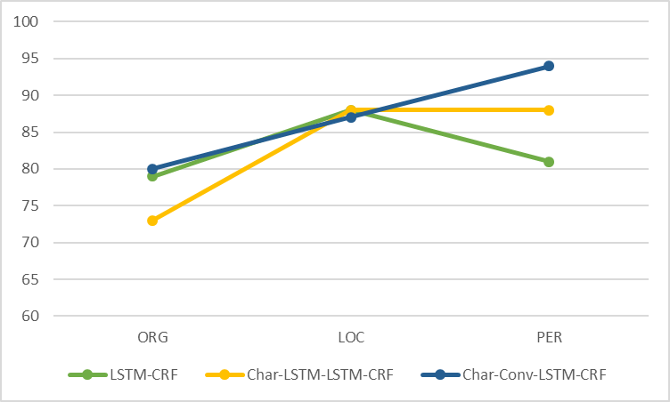
Model Evaluation
The Precision of 3 Models(Kaggle data : Lab data = 7 : 3)

Slide 11
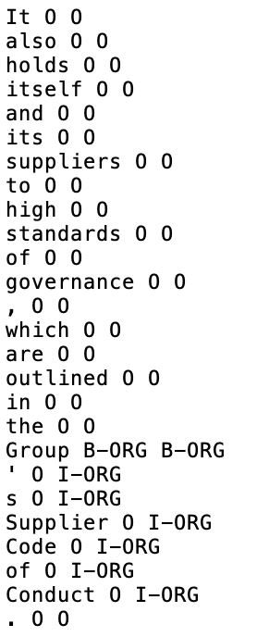
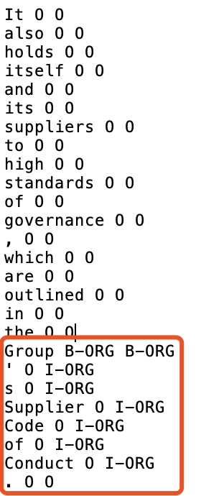
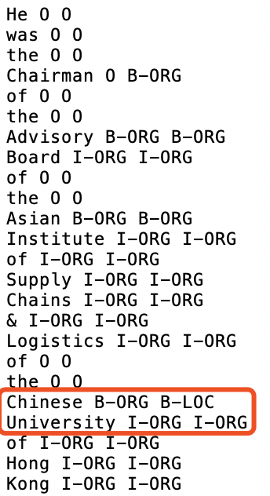
Learn from mistakes
It also holds itself and its suppliers to high standard of governance, which are outlined in the Group's Supplier Code of Product.
He was Chairman of the Advisory Board of the Asian Institute of Supply Chains & Logistics of the Chinese University of Hong Kong

Slide 12
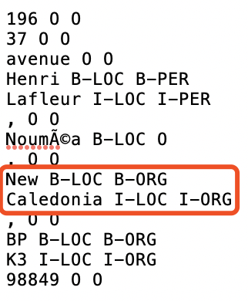
Learn from mistakes
Flexible location data format : 196 37 avenue Henri Lafleur ,NoumÃ©a, New Caledonia, BP K3 98849

Slide 13
Some example rules in labeling
1. Something issued by ORG:
2. Mr. PER Dr. PER

Slide 14
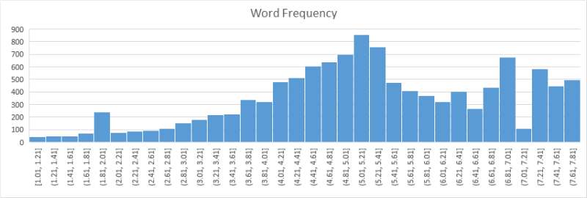
Rare Word Recognition
Rare word recognition rules
Word Frequency < 2.0
Not digit(e.g., flight number, law's name), not Chinese character
Length > 8

Slide 15
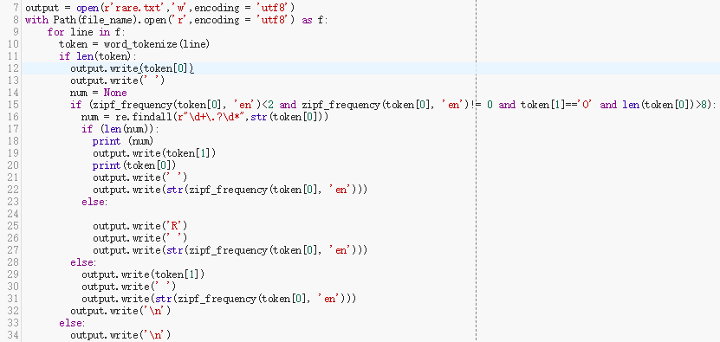
Rare Word Recognition
We use the open source python library wordfreq to predict the rare words based on the rules we set.

Slide 16
Schedule
Labeling job
Literature Review
Neural Architectures for NER
Bidirectional LSTM-CRF Models for Sequence Tagging
Web Page
Build Model
Model Evaluation
Rare Word Recognition
Final report

Slide 17
THANK YOU!
Wang Dezhao, Liu Wenjing, Wei Jian

