Slide 1

GROUP 18: Object recognition in food pictures based on CNN network
Wang de zhao 3035562100
Wei Jian 3035561481
Wu Jian 3035561766
Zhou ya tong 3035562344

Slide 2
Outline
• Overview
• Linear regression used for image recognition
• CNN used on spark
• Web Interface

Slide 3
Key Features
• Distributed Machine LearningAlgorithms
• Linear Regression (Spark MlLib)
• Convolutional Neural Networks (Deeplearning4J for Spark)
• Web Server System
• Handle submitted images , load trained model to do image recognition and return result.

Slide 4
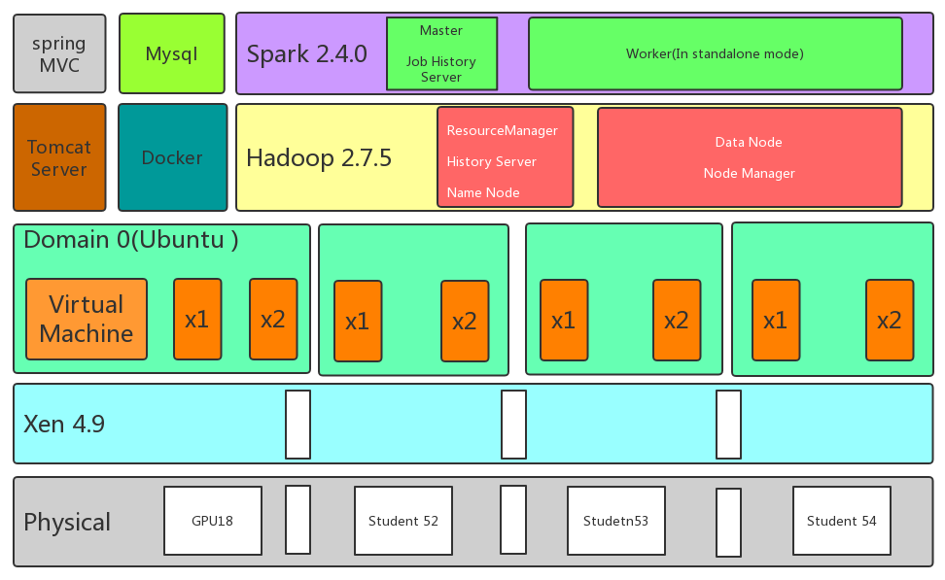
Model Structure

Slide 5
Model Structure
 |  | gpu18 |  |  | student52 |  |  | student53 |  |  | student54
CPU |  | Intel(R) Core(TM) i5‐3570 CPU @ 3.40GHz |  |  | Intel(R) Core(TM) i3‐530 CPU @ 2.93GHz |  |  | Intel(R) Core(TM) i3‐530 CPU @ 2.93GHz |  |  | Intel(R) Core(TM) i3‐530 CPU @ 2.93GHz
Disk |  | 250GB |  |  | 250GB |  |  | 250GB |  |  | 250GB
Memory |  | 16GB |  |  | 16GB |  |  | 16GB |  |  | 16GB
VM Information | Name | Dom0 | x1 | x2 | Dom0 | x1 | x2 | Dom0 | x1 | x2 | Dom0 | x1 | x2
 | RAM | 3.32G | 4GB | 4GB | 7.1GB | 3.88GB | 3.9GB | 3.2GB | 3.9GB | 3.9GB | 3.2GB | 3.9GB | 3.9GB
 | SWAP | 2GB | 8GB | 8GB | 2GB | 11GB | 10GB | 2.0GB | 9GB | 9GB | 2GB | 9GB | 8GB
 | Vcpu | 6 | 4 | 4 | 2 | 4 | 4 | 4 | 4 | 4 | 2 | 4 | 4
Role | Ganglia | master | slave | slave | slave | slave | slave | slave | slave | slave | slave | slave | slave
 | HDFS | NameNode | datanode | datanode | none | datanode | datanode | none | datanode | datanode | none | datanode | datanode
 | Yarn | RM | NM | NM | none | NM | NM | none | NM | NM | none | NM | NM

Slide 6
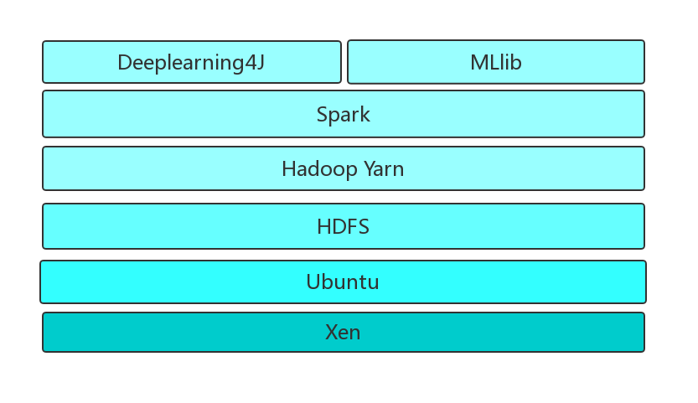





Training Architecture

Slide 7





Other Application
Tomcat
openCv
Mysql
Apache maven
Docker

Slide 8
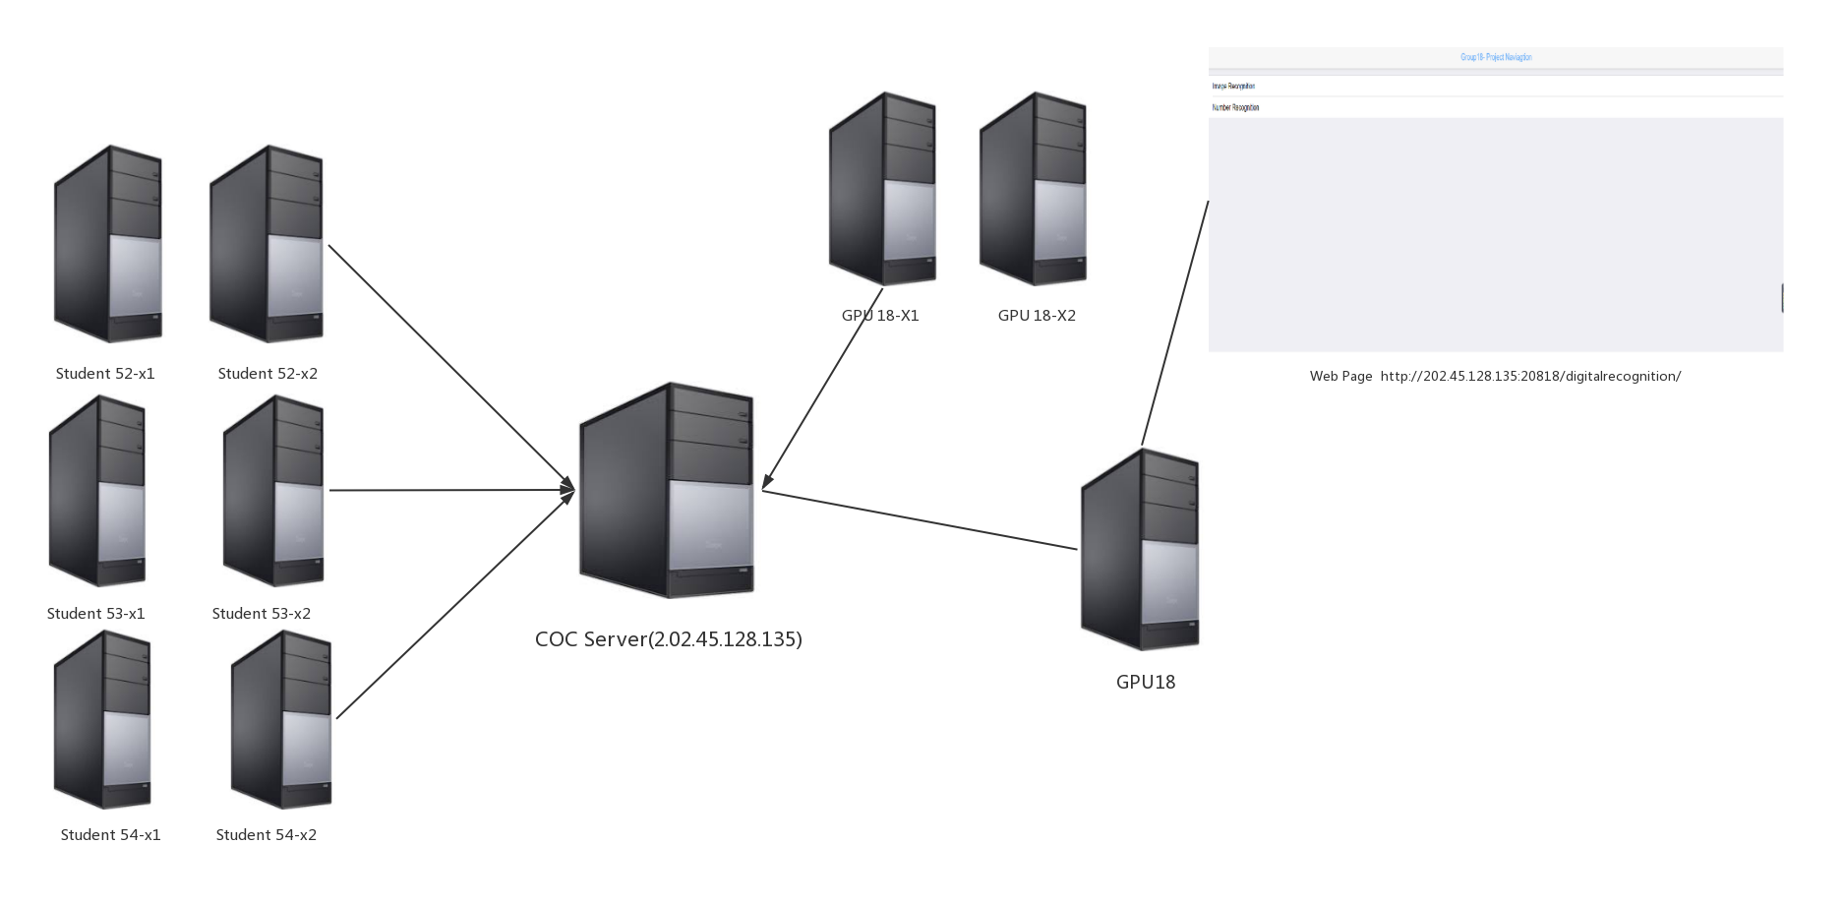
Network Topologies

Slide 9
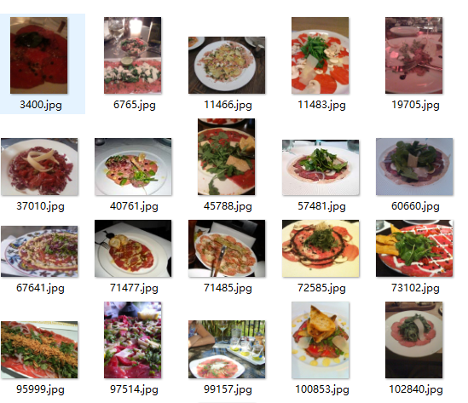
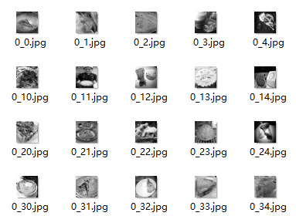
Data Pre-processing
• Target : To remove the invalid data and resize the image so that they can be trained in the model.
• First, download raw food dataset from Internet, abandon invalid images and classify them.
• Second, Reshape dataset to 28*28, convert them to grayscale and serialize them in the font of libsvm.

Slide 10
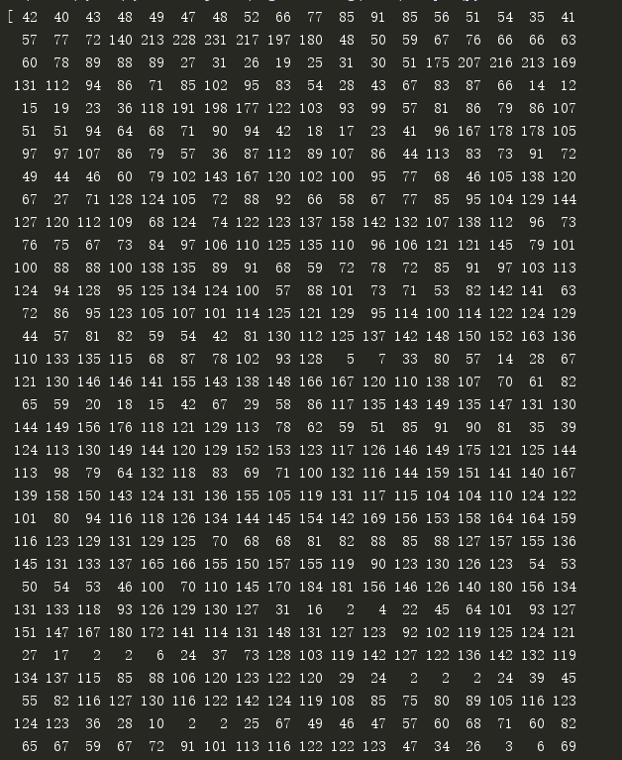
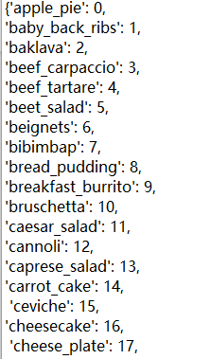
Data Pre-processing
Finally, serialize the pre-processed images to arrays of number, store them in file and identify them with a number in a dictionary.

Slide 11
Linear Regression used for image recognition
• Dataset collection:
https://www.vision.ee.ethz.ch/datasets_extra/food-101/
A dataset of food images with a size of 5GB
• SparkMLlib

Slide 12
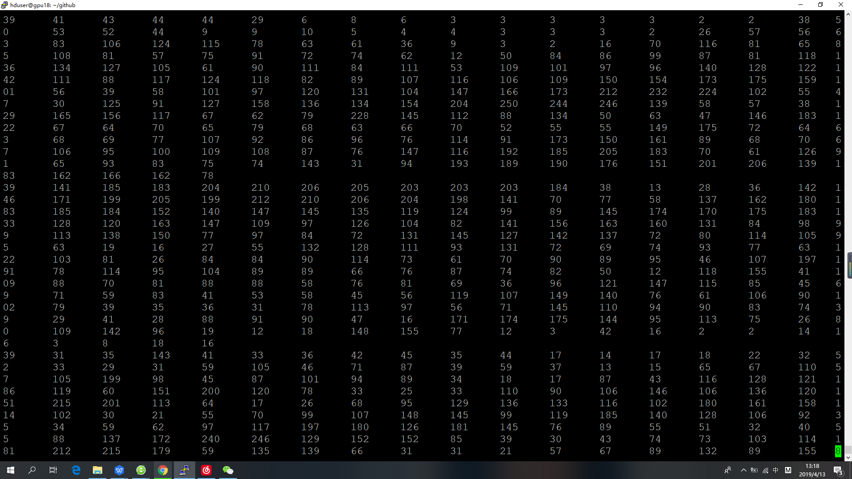
Screen shot of dataset

Slide 13
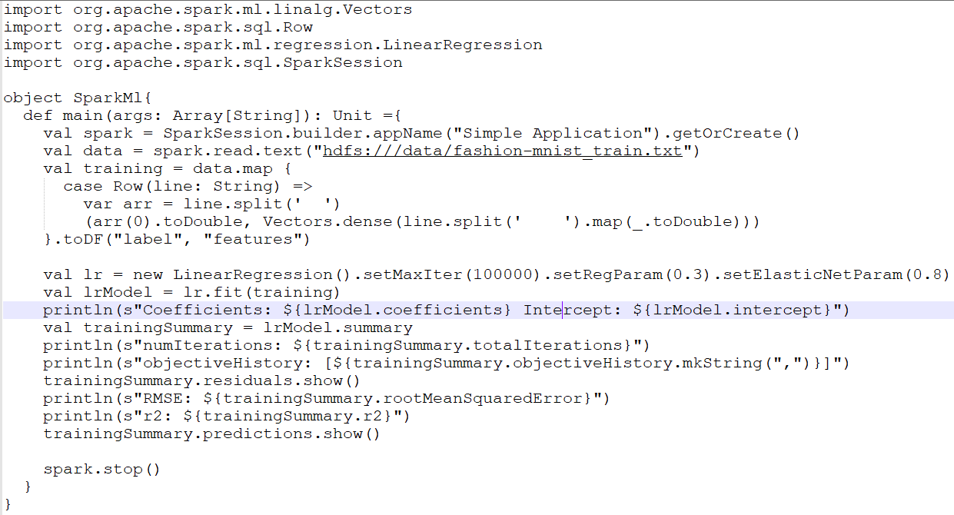
Linear Rgression(Spark MLlib)

Slide 14
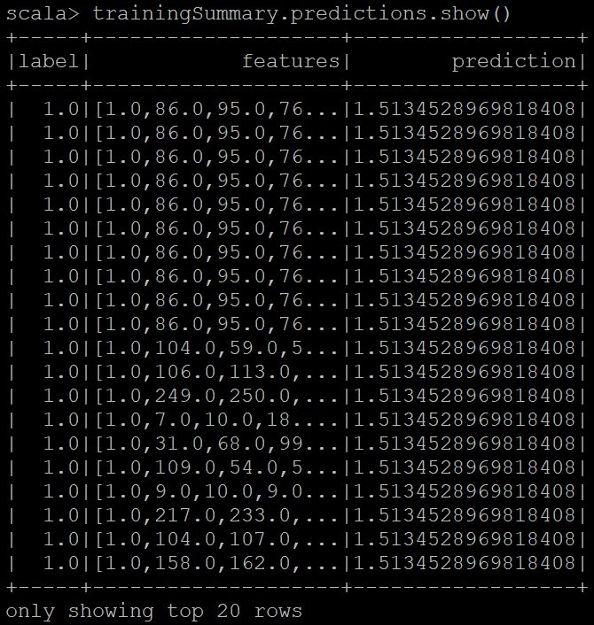
Output Results
The label is 1, but the prediction is 1.5. The accuracy is too low, so we choose the CNN model.

Slide 15
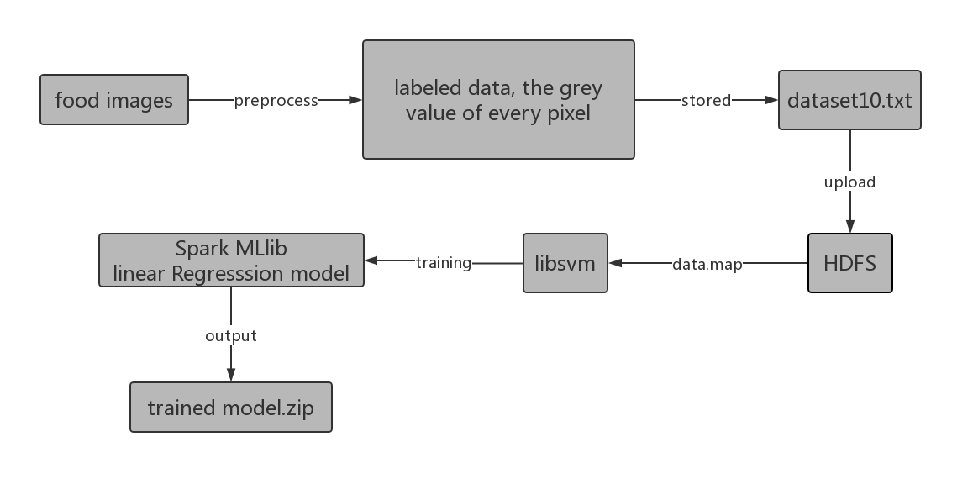
Training

Slide 16
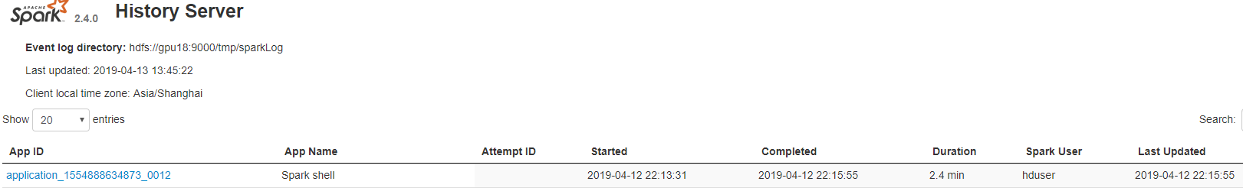
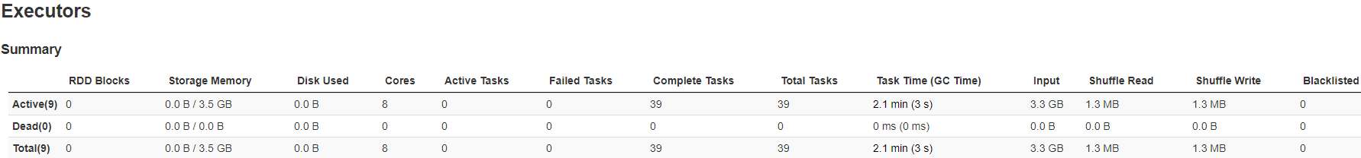
Running History
The input is 3.3 GB

Slide 17
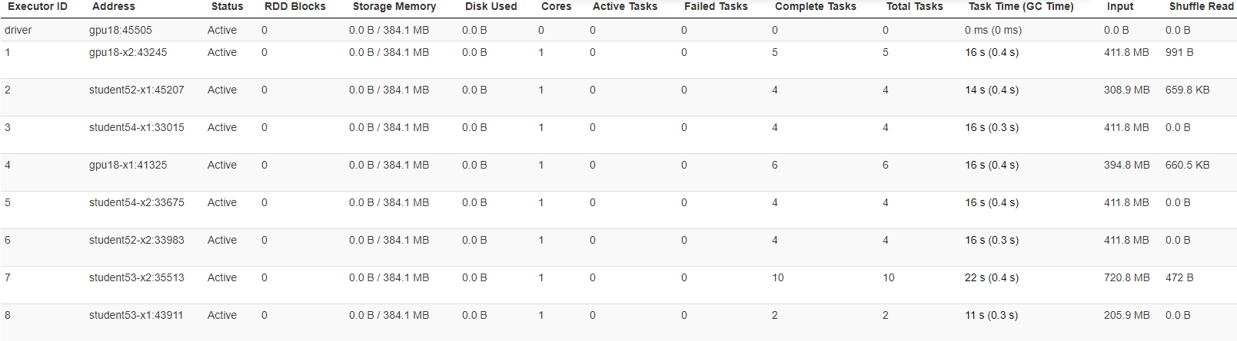
Running History
There are 8 executors

Slide 18
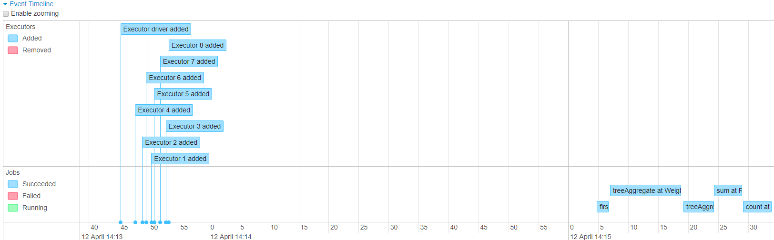
Running Hstory

Slide 19
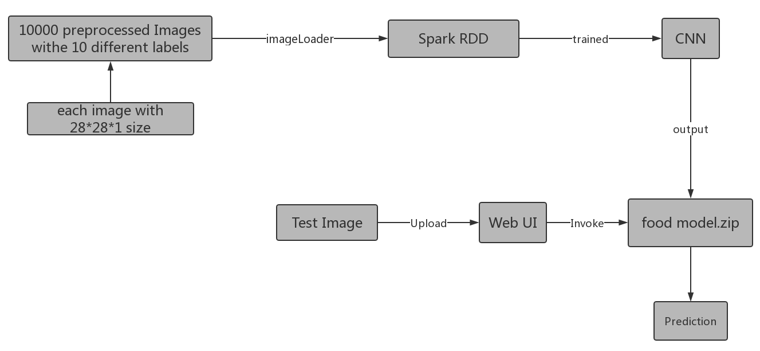
CNN used to predict food Image

Slide 20
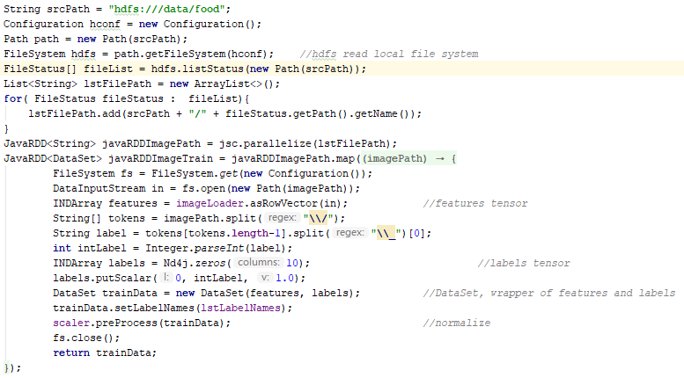
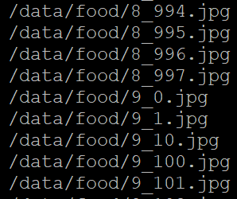
Spark RDD

Slide 21
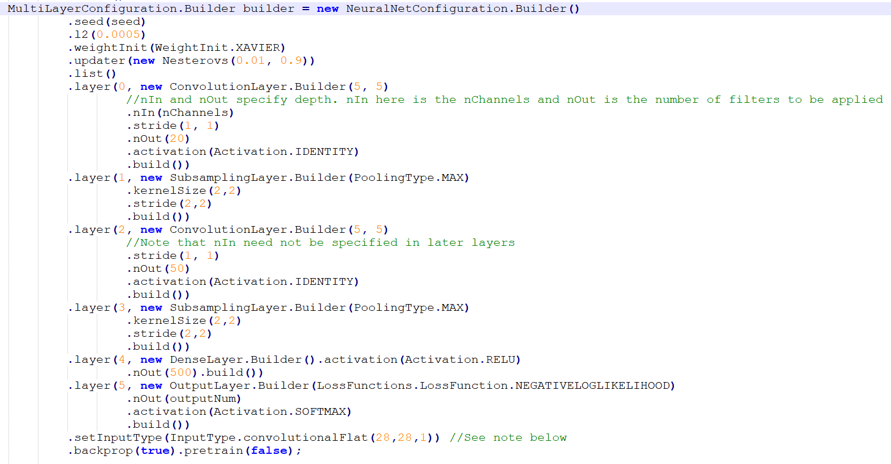
CNN ARCHITECTURE

Slide 22
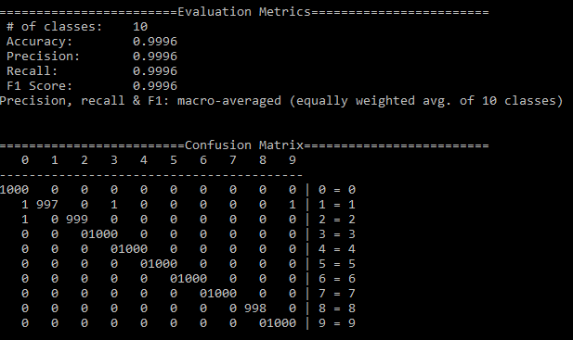
Running Result

Slide 23
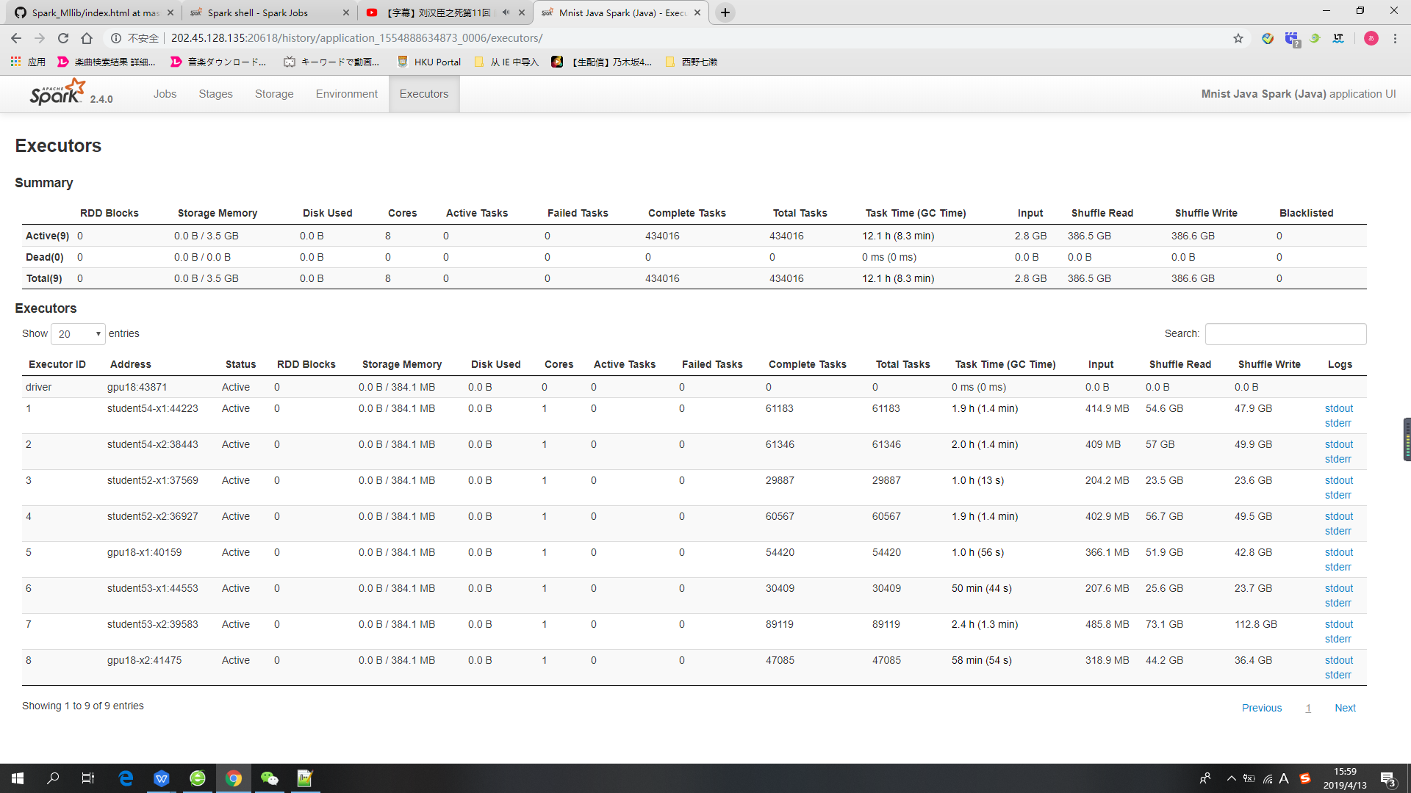
Running Result
Input 2.8 GB

Slide 24
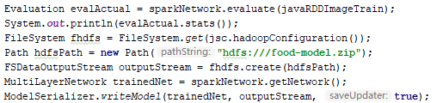
Tained model

Slide 25
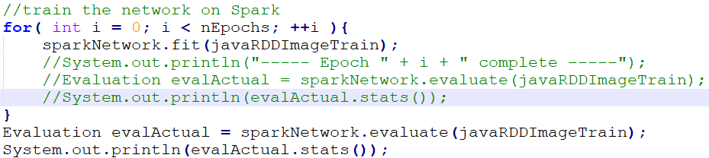
Problem & Solution
When we ran a small dataset. We saw that too much time was comsumed by the stage of treeAggregate , so we moved the evaluation stage from every iteration to the end of the training.

Slide 26

Web Interface
http://202.45.128.135:20818/digitalrecognition/

Slide 27
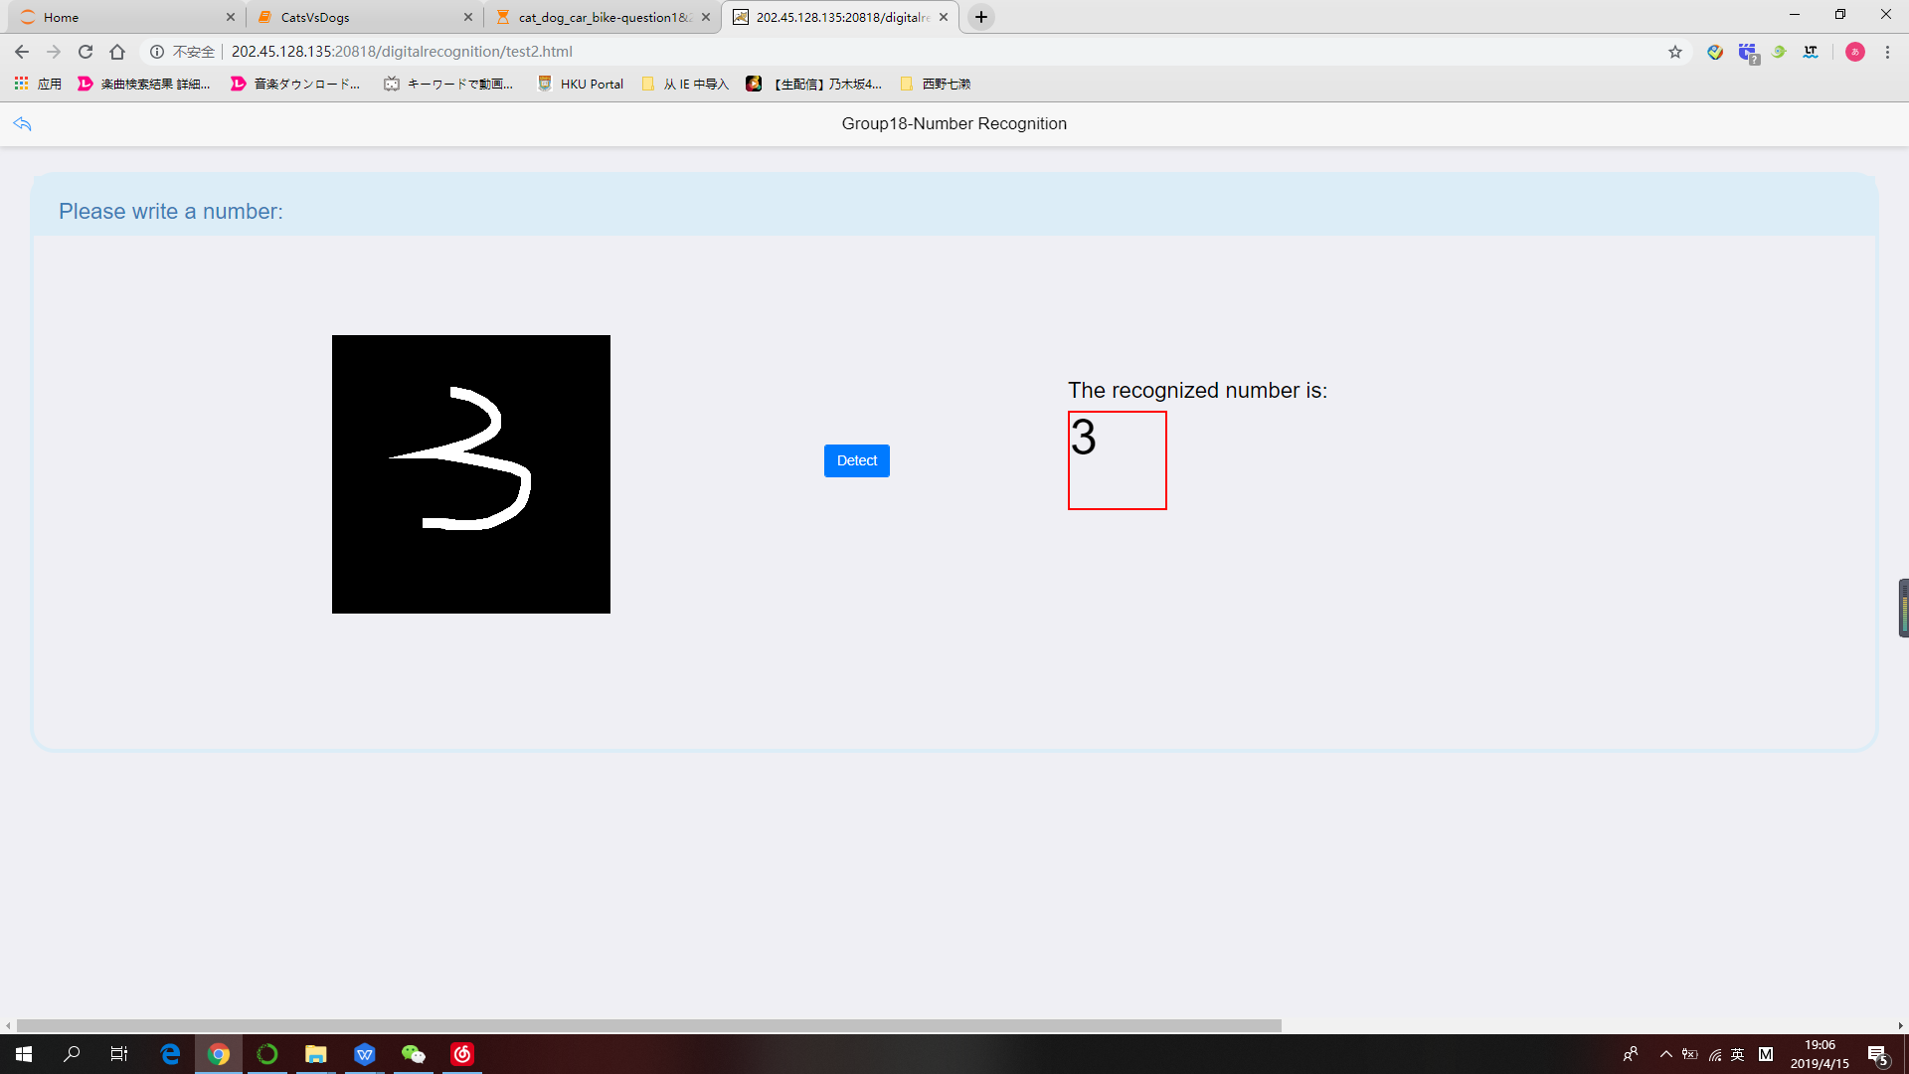
Hand-Writing

Slide 28
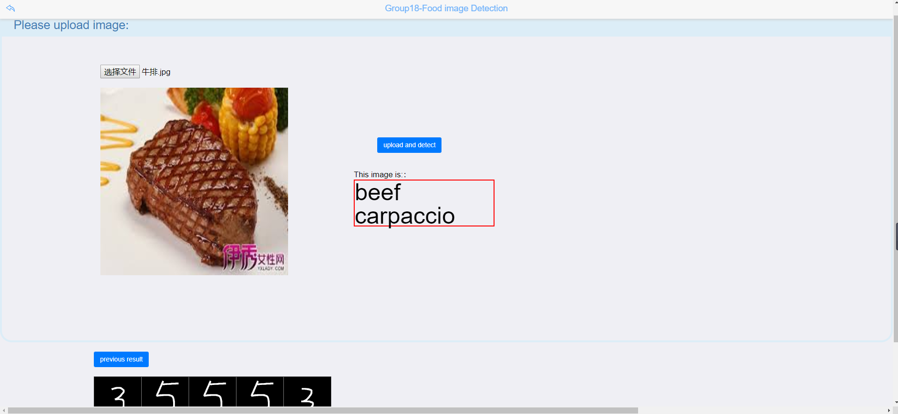
Food Recognition

Slide 29
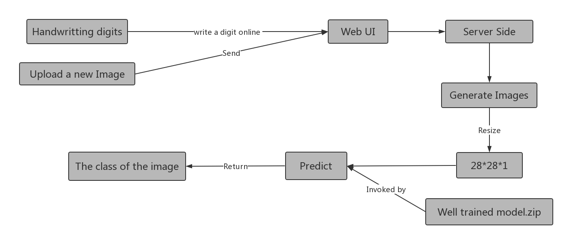
Predict
Upload a image
Invoke the pretrained model to predict the class of the image and show the result.

Slide 30
Server-side Processing
Hand-writing Detection
• User write a digit(0-9) on the web page
• Generate a image
• Resize the input image with 28*28*1
• Using the pretrained model to predict the digit
Food Image Detection
• User upload a food image
• Resize the image with 28*28*1
• Using the pretrained food model to predict the class of the image

Slide 31
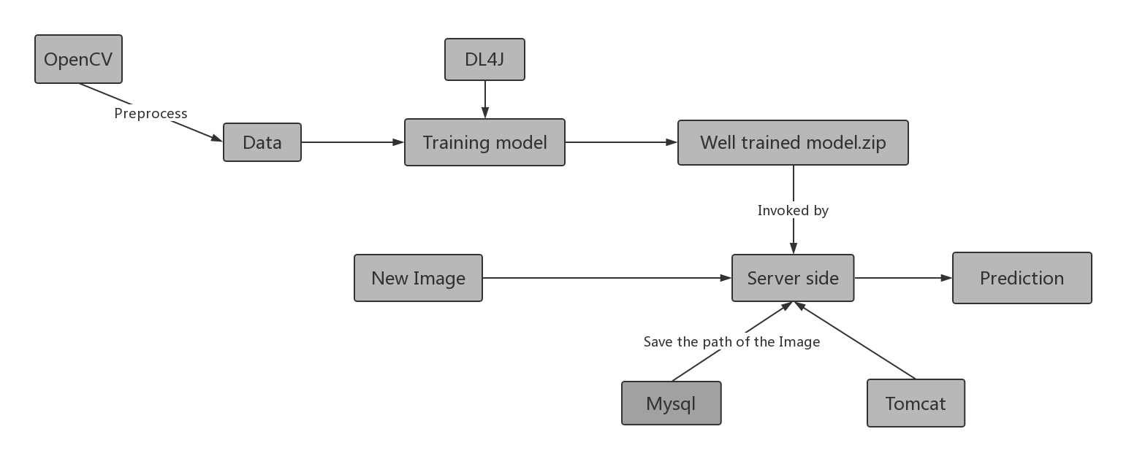
The flow chart of image recognition

Slide 32
Open-source programs
https://blog.csdn.net/wangongxi/article/details/54616842, Deeplearning4j 手写体数字识别Spark实现, wangongxi
https://gitee.com/lxkm/dl4j-demo/tree/master/digitalrecognition, dl4j-demo, 冷血狂魔
https://my.oschina.net/sunmin/blog/719693, spark mllib 预测之LinearRegression, ericSM

