Slide 1
PREDICTING CAR ACCIDENT'SEVERITY
IBM Applied Data Science Capstone Project
JEFRY HAMJAYA

Slide 2
1. INTRODUCTION / BUSINESS PROBLEM

Slide 3
In a big city where car accidents happen all the time, it can be a challenge to deploy necessary number or type of personnel on time with the limited numbers of personnel on our disposal.
The idea is to classify the severity of a car accident, in this case we will use two level of severity, 1 for Property Damage Only Collision and 2 for Injury Collision. The severity prediction will be based on the information received at the time an accident is reported.
With this simplification of early accident classification, the Dispatch Center can decide which personnel should be dispatched for the accident. For example, for accident with severity of 1 Property Damage Only Collision, the healthcare personnels are not needed on site, and they can be allocated to another injury related accident.

Slide 4
2. DATA

Slide 5
The data that will be used is to approach the problem is the sample data set from:
https://s3.us.cloud-object-storage.appdomain.cloud/cf-courses-data/CognitiveClass/DP0701EN/version-2/Data-Collisions.csv
This is a Seattle's car accident data from 2004 to 2020 which contains a number of information for each accident, such as the time, location, and the number of people / vehicle involved in each accident. Based on this historical data, we will try to build a model that is able to predict the severity of an accident based on the initial data collected from the accident site.

Slide 6
The data contains 1 target column & 37 feature columns with a total of 194673 rows of data.
Target Column:
'SEVERITYCODE'
Feature Columns:
'X', 'Y', 'OBJECTID', 'INCKEY', 'COLDETKEY', 'REPORTNO', 'STATUS', 'ADDRTYPE', 'INTKEY', 'LOCATION', 'EXCEPTRSNCODE', 'EXCEPTRSNDESC', 'SEVERITYCODE.1', 'SEVERITYDESC', 'COLLISIONTYPE', 'PERSONCOUNT', 'PEDCOUNT', 'PEDCYLCOUNT', 'VEHCOUNT', 'INCDATE', 'INCDTTM', 'JUNCTIONTYPE', 'SDOT_COLCODE', 'SDOT_COLDESC', 'INATTENTIONIND', 'UNDERINFL', 'WEATHER', 'ROADCOND', 'LIGHTCOND', 'PEDROWNOTGRNT', 'SDOTCOLNUM', 'SPEEDING', 'ST_COLCODE', 'ST_COLDESC', 'SEGLANEKEY', 'CROSSWALKKEY', 'HITPARKEDCAR'

Slide 7
The explanation for each column can be found in:
https://s3.us.cloud-object-storage.appdomain.cloud/cf-courses-data/CognitiveClass/DP0701EN/version-2/Metadata.pdf
We exclude the columns that are entered by the state as they won't be available in the initial report ('PEDCOUNT', 'PEDCYLCOUNT', 'VEHCOUNT', 'INJURIES', 'SERIOUSINJURIES', 'FATALITIES').
We also exclude the 'LOCATION' column as this is a free text column and is already represented by the coordinates ('X', 'Y').

Slide 8
These are the columns that we'll use for our model building:
X Double Longitude
Y Double Latitude
ADDRTYPE Text, 12 Collision address type: Alley, Block, Intersection
INTKEY Double Key that corresponds to the intersection associated with a
collision
PERSONCOUNT Double The total number of people involved in the collision
SDOT_COLCODE Text, 10 A code given to the collision by SDOT.
INATTENTIONIND Text, 1 Whether or not collision was due to inattention. (Y/N)
UNDERINFL Text, 10 Whether or not a driver involved was under the influence
of drugs or alcohol.

Slide 9
WEATHER Text, 300 A description of the weather conditions during the time of
the collision.
ROADCOND Text, 300 The condition of the road during the collision.
LIGHTCOND Text, 300 The light conditions during the collision.
SPEEDING Text, 1 Whether or not speeding was a factor in the collision.
(Y/N)
ST_COLCODE Text, 10 A code provided by the state that describes the collision.
SEGLANEKEY Long A key for the lane segment in which the collision occurred.
CROSSWALKKEY Long A key for the crosswalk at which the collision occurred.
HITPARKEDCAR Text, 1 Whether or not the collision involved hitting a parked car.
(Y/N)

Slide 10
3. METHODOLOGY

Slide 11
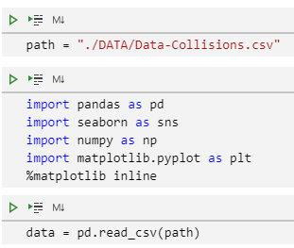
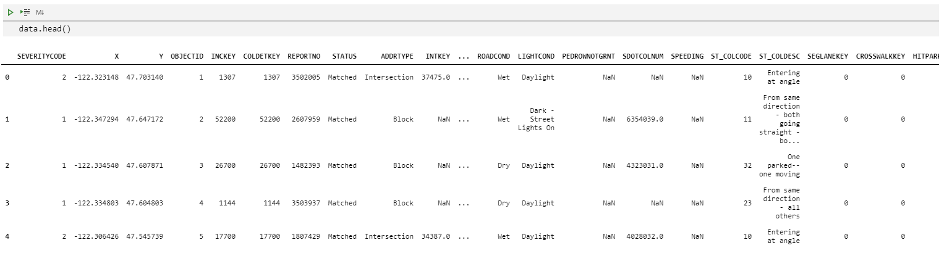
IMPORTING THE DATA
We start by importing the data in the notebook and importing some necessary packages into it.

Slide 12
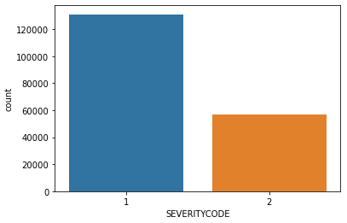
PRELIMINARY TARGET CHECK
Then, we’ll check the target column SEVERITYCODE.
Using countplot, we can see that the data is very unbalanced, and highly skewed towards SEVERITYCODE = 1. Training our model with this kind of data is not recommended due to the bias.
We’ll address this issue when we start to train our model later.

Slide 13
PRELIMINARY FEATURES CHECK
Next, we examine the features that we decided to use one by one to see their significance on the Severity value.
X, Y, ADDRTYPE, INTKEY, PERSONCOUNT, SDOT_COLCODE,
INATTENTIONIND, UNDERINFL, WEATHER, ROADCOND, LIGHTCOND,
SPEEDING, ST_COLCODE, SEGLANEKEY, CROSSWALKKEY, HITPARKEDCAR

Slide 14
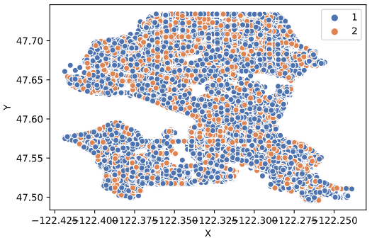
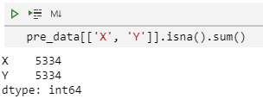
X, Y
By plotting X and Y, we can see that there is no clear separation between areas with SEVERITYCODE = 1 and 2.
Also there are 5334 rows with missing X and Y information.
We can conclude that we can drop these columns as they pose little significance for predicting SEVERITYCODE values.

Slide 15


INTKEY
INTKEY refers to intersection number related to the accident. Since more than half of the information are missing, we'll drop this column

Slide 16
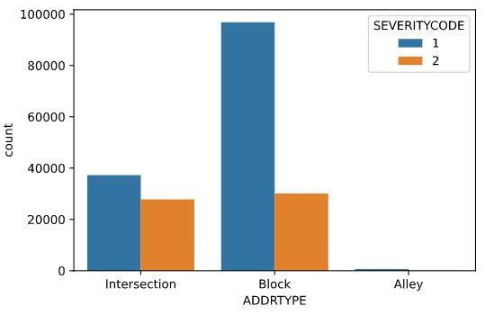
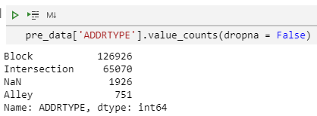
ADDRTYPE
There is a large number of accidents where the ADDRTYPE is 'Block' and most of them are under SEVERITYCODE = 1.
There are 1926 rows with missing ADDRTYPE that we’ll drop from the dataframe.

Slide 17
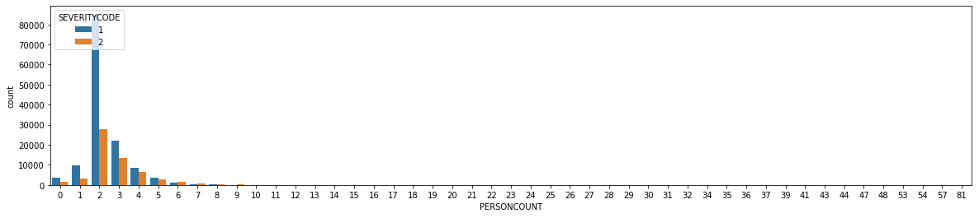
PERSONCOUNT
We can see that most car accidents involves two people.
Nothing to be done on this column as everything is in place and no missing value.

Slide 18
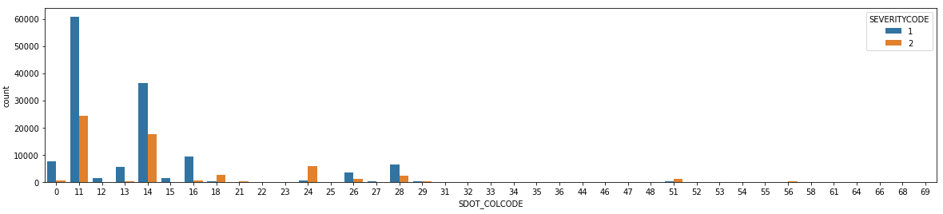
SDOT_COLCODE
The majority of accidents happen with SDOT_COLCODE = 11 & 14
SDOT_COLCODE 11 - motor vehicle struck another motor vehicle in front end
SDOT_COLCODE 14 - motor vehicle struck another motor vehicle in rear end
The data in this column are in order and no missing value either.

Slide 19
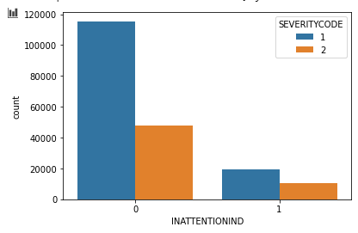


INATTENTIONIND
Since this column contains NaN and ‘Y’, we’ll need to convert them to binary value of 1 using replace function.

Slide 20
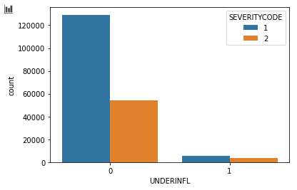

UNDERINFL
As with INATTENTIONIND, this column also needs to be tidied up since it contains multiple type of values (‘N’, ‘0’, NaN, ‘1’, ‘Y’)
We’ll also use replace function to convert it to binary values.

Slide 21
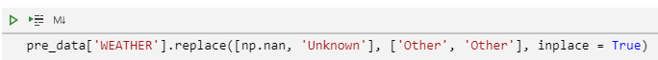
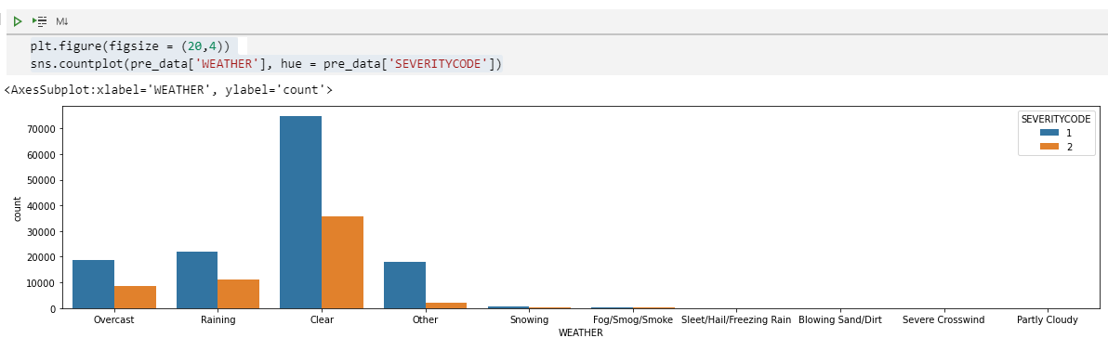
WEATHER
Here we’ll group together NaN, ‘Unknown’, and ‘Other’ as Other. Interestingly most accidents happened on clear days.

Slide 22
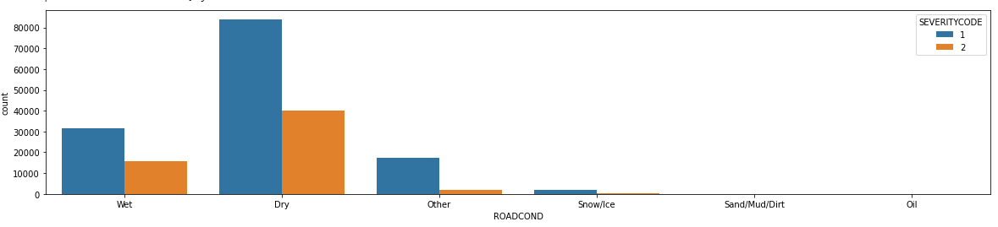
ROADCOND
There are some values that can be grouped together:
Wet (Wet, Standing Water)
Dry
Other (nan, Unknown, Other)
Snow/Ice (Snow/Slush, Ice)
Sand/Mud/Dirt
Oil

Slide 23
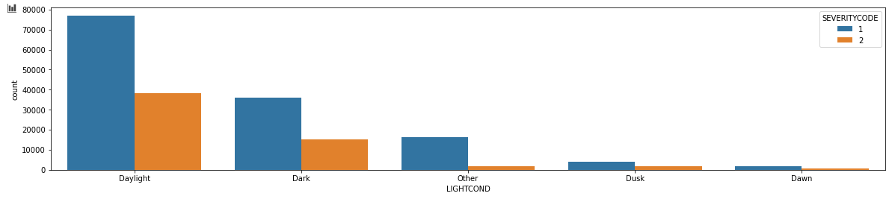
LIGHTCOND
Again, we grouped some similar values together:
Daylight
Dark (Dark - Street Lights On, Dark - No Street Lights, Dark - Street Lights Off, Dark - Unknown Lighting)
Dusk
Dawn
Other (nan, Other, Unknown)

Slide 24

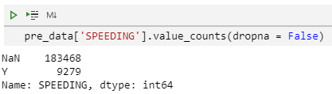
SPEEDING
We convert the values into binary data using replace function.

Slide 25
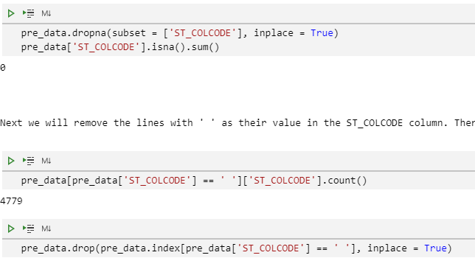
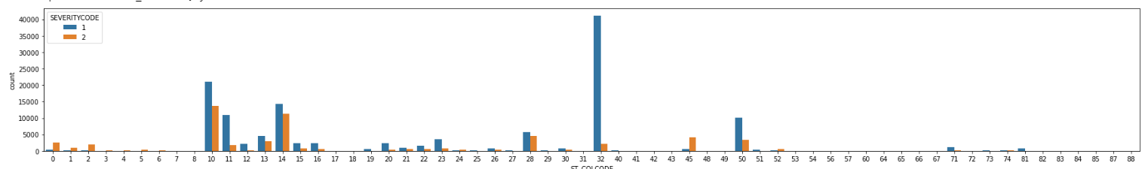
ST_COLCODE
There are 18 rows with NaN and blank space (‘ ‘) in ST_COLCODE column that we removed.

Slide 26


SEGLANEKEY, CROSSWALKKEY
Almost every rows have 0 for both SEGLANEKEY and CROSSWALKKEY. As they don’t identify anything, we dropped these two columns.

Slide 27
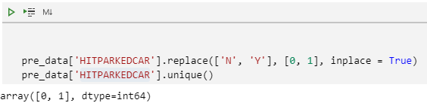
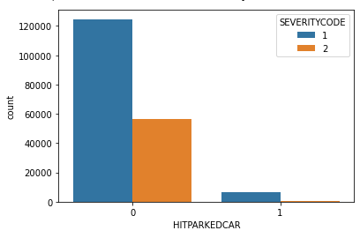
HITPARKEDCAR
We'll convert HITPARKEDCAR into binary data by replacing the values with 0 and 1.

Slide 28
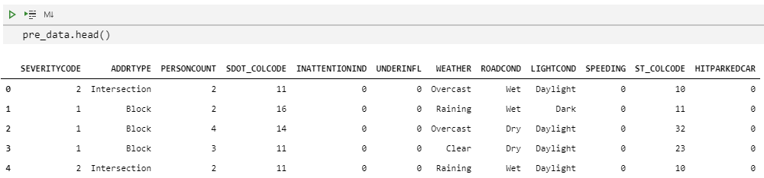
REVIEWING THE CLEANED UP DATA
This is our cleaned up dataframe now.

Slide 29
ONE-HOT ENCODING
Before we can create the train and test dataset, we need to convert the following categorical features into numerical values using one-hot encoding techniques.
ADDRTYPE
WEATHER
ROADCOND
LIGHTCOND

Slide 30
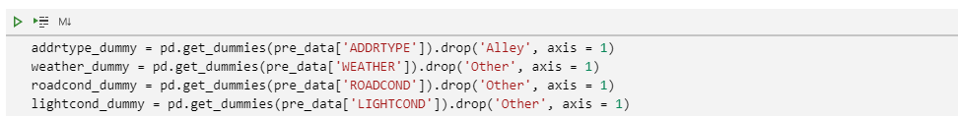
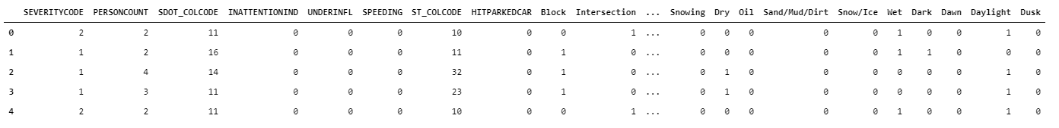
GET_DUMMIES
We’ll use the get_dummies function from pandas package to do this.

Slide 31
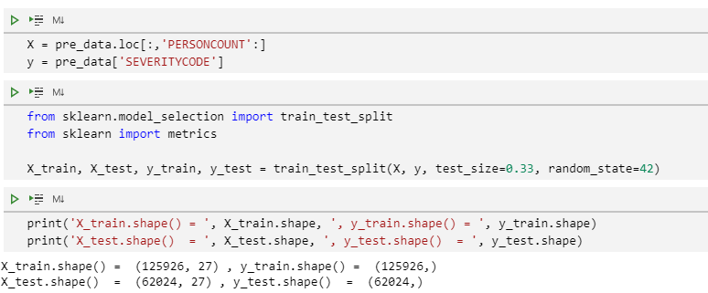
TEST, TRAIN SPLIT
Now we'll split the data into training and test dataset using test_train_split function.

Slide 32
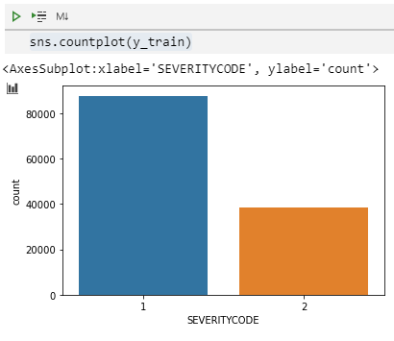
UNBALANCED DATA
Remember how our target values are very skewed towards SEVERITYCODE = 1? Now we need to address this problem before training our data.
There are several way to address this, but it this project we’ll upsample the minority part of the train data so that the number of data for SEVERITYCODE = 1 & 2 are the same. This way we don’t lose any data.
We’ll accomplish this using resample function from sklearn package.

Slide 33
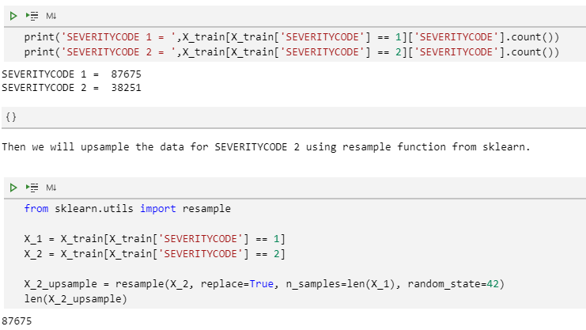
UPSAMPLING TRAINING DATA
First we will need to recombine X_train and y_train using pd.concat.
Then we upsample the data for SEVERITYCODE = 2 to the number of data for SEVERITYCODE = 1.

Slide 34
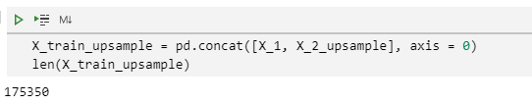

RECREATE TRAINING DATASET
Now we can split the training dataset into X_train and y_train again.
This will be the dataset for training our model.

Slide 35
BUILDING THE MODELS
Due to computanional limitation, we’ll only use the following models for our project:
Logistic Regression
Decision Tree
Support Vector Machine

Slide 36
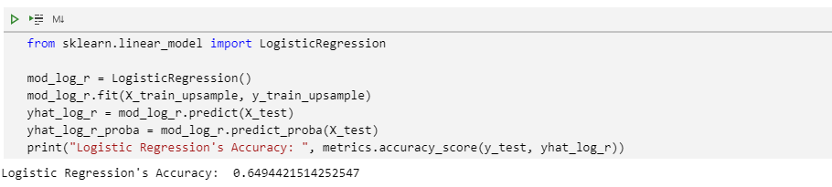
LOGISTIC REGRESSION

Slide 37
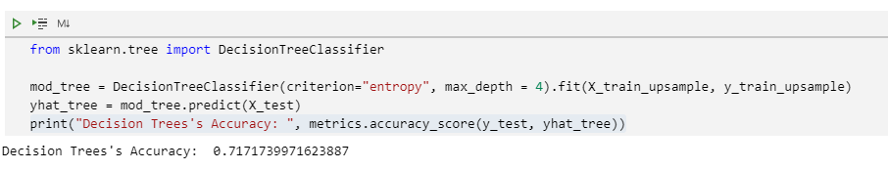
DECISION TREE

Slide 38
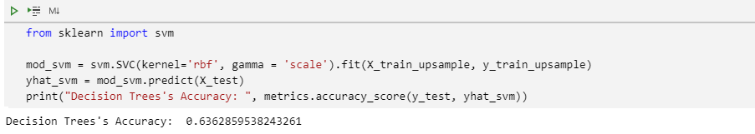
SUPPORT VECTOR MACHINE

Slide 39
4. RESULTS

Slide 40
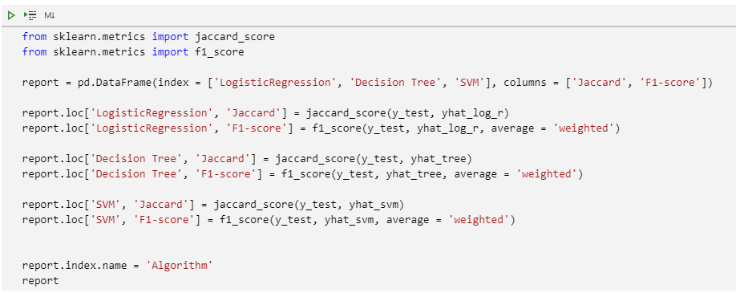
COMPARING MODEL’S ACCURACY
We’ll compare the model’s performance against the test dataset using Jaccard Score and F1-Score as the metrics.

Slide 41
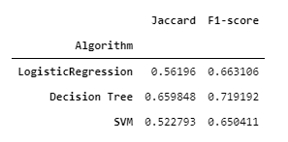
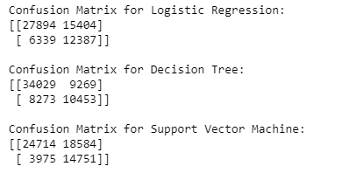
RESULT COMPARISION
Here’s the result. Decision Tree gives us the best performance, which is unsurprising since it handles unbalanced dataset better compared to Logistic Regression and Support Vector Machine.
Using confusion matrixes, we can also see how the models perform in dealing with the data.

Slide 42
5. DISCUSSION

Slide 43
While the models cannot fully predict the severity of an accident by using the data available from the accident report, they are able to give us an adequate result, especially using Decision Tree model. This prediction can help the Dispatch Centre to better allocate their personnel in a moment notice using the information from the initial report, of course, provided that the information received is accurate and complete enough.

Slide 44
6. CONCLUSSION

Slide 45
The data we use have an unbalanced number of SEVERITYCODE values and is heavily skewed toward SEVERITYCODE = 1. Also, some of the lines are missing some information. Due to those, we needed to remove rows with missing information and resampled the training data to reinforce the signal of the data in the minor category (SEVERITYCODE = 2).
With those limitations, we managed to build three classification models, Logistic Regression, Decision Tree, and Support Vector Machine, even though there are still room to improve the model’s performances.
Comparing the scores for those models, we have the Decision Tree model that gives us the best accuracy score. With better dataset, we sure can improve the performance of the model.

