Slide 1
Customer Churn Analysis
“This project analyses customer churn to identify at-risk customer segments, understand the key drivers of churn, quantify the financial impact, and recommend strategies to improve customer retention."

Slide 2




Business Objectives
1.
3.
5.
Measure customer churn
Quantify financial impact
Recommend data-driven retention strategies
2.
4.
Identify high-risk customers
Understand key churn drivers

Slide 3
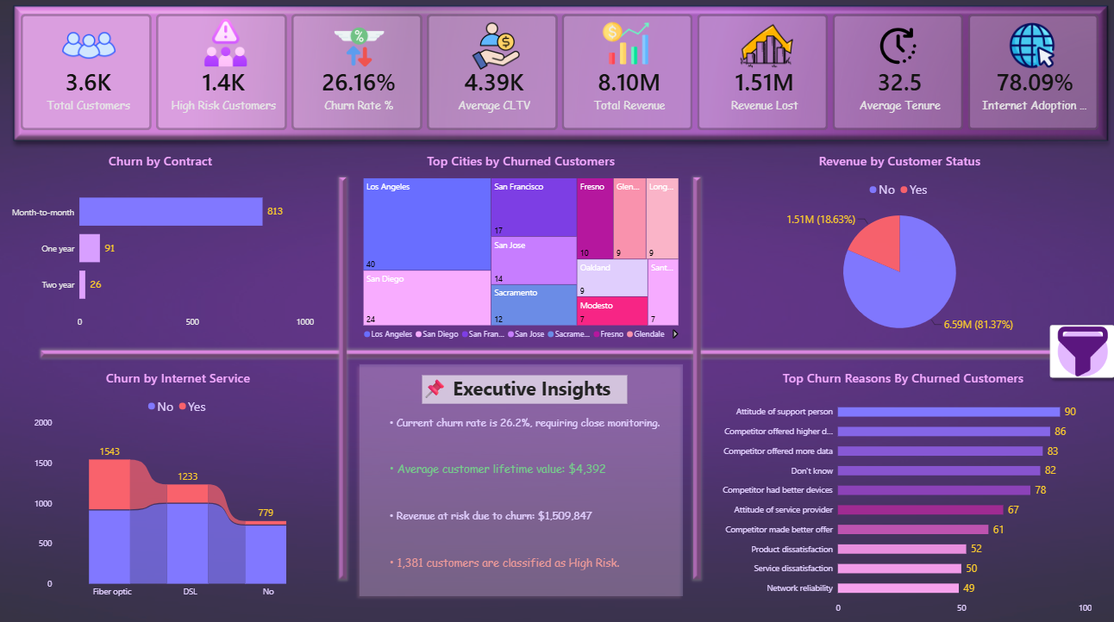
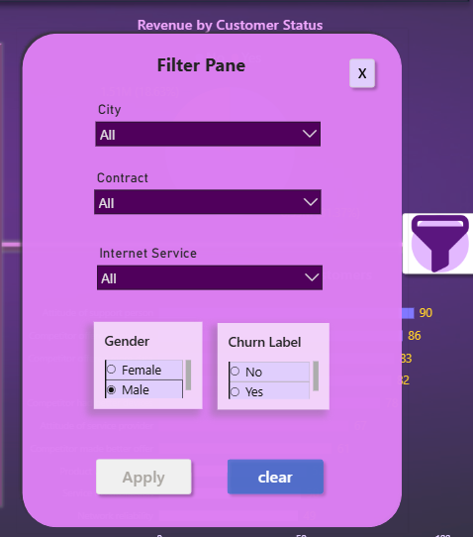
Executive Overview

Slide 4

Key Insights
Customer Retention | Financial Impact | Customer Risk | Contract Insight | Geographic Insight
The company serves approximately 7,000 customers.
The current churn rate is 26.5%, meaning nearly 1 in every 4 customers has left.
Customer churn has placed approximately $2.86M in revenue at risk.
The average Customer Lifetime Value (CLTV) is approximately $4.4K, making customer retention financially important.
Around 2.6K–2.7K customers are classified as high risk, indicating a substantial group that may churn if no action is taken.
Customers with Month-to-Month contracts account for the highest number of churn cases (1,655), suggesting contract flexibility is associated with increased churn.
Los Angeles reports the highest number of churned customers, followed by San Diego and San Francisco, highlighting opportunities for region-specific retention strategies.
Customer churn is concentrated among specific customer segments and locations, creating a measurable financial impact and requiring targeted retention efforts.

Slide 5
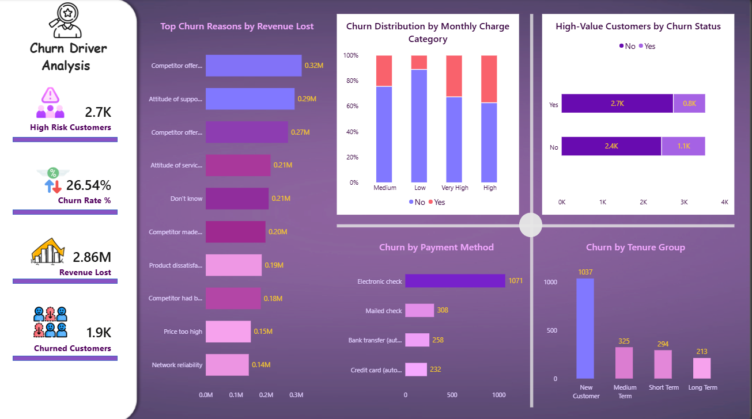
Root Cause Analysis

Slide 6




Key Findings From Churn Analysis
1
Pricing
Customers with High and Very High monthly charges exhibit the highest churn rates.
New customers experience the highest churn, indicating challenges during the onboarding and early engagement stages.
2
Customer Lifecycle
3
Payment Behaviour
Customers using Electronic Check have the highest churn compared with other payment methods.
4
High-value Customers
Even though most high-value customers are retained -
approximately 800 high-value customers have churned, representing a significant loss in future revenue potential.
Primary Churn Drivers
The largest revenue losses are driven by:
Competitor offering higher download speeds
Poor customer support interactions
Competitors offering more data

Slide 7






Key Risks & Opportunities
New Customers Churn Early
Competitor Related Churn
Enhance onboarding and first-90-day engagement
Offer personalized retention packages and review pricing
High Month-to-Month Churn
Product &Service Quality
Encourage long-term contracts through loyalty incentives
Promote AutoPay and recurring payment methods
High value Customer Churn
High Pricing Related Churn
Launch VIP retention programs –
Protects customer lifetime value
Bundle Tech Support & Online Security: bundle basic Tech Support and Online Security into the standard Fiber Optic package at no extra cost to increase perceived value.

Slide 8
Conclusion
High Risk is Concentrated, Not Random: Churn is heavily concentrated in new, uncommitted, and unassisted customers.
Friction Drives Churn: Manual payment methods (Electronic Checks) and Month-to-Month contracts create monthly friction points that invite competitor comparison.
Value is the Antidote: Bundling security, improving support staff training, and securing early-stage customer relationships are our most effective shields.

