Slide 1
Chapter 1: Introduction
Computer
Architecture and Organization

Slide 2
Learning Objectives
Know the difference bin CA & CO
Explain the general functions and structure of a digital computer.
Present an overview of the evolution of computer technology
Understand the key performance issues that relate to computer design.

Slide 3
Computer Architecture
Computer Architecture refers to those attributes of a system that have a direct impact on the logical execution of a program.
Architectural attributes are visible to the programmer
Instruction set,
Number of bits used for data representation,
I/O mechanisms, addressing techniques.

Slide 4
Computer Organization
Organization refer to how features are implemented and the operational units of the computer and their interconnections that implement the feature
Control signals,
Interfaces between computer and peripherals
The memory technology being used
So, for example, the fact that a multiply instruction is available is a computer architecture issue.
How that multiply is implemented is a computer organization issue.

Slide 5
Difference between CA & CO
Computer Architecture | Computer Organization
Higher level | Lower level (microarchitecture)
Visible and very important for programmer | Not so important for programmers
Logical components (Instruction set, Addressing modes, Data types) | Physical components (circuit design, signals, peripherals, adders)
What to do? (instruction set) | How to do? (implementation of the architecture)

Slide 6
Architecture & Organization …
All Intel x86 family share the same basic architecture
The IBM System/370 family share the same basic architecture
This means the same software can be used on different models, only the hardware changes for performance improvement.
This gives code compatibility
At least backwards

Slide 7
Structure & Function
Structure is the way in which components relate to each other
Function is the operation of individual components as part of the structure
All computer functions are:
Data processing
Data storage
Data movement
Control
Notes:
Complex parts so …….Top Down

Slide 8
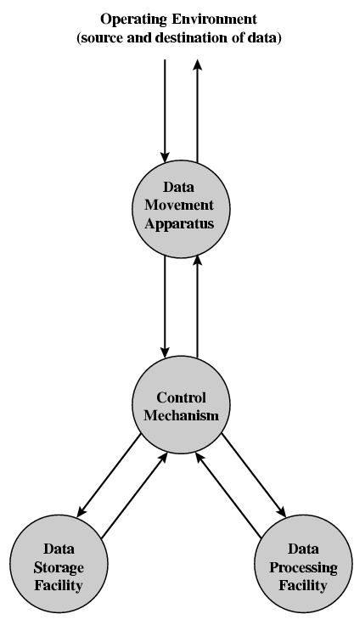
Functional View

Slide 9
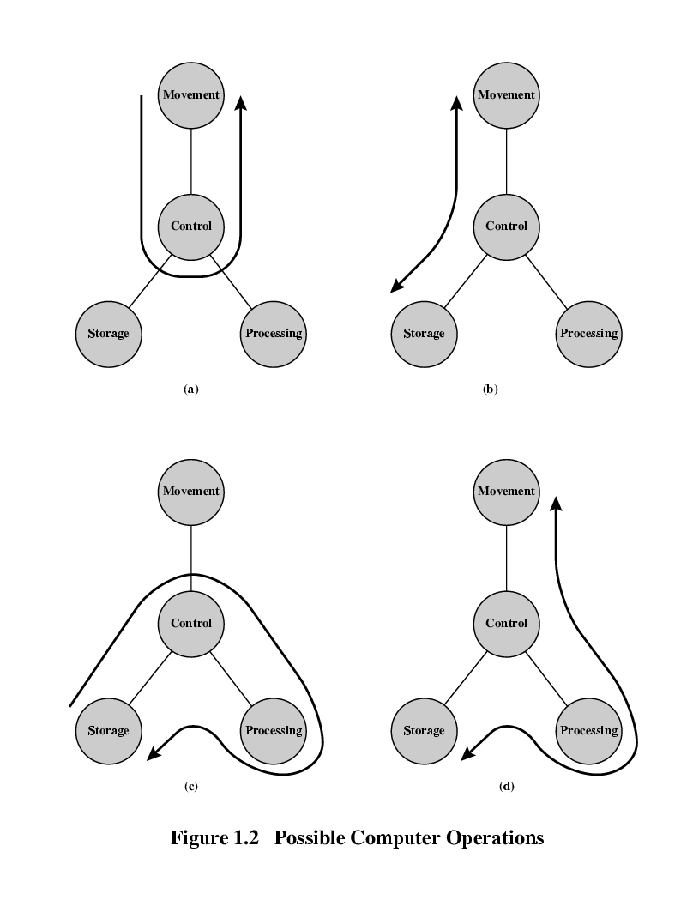
Operations (a)
Data movement
Operations (b)
Storage
Operation (c)
Processing
from/to storage
Operation (d)
Processing
from storage to I/O

Slide 10
Structure - Top Level
Peripherals
Computer
Central
Processing
Unit
Main
Memory
Computer
Systems
Interconnection
Input
Output
Communication
lines

Slide 11
Structure - The CPU
CPU
Computer
Arithmetic
and
Login Unit
I/O
Registers
System
Bus
CPU
Internal CPU
Interconnection
Memory
Control
Unit

Slide 12
Structure - The Control Unit
Control Unit
CPU
ALU
Sequencing
Logic
Internal
Bus
Control
Unit
Control Unit
Registers and
Decoders
Registers
Control
Memory

Slide 13
Evolution of a Computer
The First Generation: Vacuum Tubes
Computers used vacuum tubes for digital logic elements and memory.
Stored-program concept (John von Neumann/ Alan Turing)
The first publication of the idea was in a 1945 proposal by von Neumann for a new computer, the EDVAC (Electronic Discrete Variable Computer).
IAS (1946-1952)
a new stored-Program computer by von Neumann and his colleagues
at the Princeton Institute for Advanced Studies.
With rare exceptions, all of today’s computers have this same general structure and function

Slide 14
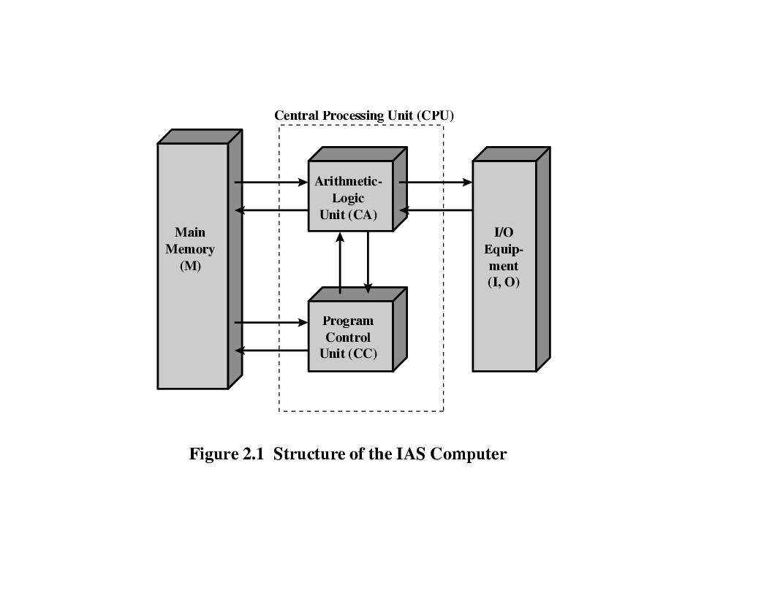
Structure of von Neumann machine
A main memory, which stores both data and instructions
An arithmetic and logic unit (ALU)capable of operating on binary data
A control unit, which interprets the instructions in memory and causes them to be executed
Input/output(I/O) equipment operated by the control unit

Slide 15
Brief Description of the IAS computer
The memory of the IAS consists of storage locations, called words, of 40 binary digits (bits) each.
Both data and instructions are stored there.
Numbers are represented in binary form, and each instruction is a binary code.

Slide 16
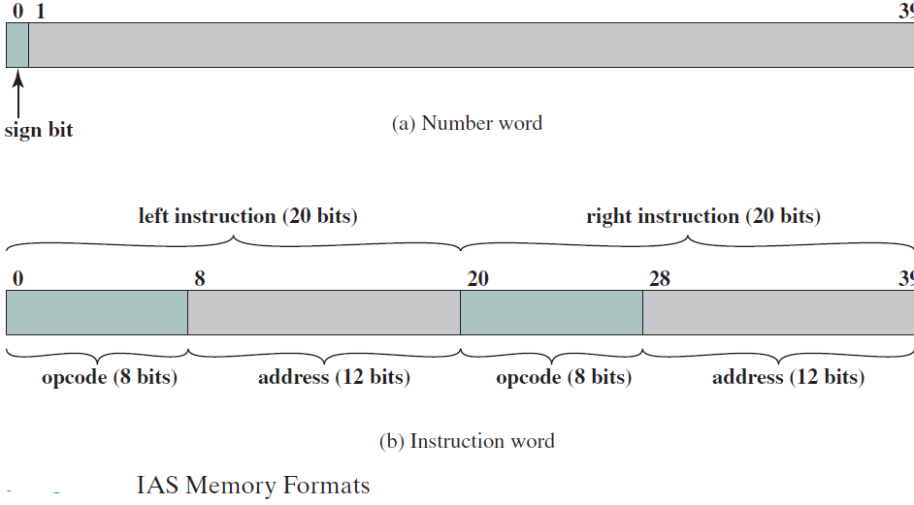
IAS Memory Format
Each number is represented by a sign bit and a 39-bit value.
A word may also contain two 20-bit instructions, with each instruction consisting of 8-bit operation code (opcode) and 12-bit address

Slide 17
IAS Main Registers
Memory buffer register (MBR):Contains a word to be stored in memory or sent to the I/O unit, or is used to receive a word from memory or from the I/O unit.
Memory address register (MAR):Specifies the address in memory of the word to be written from or read into the MBR.
Instruction register (IR):Contains the 8-bit opcode instruction being executed.
Instruction buffer register (IBR):Employed to hold temporarily the right hand instruction from a word in memory.
Program counter (PC):Contains the address of the next instruction pair to be fetched from memory.
Accumulator (AC) and multiplier quotient (MQ): Employed to hold temporarily operands and results of ALU operations. For example, the result of multiplying two 40-bit numbers is an 80-bit number; the most significant 40 bits are stored in the AC and the least significant in the MQ.

Slide 18
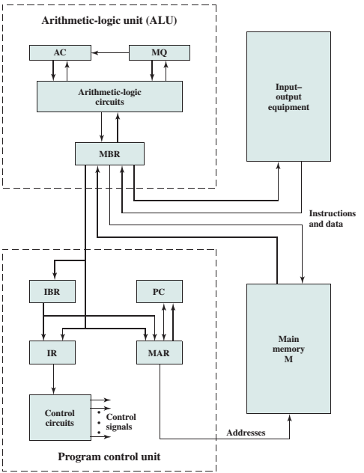
Expanded Structure of IAS Computer

Slide 19
IAS operation
Operates by repetitively performing an Instruction cycle.
Each instruction cycle consists of two subcycles. Instruction Fetch and Instruction Execute Cycle
In fetch cycle the opcode of the next instruction is loaded into the IR and the address portion is loaded into the MAR.
This instruction may be taken from the IBR or from memory by loading a word into the MBR, and then down to the IBR, IR, and MAR.
There is only one register that is used to specify the address in memory for a read or write and One register is used for the source or destination.
Once the opcode is in the IR, the execute cycle is performed.
Control circuitry interprets the opcode and executes the instruction.

Slide 20
IAS Instruction Set
The IAS computer had a total of 21 instructions, which can be grouped as follows:
Data transfer: Move data between memory and ALU registers or between two ALU registers.
Unconditional branch: Normally, the control unit executes instructions in sequence from memory. This sequence can be changed by a branch instruction, which facilitates repetitive operations.
Conditional branch: The branch can be made dependent on a condition, thus allowing decision points.
Arithmetic: Operations performed by the ALU.
Address modify: Permits addresses to be computed in the ALU and then inserted into instructions stored in memory. This allows a program considerable addressing flexibility.

Slide 21
The Second Generation : Transistors
Transistor Based Computers
More complex arithmetic and logic units and control units,
The use high-level programming languages and software provided the ability to load programs,(beginning of OSes)
Data channels:-independent I/O module with its own processor & Instruction set. -relieves the CPU of a considerable processing burden.
Multiplexor :- termination point for data channels, the CPU, and memory.
- schedules access to the memory from the CPU and data channels

Slide 22
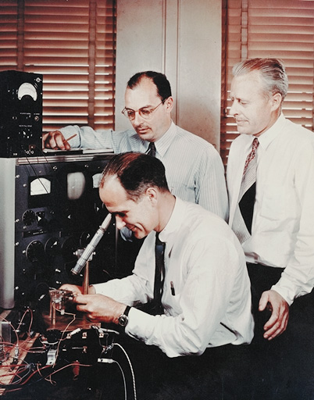

Transistors
Replaced vacuum tubes
Smaller
Cheaper
Less heat dissipation
Solid State device
Made from Silicon
Invented 1947 at Bell Labs
William Shockley et al.

Slide 23
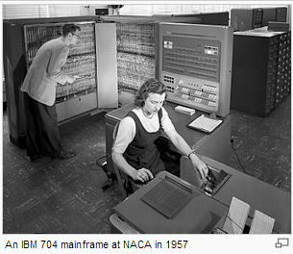
IBM
Punched-card processing equipment
1953 - the 701
IBM’s first Electronic stored program computer
Scientific calculations
1955 - the 702
Business applications
Lead to 700/7000 series

Slide 24
The Third Generation: Integrated Circuits
Microelectronic
Literally - “small electronics”
A computer is made up of gates, memory cells and interconnections
These can be manufactured on a semiconductor material. e.g. silicon wafer
Jack Kilby invented the integrated circuit at Texas Instruments in 1958 creating a transistor , resistor and capacitor from a piece of Germanium
Robert Noyce also independently invented IC

Slide 25
Moore’s Law
Gordon Moore – co-founder of Intel
Number of transistors on a chip will double every year
Since 1970’s development has slowed a little
Number of transistors doubles every 18 months
Cost of a chip has remained almost unchanged
Consequence of Moore’s Law
Higher packing density means shorter electrical paths, giving higher performance
Smaller size gives increased flexibility
Reduced power and cooling requirements
Fewer interconnections increases reliability

Slide 26
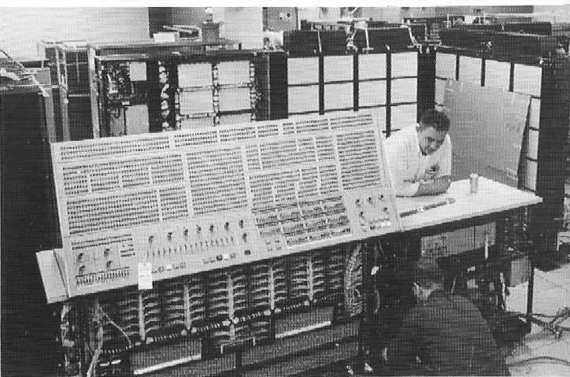
IBM 360 series
1964
Replaced (& not compatible with) 7000 series
First planned “family” of computers
Similar or identical instruction sets
Similar or identical O/S
Increasing speed
Increasing number of I/O ports (i.e. more terminals)
Increased memory size
Increased cost

Slide 27
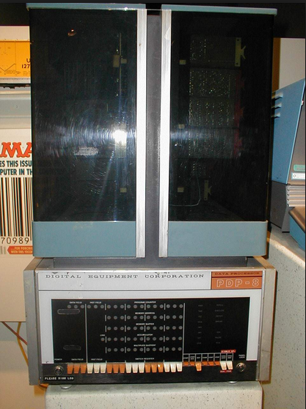
DEC PDP-8
1964
First minicomputer
(after miniskirt!)
Small enough to
sit on a lab bench
$16,000
$100k+ for IBM 360

Slide 28
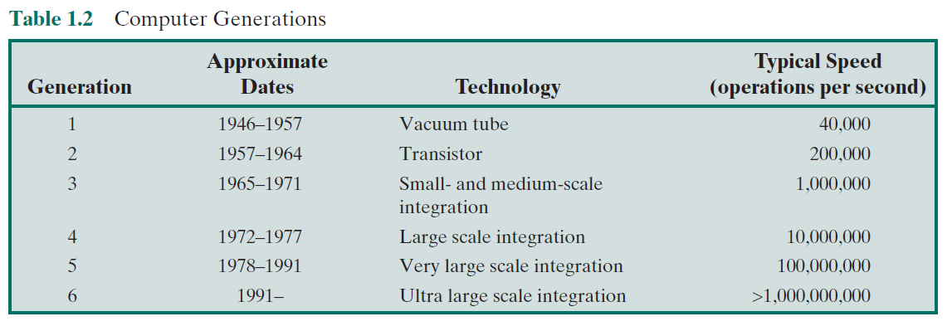
Later Generations
Beyond the third generation there is less general agreement on defining generations of computers.

Slide 29
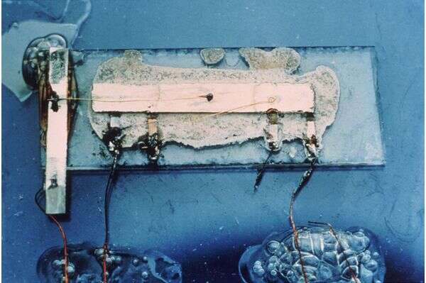
Evolution of INTEL Microprocessors
1958: First Semiconductor Integrated Circuit (IC),
Jack S. Kilby demonstrated the first working integrated circuit to managers at Texas Instruments. USA
This was the first time electronic components were integrated onto a single substrate.

Slide 30
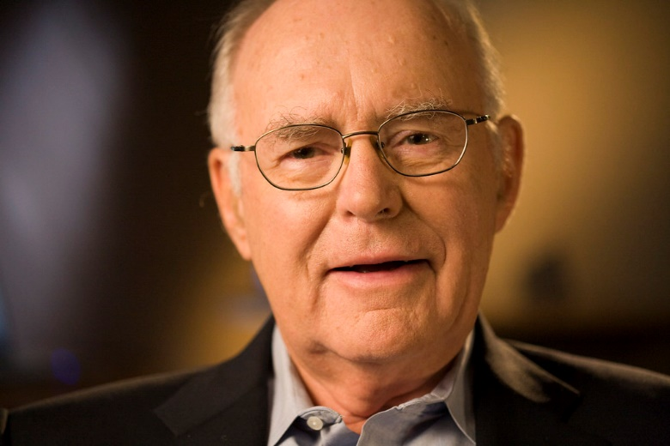
Cont…
1965: Moore’s Law
Gordon Moore, cofounder of Intel
“The number of transistors on a microchip doubles every two years, though the cost of computers is halved.”

Slide 31

Cont…
1968-1970: “Tomcat”
The World's First Microprocessor
Was designed for the US Navy F14A “TomCat” fighter jet

Slide 32
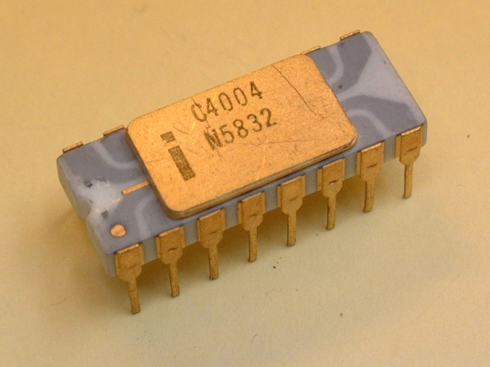
Cont…
1971: Intel 4004
The first commercially available µP
4 bit processor, made by Intel,
had 2300 transistors,
speed up to 740 KHz

Slide 33
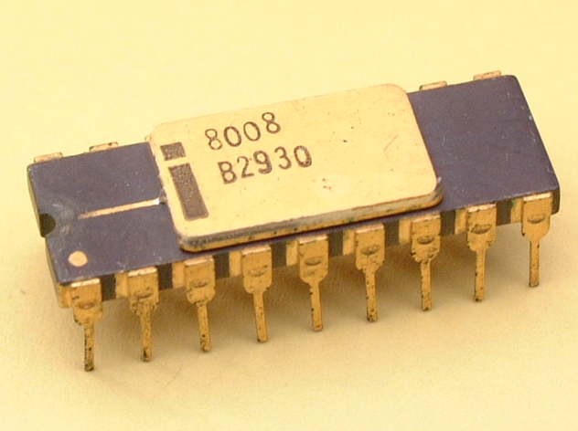
Cont…
1972: Intel 8008
8 bit processor,
14 Bit Address width
Had 3,500 Transistors
Originally designed for Datapoint Corp. as a CRT display controller

Slide 34
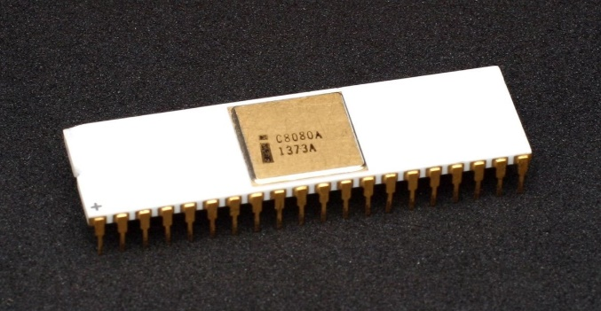
Cont…
1974: Intel 8080
8 bit processor with 16 bit address bus
Speed: 2 MHz to 3.125 MHz
6000 transistors
Apple II -- Steve Jobs and Steve Wozniak 1976, Apple inc.
Bill Gates and Allen Paul: BASIC, 1975 --> Microsoft corp

Slide 35
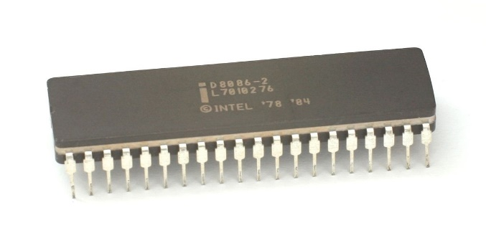
Cont…
1978: Intel 8086/8088
16 bit processor with 20 bit address bus
Speed: 5 MHz to 10 MHz
29,000 Transistors
1979: 8088 a slightly modified chip with an external 8-bit data bus
8088 (used in the IBM PC)
8086 gave rise to the x86 architecture, which eventually became Intel's most successful line of processors

Slide 36
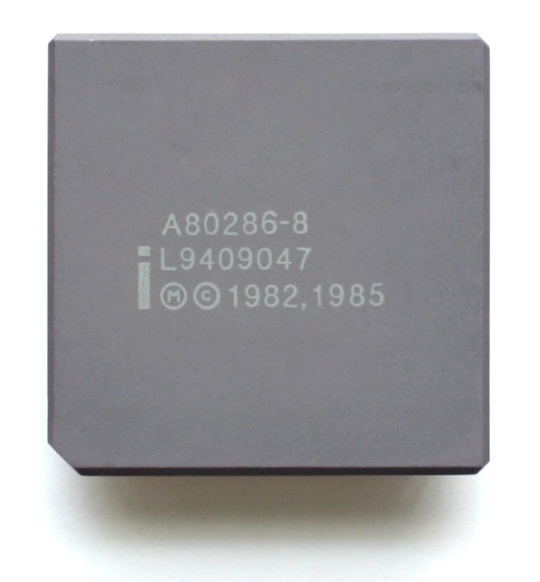
Cont…
1982: Intel 80286
16 bit processor with 24 bit address bus
Speed: 4 MHz to 25 MHz
134,000 Transistors
16 MB of physical MEM and 1 GB of virtual mem
IBM PC/AT in 1984, IBM PS/2 Model 50 and 60

Slide 37
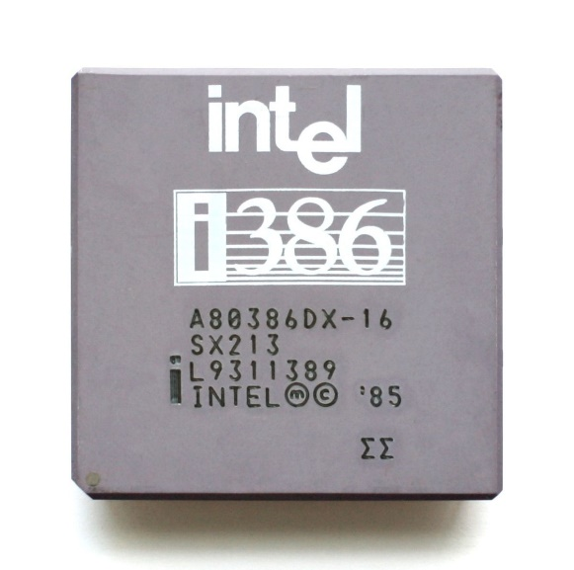
Cont…
1985: Intel 80386
32 bit processor with 32 bit address bus
Speed: 12 MHz to 40 MHz
275,000 Transistors
up to 4 GB of memory.
Memory paging and enhanced I/O permission features

Slide 38
Cont. . .
Intel 80486
Intel Pentium , Pentium II, Pentium III, Pentium 4,
Core, Core 2,
Core i3, i5, i7, i9

Slide 39
Performance Balance
Processor speed increased
Memory capacity increased
Memory speed lags behind processor speed

Slide 40
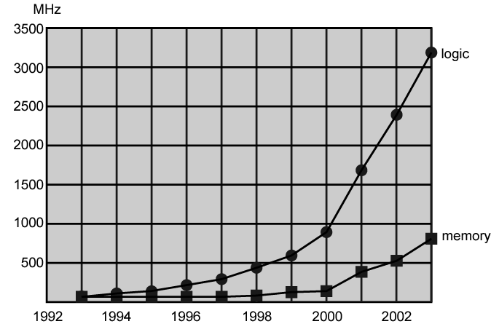
Logic and Memory Performance Gap

Slide 41
Solutions
Increase number of bits retrieved at one time
Make DRAM “wider” rather than “deeper” by using wide bus data paths
Change DRAM interface
including a cache or other buffering scheme on the DRAM chip
Reduce frequency of memory access
This includes the incorporation of one or more caches on the processor chip as well as on an off-chip cache close to the processor chip.
Increase interconnection bandwidth
High speed buses and Hierarchy of buses

Slide 42
How to increase processor speed
Increase the hardware speed of the processor.
Shrinking the size of the logic gates and packed together more tightly and increase clock rate
An increase in clock rate means that individual operations are executed more rapidly.
Increase the size and speed of caches
Dedicating a portion of the processor chip itself to the cache, cache access times drop significantly.
Make changes to the processor organization and architecture
Using parallelism (instruction pipelining and superscalar )

Slide 43
How to increase processor speed
Instruction pipelining works like assembly line
Different stages of execution of different instructions at same time along pipeline
A superscalar processor is a CPU that implements a form of parallelism called instruction-level parallelism within a single processor.
Scalar processor:- execute at most one single instruction per clock cycle,
Superscalar processor can execute more than one instruction during a clock cycle by simultaneously dispatching multiple instructions to different duplicate functional units on the processor.
Each functional unit is just an execution resource inside the CPU core, like an arithmetic logic unit (ALU), floating point unit (FPU), a bit shifter, or a multiplier.
Most superscalar CPUs are also pipelined,

Slide 44
Problems with overclocking and Logic Density
Power
Power density increases with density of logic and clock speed
Dissipating large amount of heat and controlling the heat is becoming difficult which will lead to permanent damage of transistor
RC delay
Speed at which electrons flow limited by resistance and capacitance of metal wires connecting them
Delay increases as RC product increases
Wire interconnects thinner, increasing resistance
Wires closer together, increasing capacitance
Solution:
More emphasis on other organizational and architectural approaches

Slide 45
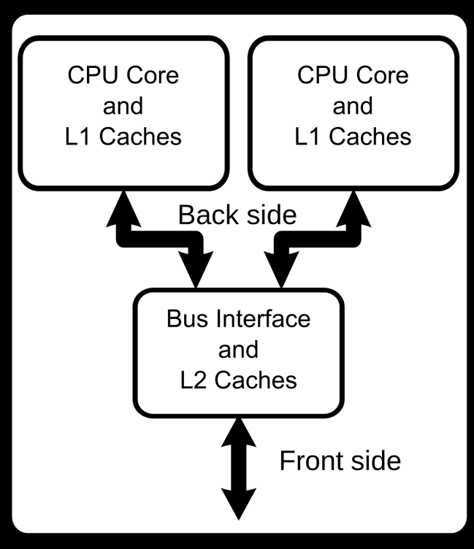
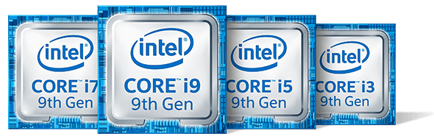
New Approach – Multiple Cores
A multi-core processor is a computer processor on a single IC with two or more separate processing units, called cores, each of which reads and executes program instructions.
Single processor can run instructions on separate cores at the same time, increasing overall speed for programs.
In particular, possible gains are limited by the fraction of the software that can run in parallel simultaneously on multiple cores

Slide 46
Part 2
Chapter 1

Slide 47
Learning Objectives
Understand the basic elements of an instruction cycle and the role of interrupts.
Describe the concept of interconnection within a computer system.

Slide 48
What we already know?
The von Neumann architecture and is based on three key concepts:
Data and instructions are stored in a single read–write memory.
The contents of this memory are addressable by location, without regard to the type of data contained there.
Execution occurs in a sequential fashion (unless explicitly modified) from one instruction to the next.
For each instructions has a unique operation code
CU accepts the Opcode decode it then issues the control signals

Slide 49
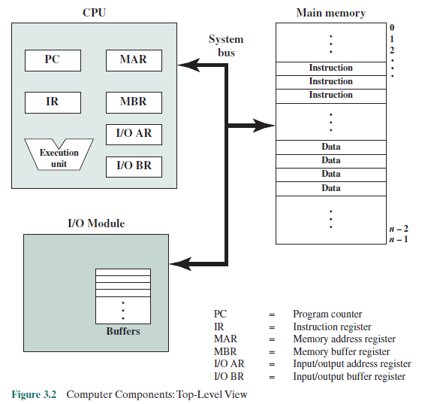

Slide 50
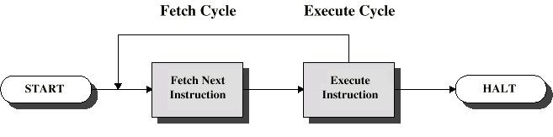
How Computer Execute instructions?
Two steps:
Fetch
Execute
The instruction execution may involve several operations and depends on the nature of the instruction
Instruction Cycle

Slide 51
instruction cycle
The processing required for a single instruction is called an instruction cycle
Fetch cycle
Program Counter (PC) holds address of next instruction to fetch
Processor fetches instruction from memory location pointed to by PC
Increment PC
Unless told otherwise
The Opcode of the Instruction loaded into Instruction Register (IR)
Execute cycle
Processor interprets instruction and performs required actions

Slide 52
Cont…
In general, these actions fall into four categories
Processor-memory
data transfer between CPU and main memory
Processor I/O
Data transfer between CPU and I/O module
Data processing
Some arithmetic or logical operation on data
Control
Alteration of sequence of operations
e.g. jump
Combination of above

Slide 53
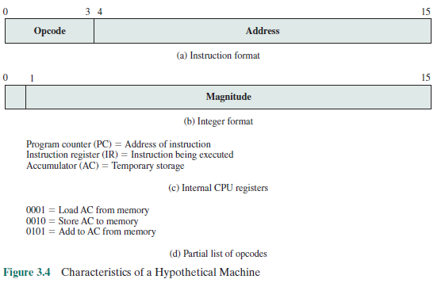
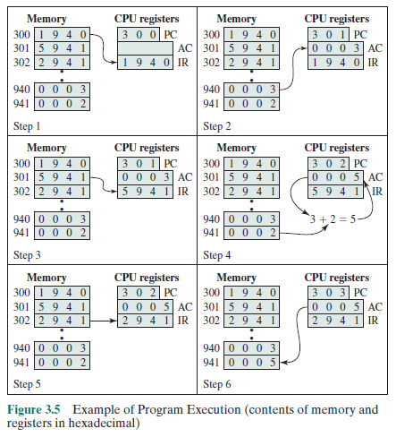
Example for a Simple hypothetical Machine

Slide 55
Cont…
Some older processors, included instructions that contain more than one memory address in a single instructions
Thus, the execution cycle for a particular instruction on such processors could involve more than one reference to memory.
For example, the PDP-11 processor ADD B,A instruction
Also, instead of memory references, an instruction may specify an I/O operation.
With these additional considerations in mind, Instruction cycle state diagram provides a more detailed look at the basic instruction cycle
For any given instruction cycle, some states may be null and others may be visited more than once.

Slide 56
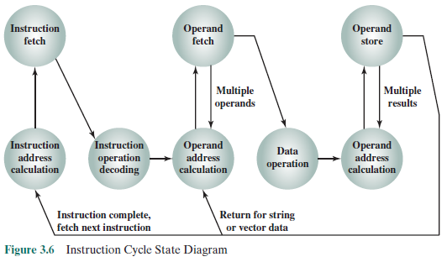
PDP-11 instruction ADD A,B results in the following sequence of states:
iac, if, iod, oac, of, oac, of, do, oac, os.
Notes:
States in the upper part of Figure 3.6 involve an exchange between the processor
and either memory or an I/O module. States in the lower part of the diagram
involve only internal processor operations.

Slide 57
Interrupts
A mechanism to improve the efficiency of processing
Mechanism by which other modules (e.g. I/O) may interrupt normal sequence of processing
Program
e.g. overflow, division by zero
Timer
Generated by internal processor timer
Used in pre-emptive multi-tasking
I/O
from I/O controller
Hardware failure
e.g. memory parity error

Slide 58
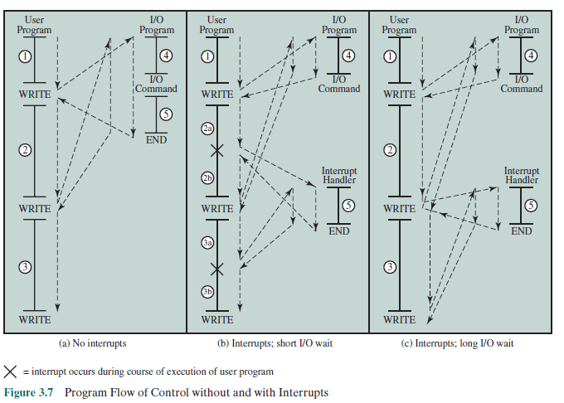
Interrupts are provided primarily as a way to improve processing efficiency.

Slide 59
Interrupt Cycle
Added to instruction cycle to accommodate interrupts
Processor checks for interrupt
Indicated by an interrupt signal
If no interrupt, fetch next instruction
If interrupt pending:
Suspend execution of current program
Save context
Set PC to start address of interrupt handler routine
Process interrupt
Restore context and continue interrupted program

Slide 60
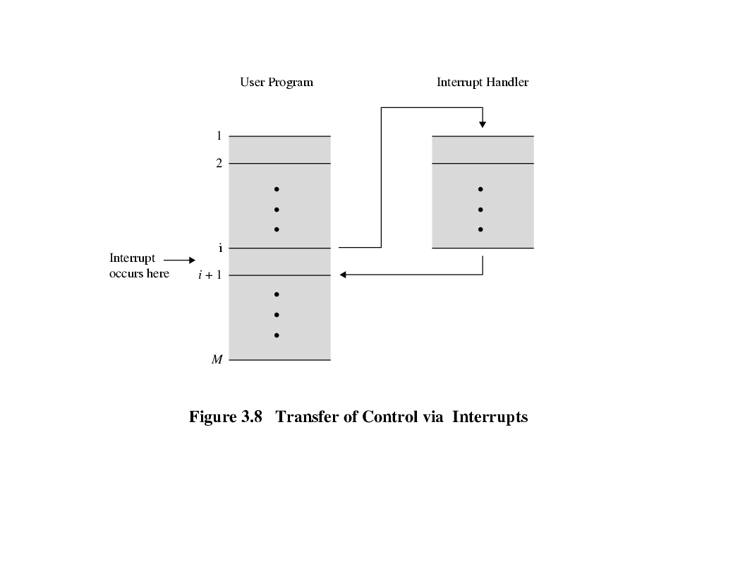
Transfer of Control via Interrupts

Slide 61
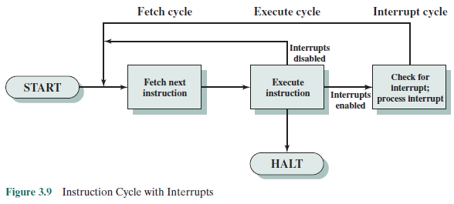

Slide 62
Multiple Interrupts
Two approaches
A disabled interrupt
Simply means that the processor can and will ignore that interrupt request signal. If an interrupt occurs during this time, it generally remains pending and will be checked by the processor after the processor has enabled interrupts.
The drawback to the preceding approach is that it does not take into account relative priority or time-critical needs.
A second approach is to define priorities for interrupts and to allow an interrupt of higher priority to cause a lower-priority interrupt handler to be itself interrupted

Slide 63
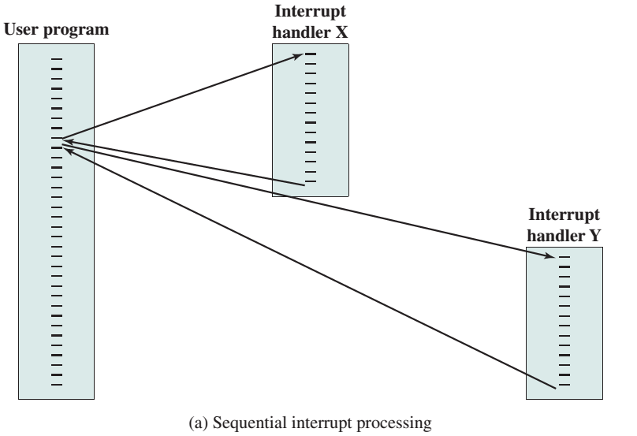

Slide 64
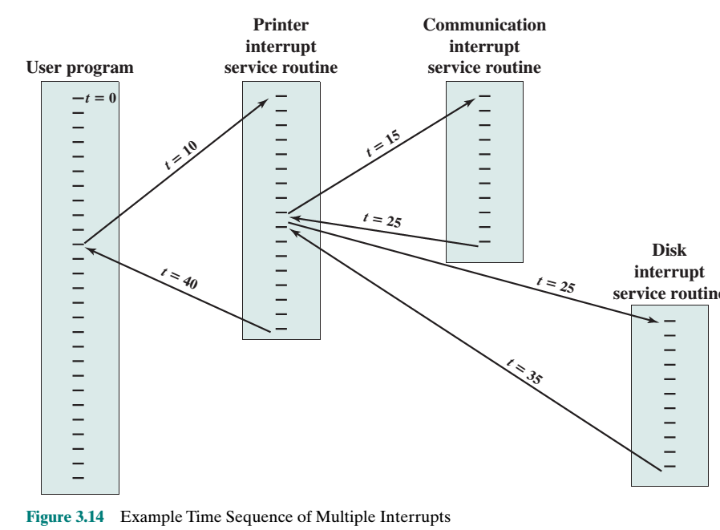
Communication Priority > Disk Priority > Printer Priority

Slide 65
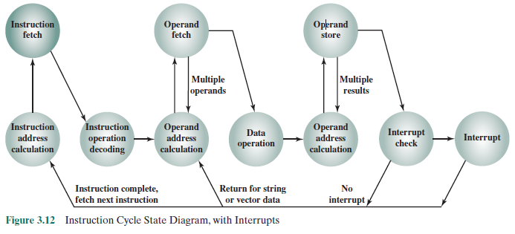
Instruction Cycle State Diagram, with Interrupts

Slide 66
Interconnection Structures
A computer consists of a set of components or modules of three basic types (processor, memory, I/O) that communicate with each other.
The collection of paths connecting the various modules is called the interconnection structure.
The design of this structure will depend on the exchanges that must be made among modules.

Slide 67
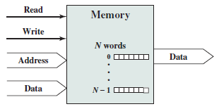
Memory
Typically, a memory module will consist of N words of equal length.
Each word is assigned a unique numerical address (0, 1, .., N-1).
A word of data can be read from or written into the memory.
The nature of the operation is indicated by read and write control signals.
The location for the operation is specified by an address.

Slide 68
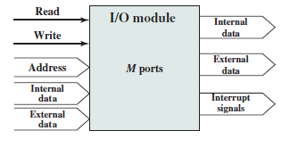
I/O module
There are two operations; read and write.
Further, an I/O module may control more than one external device. We can refer to each of the interfaces to an external device as a port as a unique address (e.g., 0, 1, c, M-1).
In addition, there are external data paths for the input and output of data with an external device.
Finally, an I/O module may be able to send interrupt signals to the processor.

Slide 69
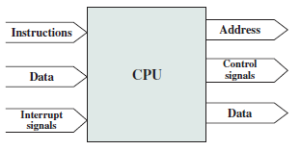
Processor
The processor reads in instructions and data, writes out data after processing, and uses control signals to control the overall operation of the system.
It also receives interrupt signals

Slide 70
Bus Interconnection
Bus is a shared communication pathway connecting two or more devices
Usually broadcast
Often grouped
A number of channels in one bus
e.g. 32 bit data bus is 32 separate single bit channels
Only one device at a time can successfully transmit
Power lines may not be shown
Computer systems contain a number of different buses
A bus that connects major computer components (processor, memory, I/O) is called a system bus.
Bus lines can be classified into three functional groups: data, address, and control lines.

Slide 71
Data bus
The data lines (Data Bus) provide a path for moving data among system modules.
The width of the data bus may consist of 32, 64, 128, or even more separate lines.
The number of lines determines how many bits can be transferred at a time.
The width of the data bus is a key factor in determining overall system performance.
For example, if the data bus is 32 bits wide and each instruction is 64 bits long, then the processor must access the memory module twice during each instruction cycle.

Slide 72
address BUS
The address lines are used to designate the source or destination of the data on the data bus.
For example, if the processor wishes to read a word (8, 16, or 32 bits) of data from memory, it puts the address of the desired word on the address lines.
The width of the address bus determines the maximum possible memory capacity of the system
Furthermore, the address lines are generally also used to address I/O ports.
Typically, the higher-order bits are used to select a particular module on the bus, and the lower-order bits select a memory location or I/O port within the module.
For example, on an 8-bit address bus, address 01111111 and below might reference locations in a memory module (module 0) with 128 words of memory, and address 10000000 and above refer to devices attached to an I/O module (module 1).

Slide 73
Control Bus
The control lines are used to control the access to and the use of the data and address lines.
Because the data and address lines are shared by all components, there must be a means of controlling their use.
Control signals transmit both command and timing information among system modules.
Timing signals indicate the validity of data and address information.
Command signals specify operations to be performed

Slide 74
Typical control lines
Memory write: causes data on the bus to be written into the addressed location
Memory read: causes data from the addressed location to be placed on the bus
I/O write: causes data on the bus to be output to the addressed I/O port
I/O read: causes data from the addressed I/O port to be placed on the bus
Transfer ACK: indicates that data have been accepted from or placed on the bus
Bus request: indicates that a module needs to gain control of the bus
Bus grant: indicates that a requesting module has been granted control of the bus
Interrupt request: indicates that an interrupt is pending
Interrupt ACK: acknowledges that the pending interrupt has been recognized
Clock: is used to synchronize operations
Reset: initializes all modules.

Slide 75
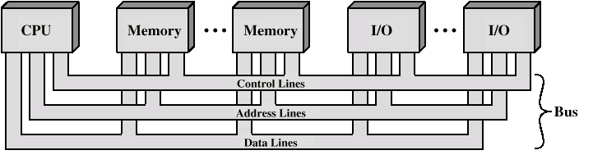
Bus Interconnection Scheme

Slide 76
Single Bus Problems
Lots of devices on one bus leads to:
Propagation delays
Long data paths mean that co-ordination of bus use can adversely affect performance
Most systems use multiple buses to overcome these problems

Slide 77
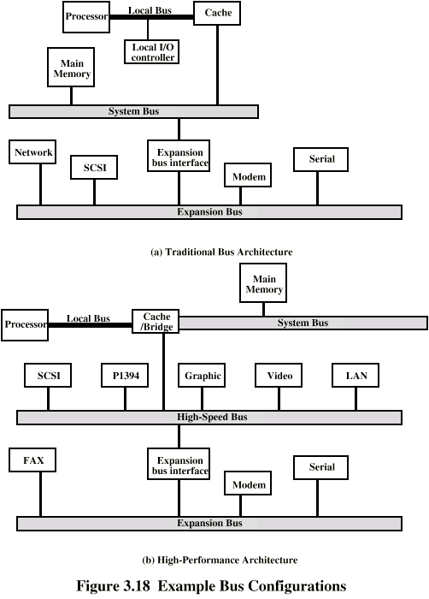
Traditional (ISA) (with cache)

Slide 78
High Performance Bus

Slide 79
Bus Types
Dedicated
Separate data & address control lines
Multiplexed
Shared lines
Time multiplexed
Advantage - fewer lines
Disadvantages
More complex control
Reduction performance

Slide 80
Bus Arbitration
Centralized
Single hardware device controlling bus access
Bus Controller
Arbiter
May be part of CPU or separate
Distributed
Each module may claim the bus
Control logic on all modules

