Slide 1

Chapter Four Requirements Analysis

Slide 2
Topics to be covered
Requirements Classification Conceptual Modeling Architectural Design & Requirements Allocation Requirements Negotiation Formal Analysis

Slide 3
Requirements analysis
The fundamental process of analyzing requirements to:
detect and resolve conflicts between requirements;
discover the bounds of the software and how it must interact with its organizational and operational environment;
elaborate system requirements to derive software requirements.

Slide 4
Requirements classification
Requirements can be classified on a number of dimensions. Examples include the following:
Whether the requirement is functional or non functional
Whether the requirement is derived from one or more high-level requirements or an emergent property or is being imposed directly on the software by a stakeholder or some other source.
Whether the requirement is on the product or the process.

Slide 5
Cont’d…
The requirement priority. The higher the priority, the more essential the requirement is for meeting the overall goals of the software.
Often classified on a fixed-point scale such as mandatory, highly desirable, desirable, or optional,
the priority often has to be balanced against the cost of development and implementation.

Slide 6
Cont’d…
The scope of the requirement. Scope refers to the extent to which a requirement affects the software and software components.
global scope may strongly affect the software architecture and the design of many components,
whereas one with a narrow scope may offer a number of design choices and have little impact on the satisfaction of other requirements.

Slide 7
Cont’d…
Volatility/stability. Some requirements will change during the life cycle of the software - and even during the development process itself.
It is useful if some estimate of the likelihood that a requirement will change can be made.
For example, changing of government legislation (even during your software development process)

Slide 8
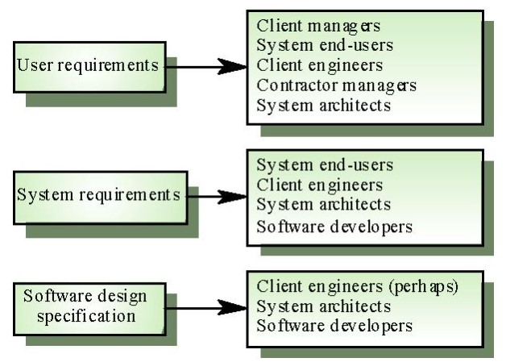
Cont’d…

Slide 9
Conceptual modeling
The development of models of a real-world problem is key to software requirements analysis.
Their purpose is to aid in understanding the situation in which the problem occurs, as well as depicting a solution.
Hence, conceptual models comprise models of entities from the problem domain, configured to reflect their real-world relationships and dependencies.

Slide 10
Cont’d…
Several kinds of models can be developed. These include
use case diagrams,
data flow models,
state models,
goal-based models,
user interactions,
object models,
data models, and many others.
Many of these modeling notations are part of the Unified Modeling Language (UML).

Slide 11
Cont’d…
The factors that influence the choice of model include
The nature of the problem. Some types of software demand that certain aspects be analysed particularly rigorously. For example, control flow and state models are likely to be more important for real-time software than for management information software, while it would usually be the opposite for data models.
The expertise of the software engineer. It is often more productive to adopt a modeling notation or method with which the software engineer has experience.

Slide 12
Cont’d…
The process requirements of the customer. Customers may impose their favoured notation or method, or prohibit any with which they are unfamiliar. This factor can conflict with the previous factor.
The availability of methods and tools. Notations or methods which are poorly supported by training and tools may not achieve widespread acceptance even if they are suited to particular types of problems.

Slide 13
Cont’d…
Note that, in almost all cases, it is useful to start by building a model of the software context.
The software context provides a connection between the intended software and its external environment.
This is crucial to understanding the software's context in its operational environment and to identifying its interfaces with the environment.

Slide 14
Architectural Design & Requirements Allocation
Architectural design is the point at which the requirements process overlaps with software or systems design and illustrates how impossible it is to cleanly decouple the two tasks.
In many cases, the software engineer acts as software architect because the process of analysing and elaborating the requirements demands that the architecture/design components that will be responsible for satisfying the requirements be identified.

Slide 15
Cont’d…
This is requirements allocation–the assignment to architecture components responsible for satisfying the requirements.
Allocation is important to permit detailed analysis of requirements.
for example, once a set of requirements has been allocated to a component, the individual requirements can be further analysed to discover further requirements on how the component needs to interact with other components in order to satisfy the allocated requirements.

Slide 16
Cont’d…
In large projects, allocation stimulates a new round of analysis for each subsystem.
Architectural design is closely identified with conceptual modeling. The mapping from real-world domain entities to software components is not always obvious, so architectural design is identified as a separate topic. The requirements of notations and methods are broadly the same for both conceptual modeling and architectural design.

Slide 17
Requirements Negotiation
Another term commonly used for this sub-topic is "conflict resolution".
This concerns resolving problems with requirements where conflicts occur between two stakeholders requiring mutually incompatible features, between requirements and resources, or between functional and non-functional requirements.

Slide 18
Cont’d…
In most cases, it is unwise for the software engineer to make a unilateral decision, and so it becomes necessary to consult with the stakeholder(s) to reach a consensus on an appropriate trade-off.
It is often important for contractual reasons that such decisions be traceable back to the customer.

Slide 19
Requirements prioritization
Requirements prioritization is necessary, not only as a means to filter important requirements, but also in order to resolve conflicts and plan for staged deliveries, which means making complex decisions that require detailed domain knowledge and good estimation skills.
Another requirements prioritization approach called the analytic hierarchy process involves comparing all unique pairs of requirements to determine which of the two is of higher priority, and to what extent.

Slide 20
Formal Analysis
Formal analysis has made an impact on some application domains, particularly those of high integrity systems.
The formal expression of requirements requires a language with formally defined semantics.
The use of a formal analysis for requirements expression has two benefits.

Slide 21
Cont’d…
First, it enables requirements expressed in the language to be specified precisely and unambiguously, thus (in principle) avoiding the potential for misinterpretation.
Secondly, requirements can be reasoned over, permitting desired properties of the specified software to be proven.

Slide 22
Cont’d…
Formal reasoning requires tool support to be practicable for anything other than trivial systems.
Tools generally fall into two types: theorem proverbs or model checkers.
In neither case can proof be fully automated, and the level of competence in formal reasoning needed in order to use the tools restricts the wider application of formal analysis.

Slide 23
Reading Assignment – Quiz
Chapter IV: Requirements Analysis | Sommerville - 2011 | Wiegers – 2003
4.1. Requirements Classification | Chapter 4 – section 1 Chapter 4 – section 5 Chapter 10 – section 4 Chapter 12 – section 5 | Chapter 7 Chapter 11 Chapter 12 Chapter 17
4.2. Conceptual Modeling
4.3. Architectural Design and Requirements Allocation
4.4. Requirements Negotiation
4.5. Formal Analysis

Slide 24
END OF CHAPTER FOUR

