Slide 1



SIGKDD 2025 AI Agent for Information Retrieval (Agent4IR)
W. Seo, H. An, S. Lee
A New Query Expansion Approach for Enhancing Information Retrieval via Agent-Mediated Dialogic Inquiry
Wonduk Seo^{1,2} Hyunjin An¹ Seunghyun Lee^{1*}
¹Enhans, Seoul, South Korea
²Peking University, Beijing, China
* Denotes Corresponding Author; Speaker: Wonduk Seo

Slide 2
A New Query Expansion Approach for Enhancing Information Retrieval via Agent-Mediated Dialogic Inquiry
W. Seo, H. An, S. Lee
1. Introduction and Motivation
Importance of Query Expansion:
Improves Information Retrieval (IR) by enriching user queries.
Current Challenges:
1. Homogeneous and narrow expansions.
2. Lack of contextual diversity.
3. Inability to fully capture nuanced user intent.
Goal: Develop sophisticated, intent-aligned query expansions.
Notes:
Query expansion is essential for improving Information Retrieval (IR) by enriching user queries with additional context. However, existing methods face challenges, such as generating homogeneous and narrow expansions, lacking diversity, and missing nuanced user intents. Thus, there is a clear need for a more sophisticated approach capable of generating richer, more diverse query representations aligned with user intent.

Slide 3
SIGKDD 2025 AI Agent for Information Retrieval (Agent4IR)
W. Seo, H. An, S. Lee
2. Limitations of Existing Methods
Traditional Methods (e.g., PRF)
Rely heavily on static term selection.
Limited ability to capture nuanced intents.
Recent LLM-based Approaches
Often produce redundant or overly narrow expansions.
Lack of dynamic mechanisms to filter irrelevant expansions.
Fail to adequately address complex, diverse information needs.
Notes:
Traditional query expansion methods like Pseudo-Relevance Feedback (PRF) rely heavily on static term selection, limiting their ability to capture diverse user intents. Also, recent Large Language Model (LLM)-based methods, though dynamic, often produce redundant and narrowly scoped expansions due to simplistic prompting and the absence of dynamic feedback mechanisms, thereby inadequately addressing complex information needs.

Slide 4
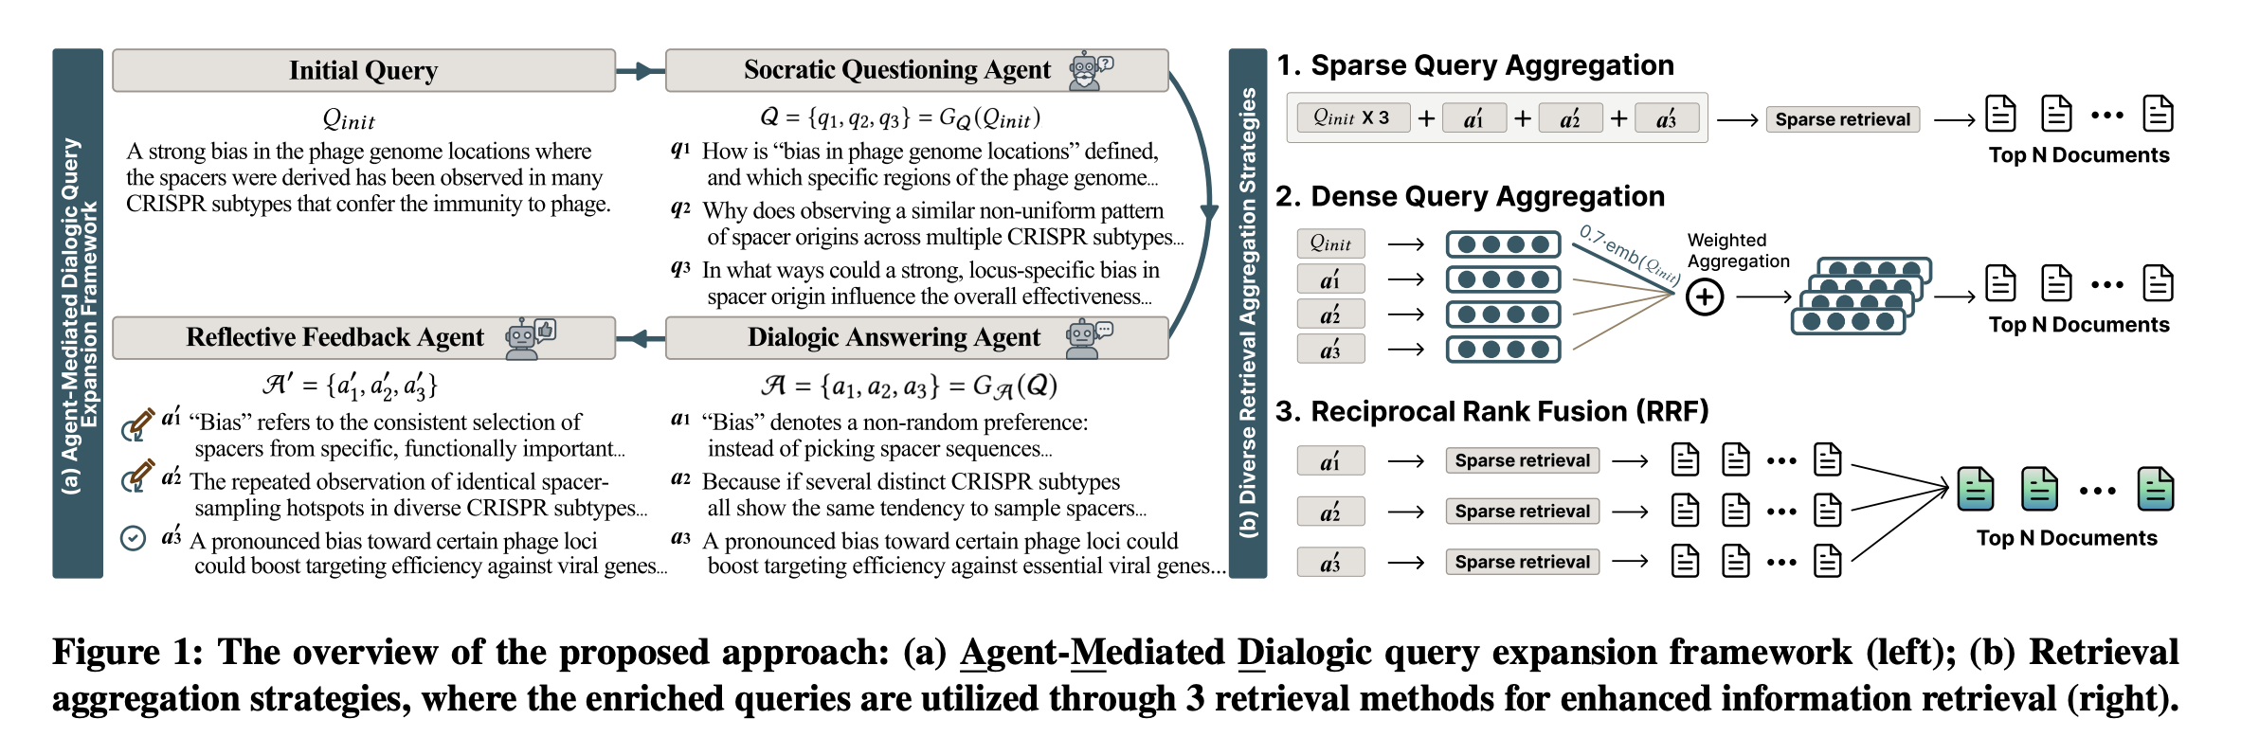
A New Query Expansion Approach for Enhancing Information Retrieval via Agent-Mediated Dialogic Inquiry
W. Seo, H. An, S. Lee
3. Proposed Framework - AMD
Multi-agent dialogic approach
Socratic Questioning Agent.
Dialogic Answering Agent.
Reflective Feedback Agent.
Key Advantages
Promotes diverse, multi-faceted expansions.
Enhances alignment with complex user intents.
Notes:
To address these limitations, we introduce AMD, an innovative Agent-Mediated Dialogic framework leveraging a multi-agent approach. Our method involves three distinct agents: a Socratic Questioning Agent, a Dialogic Answering Agent, and a Reflective Feedback Agent. This structured dialogic interaction ensures diverse and comprehensive query expansions that effectively reformulate a given query to capture complex user intents.

Slide 5
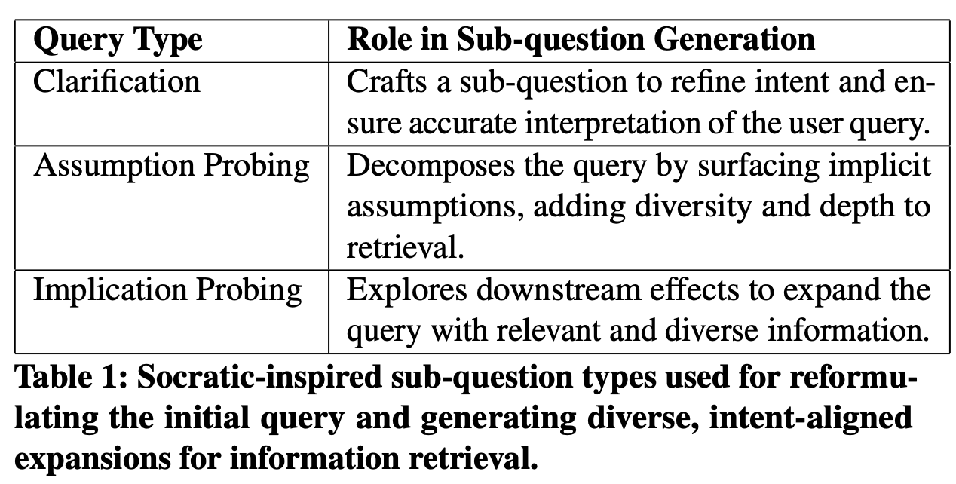

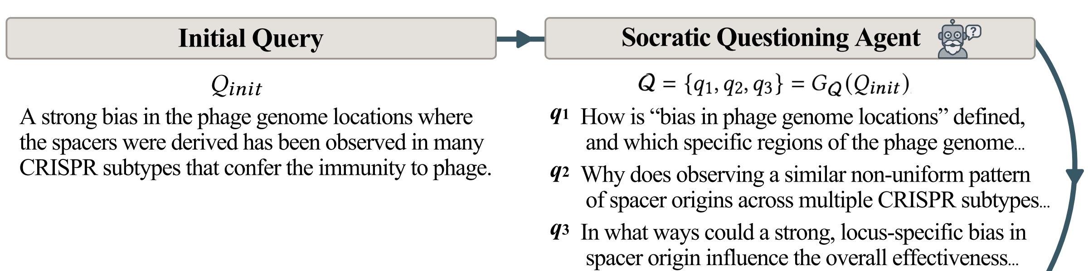
SIGKDD 2025 AI Agent for Information Retrieval (Agent4IR)
W. Seo, H. An, S. Lee
4.1. Methodology – Socratic Questioning Agent
Purpose
Reformulate initial queries into diverse, targeted sub-questions.
Socratic Dimensions Utilized
(1) Clarification, (2) Assumption Probing, and (3) Implication Probing
Notes:
Firstly, prior studies have shown that structured Socratic questioning leads to more interpretable reasoning by prompting models to consider alternative perspectives, key concepts, and construct solutions. Motivated by these findings, we employ a Socratic Questioning Agent to reformulate the user’s information need into 3 diverse and targeted sub-questions, each aligned with specific Socratic questioning dimensions such as (1) clarification, (2) assumption probing, and (3) implication probing. This targeted questioning strategy enriches query representation and helps surface implicit user intentions, enhancing diversity and depth.

Slide 6

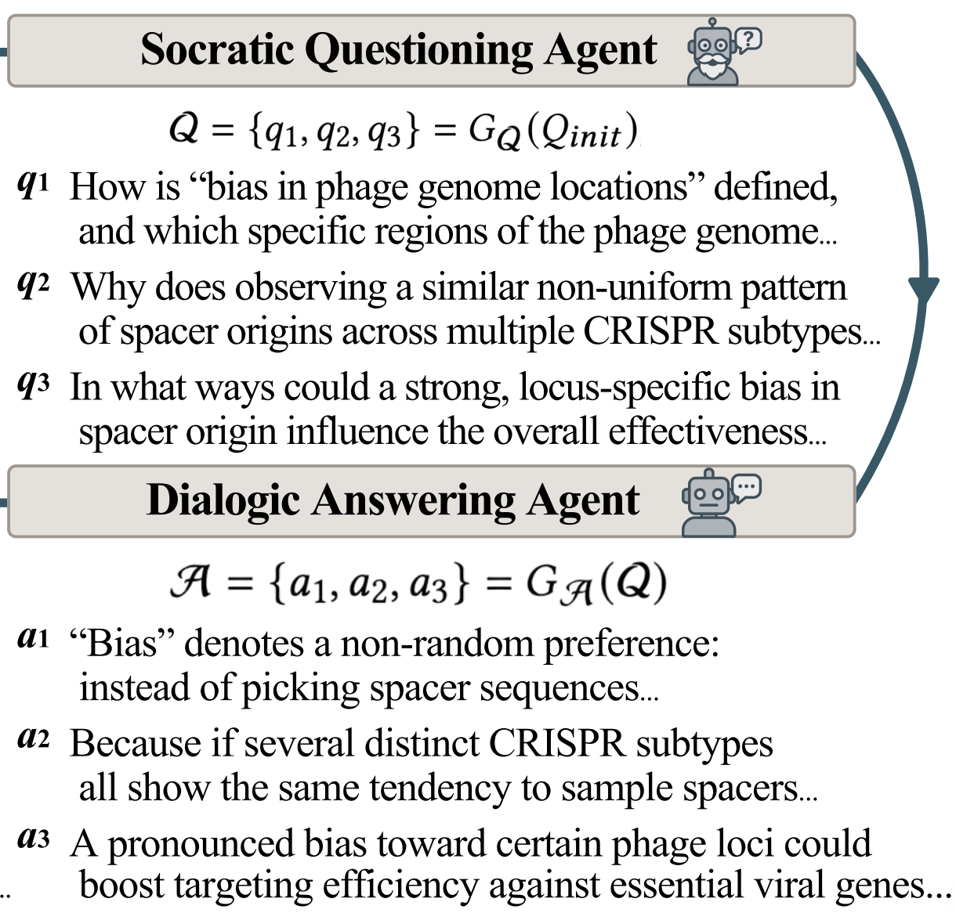
A New Query Expansion Approach for Enhancing Information Retrieval via Agent-Mediated Dialogic Inquiry
W. Seo, H. An, S. Lee
4.2. Methodology – Dialogic Answering Agent
Purpose
Generate informative pseudo-answers to each sub-question.
Characteristics of Generated Answers
Multi-perspective and intent-aligned. 2. Serve as surrogate documents providing diverse context.
Notes:
Following the generation of sub-questions, the Dialogic Answering Agent produces pseudo-answers to these sub-questions, creating surrogate knowledge units. These pseudo-answers reflect multiple perspectives aligned with user intent, thereby significantly enriching the initial query representation with diverse and meaningful content.

Slide 7

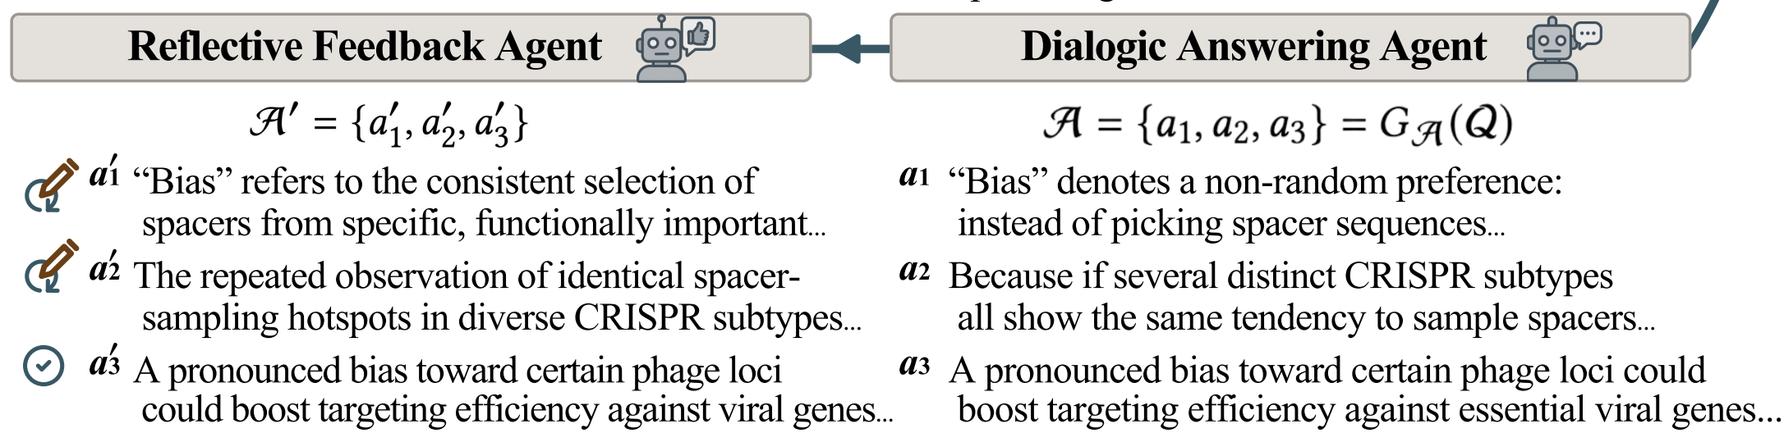
SIGKDD 2025 AI Agent for Information Retrieval (Agent4IR)
W. Seo, H. An, S. Lee
4.3. Methodology – Reflective Feedback Agent
Purpose
Critically evaluates and refines pseudo-answers.
Filtering Process
(1) Identifies and removes irrelevant or redundant content. (2) Ensures retention of only the most informative expansions.
Notes:
Finally, the Reflective Feedback Agent critically assesses and refines these pseudo-answers by filtering out irrelevant or redundant content. This dynamic feedback mechanism ensures that only the most informative and intent-aligned expansions are retained, resulting in highly refined query augmentations.

Slide 8
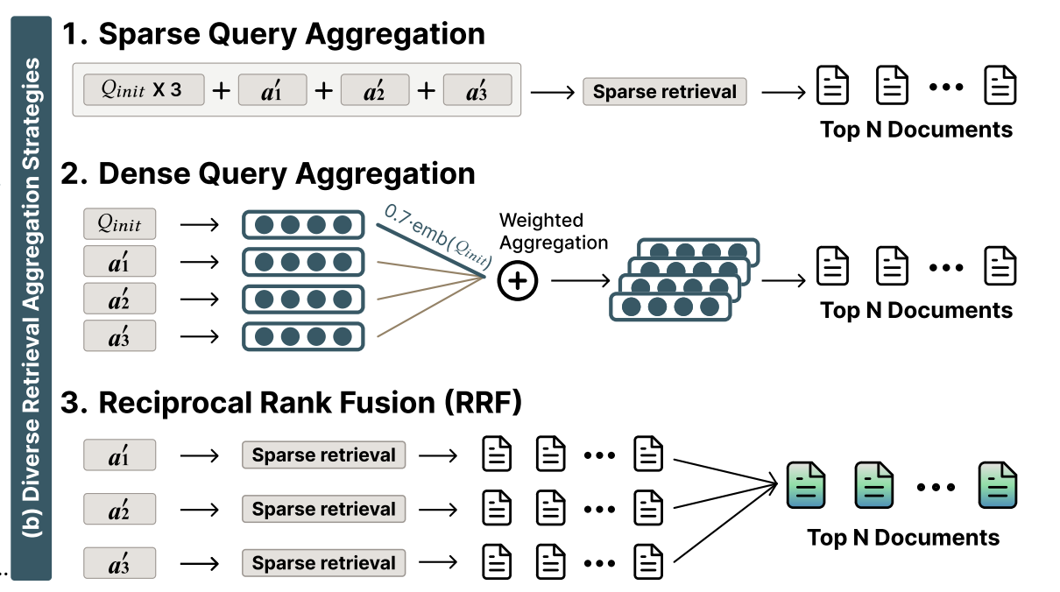
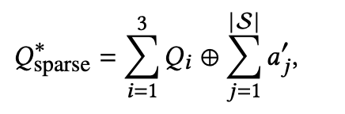
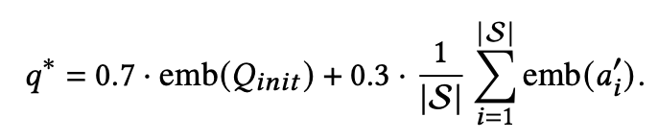
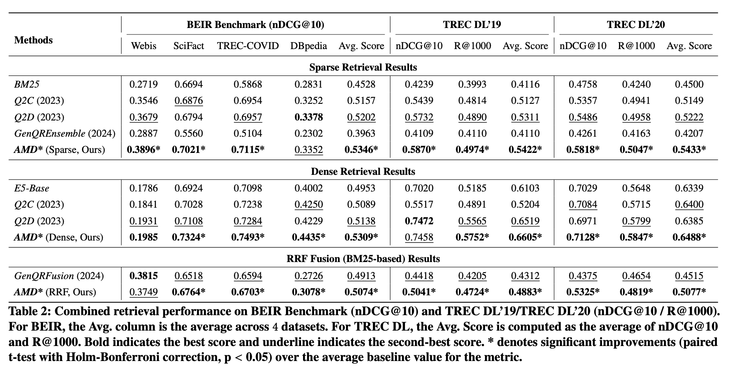
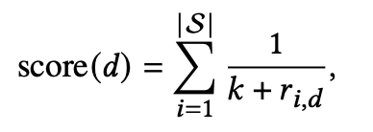
A New Query Expansion Approach for Enhancing Information Retrieval via Agent-Mediated Dialogic Inquiry
W. Seo, H. An, S. Lee
5. Experimental Evaluation
Evaluated on established benchmarks: BEIR and TREC datasets.
Observed Results
Consistent and significant performance improvements.
Effective across diverse retrieval strategies (sparse, dense, and fusion-based).
Validates robustness and effectiveness of AMD framework.
Notes:
We evaluated our AMD framework extensively across benchmarks, including 4 BEIR and 2 TREC datasets. Our experiments demonstrated consistent and significant improvements over in retrieval performance compared to existing query expansion method including Query2Doc, Query2CoT, GenQREnsemble and GenQRFusion. Our framework specifically achieved overall superior performance in sparse retrieval, dense retrieval, and Reciprocal Rank Fusion scenarios, validating the robustness and effectiveness of our approach.

Slide 9
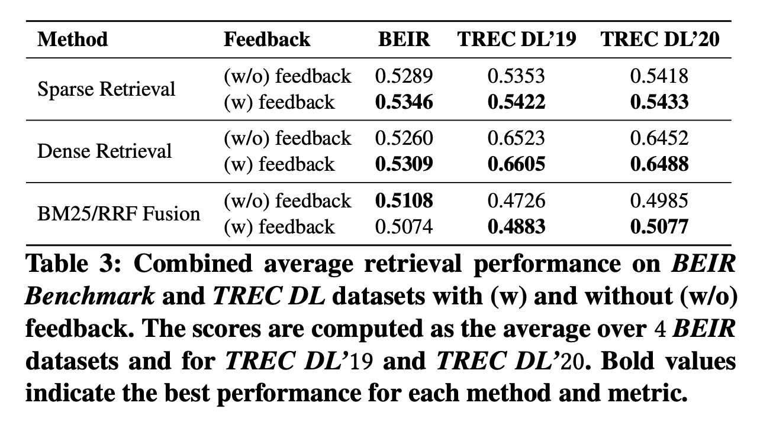
SIGKDD 2025 AI Agent for Information Retrieval (Agent4IR)
W. Seo, H. An, S. Lee
6. Experiment - Ablation Study
Compared the retrieval performance of the full AMD framework against a variant without the feedback agent.
Notes:
To assess the effectiveness of the Reflective Feedback Agent, an ablation study was conducted on the BEIR Benchmark and TREC datasets. Table in the slide compares the retrieval performance of the full AMD framework against a variant without the feedback agent. The results indicate that incorporating the Reflective Feedback Agent improves the overall average score.

Slide 10
A New Query Expansion Approach for Enhancing Information Retrieval via Agent-Mediated Dialogic Inquiry
W. Seo, H. An, S. Lee
7. Conclusions and Future Work
Summary
Successfully demonstrated effectiveness of the AMD framework.
Future Directions
Fine-tuning Reflective Feedback Agent for increased precision.
Conducting detailed qualitative analysis of agent interactions.
Exploring embedding visualizations for deeper insights into query expansions.
Notes:
In conclusion, our AMD framework offers a robust, multi-agent-based solution for generating diverse and intent-aligned query expansions, significantly improving retrieval outcomes. Future research directions include fine-tuning the Reflective Feedback Agent for enhanced selectivity, deeper qualitative analyses of agent interactions, and exploring more detailed embedding visualizations to further understand our framework’s strengths and limitations.

