Slide 1


Joint Conference on Digital Libraries 2025
QR code for paper
Retrieval-Augmented Contrastive Reasoning for Automatic Prompt Optimization
Authors: Juhyeon Lee*, Wonduk Seo*, Hyunjin An, Seunghyun Lee, Yi Bu$^{†}$
* denotes equal contribution
$†$ denotes corresponding author

Slide 2
Motivation
Prompt optimization matters because small prompt changes can cause big output differences. Existing methods often optimize prompts in isolation and lack explicit comparison between good and bad examples, making improvements less interpretable and controllable.
We therefore motivate CRPO: retrieve exemplars, apply contrastive reasoning, and optimize prompts in a multi-metric way to handle quality trade-offs.

Slide 3
Research Gaps
Isolation: Prior methods optimize prompts in isolation, underusing good vs. bad comparative signals.
Handcrafted pipelines: Prior methods rely on hand-engineered optimization pipelines, limiting generality and scalability.
Low interpretability/usability: Prior methods focus on output quality but lack interpretability and usability, making prompts harder to control and reuse.

Slide 4
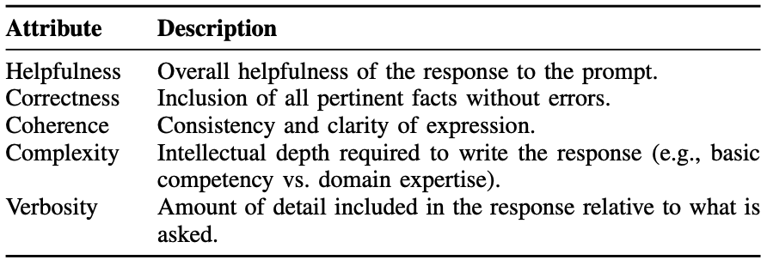
Dataset
HelpSteer2 (NVIDIA; NeurIPS 2024 Datasets & Benchmarks)
{
“prompt”: “prompt_content”,
“response”: “response_content”,
“helpfulness”: “helpfulness_score”,
“correctness”: “correctness_score”,
“coherence”: “coherence_score”,
“complexity”: “complexity_score”,
“verbosity”: “verbosity_score”,
}, …
Z. Wang, Y. Dong, O. Delalleau, J. Zeng, G. Shen, D. Egert, J. J. Zhang, M. N. Sreedhar, and O. Kuchaiev, “HelpSteer2: Open-source dataset for training
top-performing reward models,” in Advances in Neural Information Processing Systems (NeurIPS 2024), Datasets and Benchmarks Track, 2024.

Slide 5
Methodology

Slide 6
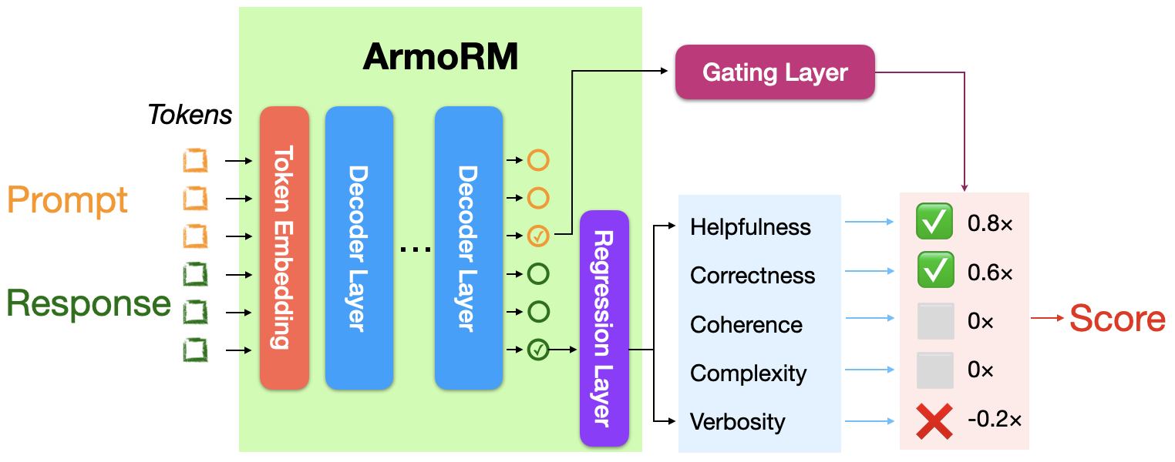
Reward Model
ArmoRM-Llama3-8B-v0.1 (RLHFlow; Findings of EMNLP 2024)
ArmoRM-Llama3-8B-v0.1
“helpfulness”: “helpfulness_score”,
“correctness”: “correctness_score”,
“coherence”: “coherence_score”,
“complexity”: “complexity_score”,
“verbosity” : “verbosity_score”,
Query
CRPO
Each score range in
[0, 4]

Slide 7
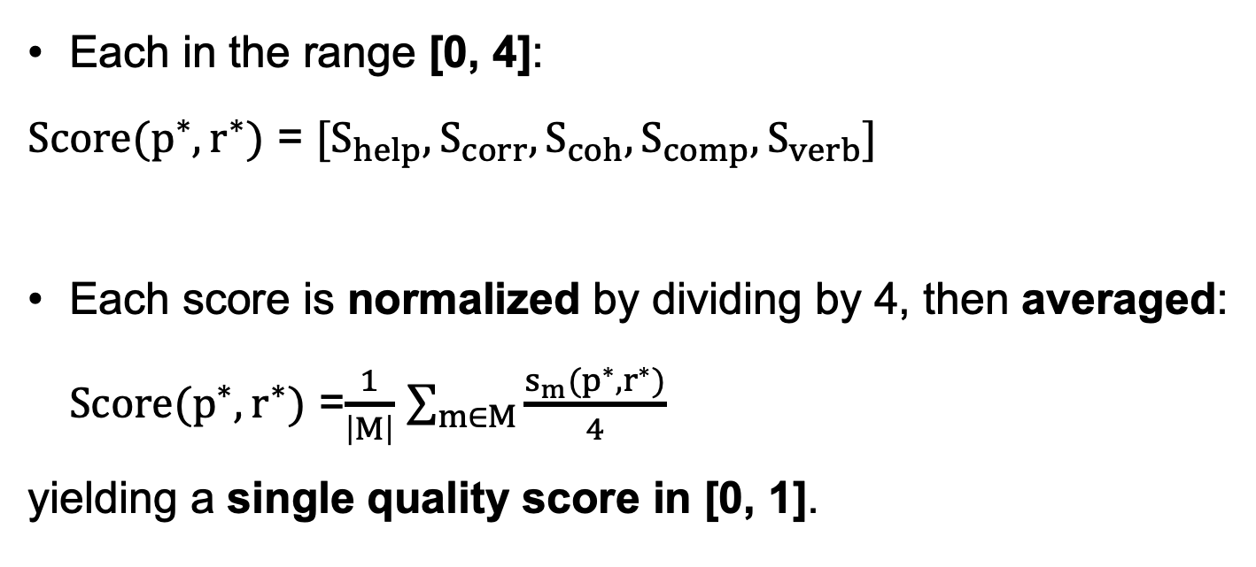
Evaluation
Each in the range [0, 4]:
$Score(p^{∗},r^{∗})$ = $[S_{help},S_{corr},S_{coh},S_{comp},S_{verb}]$
Each score is normalized by dividing by 4, then averaged: $Score(p^{∗},r^{∗})$ =$\frac{1}{\left|M\right|}$ $\sum_{m∈M}{\frac{s_{m}(p^{∗},r^{∗})}{4}}$
yielding a single quality score in [0, 1].

Slide 8
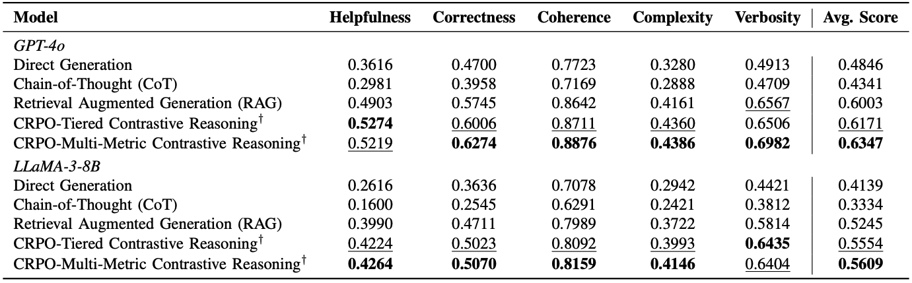
Experiment Results

Slide 9
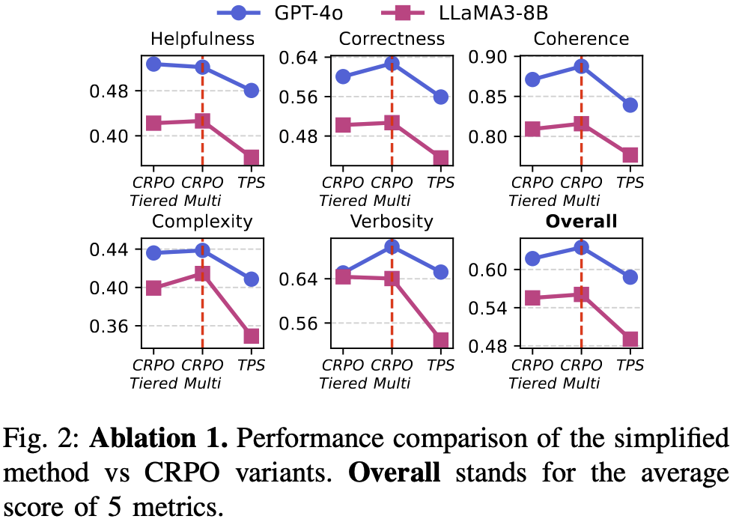
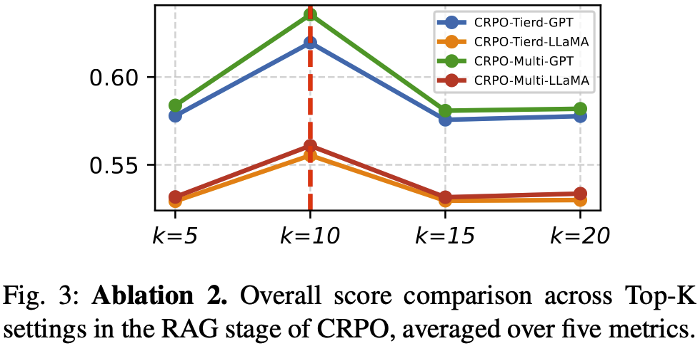
Ablation
(1) Trimaximal-Prompt Selection (TPS) ablation: Ablate CRPO by removing contrastive reasoning and restricting the method to only the top-3 retrieved prompts.
(2) Top-k ablation:Vary the retrieval size in the RAG stage by setting top-k = 5/10/15/20 and compare performance to identify the best k.

Slide 10
Conclusion
CRPO is an automatic prompt optimization method that first retrieves (RAG) prompt–response exemplars from HelpSteer2 and then uses contrastive reasoning over good vs. bad cases to generate a better prompt. It introduces two variants; Tiered (comparing high/medium/low-quality examples) and Multi-metric (integrating the best exemplars per evaluation dimension); and shows overall improvements in average quality scores.
Implications
Isolation hurts: optimizing a single prompt misses good vs. bad learning signals.
Retrieval isn’t sufficient: without contrast, RAG yields shallow or redundant edits.
Need interpretability: black-box settings require controllable, explainable improvements.

Slide 11
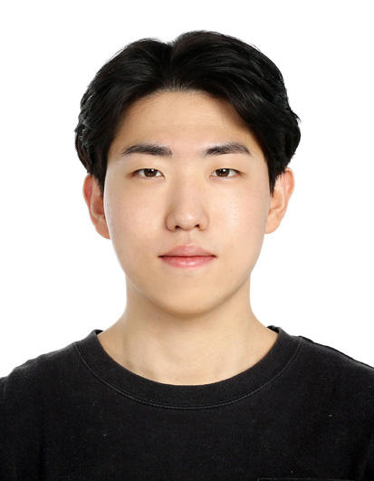




Authors
Juhyeon Lee
Undergraduate Student@PKU
Wonduk Seo
AI Researcher@Enhans
Hyunjin An
AI Researcher@Enhans
Seunghyun Lee
AI Researcher@Enhans
Yi Bu
Assistant Professor@PKU

Slide 12
QR code for paper
Thanks!
Juhyeon Lee
Undergraduate Student, Peking University
leejuhyeon@stu.pku.edu.cn

