Slide 1

Digital Marketing Excellence
A Premium Template for Agencies & Brands — Crafting compelling narratives, showcasing data-driven strategies, and elevating client engagement in the competitive digital landscape.
STRATEGIC GROWTH & CREATIVE INNOVATION
DESIGNED FOR THE MODERN MARKETING PROFESSIONAL
Notes:
Welcome to our premium presentation template, designed for the modern digital marketing professional. This template is your blueprint for crafting compelling narratives, showcasing data-driven strategies, and winning over clients in the competitive world of digital advertising. Let's begin.

Slide 2

CONTENTS
01.Marketing Campaign Proposal
A strategic framework for winning pitches, outlining actionable steps to captivate stakeholders and align creative vision with business objectives.
04.Advertising ROI Report
Uncovering the true value of your ad spend, translating complex metrics into clear insights that demonstrate tangible returns and guide budget allocation.
02.Social Media Post-Mortem
Data-driven analysis for continuous improvement, dissecting campaign performance to identify successes, gaps, and opportunities for future growth.
05.Consumer Persona
Deep diving into your audience's psyche, creating detailed profiles to understand motivations, behaviors, and pain points for hyper-targeted messaging.
03.Brand Strategy
Building a permanent ecosystem for brand loyalty, crafting a cohesive identity that resonates deeply and fosters long-term customer connection.
06.E-commerce Promotion Plan
A tactical playbook for driving sales, combining promotional calendar planning, channel optimization, and conversion strategies to boost revenue.
Notes:
This comprehensive template covers six essential scenarios in digital marketing. From crafting a winning campaign proposal to analyzing ROI and building detailed consumer personas, each section is designed to equip you with the tools and language to excel in your field.

Slide 3

01
Marketing Campaign Proposal
Notes:
Our first section focuses on the Marketing Campaign Proposal. This is your playbook for structuring a compelling argument that not only addresses the client's challenges but also presents a clear, data-backed path to success.

Slide 4



Executive Summary: Our Strategic Thesis
01 / THE IMPERATIVE: THE 2026 LANDSCAPE
02 / STRATEGIC THESIS: COMMUNITY-LED GROWTH
The digital realm is defined by AI-driven hyper-personalization and fragmented consumer attention. Brands grapple with escalating Customer Acquisition Costs (CAC), a diluted brand voice across cluttered channels, and rapidly declining user loyalty in an experience-first market.
We propose an integrated ecosystem that unites AI-powered hyper-personalization with cross-channel attribution optimization. By centering the strategy on building authentic, value-driven communities, we create a sustainable growth flywheel that aligns brand purpose with consumer identity.
Brand Resonance
Efficient Acquisition
Revenue Optimization
+30% organic brand search volume and 75% positive social sentiment, establishing market authority.
20% reduction in CAC paired with a 15% lift in new customer conversion via high-intent targeting.
Achieving a 6:1 ROAS and driving a 25% increase in Customer Lifetime Value (LTV) through retention.
40%Programmatic Ads
Data-driven, hyper-targeted media placement for maximum reach efficiency.
30%Content & Community
Authentic storytelling and platform cultivation to build loyal user bases.
20%SEO & Technology
Technical infrastructure and organic search dominance for sustainable visibility.
10%KOL Partnerships
Micro-influencer collaborations to amplify reach and credibility in niche markets.
Notes:
The executive summary is your elevator pitch. It must clearly state the problem, our strategic solution, and the quantifiable results we expect to achieve. This sets the stage for the detailed proposal that follows.

Slide 5
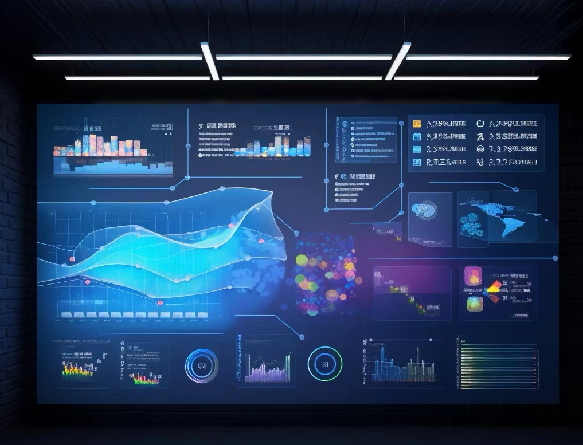



Market Insight & Opportunity Analysis
01 / MACRO TRENDS
AI Hyper-Personalization
70%+ ads use AI for real-time optimization, delivering seamless "segment-of-one" consumer experiences.
Owned Community Shift
As social algorithm红利 fades, brands build owned communities to reduce costs and retain high-value users.
Omnichannel Attribution
Markov Chain models replace last-click logic, providing a "God's eye" view for precise budget allocation.
02 / STRATEGIC OPPORTUNITIES
The modern marketing landscape is defined by data-driven precision and technological innovation. The dashboard above represents the real-time analytics and AI modeling that now underpins every strategic decision, moving beyond intuition to actionable, hyper-targeted insights.
Topic Authority
Identify competitor content gaps and establish thought leadership to capture organic trust and search visibility.
Emerging Channels
Leverage Connected TV (CTV) and Digital Out-of-Home (DOOH) to reach audiences in immersive, unskippable environments.
Immersive Tech
Integrate AI and AR tools to enhance user interaction, visualize products dynamically, and boost conversion rates.
Notes:
Understanding the market is crucial. We analyze macro trends to identify shifts like the rise of AI personalization and the move from rented to owned audiences. This allows us to pinpoint strategic opportunities in content, channels, and technology that our competitors may have missed.

Slide 6
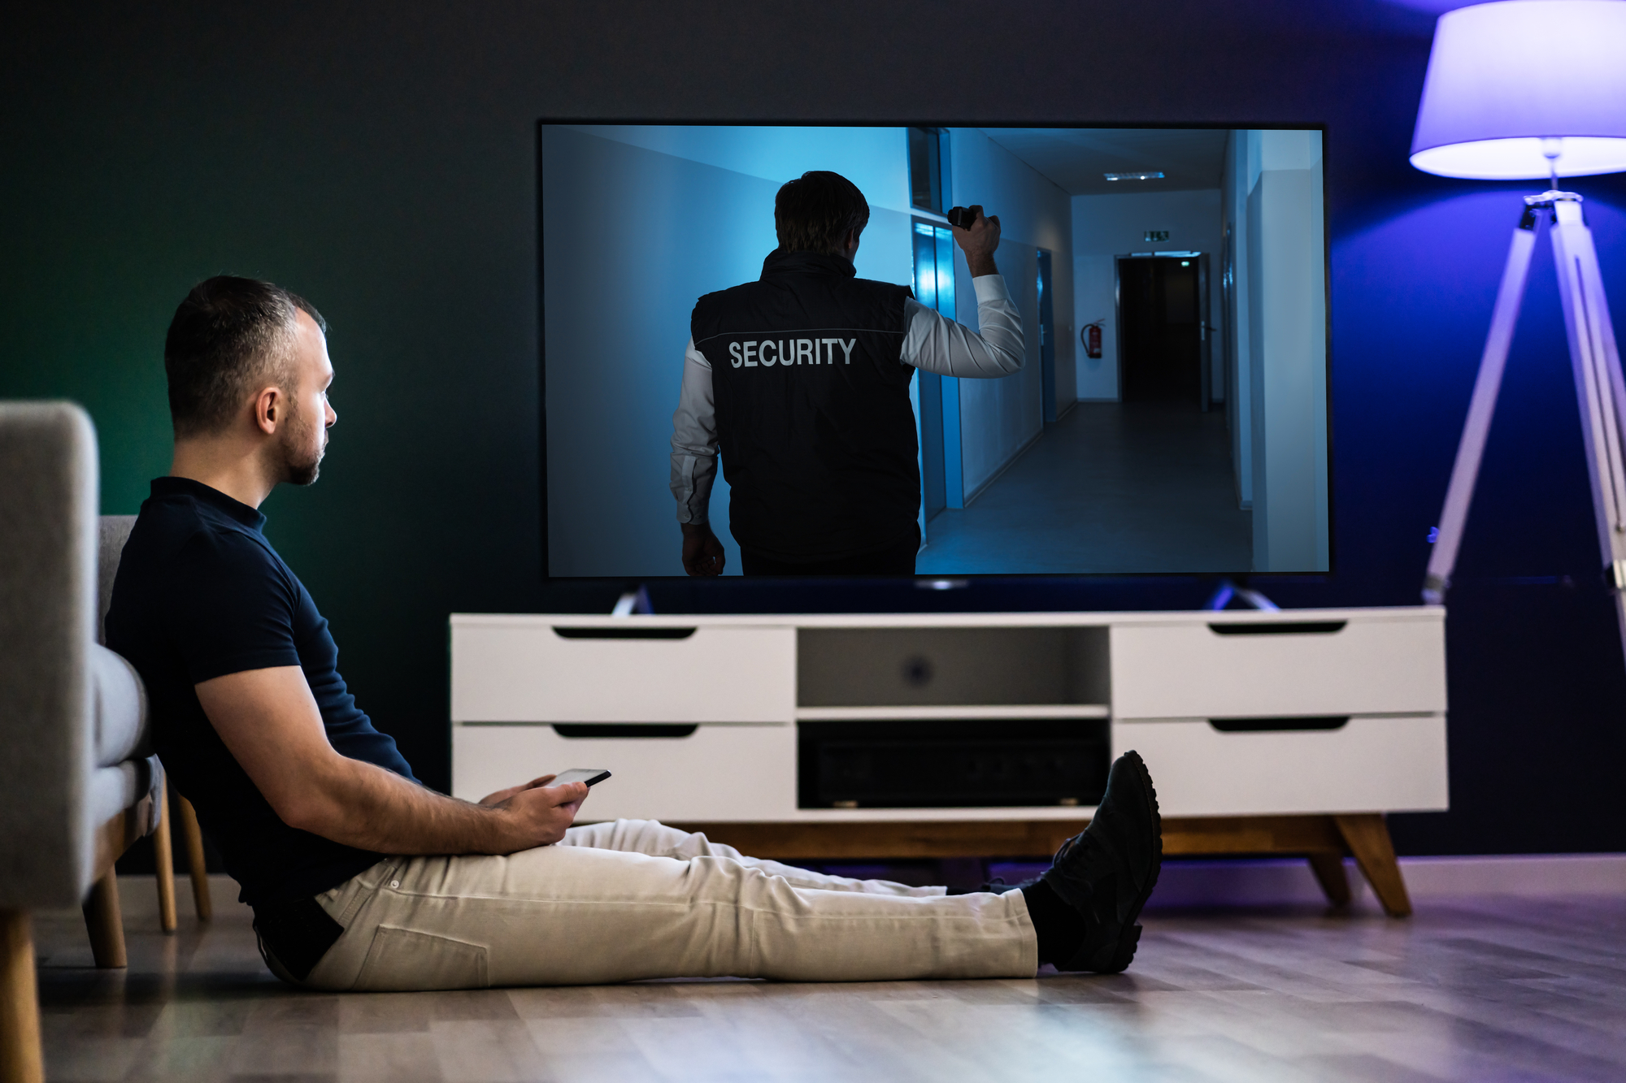
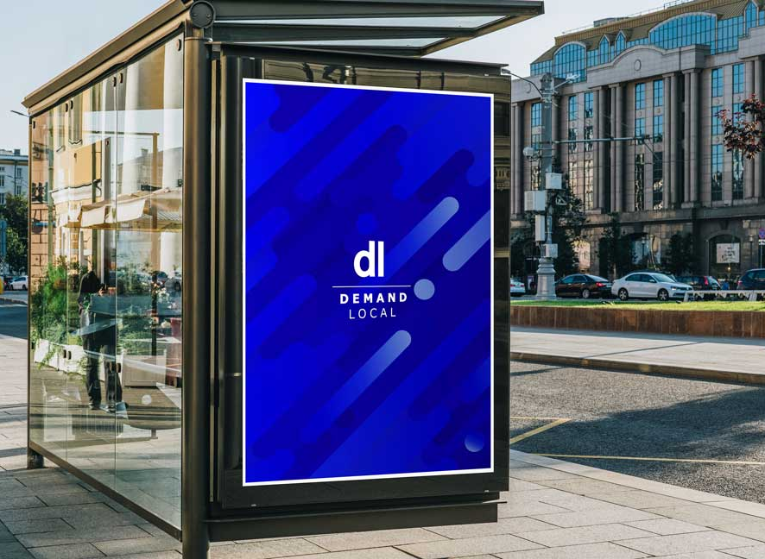
Integrated Marketing Strategy: Channels
02. ADVANCED SEO & AI RETRIEVAL
Paradigm Shift:Move beyond "keyword ranking" to "AI retrieval & citation." Build comprehensive "Topic Authority" content clusters to become a trusted source for search engines.
01. PROGRAMMATIC ADVERTISING
Key Objectives & KPIs
Strategy:Deploy AI predictive targeting across CTV and DOOH for upper-funnel reach, paired with retargeting to capture high-intent users efficiently.
Measurement:Prioritize Attention Metrics and creative quality over vanity clicks to ensure meaningful engagement.
Earn Featured Snippets and secure AI answer citations. Track success via "Citation Frequency" across platforms and "AI Answer Visibility" to quantify thought leadership impact.
Notes:
Our channel strategy is multi-pronged. For programmatic advertising, we leverage AI to target effectively across emerging channels like CTV and DOOH. For SEO, we're moving beyond traditional keyword chasing to build content that becomes an authoritative source for AI search engines.

Slide 7
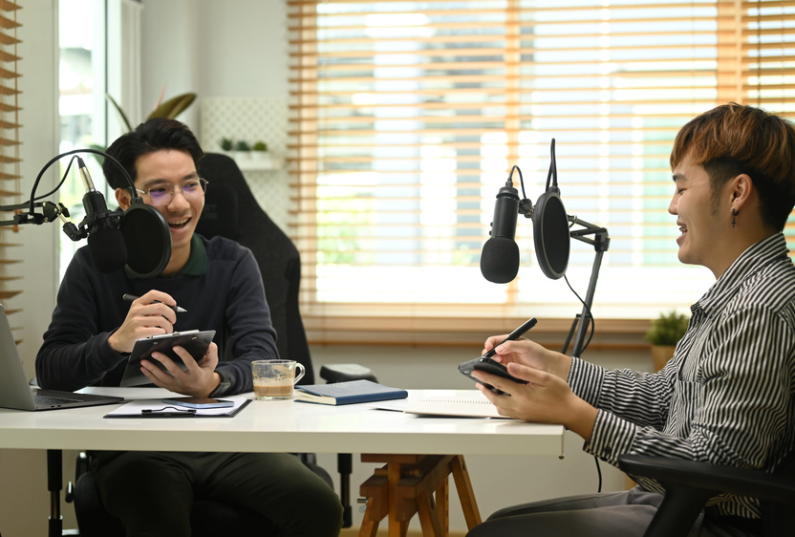


Integrated Marketing Strategy: Content & Community
Content & Community (CLG Strategy)
Strategy:Launch interactive podcasts and live streams to build a private brand community, driving organic growth through shared values and user participation.
KPIs:Community activity levels, UGC volume, and conversion rates from engaged community members.
Dual-Channel Social Media Strategy
Strategy:Leverage short-form videos (TikTok/Reels) for viral brand reach, paired with LinkedIn to establish thought leadership and build B2B professional credibility.
KPIs:Engagement rate, share rate, and Cost Per Lead (CPL) across platforms to optimize ROI.
Creating authentic, engaging content—like podcasts and live discussions—fosters deep connections, turning passive audiences into active, loyal brand advocates and community members.
Notes:
Content is the fuel for community. We'll create engaging content like podcasts to foster a loyal user base. On social media, we'll use a mix of platforms to achieve both broad reach and targeted professional networking, ensuring our message resonates across different audiences.

Slide 8


Execution Plan & Measurement Framework
01 / PROJECT TIMELINE
02 / MEASUREMENT & METRICS
Phase 1 (4 Weeks): Foundation & Prep
Focus on core tech stack setup, content asset creation, and initial stakeholder alignment to ensure a seamless launch of subsequent phases.
North Star Metric: MAPU
Monthly Active Paying Users is our primary guiding metric, ensuring all efforts align with driving sustainable, active revenue streams.
Phase 2 (8 Weeks): Testing & Optimization
Conduct A/B testing across key channels, refine messaging based on early data signals, and optimize conversion funnels for maximum efficiency.
BUSINESS LEVEL
LTV, CAC, ROAS, and Market Share tracking to measure overall profitability and market penetration.
MARKETING LEVEL
Conversion Rate (CVR), CTR, CPA, and CPE to optimize campaign efficiency and user acquisition cost.
CHANNEL LEVEL
Impressions, Reach, and Video Completion Rate to assess content performance and audience engagement.
Phase 3 (12 Weeks): Scale & Expansion
Roll out full-scale promotion across all channels, leverage high-performing tactics, and explore new market segments to drive sustainable growth.
Attribution Model: U-Shape Multi-Touch
Giving weight to both first and last touches, complemented by Lift Tests to validate true incremental impact of marketing efforts.
Notes:
A solid plan needs a clear roadmap and a robust measurement framework. We use a phased approach to execution and define a North Star metric to keep everyone aligned. Our KPI pyramid ensures we track performance at every level, from channel-specific metrics up to business outcomes.

Slide 9
02
Social Media Post-Mortem
Notes:
Next, we move to the Social Media Post-Mortem. This section is all about learning from past campaigns. We'll dissect what worked, what didn't, and provide actionable insights for future optimizations.

Slide 10
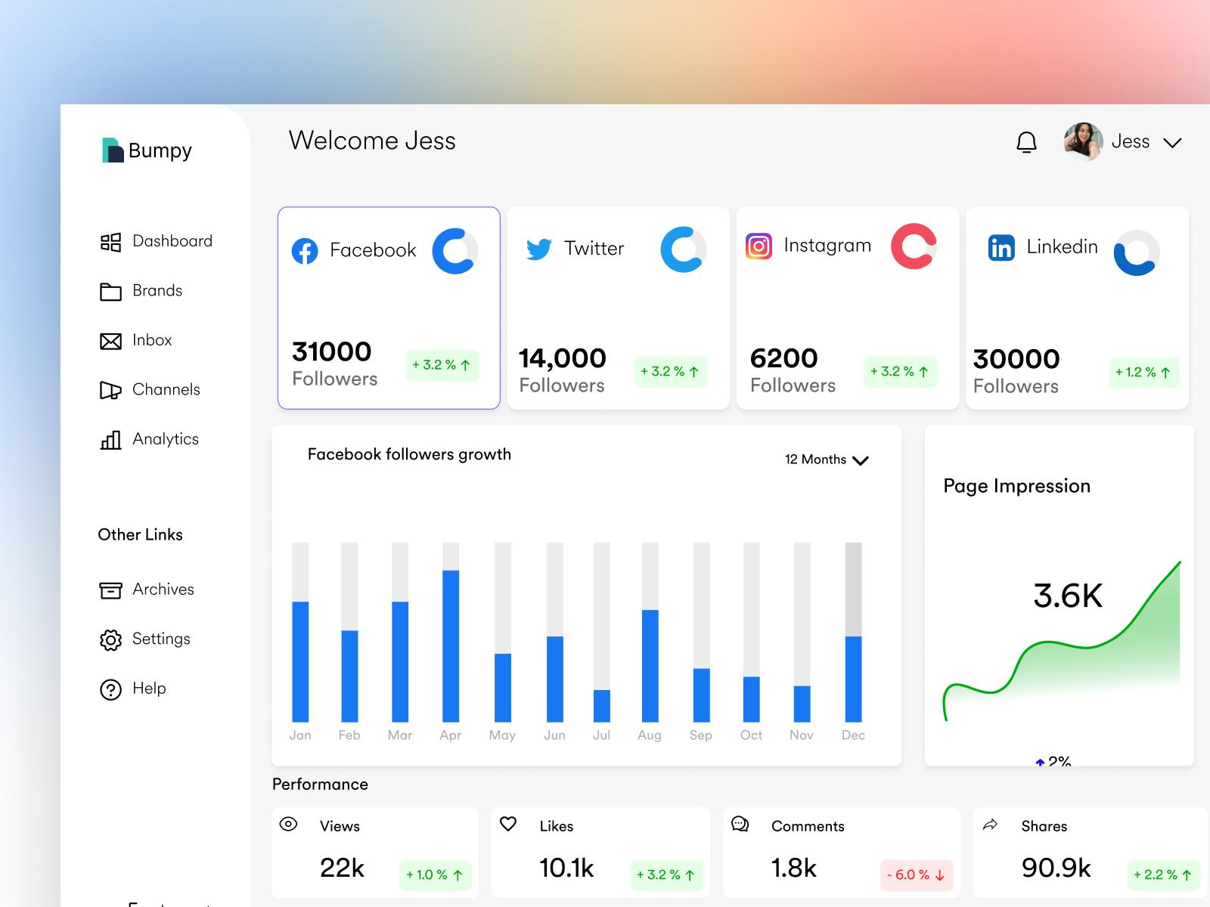
Campaign Overview & Key Performance Metrics
01. SMART Goals Recap
02. Key Performance Metrics
Brand Growth
+20% increase in Instagram mentions, expanding brand visibility across social channels.
Engagement Rate
Achieved 3% average engagement rate, fostering deeper connections with the target audience.
Total Revenue & Efficiency
$XXX,XXX
Total Sales | ROAS: X:1 (Industry benchmark: 3:1)
High-Quality Traffic
Drove 10,000 qualified visitors to the website, with a low bounce rate and high session duration.
Sales & ROAS
Sold 500 units with a ROAS of 5:1, exceeding the initial revenue and profitability targets.
Investment & Reach
Spend: $XX,XXX | Impressions: X,XXX,XXX – Maximizing brand exposure within budget.
Engagement & CTR
Engagement: XX,XXX | CTR: X.X% – Well above the industry average of 2.1%.
The campaign's strategic alignment of brand building and direct response tactics has delivered a well-rounded performance, meeting or exceeding all predefined SMART goals across the marketing funnel.
Conversion & CPA Performance
Total Conversions: XXX | Cost Per Acquisition (CPA): $XXX – Optimized to be 15% lower than forecasted, ensuring cost efficiency.
Notes:
We start by reviewing the initial goals and then present the key performance metrics. This dashboard view provides a quick, high-level understanding of the campaign's overall success against our targets.

Slide 11






Deep Dive Analysis: By Platform & Content
01. PERFORMANCE BY PLATFORM
02. IMPACT BY CONTENT FORMAT
Instagram: The Best Performer (ROAS 6:1)
Feed Ads maximized broad reach, while Story Ads drove exceptional user engagement. The platform’s visual focus aligned perfectly with our brand aesthetic.
Video: Highest Conversion for Demos
Product demo videos achieved an average watch time of 15s and a 45% completion rate, proving most effective at guiding users to purchase.
TikTok: Most Cost-Effective (Lowest CPA)
Viral challenges generated massive UGC and awareness at a low cost, though conversion from the app to our website remained a challenge to optimize.
Carousel: Lowest Engagement Cost
Ideal for showcasing multiple product details and features in a single ad unit, Carousels delivered strong engagement at the lowest cost per interaction.
LinkedIn: High-Quality B2B Decision-Makers
Successfully reached key stakeholders, but incurred the highest CPM and CPA. Its value lies in long-term relationship building rather than immediate sales.
Ad Copy: "Pain Point + Solution" Wins
Copy structured around addressing customer pain points and presenting our product as the solution outperformed feature-focused copy by 30% in CTR.
Notes:
The devil is in the details. We analyze performance by platform to understand where our budget was most effective. We also break down results by content format, revealing that video and a specific copy structure were key drivers of success.

Slide 12




Insights & Learnings
What Worked
What Didn't Work
Creative Insight:"User story" videos resonated more emotionally and drove significantly higher social shares than polished "brand promo" videos, creating authentic connections.
Landing Page Mismatch:TikTok-driven traffic saw an 80% bounce rate, revealing a stark style and messaging disconnect between the platform's vibe and the landing page's formal tone.
Timing Insight:Engagement peaked consistently on Wednesday and Sunday evenings between 8–10 PM, aligning with users' leisure browsing habits.
Budget Misallocation:LinkedIn's spend accounted for a disproportionate share of the budget relative to its contribution to total sales, indicating inefficient resource distribution.
Channel Insight:A dual strategy of Instagram and TikTok effectively covered distinct user segments, expanding reach across age groups and content preferences.
Lengthy Conversion Path:An excessive number of steps from initial ad view to final purchase created significant drop-off points in the user journey, hindering conversions.
Notes:
Every campaign is a learning opportunity. We identify what worked, such as the power of user stories and optimal posting times. Equally important, we highlight what didn't work, like the poor landing page experience for TikTok users, which is crucial for future improvements.

Slide 13


Recommendations for Future Campaigns
Strategic Optimization
Execution Optimization
Data-Driven Testing Plan
CREATIVE FRAMEWORK
Adopt a "user story" core for all video content to build emotional resonance and drive engagement.
BUDGET REALLOCATION
Prioritize high-ROAS Lookalike Audiences, cut low-converting Interest Audiences, and shift LinkedIn spend to Instagram retargeting.
DEDICATED LANDING PAGES
Design visually cohesive, high-impact landing pages specifically tailored for TikTok traffic to align with platform aesthetics.
STREAMLINED CONVERSION
Test one-click purchase flows and simplified form-filling processes to minimize drop-off and accelerate the user journey.
ITERATIVE A/B TESTING
Continuously test variations in CTAs, button colors, and ad copy to identify high-performing creative elements for scaling.
INCREMENTALITY LIFT TESTS
Conduct rigorous lift tests on core ad sets to isolate and accurately measure the true business contribution of paid media.
By combining strategic refocusing, operational streamlining, and rigorous testing, we aim to drive sustainable growth and maximize ROI across all channels.
Notes:
Based on our analysis, we provide clear, actionable recommendations. Strategically, we'll shift our creative approach and budget allocation. Operationally, we'll fix the landing page and simplify the conversion path. Finally, we'll implement a rigorous testing plan to continuously improve performance.

Slide 14
03
Brand Strategy
Notes:
Now we turn to Brand Strategy. This section moves beyond tactical execution to the strategic level, focusing on building a brand that endures and thrives in the long term by creating a permanent ecosystem of value.

Slide 15
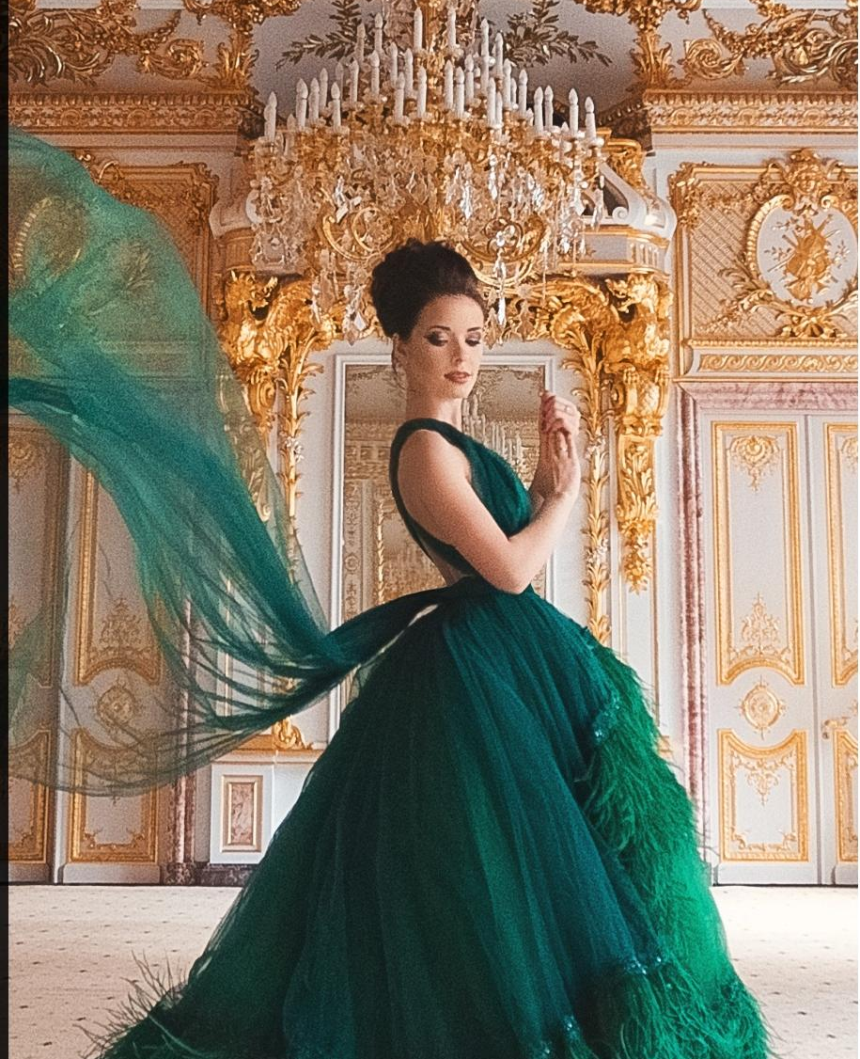
Brand Current State & Challenges
01 / BRAND EQUITY ASSESSMENT
Awareness:High (Broad market reach, top-of-mind recall)
Reputation:Neutral (Lack of emotional resonance with audiences)
Loyalty:Low (High churn rate; little resistance to switching)
Associations:Generic & Product-Focused (No distinct emotional identity)
The Legacy Dilemma:Has the brand story become mere "wallpaper," losing its ability to captivate and inspire new generations?
Diluted Exclusivity:63% of luxury consumers feel messages are generic (Deloitte, 2026). Templated VIP experiences erode the sense of privilege.
Tech's Double-Edged Sword:Does the drive for AI efficiency come at the cost of the human touch and unique, memorable interactions that define luxury?
Notes:
A strong brand strategy starts with an honest assessment of the current state. We evaluate brand equity and confront the hard truths: Is the brand story stale? Is exclusivity being diluted? Is technology eroding the human connection? These are the challenges we aim to address.

Slide 16


Future Brand Strategy: Five Strategic Pillars
Core Idea: Building a Permanent Ecosystem —Shift from one-off campaigns to creating a continuous value-generating brand ecosystem that fosters long-term loyalty and sustainable growth.
01. Cultural Franchises
02. Autonomous Orchestration
03. Transparent Participation
Bind the brand to art, film, or sports to create cultural value that transcends products, making the brand an integral part of lifestyle and identity.
Leverage AI for "Customer Journey Orchestration," automating routine interactions to free human teams to deliver thoughtful, personalized surprises.
Transform scarcity into exclusive, transparent experiences. Turn simple transactions into deep, long-term feelings of belonging and community ownership.
04. Trust as a Monetizable Asset
05. Seamless Commerce
Communicate uncompromising data security and ethical governance as core brand values, turning trust from a cost center into a revenue-driving asset.
Break down online/offline barriers, ensuring a fluid, uninterrupted customer journey across all touchpoints for effortless and intuitive interactions.
Notes:
Our future strategy is built on five pillars. We'll turn the brand into a cultural franchise, use AI to orchestrate seamless experiences, create exclusive participation, build trust as an asset, and ensure commerce is seamless across all touchpoints. This moves us from marketing to ecosystem building.

Slide 17
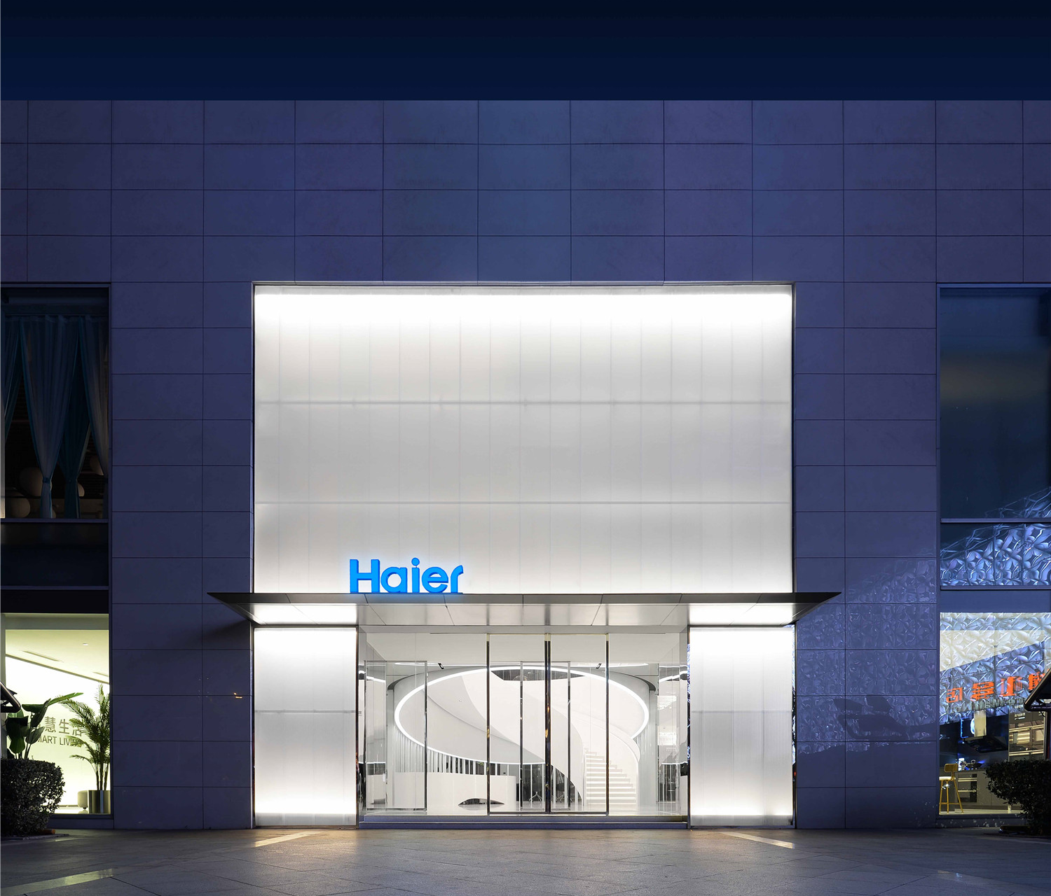
Brand Experience Touchpoint Design
01. Website & App
02. Social Media
Create immersive, interactive digital journeys with AR try-on features, blurring the lines between the virtual and physical worlds for a seamless user experience.
Shift from one-way broadcasting to two-way dialogue. Cultivate vibrant brand communities, encourage authentic UGC, and foster deeper emotional connections.
03. Physical Stores
04. Customer Service
Transform retail spaces into experiential centers, social lounges, and cultural salons. Offer curated events and personalized interactions that delight and surprise.
Empower frontline staff to deliver hyper-personalized service that anticipates needs. Turn every service interaction into a magical moment that reinforces brand loyalty.
A modern physical store reimagined as a cultural salon and social hub, where every visit becomes a memorable brand interaction.
Notes:
Strategy comes to life at the touchpoint level. We'll upgrade the website and app with immersive tech, transform social media into a community hub, reimagine physical stores as experience centers, and empower customer service to deliver magical moments.

Slide 18


Measurement & Evolution
Brand Health Tracking
Cultural Impact Assessment
Strategic Iteration
Regularly track key indicators including Brand Associations, Net Promoter Score (NPS), and Customer Lifetime Value (LTV) to quantify brand resonance and loyalty.
Monitor and measure brand mentions, positive media coverage, and influence within mainstream cultural narratives to gauge the brand’s societal relevance and prestige.
Establish an annual brand strategy review mechanism to continuously optimize the approach, ensuring alignment with evolving market dynamics and consumer feedback.
A great brand strategy is never static. By combining data-driven tracking with cultural awareness, we ensure the brand remains agile and enduring.
Notes:
A great brand strategy is never static. We'll continuously track brand health metrics and cultural impact. Most importantly, we'll establish a regular review process to ensure the strategy evolves and stays relevant in a dynamic market.

Slide 19
04
Advertising ROI Report
Notes:
The fourth section is the Advertising ROI Report. This is where we get scientific. We'll dive deep into attribution models, cross-channel contribution, and incrementality analysis to uncover the true return on your advertising investment.

Slide 20


Attribution Model & Methodology
Current Limitation Acknowledgment
The Core Problem
We first recognize that the simplistic "Last Click" model fails to account for the full customer journey, leading to misallocation of marketing budget and misinformed strategy.
"Channel-reported conversions often sum to more than actual sales."
This critical discrepancy exposes the fundamental flaw of the last-click attribution model, which overvalues the final touchpoint and ignores the cumulative impact of earlier interactions in the customer journey.
Evolving to Advanced Modeling
We start with a "U-Shape" or "Time Decay" model to capture key touchpoints, with a strategic roadmap to transition to a robust "Markov Chain-based Model" for granular path analysis.
U-Shape Model: Balanced Credit Allocation
This model logically assigns significant credit to the first interaction (awareness) and the last interaction (conversion), reflecting the reality of how customers discover and decide.
Notes:
The first step in understanding ROI is choosing the right attribution model. We move beyond the simplistic last-click model to more sophisticated models like U-Shape, which give credit to both the first interaction that creates awareness and the last interaction that drives conversion.

Slide 21
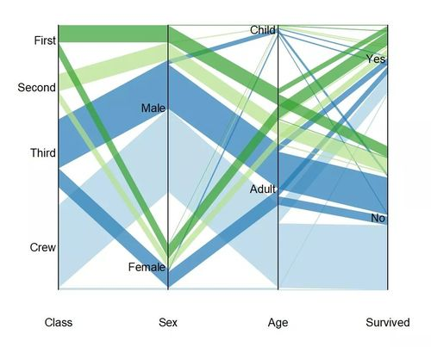


Cross-Channel Contribution Analysis
Sankey Flow Visualization
Maps user pathways across touchpoints to reveal hidden flow patterns, ensuring no critical interaction is overlooked in the attribution model.
Closers: The Final Conversion Drivers
Channels like Brand Search Ads have high last-click ROI but low Shapley value. Strategy: Defend these high-performers to maintain baseline revenue and ensure final touchpoints are optimized for conversion.
Influencers: The Silent Catalysts
Attribution Weighting
Audience Overlap
Channels such as Display Ads and KOLs have low last-click ROI but high Shapley value. Strategy: Invest strategically for growth and measure success using incremental ROAS (iROAS) to capture their true impact.
Quantify each channel's true contribution weight, moving beyond simplistic last-click models to a holistic view of value.
Identify redundant audience segments across channels to eliminate budget waste and refine targeting strategies for efficiency.
Notes:
Not all channels are created equal. We identify which channels are "Closers" that finalize sales and which are "Influencers" that build interest. Using visualizations like Sankey diagrams, we can see the customer journey and understand the true contribution of each touchpoint.

Slide 22

Incrementality Analysis & Budget Optimization
Lift Test Results
Marginal ROAS Analysis
Optimization Principle
Case Study Insight:Ghost-bidding on brand search ads revealed a mere 5% true incremental contribution, with the majority of spend serving a defensive purpose only.
Key Action:Strategically reallocate 20% of this budget to high-potential Influencer marketing channels.
Methodology:Plot granular "Spend-Return Curves" for each marketing channel to visualize how returns scale with increased investment.
Growth Insight:Channels with the steepest return curves represent untapped potential. Prioritize these to maximize ROI before diminishing returns set in.
Equilibrium Strategy:Continuously shift budget allocation from channels with lower Marginal ROAS to those with higher Marginal ROAS.
Optimal State:The budget is perfectly optimized when the Marginal ROAS values across all active channels are equal, ensuring no further gain can be made by reallocating funds.
By focusing on true incrementality and Marginal ROAS equilibrium, we transform budget management from guesswork into a data-driven strategy for maximum efficiency.
Notes:
The gold standard for measuring ROI is incrementality analysis. Through Lift Tests, we can determine the true value of a channel. By analyzing Marginal ROAS, we can optimize the budget, moving it from saturated channels to those that still offer high growth potential, maximizing overall return.

Slide 23
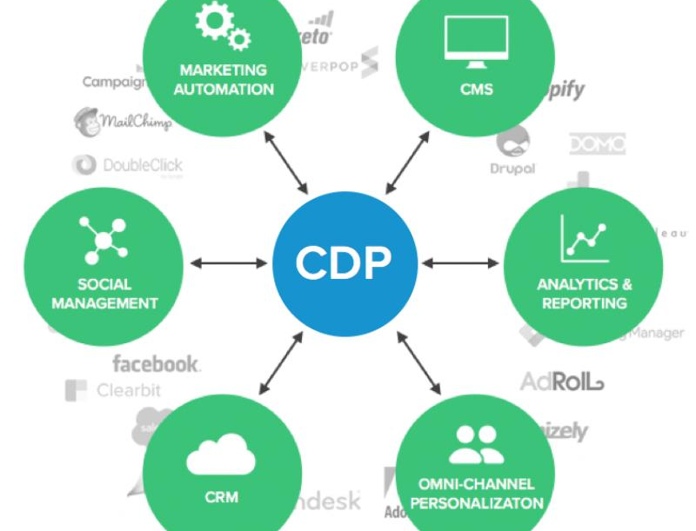

Future Outlook & Action Items
Technology Upgrade
Invest in a Customer Data Platform (CDP) and Multi-Touch Attribution (MTA) tool to support granular, cross-channel analysis and optimize marketing spend allocation.
Testing Plan
Establish a rigorous, ongoing Lift Test process to continuously validate the incremental value of each marketing channel and eliminate underperforming tactics.
Team Empowerment
A unified Customer Data Platform (CDP) architecture integrates marketing tools to create a single, comprehensive view of customer interactions, enabling precise attribution and personalization.
Provide specialized training on advanced attribution models and data analysis techniques to upskill the marketing team and foster a data-driven decision-making culture.
Notes:
To maintain a competitive edge, we recommend investing in technology like a CDP, establishing a regular testing cadence, and empowering the team with the skills to interpret data. This ensures that ROI analysis becomes a core, ongoing capability of the organization.

Slide 24
05
Consumer Persona
Crafting detailed audience archetypes to foster deep empathy and precision in every strategic touchpoint.
Notes:
Understanding your audience is the foundation of all effective marketing. In this section, we create detailed consumer personas to help the team truly "see" and empathize with the people they are trying to reach.

Slide 25





Persona 1: The Value-Driven Autonomist
Lifestyle & Consumption: "Less is More"
Immune to traditional ads; lives on podcasts, Substack, and Reddit. Willing to pay premium for quality, sustainability, and unique design. Prioritizes brands with radical transparency and clear social responsibility.
Key Pain Points
Suffers from severe information overload and a deep trust deficit in corporate messaging. Faces extreme time poverty, making it hard to research and discover new brands that align with his values.
Alex Chen, 32 | Product Manager (SF)
$150k/year. Tech-savvy professional who prioritizes substance and authenticity over mainstream trends.
High-Impact Channels
Podcast founder interviews, authentic Reddit community recs, exclusive niche event invites.
Wasted Efforts
Generic social media ads, mass promotional email blasts, and overly polished, inauthentic brand content.
Notes:
Meet Alex Chen, the "Value-Driven Autonomist." He's a tech-savvy professional who values authenticity and substance over flashy marketing. To reach him, we need to engage through trusted, niche channels and demonstrate our brand's values and quality.

Slide 26



Persona 2: The Experience-Oriented Luminary
MARGARET REYNOLDS · 68, RETIRED FINANCIAL ADVISOR
A high-net-worth resident of Palm Beach, Margaret embodies quiet luxury. She trusts personal connections over algorithms and curates her life with intention, seeking depth in every interaction.
CURATED LIFESTYLE
INVESTMENT IN LIVING
Avid reader of Monocle, regular at exclusive offline tastings, and deeply reliant on trusted personal recommendations from her inner circle.
Views consumption as an investment in quality of life. Seeks bespoke, one-of-a-kind services and scarce experiences, prioritizing brand heritage and master craftsmanship.
"I don’t buy things; I invest in moments that matter. If a brand can’t take the time to know me, to offer something truly rare and personal, then it’s not worth my attention."
— MARGARET REYNOLDS
PAIN POINTS
Tech anxiety, frustration with "mass exclusivity," and a craving for professional, tailored advice that understands her unique needs.
HIGH-TOUCH STRATEGY
Success lies in personal advisor calls, handwritten notes, and exclusive previews. Avoid impersonal SMS or overly complex digital interactions.
Notes:
Now, meet Margaret Reynolds, the "Experience-Oriented Luminary." She represents the high-net-worth consumer who values personalized service and unique experiences. Reaching her requires a high-touch approach, emphasizing exclusivity and human connection.

Slide 27
06
E-commerce Promotion Plan
A tactical playbook merging urgency, belonging, and personalization to craft a multi-layered promotional matrix for maximum sales impact.
Notes:
Finally, we have the E-commerce Promotion Plan. This is a tactical playbook designed to drive sales by combining urgency, belonging, and personalization in a multi-layered promotional matrix.

Slide 28



Goals & Core Strategy
50%Sales Growth
Urgency & FOMO
Create a compelling fear of missing out with limited-time exclusive offers and flash promotions, motivating immediate purchase decisions from potential buyers.
Achieve a substantial 50% increase in quarterly sales volume for Q4, driven by targeted promotional tactics and optimized customer engagement.
Sense of Belonging
Reward customer loyalty with exclusive perks and foster a strong community spirit, encouraging long-term engagement and advocacy among our core audience.
40%New Customer Share
Hyper-Personalization
Deliver tailored offers and curated experiences to specific customer segments, ensuring relevance and resonance for maximum conversion and satisfaction.
Expand market reach by increasing the share of new customers to 40%, focusing on untapped demographics and high-potential audience segments.
Notes:
Our goal is clear: drive sales and attract new customers. The core strategy is to create a dynamic promotion plan that uses urgency, a sense of belonging, and personalization to motivate different types of shoppers.

Slide 29

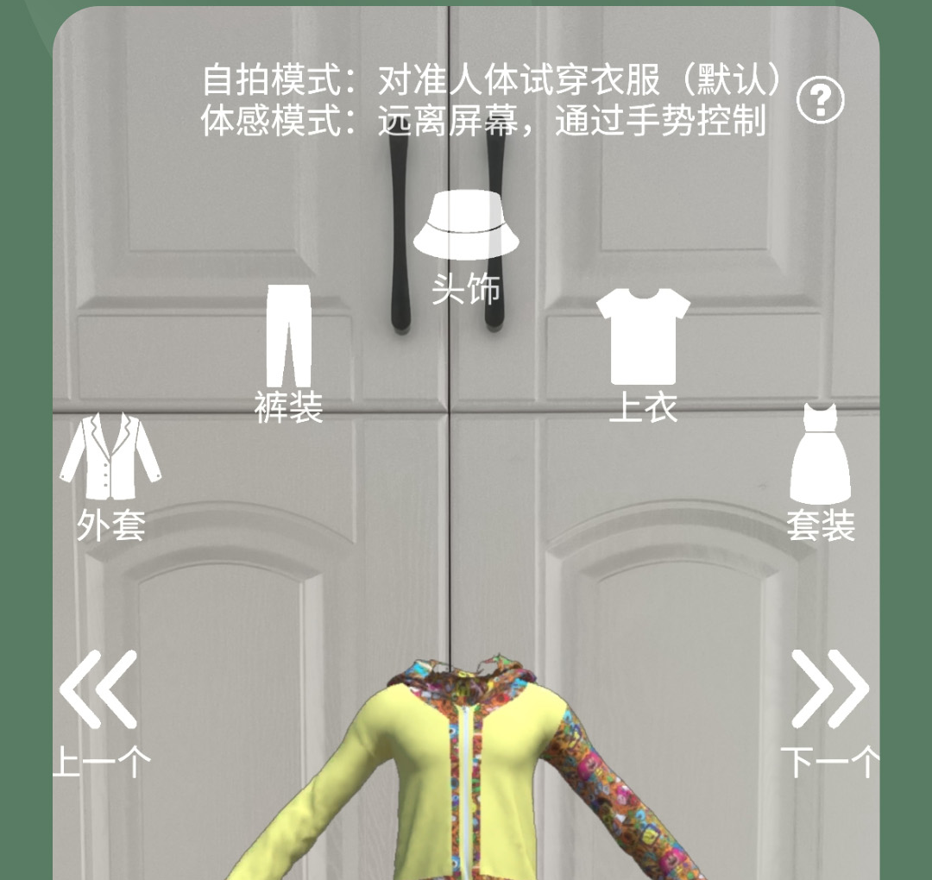
Promotion Matrix
01. Flash Sales
02. VIP Exclusive Privileges
03. Strategic Product Bundling
Target:Price-sensitive, impulse buyers seeking immediate gratification.
Action:24-hour limited offers to drive FOMO via website pop-ups & push notifications.
Target:High-value loyal customers with significant lifetime value.
Action:Reward with exclusive discounts, early access & double points via member emails & portals.
Target:Potential cross-sell targets browsing related product categories.
Action:Curate complementary product sets at a bundled price; showcase on product pages & cart.
04. Abandoned Cart Recovery
05. UGC Incentive (Social-Driven)Launch #brandchallenge on TikTok/IG to turn active users into brand advocates; reward top reviews with exclusive perks.
For Hesitant Buyers:Re-engage users who left items unpurchased by sending automated, personalized emails/SMS with unique discount codes to incentivize completion.
06. AR Try-On Experience
Empower visual decision-makers to "try" products virtually via app/plugins, boosting confidence and reducing returns.
Notes:
This is our promotion matrix. It's a toolkit of tactics designed for different user segments. From flash sales for impulse buyers to AR try-ons for visual shoppers, each tactic serves a specific purpose in driving conversions.

Slide 30
Execution Cadence & Calendar
01. PRE-LAUNCH| 2 Weeks Before Launch
02. LAUNCH WEEK| Week 1 - Maximum Impact
Build anticipation through strategic email and social media teasers. Exclusively open "Early Bird" access to VIP members to foster exclusivity and early engagement.
Fully activate flash sales, product bundling, and UGC campaigns. Scale paid ad spend to target retargeting and lookalike audiences for broad, high-conversion reach.
03. MID-CAMPAIGN| Weeks 2-3 - Sustain Momentum
04. FINAL PUSH| Last 3 Days - Urgency & Gratitude
Introduce refreshed flash sale SKUs and bundles to reignite interest. Highlight top-performing UGC content across channels and increase abandoned cart email frequency to recapture lost sales.
Deploy "Last Chance" limited-time discounts to drive immediate action. Send thank-you communications to participants, nurturing relationships while teasing upcoming future events.
Notes:
Timing is everything. We've laid out a clear execution calendar with distinct phases: pre-launch for building anticipation, launch for maximum impact, mid-campaign for maintaining engagement, and a final push for a strong finish.

Slide 31

Thank You
Let's Build the Future of Marketing Together
This strategic framework is crafted to elevate your brand's narrative and drive meaningful connections. We are committed to partnering with you every step of the way, turning visionary ideas into impactful market realities.
Notes:
Thank you for your time. This template is more than just a set of slides; it's a strategic framework to guide your decisions and elevate your marketing efforts. We look forward to partnering with you to build the future of marketing together.

