Slide 1

Intelligent Enterprise Digital Collaboration Platform
Empowering Business Growth Through Data-Driven Decisions and Intelligent Process Reengineering.
Presenter: Li Ming
Dept: Product Center
Date: June 18, 2026
Notes:
Hello everyone, welcome to this presentation. Today I will introduce our latest enterprise application product to you. This product aims to reshape enterprise efficiency and empower business growth through digital means. Next, I will elaborate on the project background, core functions, product advantages and future development plans.

Slide 2

CONTENTS
01
Project Overview
Project background, goals, and core values
05
Data Insights
Seeing the product's actual effectiveness through data
02
Core Features
In-depth analysis of the product's core capabilities and highlights
06
Success Stories
Real recognition and practice from customers
03
Product Advantages
Comparing with the market to highlight our unique value
07
Team Strength
A professional team is the guarantee of project success
04
Technical Architecture
Robust and scalable system design philosophy
08
Summary & Outlook
Review core values and look forward to future development
Notes:
本次汇报将分为八个部分。首先，我会对项目进行一个整体概述；接着，将深入介绍产品的核心功能和独特优势；然后，我们会探讨其技术架构和数据表现；之后，通过一个成功案例来展示产品的实际应用效果；最后，介绍我们的团队实力并进行总结与展望。

Slide 3






Project Overview: Unleashing a New Digital Era
Project Background
Project Goals
REINVENTING EFFICIENCY
EMPOWERING GROWTH
Rapid tech changes reveal limitations in traditional management. Information silos, cumbersome processes, and delayed decisions restrict operational refinement and growth.
Build an integrated intelligent platform to enable process automation and data-driven decisions, optimizing management and boosting core competitiveness.
Driven by digital transformation, we break down silos, integrate technology with business, and build sustainable core competitiveness.
Cost Reduction & Efficiency
Data-Driven
Agile Collaboration
Secure & Reliable
Automate repetitive tasks, cut labor costs, and boost operational efficiency.
Integrate full-link data for real-time insights and support scientific decisions.
Break down silos, enable seamless info flow, and enhance team collaboration.
Adopt enterprise-grade security architecture to protect data assets and compliance.
Notes:
Let's start with the project overview. Enterprises face immense pressure in digital transformation, and traditional management models are outdated. Our project addresses these pain points, aiming to build an integrated intelligent platform. Its core values lie in cost reduction & efficiency, data-driven decisions, agile collaboration, and robust security.

Slide 4
Core Features: An Integrated Solution
Intelligent Process Engine
Multi-dimensional Data Analysis
Efficient Collaborative Office
Mobile Office Portal
Build approval and workflow processes through visual drag-and-drop. Supports complex logic like conditional branching, joint & parallel signing, automating and standardizing business processes.
Built-in rich report templates & custom dashboards. Supports multi-dimensional data drilling, real-time calculations & visualization for instant business insights.
Integrates instant messaging, online docs & task management. Supports collaborative editing and auto-versioning for zero-delay team communication.
Provides full-functional iOS & Android Apps. Handle approvals, view reports & collaborate anytime, anywhere, breaking location limits.
The four core modules are deeply integrated to build an efficient, intelligent, and flexible integrated digital management system for enterprises.
Notes:
Next are the core features of the product. We offer four core modules: Intelligent Process Engine for automating business processes; Multi-dimensional Data Analysis for real-time insights; Efficient Collaborative Office for breaking communication barriers; and Mobile Office Portal for working anytime, anywhere. These features together form a powerful integrated solution.

Slide 5
Product Advantages: Why Choose Us?
01 Technical Architecture
02 Deployment Method
03 Integration Capability
Traditional: Monolithic architecture, high coupling, difficult to scale.
Traditional: Only supports private deployment, high cost.
Traditional: Limited API interfaces, complex integration.
Product:Microservice architecture, high cohesion, low coupling, easy to scale and maintain.
Product:Supports public cloud, private cloud, hybrid clouddeployment modes, flexible choice.
Product:Provides rich API interfaces and standard connectorsfor easy connection to existing enterprise systems.
04 Security Level
05 User Experience
06 Cost-Effectiveness
Traditional: Basic security protection.
Traditional: Outdated interface, complicated operation.
Traditional: High price, charged by module.
Product:Enterprise-grade end-to-end encryption, compliant with international security standards, ensuring data security.
Product:Modern UI/UX design, clean and intuitive, greatly reducing training costs.
Product:Offers a more competitive pricing strategy, pay-as-you-go, quick value realization.
Notes:
So, why choose our product? Compared with traditional methods or competitors, we have significant advantages in six aspects: technical architecture, deployment method, integration capability, security level, user experience, and cost-effectiveness. In particular, our microservice architecture, flexible deployment modes, and rich integration capabilities can provide enterprises with a more robust, open, and cost-effective solution.

Slide 6
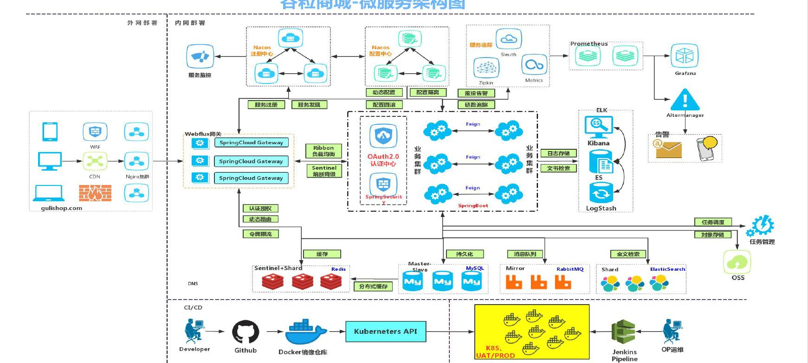



Technical Architecture: Robust, Open, Scalable
Full-link Microservice Architecture
A layered, decoupled microservices architecture with standardized interfaces. It enables independent evolution and elastic scaling of business modules, supported by containerization and automated ops for high availability and concurrency.
Presentation Layer
Business Layer
Data Layer
Infrastructure
Web: Modern SPA (Vue.js/React). Mobile: Native + React Native hybrid development for real-time data sync.
Microservice Cluster & API Gateway for traffic management, service governance and high cohesion.
MySQL/PG for core data, Redis for caching, Elasticsearch for full-text search (read-write separation).
Docker + K8s for containerization, Kafka for asynchronous decoupling (high concurrency support).
Notes:
This is our product's technical architecture diagram. We adopt an advanced microservices architecture, from the presentation layer, business layer to data layer, all following the design philosophy of robustness, openness and scalability. Through containerized deployment and automated operations, we can ensure the high availability and rapid iteration capability of the system, providing a solid technical guarantee for the long-term development of the enterprise.

Slide 7
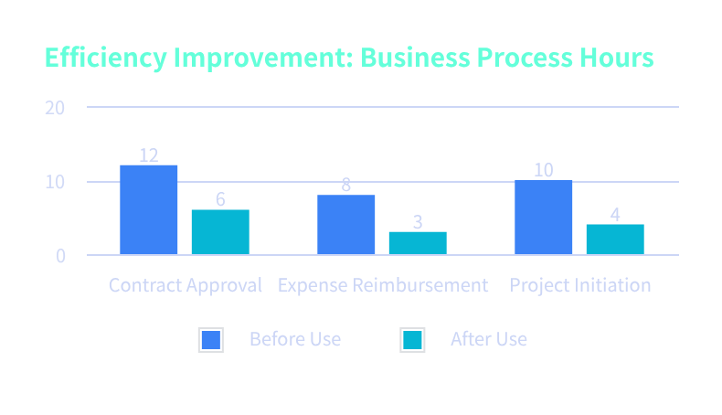
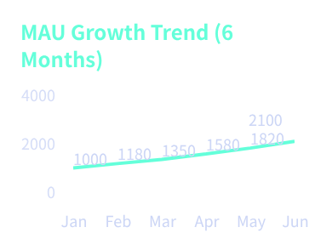
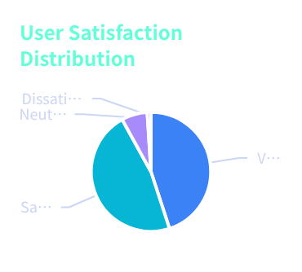
Data Insights: Quantifying Value, Driving Decisions
User Stickiness Enhanced
MAU has climbed steadily since launch, with a month-on-month growth rate above15%, showing excellent user activity.
High Market Recognition
A total of92%of users gave positive reviews, verifying the core value of the product's functions and services.
The average time of key business processes is significantly reduced, with an overall efficiency improvement of45%, significantly lowering operational costs.
Notes:
Data is the most intuitive way to measure product value. As seen in the charts, the average efficiency of business processes has improved by 45% after using our product; user activity continues to grow with a month-on-month increase of over 15%; meanwhile, user satisfaction reaches 92%. These data fully prove the product's actual effectiveness and market recognition.

Slide 8
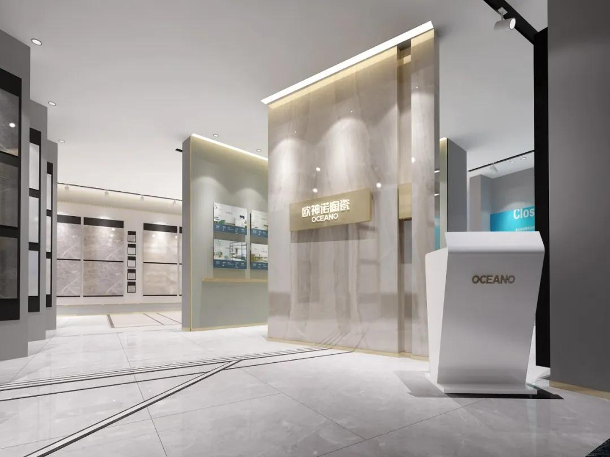
Success Stories: Empowering Industry Benchmarks
A Well-known New Retail Group| Industry: New Retail
Committed to driving retail innovation through technology and enhancing operational efficiency and user experience.
01 Key Challenges
Disconnected online-offline data & messy inventory; fragmented membership system; lengthy cross-department collaboration & delayed new product launches.
02 Omni-channel Solutions
Deployed retail middle platform to break data silos; built intelligent marketing engine for 360° user profiles; reshaped workflows to optimize R&D and launch links.
A leading new retail enterprise with thousands of employees and business operations nationwide. It has built an integrated online-offline retail network to provide consumers with a seamless shopping experience.
30%
Inventory turnover rate increased significantly, capital utilization optimized.
25%
Member repurchase rate grew, user lifetime value released.
40%
New product launch cycle shortened, fast response to market.
Notes:
Next, let's look at a real customer case. This benchmark enterprise in the new retail industry successfully solved problems such as disconnected data, difficult marketing, and cumbersome processes after using our solutions. Ultimately, their inventory turnover rate increased by 30%, member repurchase rate by 25%, and new product launch cycle was shortened by 40%, achieving significant business growth.

Slide 9

Team Strength: Professional Escort, Trustworthy
Zhang Qihang
Founder / CEO
Li Zeming
CTO
Wang Shuran
Product Director
Chen Yuwei
CS Director
15 years in enterprise digitalization. Served at a Fortune 500 tech firm, led R&D of national smart projects. Deep insights into industry trends and digital transformation pain points, with excellent strategic planning.
12 years in software architecture, proficient in microservices & cloud computing. Designed architecture for 10M-user systems, holds 8 patents. Led team to overcome technical challenges.
10 years in enterprise product design. Balances business value & user experience. Launched benchmark SaaS products, with sharp market insight for iteration.
8 years in large client service. Committed to maximizing product value, established standard service systems, served dozens of listed companies with high satisfaction.
Bringing together top industry talents, we build a full-link high-quality guarantee system from R&D to customer service, driven by professional capabilities.
Notes:
项目的成功离不开一支专业的团队。我们的核心成员均来自行业顶尖公司，拥有丰富的技术研发、产品设计和客户服务经验。从CEO到CTO，再到产品和客户成功负责人，我们团队的每一位成员都致力于为客户提供最专业的服务和最可靠的产品。

Slide 10







Summary & Outlook
Core Value Review
Integrated Platform
Integrate core workflows, break silos, and enable seamless business flow.
Thank You
Data-Driven Decisions
Provide real-time insights with visual reports for scientific decision-making.
We look forward to partnering with you to empower businesses with technology and co-create a brand new future for digital transformation.
Ultimate UX
Intuitive interface reduces training costs and boosts efficiency.
Robust & Secure
Enterprise-grade security safeguards business continuity.
Contact:[Your Name]
Tel:[Your Phone]
Email:[Your Email]
Website:[Company Website]
Notes:
In summary, our product offers an integrated platform, enables data-driven decisions, delivers an ultimate user experience, and ensures robustness and security. We believe it will be a powerful assistant for your enterprise's digital transformation. Thank you for listening. We look forward to partnering with you to co-create a digital future.

