Slide 1

[Client Brand]
Campaign Proposal
[Agency Name]
2026
Notes:
Welcome. Today, we're excited to present a tailored campaign proposal designed to elevate [Client Brand] to new heights. This presentation will outline our understanding of the market, the challenges we see, and the strategic path forward to achieve remarkable results. Let's begin.

Slide 2





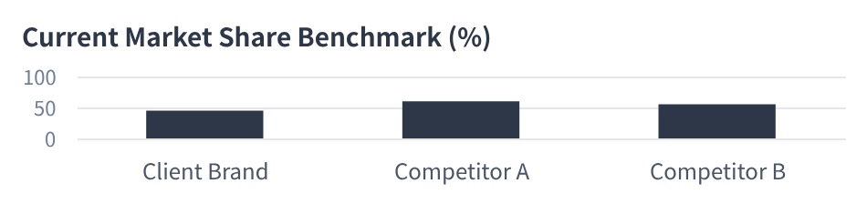
The Opportunity: Understanding Your World
Market Context & Key Trends
Digital Transformation Acceleration
Industry growth projected at [X]% CAGR through 2028 (Gartner), driven by AI integration and cloud-based solutions reshaping operational efficiency.
Evolving Consumer Expectations
Modern audiences demand authenticity, hyper-personalized interactions, and a strong commitment to sustainability—moving beyond transactional relationships.
Aggressive Market Competition
Rivals like Competitor A and B are doubling down on digital-first storytelling and immersive experiences to capture market mindshare.
Core Strategic Insight
Your brand’s established legacy and loyal customer base are powerful assets. The critical untapped potential lies in deepening Gen Z engagement and expanding your footprint in high-growth regions, where demand currently outpaces your reach.
Notes:
First, let's look at the landscape. The market is evolving rapidly, driven by digital trends and changing consumer behavior. Your brand is in a strong position, but we see a clear opportunity to grow by connecting with a new audience segment and outpacing your competitors.

Slide 3



The Challenge: Bridging the Gap to [Desired Outcome]
The Core Challenge
Despite strong brand fundamentals, [Client Brand] is experiencing a critical disconnect: declining engagement with younger demographics and inconsistent messaging across channels. This fragmentation is directly impacting growth, resulting in missed revenue opportunities estimated at $XX million annually.
Key Root Causes
No Unified Strategy
Legacy Channel Bias
Message Misalignment
A siloed approach leads to fragmented customer experiences, confusing audiences and diluting brand impact.
Over-reliance on traditional media fails to reach the growing digitally-native audience where attention resides.
Brand communications lack emotional resonance, failing to differentiate in a crowded and competitive marketplace.
The bridge symbolizes the critical transition from current limitations to future growth. To cross it, we must first identify the structural gaps in our approach.
Notes:
To seize this opportunity, we must first address the core challenge. We've identified a gap between where you are and where you want to be. This gap is caused by a few key factors, primarily around digital strategy and brand messaging. Let's break them down.

Slide 4


Our Strategic Approach: "Project Illuminate"
01. Audience-Centric Storytelling
02. Performance-Driven Media
03. Seamless Customer Experience
Reframe the narrative to resonate with your core audience by centering their values, aspirations, and unmet needs. We craft authentic, emotionally resonant stories that transform passive viewers into active brand participants.
Maximize ROI through AI-driven targeting and cross-channel optimization. We deploy data-backed allocation, real-time performance tuning, and analytics to ensure every media dollar drives measurable business outcomes.
Create a unified, frictionless journey across all touchpoints—from discovery to advocacy. Consistent, intuitive interactions build trust, enhance loyalty, and convert satisfied customers into vocal brand champions.
The Insight-to-Impact Model:Every campaign is rooted in deep consumer insights and designed for tangible, measurable growth—ensuring your strategy isn’t just creative, but a proven driver of business success.
Notes:
Our solution is a clear, data-driven strategy we call "Project Illuminate." It's built on three core pillars: telling stories that resonate with your audience, using media in the most effective way possible, and creating a seamless experience across every customer touchpoint. This approach ensures our work is not just creative, but strategically sound.

Slide 5




The Campaign Blueprint: "Your Journey, Redefined."
Creative Concept: Unleash Your Explorer Spirit
This core idea transcends traditional advertising by blending cinematic narratives with relatable user experiences. It’s about inspiring curiosity and positioning your brand as the catalyst for discovery.
Hero Film & Social Cutdowns
A 60-second cinematic hero film paired with bite-sized 15-second social edits, designed to evoke emotion and drive viral sharing across Instagram, TikTok, and YouTube.
High-Impact Visual Assets
Editorial-style photography and motion graphics featuring a diverse cast in aspirational settings, optimized for display ads, social feeds, and website banners.
Mood Board: Visualizing the aesthetic direction—where modern minimalism meets vibrant, authentic storytelling.
Influencer & UGC Strategy
Partnering with 50+ micro-influencers in the lifestyle and adventure niche to create authentic, unscripted content that amplifies reach and builds trust with your audience.
Notes:
Now for the exciting part: the creative. Our big idea is "Unleash Your Explorer Spirit," designed to inspire and connect. We'll bring this to life through a hero film, social media content, and by partnering with influencers to build authentic buzz. This is what your audience will see and feel.

Slide 6
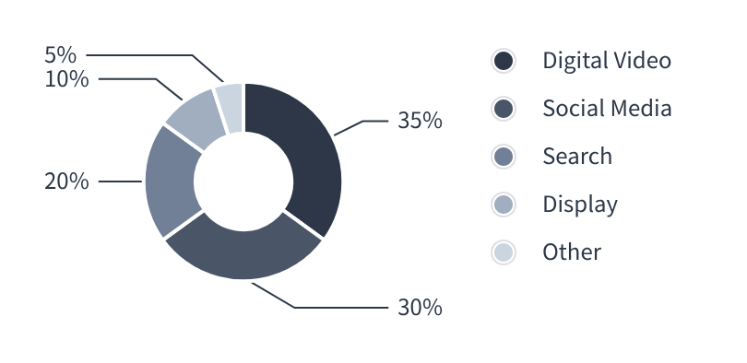



The Omni-Channel Journey: A Seamless Path to Conversion
Channel Strategy Overview
Channel Mix & Budget Allocation
01. Awareness Phase
Drive broad reach through YouTube pre-roll, programmatic display, and podcast sponsorships to capture initial audience attention.
02. Consideration Phase
Engage via LinkedIn thought leadership, Instagram Reels storytelling, and personalized email nurture sequences to build trust.
03. Conversion Phase
Strategic Rationale:This allocation prioritizes high-reach awareness channels (65% to Video & Social) to maximize top-of-funnel volume, balanced with intent-driven Search (20%) and Display (10%) for mid-to-lower funnel efficiency, ensuring a cost-effective path to conversion.
Optimize for action with Google Search ads, social conversion campaigns, and strategic retargeting to drive final conversions.
Notes:
We'll meet your audience where they are, creating a seamless journey from the moment they first hear about you to the point of conversion. Our channel strategy is designed to build awareness, foster consideration, and drive action, with a budget allocation optimized for maximum efficiency.

Slide 7
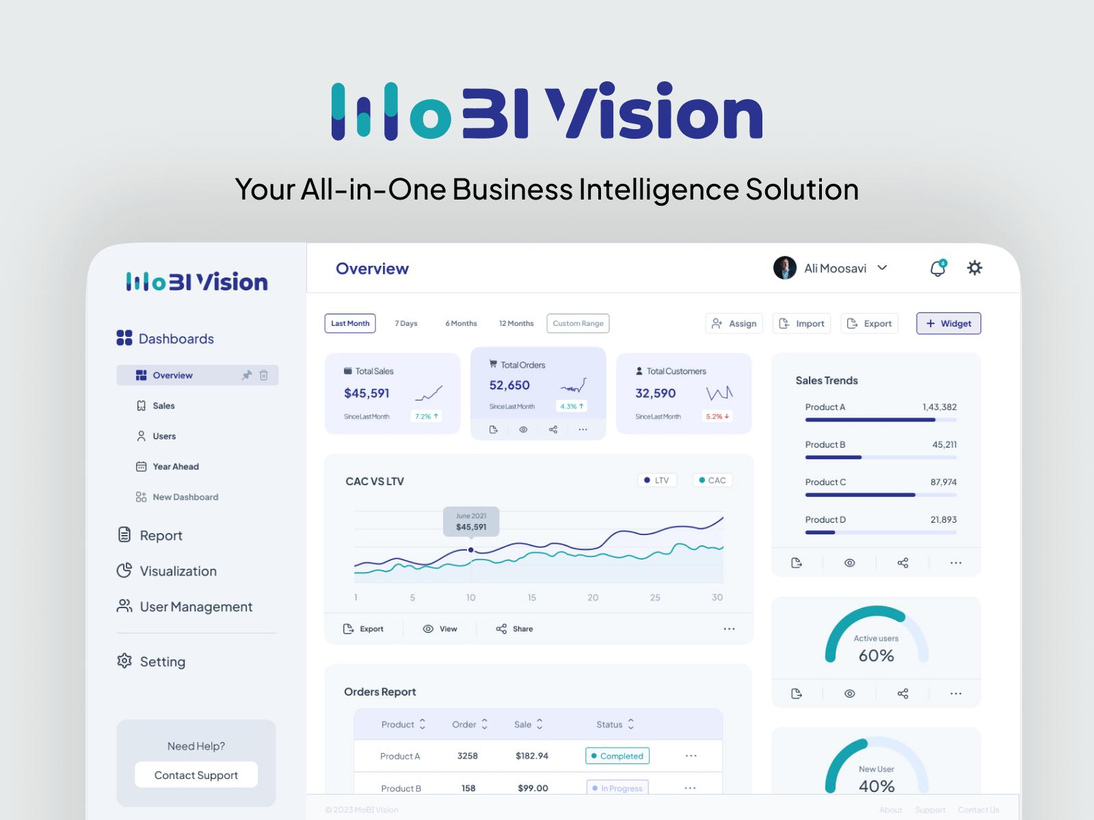

The Expected Impact: KPIs & Projected ROI
Key Performance Indicators (KPIs)
Brand Growth
Audience Reach
Lead Gen
+25% Awareness
+15% Sentiment Score
12M+ Total Impressions
8.5% Avg. Engagement
1,800+ New Leads
$35 CPA Target
Projected ROI Analysis
Total Investment
Projected Revenue
Calculated ROI
A dedicated analytics dashboard will provide real-time visibility into campaign performance, ensuring data-driven optimizations and transparent reporting throughout the project lifecycle.
$150,000
$480,000
220%
Projection based on historical performance data from similar campaigns (Q3 2024 benchmarks) with a Medium confidence level.
Notes:
Everything we do is focused on delivering measurable results. We've set clear KPIs across brand, engagement, and conversion metrics. Based on our analysis, we project a strong return on investment, making this a sound business decision, not just a creative one.

Slide 8





The Team & Timeline: Your Partners in Success
Project Roadmap & Milestones
Phase 1: Strategy & Creative (Weeks 1-3)
Deep-dive into business goals, audience insights, and concept ideation to align on a tailored plan.
Phase 2: Production & Setup (Weeks 4-5)
Content creation, asset design, technical setup, and platform configuration for seamless deployment.
Phase 3: Launch & Monitor (Weeks 6-12)
Campaign goes live with 24/7 performance tracking, real-time monitoring, and daily adjustments.
Account Director
Your dedicated point of contact for seamless communication and alignment.
Strategy Director
Crafts data-backed strategic vision and oversees the campaign roadmap.
Phase 4: Optimization & Reporting (Ongoing)
Data-driven A/B testing, budget reallocation, and weekly performance reviews to maximize results.
Creative Director
Leads innovative concept development for impactful and memorable campaigns.
Performance Manager
Manages day-to-day execution and optimizes for maximum ROI.
Phase 5: Final Analysis & Debrief (Week 13)
Comprehensive results report, key takeaways, and actionable recommendations for future growth.
Notes:
You'll be working with a dedicated team of experts who are committed to your success. Here's the core team you'll collaborate with, and a clear timeline outlining our process from start to finish. We believe in transparency and keeping you informed every step of the way.

Slide 9






Investment & Partnership: A Clear Path to Collaboration
Investment Breakdown
Partnership Model
Retainer / Project Fee: $15,000/mo
Covers strategy, account management, creative development, and detailed monthly reporting.
Performance-Based Bonus
Success is mutual. Earn a bonus structure based on exceeding KPIs like ROI, lead generation, or engagement targets.
Media Spend: $20,000/mo
Allocated to paid social, search, and display ads—managed with 100% financial transparency.
Strategic Monthly Reviews
Bi-weekly check-ins and monthly deep dives to review performance, adjust strategies, and align on goals.
Production Costs: $5,000 (one-time)
Covers high-quality video production, professional photography, and graphic asset creation.
Real-Time Collaboration
Dedicated Slack channel for instant communication, plus direct access to your account manager for urgent needs.
Total Estimated Investment: $40,000 (Initial)
Notes:
Our proposal is transparent and flexible. Here's a clear breakdown of the investment, covering our services, media spend, and production costs. More importantly, we want to build a true partnership with you, aligning our success with yours through open communication and shared goals.

Slide 10




Let's Begin: Transforming [Client Brand] Together
01. Deep Dive Workshop
02. Formalize Partnership
03. Target Launch Date
Collaborate with key stakeholders to refine the strategy, align on goals, and establish clear success metrics for the project.
Finalize contracts, SOW, and payment terms within 3 business days to secure the timeline and officially kick off operations.
Aim for an official go-live by Q4 2026, with a phased rollout strategy to ensure smooth adoption and maximize initial impact.
Sarah Jenkins
Account Director
+44 (20) 7987-6543
Direct Phone
sarah.j@agency.co
Email Address
www.agency.co
Visit Our Website
Notes:
We're ready to start transforming [Client Brand] together. Our strategy will deliver a stronger brand connection and a more efficient marketing operation. Let's take the next step. We propose scheduling a workshop to dive deeper, and we're ready to finalize the partnership to hit the ground running. Thank you.

