Slide 1

Shaping the Future of [Your Industry]
[Company Name] | Driving Growth and Efficiency Through Innovation and Strategic Vision
[Presenter Name], [Presenter Title] | [Date]
Notes:
Hello everyone, and welcome. Today, we're going to talk about how [Company Name] is not just participating in the evolution of [Your Industry], but actively shaping its future. We will explore the challenges we face, the innovative solutions we've developed, and how we can drive growth and efficiency for your business. Let's begin.

Slide 2






Agenda
01. The Imperative for Change
Understanding the market dynamics and challenges we address, and why a strategic shift is essential for sustained relevance in today’s evolving landscape.
02. Our Innovative Solution
Introducing our cutting-edge product/service and its core capabilities, engineered to directly resolve the critical pain points identified in the market analysis.
03. The Value Proposition
Delving into how we deliver measurable, data-backed results for clients, focusing on ROI, operational efficiency gains, and building long-term competitive advantage.
04. Real-World Impact
Highlighting successful client partnerships and case studies that demonstrate the tangible, transformative effect our solution has on businesses across key sectors.
05. Strategic Outlook
Mapping our growth trajectory, future product roadmap, and outlining the opportunities for you to collaborate and be an integral part of our journey toward industry leadership and shared success.
Notes:
Here's a roadmap for our discussion today. We'll start by examining the pressing need for change in our industry. Then, I'll introduce our innovative solution and its key features. We'll dive into the tangible value it brings, showcase some real-world success stories, and finally, look ahead to our strategic future.

Slide 3



The [Industry] Landscape: A Time for Transformation
Stagnation in Efficiency
Traditional workflows are limiting scalability and increasing operational costs by an average of [XX%], creating bottlenecks that hinder growth.
Evolving Customer Demands
Modern consumers expect seamless, personalized, and real-time experiences that legacy systems and current solutions are ill-equipped to deliver consistently.
Emerging Competitive Threats
Agile new market entrants are leveraging cutting-edge technologies to capture significant market share, unburdened by outdated infrastructure.
“This creates a critical juncture for businesses: adapt your strategies, modernize your operations, and embrace innovation – or risk being left behind in an increasingly dynamic market.”
Notes:
The landscape of our industry is changing rapidly. We're seeing three major trends: first, traditional methods are becoming inefficient and costly. Second, customer expectations are evolving faster than ever before. And third, new competitors are disrupting the market with agile technologies. This is not just a challenge; it's a clear call to action for transformation.

Slide 4
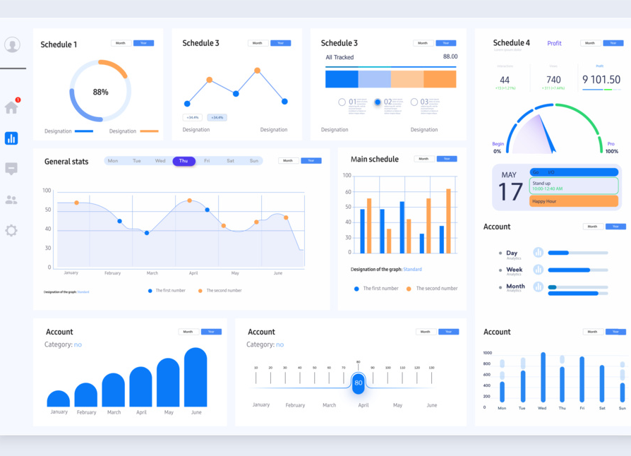


Introducing [Product/Service Name]
The All-in-One Platform for [Your Industry]
Automate Core Processes
Eliminate repetitive manual tasks and streamline workflows with intelligent automation, freeing your team to focus on high-value strategic initiatives.
Data-Driven Customer Engagement
Leverage real-time analytics to personalize interactions, anticipate needs, and build lasting relationships that drive loyalty and revenue growth.
Our intuitive dashboard delivers a unified view of your operations, making complex data accessible and actionable for every team member.
Notes:
To address these challenges, we've developed [Product/Service Name]. It's an all-in-one platform built specifically for [Your Industry]. Our solution is designed to empower your business by automating key processes, enhancing customer engagement, and enabling data-driven decisions. It's a scalable and intuitive tool that will fundamentally change how you operate.

Slide 5
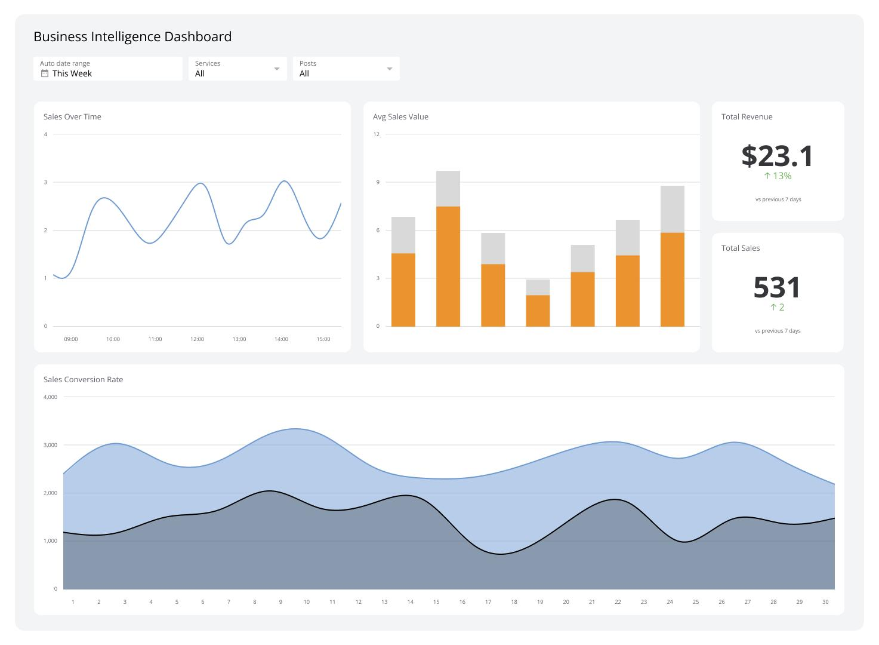



The Power of [Product/Service Name]: Key Features
Intuitive User Interface
Advanced Data Analytics
Designed for ease of use, requiring minimal training and maximizing user adoption across all team levels.
Transforms raw data into actionable insights, enabling proactive decision-making and strategic business planning.
Robust Security & Compliance
Scalable Architecture
Enterprise-grade protocols ensure your data is protected and fully aligned with the latest industry regulatory standards.
Grows seamlessly with your business, accommodating increased demand, new users, and evolving functionalities.
Our intuitive dashboard visualizes complex data streams in real time, empowering teams to monitor performance and uncover opportunities at a glance.
Notes:
Let's break down the core features that make our platform so powerful. First, it has an incredibly intuitive user interface, so your team can get up and running quickly. Second, our advanced data analytics turn complex data into clear, actionable insights. Third, we prioritize security with enterprise-grade protocols. And finally, our scalable architecture ensures the platform grows right alongside your business.

Slide 6



The Impact of [Product/Service Name]: Your Competitive Edge
Accelerate Growth
Optimize Costs
Streamline workflows to focus on strategic initiatives, driving revenue growth by an average of[XX%]. This shift from routine tasks to high-impact actions unlocks new market opportunities and scalability.
Reduce operational inefficiencies and eliminate redundant systems, resulting in cost savings of up to[XX%]. Reallocate freed resources toward innovation and customer experience enhancements for maximum ROI.
Empower Decision-Making
Strengthen Customer Loyalty
Access real-time, predictive analytics to make informed, forward-thinking business decisions. Turn raw data into actionable insights that guide strategy, mitigate risks, and capitalize on emerging market trends with confidence.
Deliver exceptional, personalized experiences that foster long-term customer relationships. Anticipate needs, resolve issues proactively, and build trust that turns first-time buyers into loyal brand advocates.
Notes:
So, what does this mean for your business? It means a real competitive edge. Our clients typically see accelerated revenue growth, significant cost optimizations, better decision-making through real-time analytics, and ultimately, stronger customer loyalty. These are not just features; these are tangible impacts on your bottom line.

Slide 7




Driving Success for Industry Leaders
The Challenge
The Solution
Struggled with fragmented data systems across departments, leading to poor operational visibility and slow, reactive decision-making.
Deployed our unified data platform to consolidate siloed sources and automate real-time reporting workflows.
Key Outcomes
Client Voice
Data processing speed improved by35%, unlocking a20% increasein cross-selling opportunities through actionable insights.
"This platform has become the backbone of our decision-making process. It's not just a tool; it's transformed how we do business."
— Sarah Jenkins, CIO
A partnership built on trust and innovation, delivering measurable results for a leading industry player.
Notes:
Don't just take our word for it. Let's look at a real-world example with [Client Company Name]. They were facing significant challenges with data fragmentation. After implementing our solution, they saw a 35% improvement in data processing speed and a 20% increase in cross-selling. As their executive said, it truly transformed their business.

Slide 8


Driven by Vision and Expertise
Elena Marquez, CEO & Founder
A visionary leader with 20+ years in sustainable manufacturing. Previously led global strategy at a Fortune 500 industrial firm, driving a 40% increase in market share through customer-centric innovation.
David Chen, Chief Technology Officer
A recognized expert in AI-driven automation, holding a PhD in Computer Science from Stanford. He has built award-winning platforms for scalable SaaS products and holds 12 patents in predictive analytics.
Sarah Jenkins, Chief Operating Officer
Our leadership team brings together decades of combined experience in industry innovation, technical excellence, and operational mastery to steer the company toward transformative success.
Brings extensive experience scaling global operations from her tenure at a leading logistics provider. She specializes in optimizing end-to-end workflows, reducing operational costs by 25% while enhancing team productivity.
Notes:
Behind every great product is a great team. Our leadership brings decades of combined experience in sustainable manufacturing and technology. From our visionary CEO Elena Marquez, who has a proven track record in global strategy, to our expert CTO David Chen, a pioneer in AI automation, and our seasoned COO Sarah Jenkins, who excels in scaling operations for efficiency, we have the knowledge and drive to deliver on our promises.

Slide 9


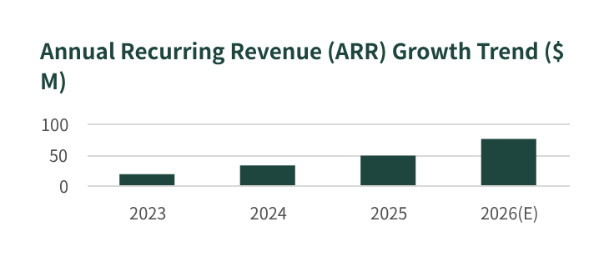

A Trajectory of Strong Growth
Consistent Revenue Growth
Achieved a 45% increase in annual recurring revenue (ARR) in 2025, driven by expanded service offerings and higher client retention rates across key verticals.
Expanding Global Client Base
Now serving over 500 enterprise clients across 30 countries, establishing a robust international footprint and diversifying our geographic revenue streams.
Strategic Series B Funding Secured
Successfully closed a $25M Series B round led by Horizon Capital, validating our market position and fueling product innovation and global expansion plans.
Notes:
Our success is also reflected in our financial performance. We've seen consistent revenue growth, our client base is expanding globally, and we've secured significant strategic funding. This growth trajectory validates our market position and our strategy for the future.

Slide 10




Ready to Transform Your Business?
Take the Next Step: Schedule a Personalized Demo
See how our solution can address your unique challenges, streamline operations, and unlock new growth opportunities tailored specifically for your business goals.
Visit Our Website
www.yourcompany.com
Explore resources and learn more
Send Us an Email
contact@yourcompany.com
We respond within 24 business hours
Call Us Directly
+1 (XXX) XXX-XXXX
Speak with a solutions expert today
Thank You.We look forward to partnering with you and helping your business thrive.
Notes:
So, are you ready to transform your business? The next step is simple: schedule a personalized demo. This will give you a firsthand look at how our solution can be tailored to your specific needs. You can find all our contact information on the screen. Thank you for your time, and we look forward to the opportunity to partner with you.

