Slide 1

[Company Name]
[Your Compelling Slogan / Value Proposition]
Date: June 19, 2026
[Company Logo]
Notes:
Hello everyone, and welcome. Today, I'm excited to share with you the vision and strategy behind [Company Name]. We are on a mission to [Your Compelling Slogan / Value Proposition], and I believe the opportunity we're addressing is truly transformative. Let's dive in.

Slide 2

Agenda
01. The Opportunity
04. Market Traction
Understanding the market landscape and unmet needs to identify the critical gaps our venture aims to fill.
Showcasing demonstrated success, key milestones achieved, customer feedback, and initial market penetration results.
02. Our Solution
05. The Team
An in-depth look at how we address the core challenges with innovative products and services tailored for the modern market.
Introducing the visionary leaders and industry experts with the diverse skill set and experience driving our mission forward.
03. Business Model
06. Future Outlook
Our robust strategy for sustainable growth, revenue generation, and long-term profitability in a competitive landscape.
A strategic roadmap outlining our expansion plans, upcoming milestones, and financial projections for the next three years.
Notes:
Here's the agenda for today. We'll start by exploring the market opportunity, then dive into our solution, business model, and market traction. We'll also introduce the team behind this vision and conclude with our future outlook and financial projections.

Slide 3




The Problem: Mid-sized Retailers are Facing Fragmented Customer Data
Core Issue: Data Silos Cripple Growth
Mid-sized retailers are drowning in disconnected customer information, leading to impersonal experiences, inconsistent service, and ultimately, significant revenue leakage from disengaged shoppers.
Operational Inefficiency
Manual, disjointed processes for onboarding and inventory management waste valuable employee time and create bottlenecks.
Prohibitive Costs & Legacy Tech
Reliance on outdated software and manual labor drives up overheads, with no clear ROI for small to medium budgets.
“Current solutions are either too expensive, too complex, or simply ineffective.”
— The Status Quo for Mid-Sized Retailers
Missed Opportunities for Growth
Without real-time analytics and scalable infrastructure, retailers fail to capitalize on trends and customer insights.
Notes:
First, let's talk about the problem. Our target market, mid-sized retailers, are facing a significant challenge: fragmented customer data. This leads to inefficiencies, high costs, and missed opportunities. The current solutions available to them are often too expensive or complex, leaving a clear gap in the market.

Slide 4


The Stakes Are High: The Cost of Inaction
Market Size
Financial Impact
Operational Impact
The global retail technology market is valued at$XX billionand is experiencing robust growth at a CAGR ofYY%. This rapid expansion underscores the urgency for businesses to adapt or risk falling behind in a hyper-competitive landscape.
Businesses lose an estimated$ZZ billion annuallydue to fragmented and poor customer data management, leading to missed opportunities and revenue leakage.
Teams wasteBB% of their timeon repetitive, manual tasks instead of high-value strategic activities, crippling productivity and employee morale.
The average retailer spends$AA per yearon inefficient manual processes, draining resources that could be invested in innovation and growth.
A staggeringCC% of customersreport dissatisfaction with impersonal experiences, directly impacting customer retention and brand loyalty.
Inaction is not an option: The cumulative toll of inefficiency, lost revenue, and disengagement threatens long-term business viability in a rapidly evolving market.
Notes:
The stakes are incredibly high. The market is massive, and the financial and operational impact of inaction is significant. Businesses are losing billions annually, and their teams are bogged down by inefficiencies. This isn't just a small problem; it's a major pain point that demands a solution.

Slide 5





Our Solution: AI-Powered Retail Data Platform
Core Value Proposition:We provide an AI-powered platform that unifies customer data, enabling retailers to deliver hyper-personalized experiences and increase customer lifetime value by30%.
How It Works (High-Level)
Why It's Different
Seamless Integration:Works effortlessly with your existing POS, CRM, and e-commerce systems.
Unmatched Simplicity:Intuitive UI/UX design means your team needs minimal training to start using it effectively.
Automated Analysis
Cleanses and processes data in real time with zero manual effort.
Actionable Insights
Delivers tailored recommendations to drive engagement.
True Scalability
Grows seamlessly with your business, from 10 to 10,000+ users.
Accessible Pricing
Enterprise-grade power at a mid-market cost.
Empowering retailers to turn data into meaningful, profitable customer relationships—without the complexity.
Notes:
This is where our solution comes in. [Product/Service Name] is an AI-powered platform that unifies customer data, empowering retailers to deliver hyper-personalized experiences. It works seamlessly with existing systems, automates complex tasks, and provides actionable insights. What sets us apart is our focus on simplicity, scalability, and affordability.

Slide 6
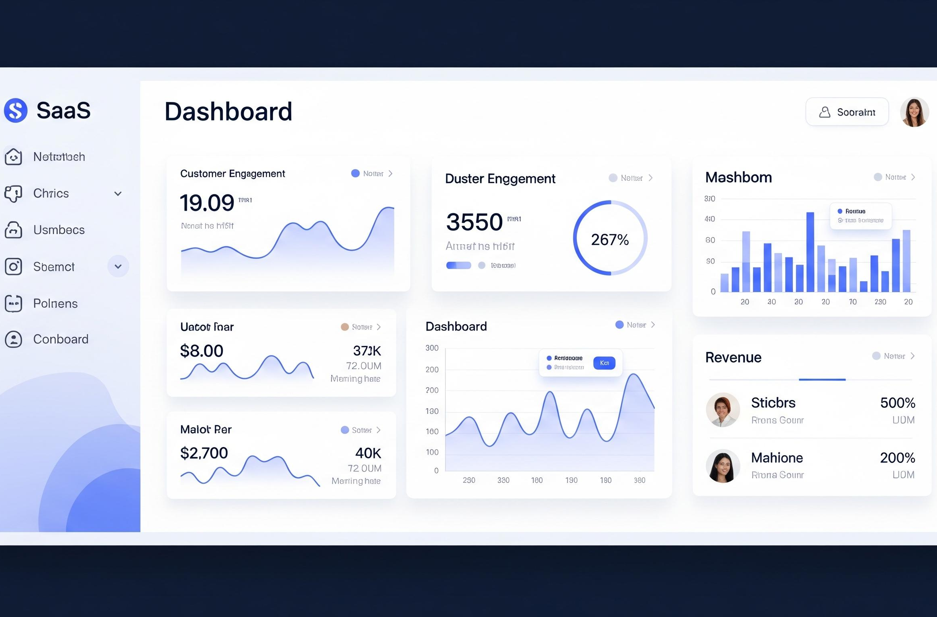


[Product Name]: Key Features & Functionality
Unified Customer Profile
Aggregate multi-source data for a 360° customer view. This holistic understanding eliminates manual data compilation, saving teams hours of work and enabling deep behavior analysis.
AI-Powered Recommendations
Leverage real-time analytics to generate hyper-personalized product suggestions. Data-driven decisions are made in minutes, not days, significantly boosting customer conversion rates.
Our intuitive SaaS dashboard integrates all core modules into a unified interface, offering real-time data visualization and streamlined workflows for maximum operational efficiency.
Automated Campaign Management
Streamline targeted campaign creation and execution across teams. Automating manual setup tasks reduces overhead, enhances cross-departmental collaboration, and speeds up project delivery.
Notes:
Let's take a closer look at our product. Key features include a Unified Customer Profile, which gives a 360-degree view of each customer. Our AI-Powered Recommendations engine drives personalization, and our Automated Campaign Management tool simplifies marketing efforts. Each feature is designed to deliver clear, measurable benefits to our users.

Slide 7



Our Path to Profitability
Diversified Revenue Streams
Scalable Pricing Tiers
Primary:SaaS subscriptions with tiered pricing based on users, features, and data volume.
Secondary:Implementation, training, and customization professional services.
Basic & Pro:Core features for small teams; advanced analytics & integrations for growing businesses.
Enterprise:Custom solutions with dedicated support for large organizations.
Robust Unit Economics
Future Growth Potential
Key Metrics:Low Customer Acquisition Cost (CAC) and high Lifetime Value (LTV) ensure efficient growth.
Ratio:A strong LTV/CAC ratio of 5:1 demonstrates a highly scalable and profitable business model.
Marketplace:Expanding into a curated marketplace to drive additional transaction fee revenue in future phases.
Innovation:Continuous feature expansion to capture new market segments and increase ARPU.
Our strategic focus on partnerships and scalable solutions drives sustainable revenue. The strong alignment of our offerings with market needs ensures long-term value creation for both clients and stakeholders.
Notes:
Our business model is designed for sustainable growth. We primarily generate revenue through SaaS subscriptions with tiered pricing to suit different business sizes. We also offer professional services. Our unit economics are strong, with a healthy LTV to CAC ratio of 5:1, demonstrating a profitable and scalable model.

Slide 8




How We Reach Our Customers
PRIMARY CHANNELS
CUSTOMER JOURNEY
Digital Marketing
Strategic content, SEO, and paid advertising on LinkedIn/Google drive brand visibility and lead generation.
01. Awareness
Webinars and thought leadership content position us as industry experts.
02. Consideration
Free trials and personalized product demos let prospects experience value.
Strategic Partnerships
Alliances with cloud providers and industry consultants extend our reach and credibility in target markets.
03. Conversion & Retention
Tailored sales process drives conversion, while onboarding and updates ensure long-term loyalty.
TARGET CUSTOMER PROFILE
Focused on Retail, Healthcare, and FinTech sectors with 50-500 employees. We engage key decision makers including CMOs and Operations Directors to align solutions with business goals.
Dedicated Sales Team
Inside sales focus on outbound prospecting and nurturing qualified leads to drive conversions.
Our holistic journey ensures every touchpoint delivers value, fostering trust and sustainable growth.
Notes:
Our go-to-market strategy is multi-faceted. We target specific industries and company sizes, focusing on key decision makers. We use a mix of digital marketing, strategic partnerships, and a dedicated sales team to reach our customers. Our customer journey is designed to guide prospects from awareness to retention, ensuring a smooth and valuable experience.

Slide 9



Proven Success & Momentum
Users & Customers
Annual Recurring Revenue
Sustained Growth
2,000+ active users and 150+ paying enterprise customers, demonstrating strong product-market fit.
Achieved $1.2M ARR with a 92% customer retention rate, building a stable and predictable revenue stream.
Experiencing 22% month-over-month (MoM) growth in new sign-ups, driven by organic referrals and marketing.
Q1 2025: MVP Launch
Q3 2025: Seed Funding
Q1 2026: Expansion
Current: Industry Leader
Successfully released MVP and onboarded the first 10 beta customers, validating core value proposition.
Secured $2.5 million in seed funding from leading investors to scale operations and product development.
Launched AI-powered analytics feature and successfully expanded services into the European market.
Achieved operational profitability and announced a strategic partnership with a Fortune 500 industry player.
"This product has completely transformed our workflow, automating tedious processes and saving our team countless hours each week. It's been a game-changer for our efficiency."— Maria Gonzalez, Operations Director, Global Retail Inc.
Notes:
We have already demonstrated significant traction in the market. Our user and customer numbers are growing rapidly, and we've achieved strong ARR. Key milestones, from launching our MVP to securing funding, show our momentum. Most importantly, our customers are seeing real value, as evidenced by their testimonials.

Slide 10

The Expertise Behind Our Vision
David Chen
CEO & Co-founder
Sarah Lin
CTO & Co-founder
Michael Tao
VP of Sales
15 years of SaaS expertise, previously led product innovation at a unicorn fintech startup. Holds an MBA from Wharton, driving strategic vision and market expansion.
AI and scalable systems expert with 8+ patents in distributed computing. Formerly built core infrastructure at Google, ensuring our tech stack is robust and future-proof.
Proven leader in building high-performing sales teams across the enterprise SaaS sector. Delivered 3x revenue growth in his last role by aligning strategy with customer needs.
“Our collective experience in SaaS, AI, and sales leadership is the cornerstone of our ability to deliver transformative solutions and drive sustainable growth.”
Combining visionary leadership, cutting-edge technical innovation, and data-driven sales strategy, our team is uniquely positioned to execute on our long-term mission.
Notes:
None of this would be possible without our exceptional team. Our founders bring decades of experience in SaaS and AI, and our key team members have proven track records in their respective fields. We have the right expertise to execute on our vision and drive the company forward.

Slide 11




Our Vision for the Future
Short-Term Goals (Next 12 Months)
Long-Term Vision (3-5 Years)
Product Innovation
Launch a major new core feature set and expand platform integrations to enhance user workflow efficiency and connectivity.
Market Leadership
Establish unrivaled authority in our niche by delivering superior value, becoming the undisputed first choice for customers and partners alike.
Market Growth
Penetrate new geographic markets and secure strategic partnerships to achieve a targeted $X million in Annual Recurring Revenue (ARR).
Strategic Diversification
Expand into high-potential adjacent markets, leveraging organic growth and strategic acquisitions to broaden our product ecosystem and reach.
Team Expansion
Scale engineering and customer success teams to support rapid growth, ensuring exceptional product quality and user satisfaction.
Industry Impact & Innovation
Redefine the operational standards of our industry through relentless innovation, setting new benchmarks for sustainability and efficiency.
Notes:
Looking ahead, we have ambitious but achievable goals. In the short term, we'll focus on product development, market expansion, and team growth. Our long-term vision is to become the market leader, expand into adjacent markets, and redefine the industry standard through continuous innovation.

Slide 12

Projected Growth & Financial Health
Revenue Projections (3-Yr)
Core Financial Assumptions
Strategic Use of Funds
Year 1 (2026):$12.5 Million
Initial market penetration and product launch phase.
Customer Acquisition Rate
Steady growth at 18% per quarter, driven by targeted marketing and referral programs.
40% Product & Innovation
R&D for next-gen features and patent filings.
Year 2 (2027):$28.0 Million
Expansion of customer base and entry into new regions.
30% Sales & Marketing
Scaling go-to-market channels and brand awareness.
ARPU & Retention
Average revenue per user at $4,800 with an annual churn rate maintained below 5%.
20% Team
Hiring key talent across engineering and sales.
10% G&A
Operational excellence and administrative overhead.
Year 3 (2028):$52.0 Million
Mature market leadership and full product ecosystem.
All forecasts are stress-tested against market volatility and adjusted for seasonality.
This financial roadmap underscores our commitment to sustainable growth, with a clear focus on innovation and market expansion to maximize ROI for stakeholders.
Notes:
Our financial projections reflect our confidence in the market opportunity and our ability to execute. We project strong revenue growth over the next three years, based on key assumptions around customer acquisition, ARPU, and churn. Any funds raised will be strategically allocated to fuel product development, sales, and team expansion.

Slide 13



Join Us in Transforming [Industry]
Recap the Value
We are solving a $XX billion problem with a proven solution that drives measurable ROI, ensuring tangible success and competitive advantage for our customers.
The Ask: Series A Funding
Seeking $X million to accelerate product development, scale our go-to-market strategy, and capture a significant share of the emerging industry landscape.
Call to Action
A collaborative approach to innovation, bringing together visionary partners to drive impactful change and sustainable growth in the market.
Partner with us to redefine the future of [industry], or invest in the leading solution for solving the critical challenges facing our market today.
Notes:
So, to recap, we are addressing a massive market with a proven solution that delivers real ROI. We are looking for partners who share our vision to transform the industry. We invite you to join us on this exciting journey.

Slide 14
Questions & Answers
Whether you’re curious about project details, implementation strategies, or future roadmaps, we’re here to address all your inquiries.
Notes:
Thank you for your time. I'm now happy to answer any questions you may have.

Slide 15




Thank You
[Your Name]| [Your Title]
Email: your.email@company.com
[Your Phone Number]
www.yourcompany.com
Notes:
Thank you again for your attention. I look forward to connecting with you further. Please feel free to reach out using the contact information provided. Have a great day.

