Slide 1

Marketing Performance Review
Data-Driven Insights & Strategic Recommendations
[Your Name/Department] | [Date]
Notes:
Good morning/afternoon. Today, I'll be presenting our marketing performance review for the past period. This presentation will provide data-driven insights into our key metrics, channel performance, and customer behavior, and will conclude with strategic recommendations for the future. Let's begin.

Slide 2





Executive Summary
01. Overall Performance
02. Top Initiative: Summer Sale
+15% YoY Revenue Growth
35% Open | 5% Conversion
Exceeded quarterly targets, driven by the new TikTok campaign that significantly boosted user engagement and direct conversions across all channels.
The email campaign was the quarter’s standout success, achieving record-high engagement and directly driving the majority of seasonal inventory turnover.
03. Key Challenge: LinkedIn ROI
04. Strategic Recommendation
-20% ROI Drop (vs Q1)
Budget Shift & Scale TikTok
Performance declined due to increased ad competition and audience saturation; current B2B targeting strategy requires immediate recalibration.
Reallocate 10% of LinkedIn’s budget to Pinterest (untapped potential) and double down on the high-performing TikTok content format to sustain growth.
Notes:
Let's start with the executive summary. Overall, we had a strong quarter with revenue up 15% year-over-year. Our email campaign was a standout success, but we did see a decline in LinkedIn ROI. Based on these insights, we recommend a strategic budget shift to capitalize on our strengths.

Slide 3




Agenda / Presentation Flow
01 Performance Review
02 Channel Deep Dive
03 Customer Journey
Analyze key metrics, growth trends, and core result highlights from the last quarter to establish a clear baseline for success.
Evaluate ROI across paid ads, social media, email campaigns, and SEO to identify high-performing channels and optimize budget allocation.
Map the end-to-end user experience, pinpoint friction points in the conversion funnel, and uncover opportunities to boost retention.
04 Audience & Market Insights
05 Strategic Plan & Next Steps
Gain a granular understanding of our target demographic’s behavior, preferences, and pain points. Analyze the competitive landscape to identify market gaps, emerging trends, and strategic positioning opportunities that align with our brand’s unique value proposition.
Outline actionable initiatives, a clear Q3-Q4 roadmap, and success metrics to drive growth. Define short-term wins and long-term goals, including cross-functional collaboration plans and resource allocation to ensure seamless execution and measurable impact.
Notes:
Here's the agenda for today. We'll start with a high-level performance review, then dive deep into channel performance and the customer journey. After that, we'll look at our audience and market, and finally, I'll present our strategic plan and next steps.

Slide 4
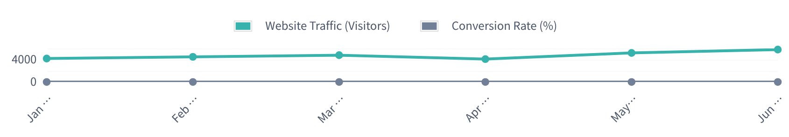
Key Performance Indicators (KPIs) - Q2 2026
Overall Revenue
Leads Generated
Customer Acquisition (CAC)
Conversion Rate
$42.5 M
18.2 K
$85.2
3.8%
▲ 12% vs. LY| ▲ 3% vs. Target
▲ 8% vs. LY| ▼ 2% vs. Target
▼ 5% vs. LY| Efficiency Gains
▲ 1.2% vs. LY| Strong Momentum
Website Traffic & Conversion Rate Trend (Jan - Jun 2026)
Key Takeaway:Traffic has steadily risen (+38% YoY), but conversion rates dipped in April due to a competitor’s product launch. Post-May, recovery is evident as we refined our landing page experience, aligning with a rebound in conversion rates to 4.1% in June.
Notes:
Now let's look at our key performance indicators. Revenue and CAC are trending positively, but lead generation is slightly below target. The chart shows that while website traffic is up, our conversion rate is inconsistent, which we believe is linked to competitive activity in April.

Slide 5
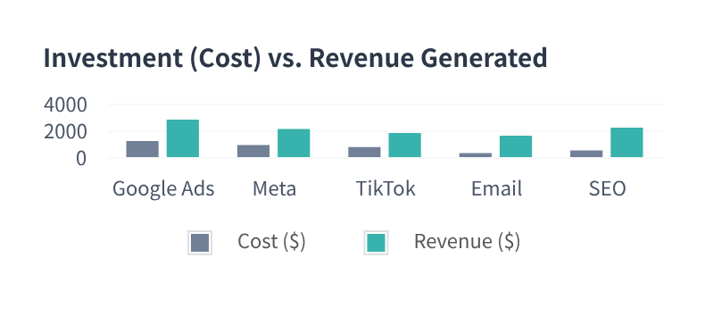

Channel Performance & ROI Analysis
Strategic Performance Insight
Email Marketing leads with a 5:1 ROI and the lowest CAC ($15), proving its unmatched cost-effectiveness. TikTok demonstrates high conversion potential (3.8%) but requires spend optimization to enhance profitability. SEO/Content remains a stable revenue driver with long-term value and low acquisition costs.
Channel Efficiency Metrics Breakdown
Channel | Total Spend ($) | Revenue ($) | ROI Ratio | CAC ($) | Conversion Rate
Google Ads | $1,200 | $2,800 | 2.33:1 | $45 | 2.1%
Meta (FB/IG) | $900 | $2,100 | 2.33:1 | $38 | 2.4%
TikTok | $750 | $1,800 | 2.40:1 | $32 | 3.8%
Email Marketing | $300 | $1,600 | 5.33:1 | $15 | 4.2%
Notes:
Diving into channel performance, this chart and table give us a clear picture. Email marketing remains our most profitable channel by far. TikTok is a rising star with high conversion rates, and we should look to optimize our spend there. This data helps us make informed decisions about budget allocation.

Slide 6

Customer Journey & Conversion Funnel
01 AwarenessWebsite Visitors: 1,000,000
02 InterestProduct Page Views: 200,000
Key Conversion Bottleneck
03 ConsiderationAdd to Cart: 50,000
The sharpest decline occurs between"Add to Cart"and"Initiated Checkout". This signals significant friction, likely due to unexpected shipping costs, a cumbersome checkout process, or a lack of preferred payment options.
04 IntentInitiated Checkout: 20,000
05 PurchaseCompleted: 10,000
Actionable Insight:Implement transparent shipping cost calculators early in the journey and simplify the checkout form fields.
Notes:
Understanding the customer journey is key to improving conversions. Our funnel analysis shows that we lose the most users between adding items to their cart and starting the checkout. This is our primary bottleneck and a key area for optimization.

Slide 7




Target Audience & Market Landscape
Persona Profile: “Tech-Savvy Tina”
Competitive Positioning (Innovation vs. Price)
Demographics:28-35, Urban Professional (tech/finance), High disposable income, values career & lifestyle balance.
Basic/Standard
High Innovation
Core Goals:Seeks efficient, premium products that save time; prioritizes quality over quantity; early adopter of new tech.
Comp
A
Our
Brand
Key Challenges:Decision fatigue from oversaturation; distrusts greenwashing; craves authentic, sustainable brands.
Media Habits:Active on LinkedIn/Twitter; reads Wired/The Verge; listens to tech/leadership podcasts during commutes.
Comp B
Comp C
Low Price Point
Premium Pricing
Strategic Takeaway
While we dominate the premium innovation space, Competitor A is directly targeting our audience segment with similar features at a lower cost. This necessitates a focus on storytelling that emphasizes our unique brand authenticity and superior user experience to justify the price premium.
Notes:
To win in the market, we must understand our audience and our competition. Our primary persona, 'Tech-Savvy Tina', values efficiency and quality. The competitive matrix shows we are the premium leader, but we need to be mindful of Competitor A, who is targeting a similar audience at a lower price.

Slide 8



Strategic Plan & Roadmap - 2026-2027
Key Marketing Initiatives (Q3 '26 – Q2 '27)
Q3 '26 | Foundation
Q4 '26 | Acceleration
H1 '27 | Expansion
New Website Beta Launch
Finalize UX/UI, migrate core content, and begin internal & beta testing with select users.
Holiday Campaign Go-Live
Omni-channel push with targeted promotions, influencer collabs, and retargeting ads.
Product Line Extension
Launch new SKUs, expand into adjacent markets, and optimize supply chain for scale.
Core Strategic Pillars
Content Excellence
Audience-Centric Growth
Seamless CX Journey
Build authority with SEO-optimized, data-backed content. Focus on thought leadership to drive organic traffic and brand trust.
Reallocate budget to high-ROI channels (TikTok, Email). Refine targeting with analytics to reach and convert high-intent users.
Optimize every touchpoint from discovery to post-purchase. Reduce friction in the funnel and enhance retention with personalized care.
Notes:
Looking ahead, this is our strategic roadmap. We'll be focusing on three key pillars: content excellence, audience-centric acquisition, and a seamless customer experience. The timeline outlines our major initiatives for the next year, including the Q4 holiday campaign and a new website launch.

Slide 9



Key Initiatives & Action Plan
Initiative | Action Item | Owner | Deadline | Status
Q4 Holiday Campaign | Finalize campaign theme & messaging | Jane D. | Aug 15, 2026 | Not Started
 | Develop email campaign sequence | Mike S. | Sep 1, 2026 | Not Started
TikTok Content Series | Identify 5 new content creators | Sarah L. | Jul 31, 2026 | In Progress
Total Allocated Budget
Paid Media Spend
Content Creation
$50,000
$25,000
$20,000
Base funding for all marketing initiatives
Targeted social ads & influencer boosts
Production costs & creator collaboration fees
Notes:
To turn our strategy into action, here's a breakdown of our key initiatives. Each action item has a clear owner and deadline. We've also allocated the necessary budget to ensure these initiatives are properly resourced.

Slide 10




Q&A / Thank You
01 Follow-up Report
02 Budget Approval
03 Team Sync Meeting
A comprehensive post-presentation report, including detailed metrics and analysis, will be shared via email by EOD tomorrow.
Seeking formal sign-off for the proposed Q4 campaign budget allocation by this Friday to ensure timely execution.
Next cross-functional marketing alignment is scheduled for Wednesday, 10:00 AM (GMT+8) to review next steps.
Thank you for your time and attention.
Alex Chen | Senior Marketing Director | alex.c@marketing.com
Notes:
That concludes my presentation. Thank you for your time. A detailed report will follow, and I'd now like to open the floor for any questions you may have. Let's discuss how we can drive even greater success in the coming quarter.

