Slide 1
[Your Startup Name]
[Your Compelling Slogan]
Pitch Deck
June 2026
Notes:
Hello everyone, and thank you for joining us today. My name is [Your Name], and I'm the [Your Title] of [Your Startup Name]. Today, I'm excited to share with you our vision to [briefly state your mission].

Slide 2



The Problem
Inefficiency
High Costs
Lack of Insight
[Industry/Market] is Broken
Current solutions are slow, cumbersome, and fail to integrate with modern workflows, leading to massive, avoidable productivity loss.
Businesses overpay for rigid, one-size-fits-all software that ignores their unique needs, draining resources with little return on investment.
Critical data is trapped in isolated silos, leaving companies unable to make informed, data-driven decisions and missing key growth opportunities.
Current systems are outdated, disconnected, and unfit for modern business demands. This isn’t just a minor inconvenience—it’s a systemic failure that cripples productivity and stunts sustainable growth across organizations.
This broken ecosystem creates a vicious cycle: wasted time, wasted money, and wasted potential—all while competitors using modern tools pull ahead.
Notes:
Let's start with the problem. The [target industry] is facing a critical challenge. Current tools are inefficient, costing businesses time and money. Worse, they create data silos, leaving companies flying blind. This isn't just an inconvenience; it's a major barrier to growth.

Slide 3



Our Solution: [Product Name]
The All-in-One Platform for [Target Audience]
[Product Name] is a powerful, intuitive SaaS platform designed to streamline your workflow and unlock data-driven growth. We eliminate tool fragmentation and empower teams with a unified, intelligent system that scales with your ambition.
Seamless Integration
Connects all your essential tools—CRM, analytics, and project management—into a single, unified dashboard for complete visibility.
AI-Powered Insights
Transform raw data into actionable recommendations to identify opportunities and drive strategic decisions.
Flexible & Scalable
Adapt to your business needs—from early-stage startups to enterprise clients—with transparent, tiered pricing.
"Unlocking efficiency, one workflow at a time."
Notes:
Our solution, [Product Name], is the answer to these challenges. It's an all-in-one platform that seamlessly integrates your existing tools and uses the power of AI to turn your data into actionable insights. It's flexible, scalable, and built for the way modern businesses work.

Slide 4


Product Overview: Key Features
An All-in-One Platform for Modern Teams
Seamlessly integrating data, processes, and people to deliver a unified experience. Our intuitive interface centralizes critical business functions, enabling faster decisions and streamlined operations—all within a single, accessible workspace.
Smart Dashboard
Automated Workflows
Advanced Collaboration
Gain a bird's-eye view of your business with real-time analytics and fully customizable reporting modules, turning raw data into actionable insights at a glance.
Eliminate repetitive manual tasks with flexible automation rules. Streamline approvals, data entry, and notifications to save hours of work every week for your team.
Foster seamless teamwork with integrated chat, shared workspaces, and real-time co-editing. Keep everyone aligned and connected, no matter where your team is located.
Notes:
Let's take a quick look at the product. At its core is our Smart Dashboard, giving you real-time insights. We've also built powerful Automated Workflows to save you time, and Advanced Collaboration features to keep your team connected. It's designed to be intuitive, so your team can get up and running in minutes.

Slide 5



Market Opportunity: A Massive, Growing Market
Total Addressable Market (TAM)
Serviceable Addressable Market (SAM)
Serviceable Obtainable Market (SOM)
$XX.X B
$XX.X B
$XX.X M
The global market for enterprise software solutions, encompassing all industries and regions with demand for scalable digital transformation tools.
The focused segment of mid-sized retail businesses in North America actively seeking cloud-based SaaS inventory and customer management platforms.
Our realistic, near-term target: capturing a measurable share of the SAM within the next 3–5 years through strategic partnerships and regional expansion.
This tiered market structure validates a clear path from broad potential to actionable, revenue-driving opportunities, ensuring sustainable growth and scalability.
Notes:
The market opportunity is enormous. We're targeting a Total Addressable Market of $XX.X billion. Our immediate focus is on a Serviceable Addressable Market of $XX.X billion, and we believe we can capture a significant portion of a $XX.X million Serviceable Obtainable Market in the coming years.

Slide 6


Business Model: Proven & Profitable
We operate on aSaaS subscription modelwith tiered pricing designed to align with businesses of all sizes, from startups to enterprise clients. This recurring revenue structure ensures predictable cash flow and sustainable long-term growth.
Customer Lifetime Value (LTV)
Customer Acquisition Cost (CAC)
$2,400
$450
Basic Tier: For Individuals & Startups
Entry-level access to core features, ideal for early-stage teams looking to adopt our platform with minimal upfront investment.
LTV / CAC Ratio (Industry Benchmark: 3:1)
5.3:1— Demonstrating highly efficient and sustainable customer acquisition and retention.
Pro & Enterprise: For Scaling & Enterprise Teams
Advanced functionality, dedicated support, and custom integrations for growing businesses and large organizations requiring tailored solutions.
Notes:
Our business model is straightforward and proven. We offer SaaS subscriptions with clear tiered pricing. Our unit economics are strong, with a Customer Lifetime Value that is X times our Customer Acquisition Cost, demonstrating a highly efficient and scalable growth engine.

Slide 7
Competitive Landscape: Standing Out from the Crowd
Competitor A
Competitor B
STRENGTHS:
Established large brand presence with a comprehensive, wide feature set for enterprise use cases.
WEAKNESSES:
Prohibitive pricing tiers, outdated and clunky UI, and notoriously slow customer support response.
STRENGTHS:
Aggressively low price point that appeals to small businesses and price-sensitive startups.
WEAKNESSES:
Extremely limited core functionality and a rigid architecture that offers poor scalability for growth.
Competitor C
[Our Product]
STRENGTHS:
Hyper-focused on a narrow niche market, delivering specialized features for that segment.
WEAKNESSES:
Lacks third-party integrations, has a stagnant product roadmap, and struggles to adapt to broader needs.
OUR STRENGTHS:
Industry-first AI-powered insights, seamless cross-tool integration, and an intuitive, user-centric UX.
KEY CONSIDERATIONS:
As a newer brand, we are actively building market share and trust, with rapid iteration to address feedback.
OUR USP:We combine the power of AI-driven insights with a truly unified platform experience—eliminating the tradeoffs of cost, complexity, and capability that plague our competitors.
Notes:
The market is competitive, but fragmented. Competitors are either too expensive, too limited, or too difficult to use. [Our Product] stands out by combining AI-powered insights with a seamless, integrated experience. This is our unique selling proposition.

Slide 8


Go-to-Market Strategy
Phase 1: Product-Led
Phase 2: Sales-Led
Phase 3: Channel Partners
Utilize a freemium model and data-driven content marketing to drive organic sign-ups. Focus on building a loyal user base and refining the product through direct user feedback loops.
Build a dedicated sales team to target mid-market and enterprise clients. Implement account-based sales strategies to close high-value deals and scale revenue efficiently.
Establish strategic alliances with complementary software providers and industry consultants. Leverage partner networks for expanded market reach and accelerated customer acquisition.
NOW — Immediate Traction
NEXT 6–12 MONTHS — Scaling Revenue
12+ MONTHS — Ecosystem Expansion
Notes:
Our go-to-market strategy is phased and multi-pronged. We're currently leveraging product-led growth with a freemium model to gain initial traction. Next, we'll build a sales team to target larger clients, and eventually, we'll expand through strategic channel partnerships.

Slide 9


The Team: Built for Success
Elena Marquez
FOUNDER & CEO
Marcus Reed
CHIEF TECHNOLOGY OFFICER
Sofia Chen
CHIEF PRODUCT OFFICER
Serial entrepreneur with 15+ years of experience scaling SaaS and AI ventures. Previously founded and exited a B2B SaaS platform acquired by a Fortune 500 tech leader. Deeply passionate about building products that solve real-world operational pain points.
Tech visionary with 12 years of building resilient, scalable cloud-native platforms. Expert in AI/ML model deployment and distributed systems architecture. Led engineering teams at two high-growth startups, delivering enterprise-grade solutions with 99.99% uptime.
Product growth expert with a proven track record of scaling user bases from 0 to millions. Previously led product strategy at a top-tier fintech unicorn, driving adoption through data-informed iteration and user-centric design principles.
Combining entrepreneurial grit, cutting-edge technical expertise, and data-driven product strategy, our team is uniquely positioned to deliver transformative solutions for the market.
Notes:
None of this would be possible without our exceptional team. We bring together deep expertise in entrepreneurship, technology, and product growth. We've been there, done that, and we're passionate about solving this problem.

Slide 10
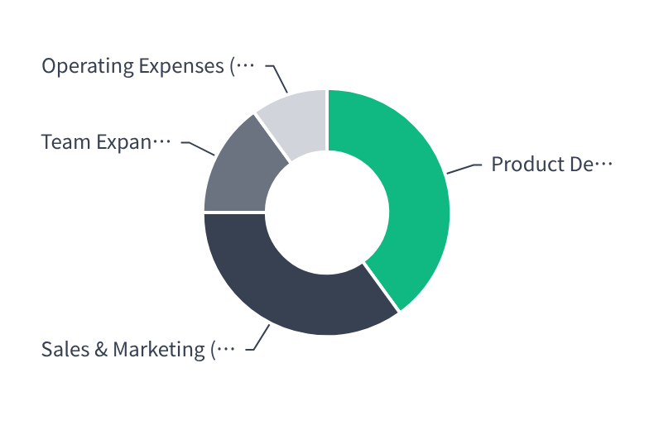
The Ask: Fueling Our Growth
Use of Funds Allocation
$[X] Million
Seeking Seed / Series A funding to accelerate product development and scale go-to-market operations.
3-Year ARR Target
Projecting $[X] Million in Annual Recurring Revenue by Year 3, driven by market adoption and scalable customer acquisition channels.
Prioritizing product innovation and customer growth to establish market leadership and sustainable revenue streams.
Notes:
To bring this vision to life, we are seeking $[X] million in funding. This capital will be primarily allocated to product development and scaling our go-to-market efforts. With this investment, we project reaching $[X] million in Annual Recurring Revenue within three years.

Slide 11


Thank You
Q & A
Name
[Your Name]
Title
[Your Title]
Email
[Email Address]
Website
[Website]
Notes:
Thank you for your time. We believe [Your Startup Name] is poised to transform the [target industry]. We're excited to answer any questions you may have.

