Slide 1
SynergyOS
The Next-Generation Enterprise Digital Collaboration Platform
Connect · Synergize · Intelligentize
Presenter: [Your Name/Department] | Date: June 18, 2026
Notes:
大家好，欢迎参加今天的分享。今天我将向大家介绍一款革命性的产品——SynergyOS，它是新一代的企业数字化协同平台。我们的核心理念是“连接、协同、智能”，旨在帮助企业在数字化浪潮中抓住机遇，应对挑战，构建全新的竞争力。

Slide 2
CONTENTS
01
Era Background & Corporate Challenges
Opportunities and Challenges in the Digital Wave; Core Pain Points of Traditional Office Models.
04
Core Advantages & Value
Revolutionary Differences; Why Choose SynergyOS.
02
SynergyOS Solution Overview
Product Vision & Core Values; Overall Architecture & Design Philosophy.
05
Value Quantification & Data
KPI Improvement Analysis; ROI Model Overview.
03
Core Functional Modules
Collaboration Hub, Integrated Processes, Data Cockpit.
06
Success Case Sharing
[XX Group] Digital Transformation Journey.
07
Cooperation Outlook
Implementation Path & Future.
Notes:
本次分享将分为七个部分。首先，我们将探讨当前的时代背景与企业面临的挑战。接着，我会介绍SynergyOS的整体解决方案。然后，我们将深入了解其三大核心功能模块。之后，通过对比和数据展示，量化其价值。最后，我们会分享一个成功案例，并展望未来的合作。

Slide 3



01
Era Background & Corporate Challenges
The Global Surge of Digitalization
Stagnant Business Growth
Organizational Capabilities Need Urgent Upgrade
Rapid tech iteration, blurred markets, intertwined global rivalry and local needs have fundamentally reshaped corporate operating landscapes.
Stagnant traditional models, fading traffic gains and rising customer costs call for new value & profit growth engines.
Stiff processes, disjointed data and weak team digital skills fail to meet demands for agile decisions & efficient teamwork.
Notes:
首先，让我们进入第一部分，探讨我们所处的时代背景以及企业在数字化转型过程中普遍面临的挑战。理解这些宏观环境和具体痛点，是我们找到有效解决方案的前提。

Slide 4



Embrace Change: The New Paradigm for Enterprises in the Digital Wave
Driven by both global economic integration and technological revolution, digital transformation has evolved from an 'option' to a 'necessity' for corporate survival and development. Technologies such as cloud computing, big data, and artificial intelligence are profoundly reshaping the business landscape, driving fundamental changes in operational models, organizational structures, and customer interaction methods.
Information Silos
Process Fragmentation
Decision Latency
Inefficient Collaboration
Business systems operate in isolation, data cannot flow and share freely, leading to difficulties in cross-departmental collaboration and a lack of a global perspective in decision-making.
Key business processes rely on email, Excel, and offline communication, resulting in numerous process breakpoints, opaque status, and low efficiency.
Managers lack real-time, accurate data support, relying on periodic reports and experience for decision-making, unable to respond quickly to market changes.
Team communication relies on instant messaging tools and email, leading to fragmented information, confusion with important document versions, and difficulty in task tracking.
SynergyOS's Way to Break the Deadlock:SynergyOS is born to address the above challenges. Through our three core capabilities of Connection, Synergy, and Intelligence, we break down information silos, integrate business processes, empower smart decision-making, and help enterprises build agile, efficient, and intelligent digital core competencies.
Notes:
We are in an irreversible digital age. However, many enterprises face four major 'invisible shackles' in their transformation: information silos, process fragmentation, decision latency, and inefficient collaboration. These issues severely restrict enterprise development. SynergyOS was born to break these shackles, providing enterprises with a brand-new digital collaboration operating system through Connection, Synergy, and Intelligence.

Slide 5




02
SynergyOS Solution Overview
Full-Stack Collaborative Architecture
AI Intelligent Engine
Open & Compatible Ecosystem
Enterprise-Grade Security & Compliance
Create an integrated digital foundation for the fusion of organization, processes, and data, enabling efficient collaboration in multi-system heterogeneous environments.
Built-in intelligent algorithm models provide data insights, process automation, intelligent Q&A, and other capabilities to drive business intelligence.
Boasts a powerful low-code ecosystem and open APIs, easily connecting existing IT assets and protecting corporate investments.
Adheres to international standards for data privacy protection and security management systems, ensuring the security of core corporate data and business assets.
Notes:
Next, I will provide a detailed introduction to the SynergyOS solution. We will see that it is not just a software tool, but a complete enterprise digital collaborative operating system.

Slide 6
SynergyOS: Integrated Collaboration, Driving Business Growth
Intelligent Collaboration Hub
Integrated Business Processes
Panoramic Data Cockpit
Reshape Team Collaboration, Inspire Organizational Vitality
Drive Efficient Operations, Optimize Resource Allocation
Empower Smart Decision-Making, Insight into Business Opportunities
Unified Work Entry:Integrates all collaboration tools such as instant messaging, audio/video conferencing, online documents, and task management.
AI Intelligent Assistant:Automatically generates meeting minutes, task to-dos, and information summaries, and intelligently recommends relevant documents and contacts.
Knowledge Management:Converts project docs and communication records into a structured corporate knowledge base.
Low-Code Process Engine:A visual designer allows quick building/optimization of approval processes without programming.
Cross-System Integration:Connects ERP, CRM via open APIs, breaking information silos.
Mobile Approval:All processes support mobile handling for anytime, anywhere approval.
Multi-dimensional Dashboard:Drag-and-drop custom reports display core business indicators in real-time.
Intelligent Analysis:Built-in models identify trends, detect anomalies, and provide alerts.
Self-Service Analysis:Easy tools enable business personnel to explore data independently.
Notes:
SynergyOS consists of three core modules. First, the "Intelligent Collaboration Hub" reshapes team collaboration by integrating all tools into a unified workspace. Second, "Integrated Business Processes" drive operational efficiency through a low-code engine and open integration capabilities. Finally, the "Panoramic Data Cockpit" provides managers with real-time, intelligent data insights to empower smart decision-making.

Slide 7
03
Core Advantages & Value Comparison
Say goodbye to the efficiency bottlenecks of traditional office models. By reconstructing collaboration processes, integrating core data, and optimizing resource allocation, SynergyOS brings revolutionary value to enterprises in terms of cost reduction and efficiency improvement. This chapter will deeply analyze its irreplaceable core competitiveness from three dimensions: efficiency, cost, and experience.
Notes:
那么，SynergyOS相比传统的办公模式，究竟有哪些革命性的差异和优势呢？在第三部分，我们将通过一个直观的对比来揭示其核心价值。

Slide 8
Revolutionary Differences: SynergyOS vs. Traditional Office Models
Core Dimension
Pain Points of Traditional Models
SynergyOS Next-Gen Solution
Key Value Output
Information Flow
Information silos, data scattered across systems, heavily reliant on manual aggregation, inefficient and error-prone.
Data Interconnection: Build a unified data foundation, break down system barriers, enable seamless flow.
90% Increase in Information Transparency
Collaboration Efficiency
Decentralized communication, repetitive processes, prone to information loss or distortion.
Scenario-based Collaboration: Aggregates info around tasks, clear context, efficient tracking.
50% Increase in Team Collaboration Efficiency
Process Management
Lengthy approval processes, opaque status, heavily reliant on offline reminders.
Process Automation: Visual engine, full online flow, real-time tracking, shorter cycles.
70% Reduction in Process Handling Time
Decision Support
Relies on lagging reports and experience, high risk, slow response to market changes.
Data-Driven: Real-time dashboards & intelligent alerts assist forward-looking decisions.
60% Increase in Decision Response Speed
Notes:
This slide highlights the revolutionary differences between SynergyOS and traditional office models across key dimensions like Information Flow, Collaboration Efficiency, Process Management, and Decision Support. SynergyOS delivers tangible value such as 90% increase in information transparency, 70% reduction in process handling time, and more, driving substantial business improvements.

Slide 9


04
Value Quantification & Data Presentation
Significant Efficiency Leap
Sharp Drop in Operating Costs
Scientific & Visual Decision-Making
Through process automation and resource allocation optimization, core business processing efficiency is increased by more than 45%, significantly shortening project delivery cycles.
Integrate redundant systems and optimize resource allocation, reducing overall operating costs by 30%, thus achieving leaner resource input and output.
Build a global data dashboard, transforming business insights into visual decision-making basis, making management and strategic decisions precise and evidence-based.
Notes:
Next, we will quantify the measurable benefits SynergyOS brings to the enterprise through specific data. These data will visually demonstrate its outstanding performance in improving efficiency, reducing costs, and optimizing decision-making.

Slide 10
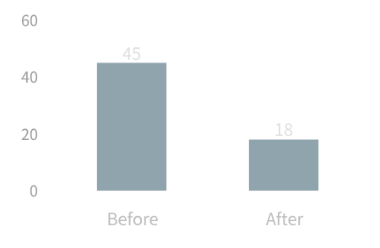
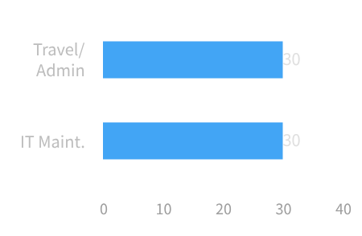
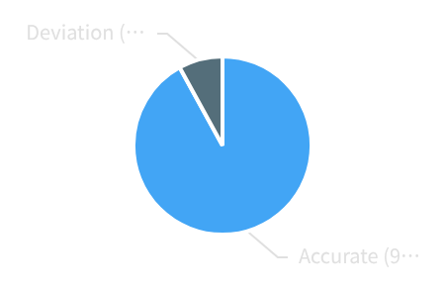
Quantified Value: Tangible Benefits of SynergyOS for Enterprises
01 Significant Improvement in Operational Efficiency
02 Effective Reduction in Operating Costs
03 Optimization of Decision Quality & Speed
Cross-departmental project delivery cycles shortened by60%, employees' average daily effective working hours increased by27%, achieving a dual leap in efficiency and collaboration speed.
Replacing offline operations with digital processes cuts annual travel/administrative and IT maintenance costs by30%each, effectively reducing unnecessary fixed expenditures.
Strategic decision info access shortened from 48h tonear real-time, with key business indicator prediction accuracy up to 92%, enabling more precise and timely decisions.
Notes:
Data is the best proof. After using SynergyOS, our customers have seen cross-departmental project delivery cycles shortened by 60% and employees' average daily effective working hours increased by 27%. Meanwhile, travel/administrative expenses and IT maintenance costs have both been reduced by 30%. Most importantly, strategic decision information acquisition has been shortened from 48 hours to real-time, with prediction accuracy also greatly improved. These figures fully demonstrate the enormous value of SynergyOS.

Slide 11
05
Success Case Sharing
Taking the Fortune 500 company XX Group as a benchmark, we deeply analyze the outstanding highlights of its full-link digital transformation with the help of SynergyOS. From business pain point identification to solution implementation, from efficiency improvement to data-driven management change, we comprehensively present the real transformation of technology empowering business value.
Notes:
理论和数据固然重要，但真实的案例更具说服力。接下来，让我们分享一个世界500强企业——XX集团的数字化转型故事，看看他们是如何通过SynergyOS实现蜕变的。

Slide 12
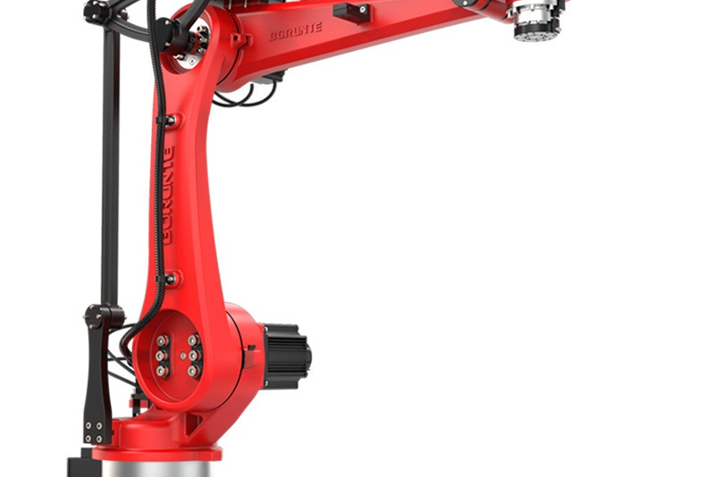

Success Story: [XX Group]'s Digital Transformation Journey
Global Collaborative Workspace, Breaking Communication Boundaries
Build a unified digital collaborative workspace to enable barrier-free communication for global teams, integrating multi-language real-time translation, a unified global calendar view, and cross-time zone meeting scheduling functions.
Integrated Supply Chain, Full-Link Visible & Controllable
Connect the entire chain of design, production, customers, and logistics to achieve real-time information flow synchronization, greatly improving order processing efficiency and inventory turnover rate.
Client Background:As a Fortune 500 intelligent manufacturing enterprise, XX has 80,000 global employees, operates in more than 30 countries, and is a leader in the industry.
33%
R&D Cycle Reduction
60%
Supply Chain Efficiency
2h
Data Prep Time
Challenges Faced:The existing collaboration barriers and data lag have led to slow and heavily impeded decision-making.
"SynergyOS is more than just a tool; it has become the core engine for our group's digital transformation."
—— Global CIO, [XX Group]
Notes:
As a large multinational manufacturing enterprise, XX Group faced severe challenges such as global collaboration barriers, complex supply chains, and delayed decision-making. By deploying SynergyOS, they built a global collaborative workspace, an integrated supply chain platform, and a group-level data cockpit. Ultimately, the new product R&D cycle was reduced by 33%, supply chain efficiency was increased by 60%, and decision-making efficiency also achieved a qualitative leap. As their CIO said, SynergyOS has become the core engine of their digital transformation.

Slide 13
06
Cooperation Outlook & Next Steps
01 Strategic Synergy Planning
02 Full Business Implementation
03 Long-Term Value Empowerment
Deeply align with the core development strategies of both parties, establish a high-level regular communication mechanism, and ensure the cooperation direction is highly consistent with the long-term vision of the enterprise.
Extend from pilot projects to full business scenarios, break down data silos and process barriers, and drive continuous growth of business value with actual implementation results.
Build a talent development and technology iteration system, accumulate digital transformation methodologies, and create sustainable core competitiveness for the enterprise.
Notes:
最后，让我们共同展望未来的合作。我们希望能与您携手，开启贵公司的数字化转型之旅。

Slide 14




Co-creating the New Future of Enterprise Digitalization
01 Connect
02 Synergize
03 Intelligence
Break down system and departmental barriers to achieve full integration of data and processes.
Reshape team work styles to inspire organizational vitality and innovative potential.
Empower data-driven decision-making to lead enterprises towards intelligent operations.
Professional Implementation Team
Flexible Scalability
Reliable Security Assurance
Bringing together industry experts to provide full lifecycle services from consulting, deployment to training, ensuring the smooth implementation of the solution.
Modular design supports enterprises in continuously iterating and expanding functions according to business development, protecting long-term corporate investment.
Adopting financial-grade security technologies and protection systems, establishing a complete data security protection closed loop to ensure the security of core corporate data assets.
Start your digital transformation journey now, and let us embrace an agile, efficient, and intelligent future enterprise together!
Website: www.yourcompany.com | Tel: 400-XXX-XXXX | Email: contact@yourcompany.com
Notes:
总结一下，SynergyOS通过连接、协同、智能三大核心能力，为企业提供了一套完整的数字化协同解决方案。我们承诺提供专业的服务、灵活的扩展能力和可靠的安全保障。我们诚挚地邀请您，即刻开启数字化转型之旅，与我们共创企业数字化的新未来。

Slide 15
Thank You
Notes:
我的分享到此结束，感谢大家的聆听！

