Slide 1



EasyEats
By: Tejas Bhoir, Elizabeth Caronia, Brett Lechner, Raj Patel, Kristen Wong, Prithvi Venkateswaran

Slide 2
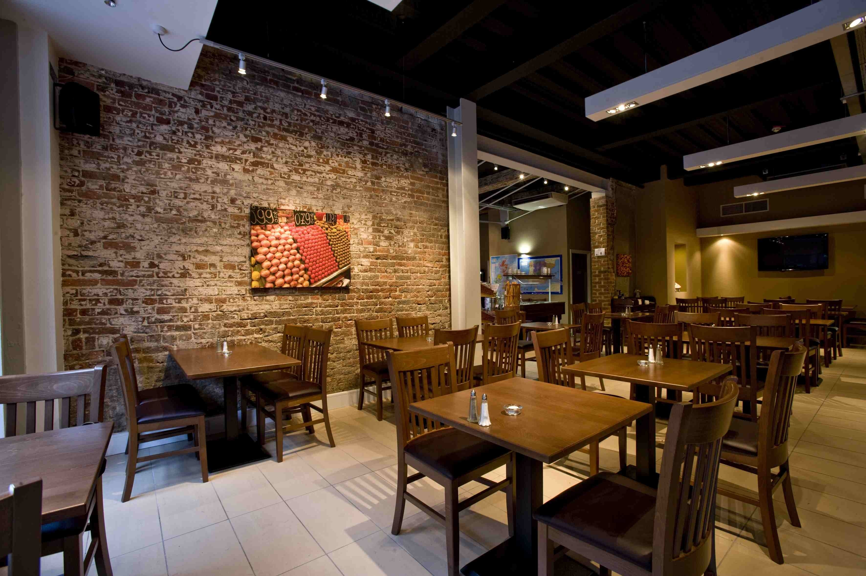
Problems
Efficiency
Table seating
Food
Creation
Delivery
Ordering
Menu correction
Responsiveness to customers
Ordering
Paying
Reviews

Slide 3
Unique
Our perspective is:
What we have finished => transition to next slide

Slide 4
Walkthough
https://github.com/wongkristen/SE_RestaurantAutomation/tree/elizabeth/RestaurantAutomation

Slide 5
Technical challenges
Lack of direction
Lack of time to fully dedicate
Asynchronous development
MEAN vs Java vs javascript vs php + sql +angularjs

Slide 6
Plan to continue
Managers:
Automate:
Stats
Employee shifts
Waitress
Customers
Notes:
For instance I have literally never once remembered what the house special is, and as a result I have never ordered one. If the chef can put his specials on the menu, customers will much easier able to order them

