Slide 1

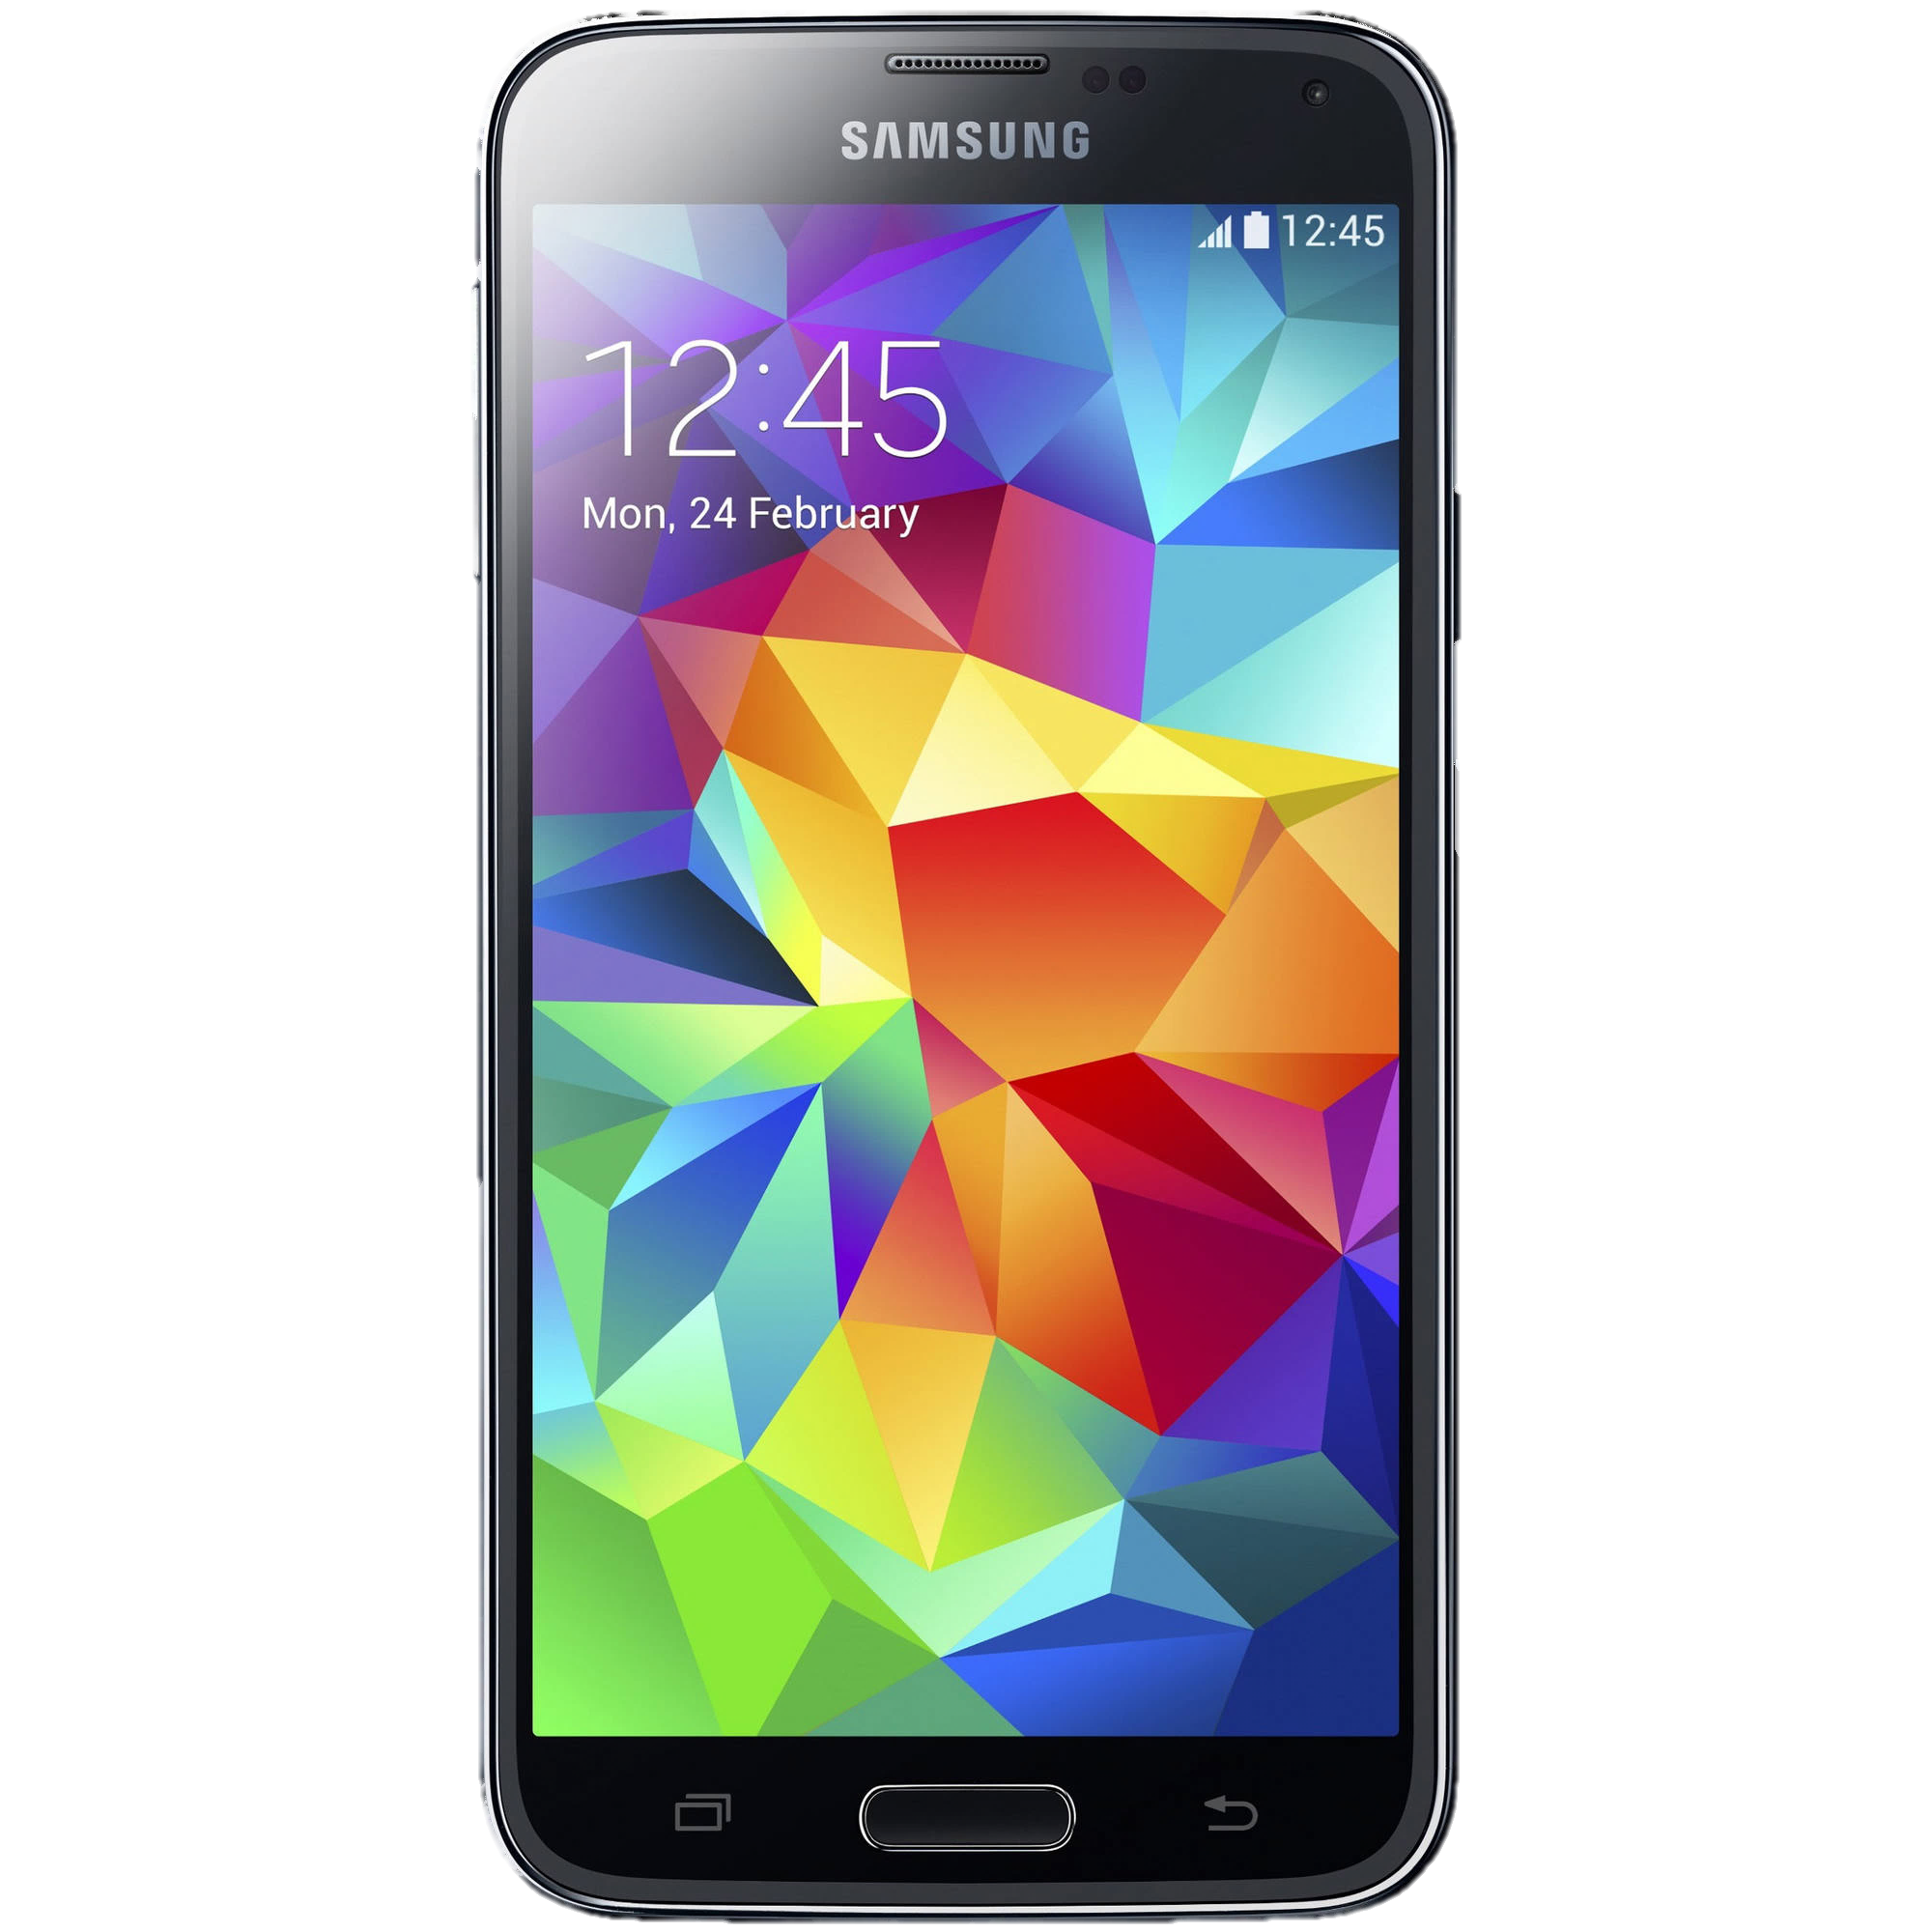

EasyEats
By: Tejas Bhoir, Elizabeth Caronia, Mithulesh Kurale, Brett Lechner, Raj Patel, Kristen Wong, Prithvi Venkateswaran

Slide 2
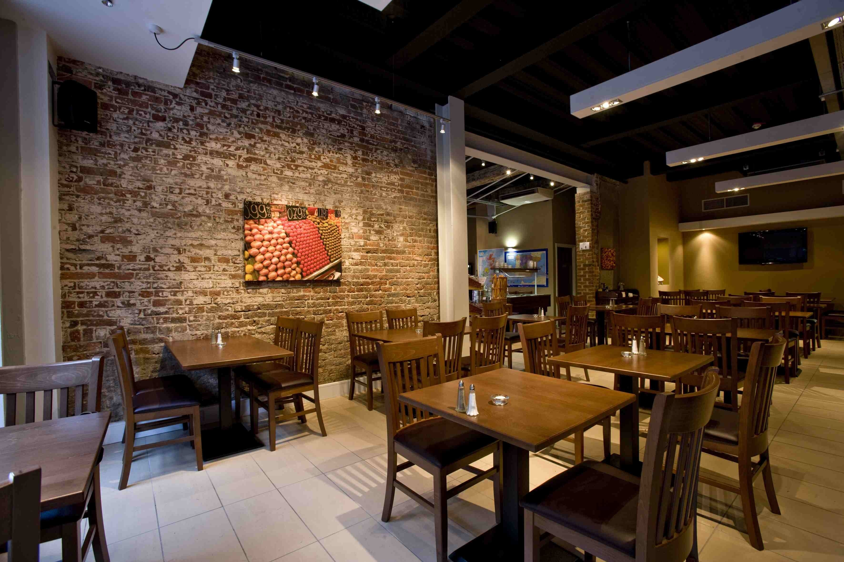
Problems
Efficiency
Table seating
Food
Creation
Delivery
Ordering
Menu correction
Responsiveness to customers
Ordering
Paying
Reviews

Slide 3
Unique
Our perspective is:
What we have finished => transition to next slide

Slide 4
Technical challenges
Lack of direction
Lack of time to fully dedicate
Asynchronous development
MEAN vs Java vs javascript vs php + sql +angularjs

Slide 5
Plan to continue
Managers:
Automate:
Stats/ profit page
Employee shifts
Login page => correct location
Server
Waitress
Customers
Notes:
For instance I have literally never once remembered what the house special is, and as a result I have never ordered one. If the chef can put his specials on the menu, customers will be able to devote as much attention to them, and be able to order them

