Slide 1

Enron Case
Group 15

Slide 2
Contents
Introduction
Case Background
Risk and red flags
Objectives
Data source
Fraud Detection
Exploratory data analysis
Data pre-processing
Model training
Non-data analytics consideration
Summary and Recommendations

Slide 3
Background

Slide 4
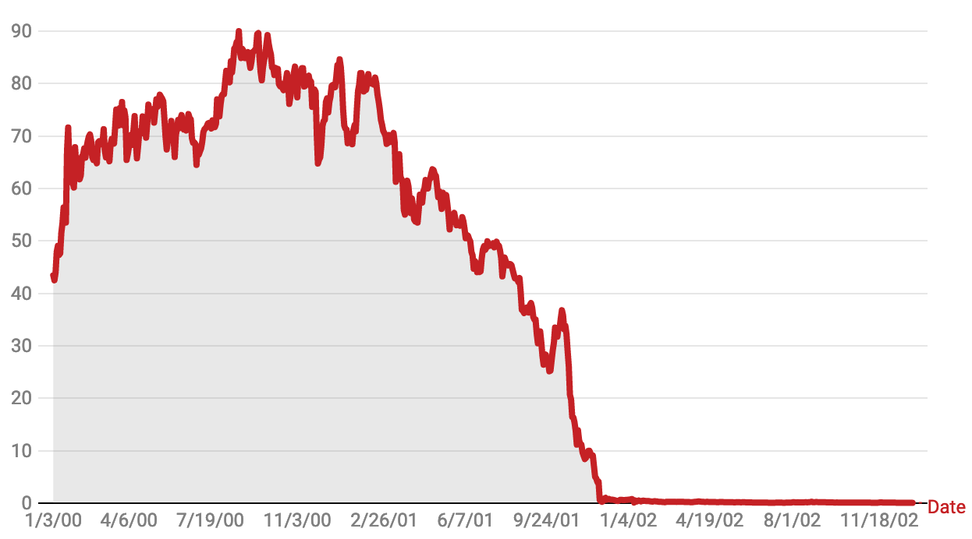
Background
Enron’s stakeholders
7th largest energy trading company in USA formed in 1985.
Enron’s self-interest managers make profits at the Corporation’s expenses without internal control.
Because of large-scale corporate fraud and corruption, they started losing money in 1997. Later, they filed bankruptcy in 2001.
During the year before bankruptcy, 144 senior Enron executives received $744 million in performance incentives while 24,000 retirement accounts lost $1 billion.
Key stakeholders:
Kenneth Lay (the Chairman and the CEO) approved a series of hedge contracts even through analysts questioned viability and market demand of their service in 2000.
Andrew Fastow (CFO) misled Enron’s board of directors and audit committee on high-risk accounting practices and pressured Arthur Andersen to ignore the issues.
Notes:
· What are the risks and red flags of the case, with the objective to prevent similar financial frauds in future?

Slide 5

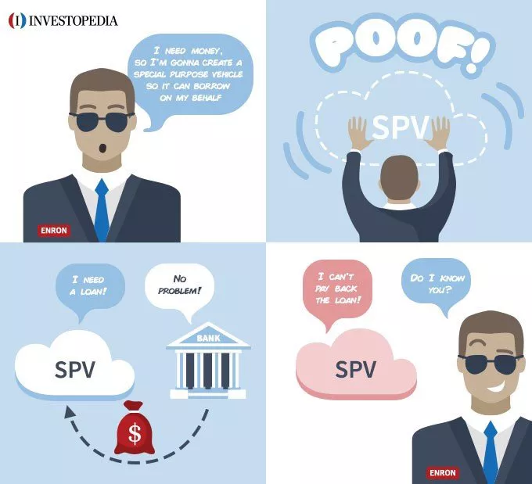
Background
Enron’s red flags
Key red flags:
Was using off-balance-sheet special purpose vehicles (SPVs), also known as special purposes entities (SPEs), to hide its mountains of debt and toxic assets from investors and creditors.
Adopted MTM (mark-to-market) accounting technique for earnings management, that overestimate future unrealized profits, or to hide or understate future unrealized losses from soured contracts.
Corporate culture problems and lack of internal control.
Enron employees were encouraged to push behavior and financial reporting to ethical and professional limit.
Management was uncomfortable with criticism.
Skilling called a financial analyst a donkey-related term when questioned about Enron's performance.
Notes:
· What are the risks and red flags of the case, with the objective to prevent similar financial frauds in future?

Slide 6

Objectives to prevent similar financial fraud in the future
Develop machine learning models for potential person of interest (POIs) identification to detect fraud from all internal communication channels (fraud classification from text):
Increase the possibility of data acquisition for the entire organization and implement real-time analysis process to automatically detect possible financial fraud
Avoid relying on senior management
Ensure security control, significantly avoid heavy manual work, and reduce the workload of the audit team
Discover and use hidden information and detect potential POIs for social network analysis

Slide 7
Exploratory Data Analysis

Slide 8

EDA Enron dataset - POI
Original dataset: Latest version was released by CMU in 2015, containing over 600,000 emails from 158 employees of the Enron corporation.
For simplicity, we picked an open source person of interest (POI) dataset, which has been combined with the email dataset, to help develop fraud detection models.
POI dataset: Contained 145 records consisting of 14 financial attributes, 7 email attributes and a class label (POI).
The dataset contains information that is common among many companies, which may be useful to identify person of interests in similar situations.
Data source: https://github.com/missmariss31/enron/blob/master/enron.csv

Slide 9
Attribute types
Financial attributes (in US dollar) | “salary” “deferred_payments” “total_payments” “loan_advances” “bonus” “resticted_stock_deferred” “deferred_income” “total_stock_value” “expenses” “exercised_stock_options” “other” “long_term_incentive” “restricted_stock” “director_fees”
Email attributes (in # of messages, except email_address) | “to_messages” “from_messages” “email_address” “from_this_person_to_poi” “from_poi_to_this_person” “shared_receipt_with_poi” “employee”
Class label (True = is POI) | “poi”

Slide 10

# of missing data
Many missing values!
name | 0 | total_stock_value | 20 | bonus | 64 | poi | 0
salary | 51 | expenses | 51 | restricted_stock | 36 | director_fees | 129
to_messages | 59 | loan_advances | 142 | shared_receipt_with_poi | 59 | deferred_income | 97
deferral_payments | 107 | from_messages | 59 | restricted_stock_deferred | 128 | long_term_incentive | 80
total_payments | 21 | other | 53 | email_address | 0 | from_poi_to_this_person | 59
exercised_stock_options | 44 | from_this_person_to_poi | 59 | Total number of missing data | 1318 | Proportion of missing data | 41.3%

Slide 11
POIs
Most of them are senior management!
12.3% of persons are POI.
HANNON KEVIN P | Chief operating officer | DELAINEY DAVID W | Chief Executive Officer | CALGER CHRISTOPHER F | Vice president
COLWELL WESLEY | Chief Accounting Officer | LAY KENNETH L | CEO | RICE KENNETH D | Co-CEO
RIEKER PAULA H | Managing Director | BOWEN JR RAYMOND M | Chief Financial Officer | SKILLING JEFFREY K | CEO
KOPPER MICHAEL J | Executive | BELDEN TIMOTHY N | Chief Financial Officer | YEAGER F SCOTT | Senior Vice-President
SHELBY REX | Senior Vice-President | FASTOW ANDREW S | Chief Financial Officer | HIRKO JOSEPH | Co-chief Executive Officer
KOENIG MARK E | Executive Vice-President | CAUSEY RICHARD A | Chief Accounting Officer | GLISAN JR BEN F | Treasurer

Slide 12

Insights Enron fraud case
Lots of missing data, requires imputation
Imbalanced dataset with only 145 records, not enough to produce good fraud detection model
Feature engineering is very important to get good performance
Can try different ML models to see how they perform, e.g. Naive Bayes, SVM, Random Forest, ANN.

Slide 13
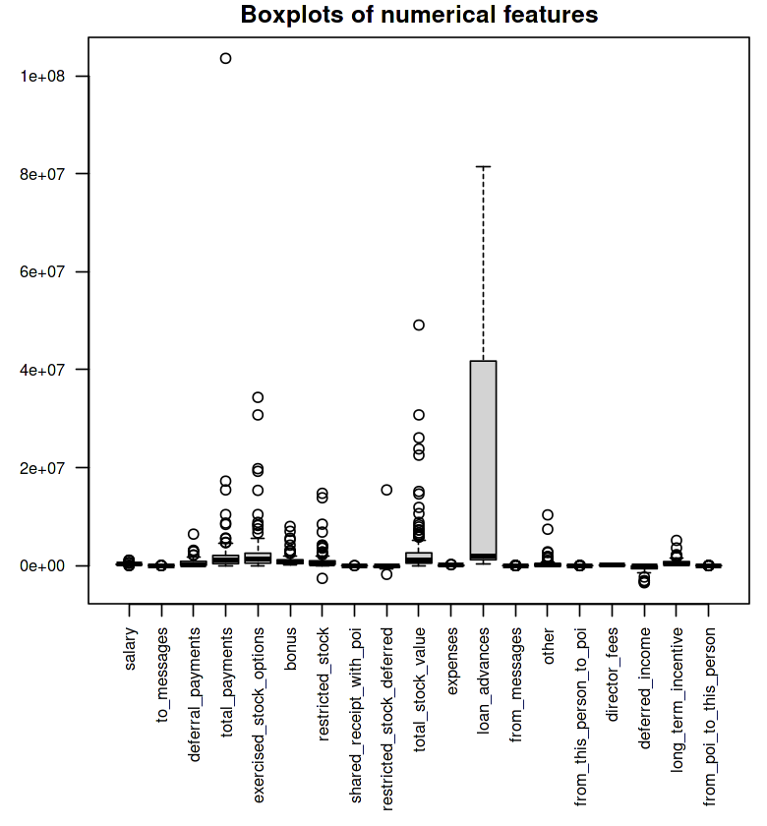
Outlier Analysis using boxplots
One “total_payments” record very far from other records
Is a POI record and so was kept

Slide 14
Data Pre-processing

Slide 15

Data pre-processing
Removed 2 records:
“Travel agency in the park” which is considered irrelevant
“Lockhart Eugene E” which has over 17 missing values
Removed 5 features: “name”, “email address”, “restricted stock deferred”, “loan advances”, “director fees”
“name” and “email address” not useful in general financial data
Over 85% missing values for the other 3 features
Stratified random split: 70-30 training/test split
Maintain similar class distribution between training and test sets
Performed mean imputation using “MICE” package
Training set imputed using mean imputation
Test set imputed using same imputation parameters as training set

Slide 16
Data standardization
For artificial neural network and support vector machine, standardization is used
Standardization applied to both imputed training and test sets
Test set standardized using same standardization parameters as training set
Allows model assumptions to also hold on test sets

Slide 17
Model-training

Slide 18

Machine learning methods
6 machine learning methods used:
Decision tree
Artificial neural networks
Support vector machine
Naive Bayes classifier
Random forest
AdaBoost

Slide 19
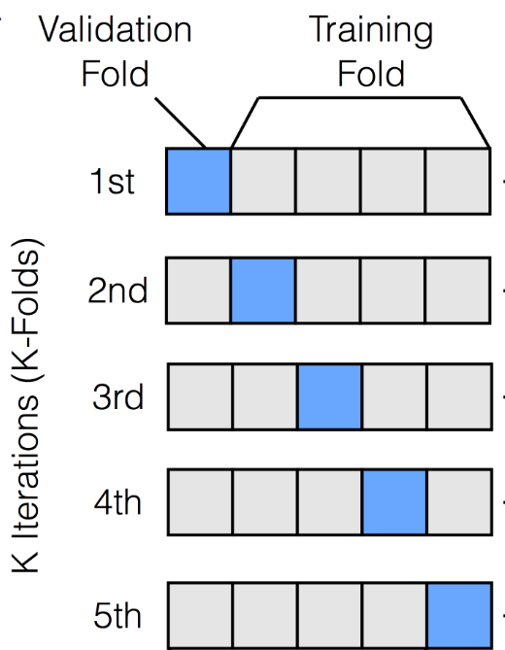
5-fold cross validation with data balancing
For each method, 5-fold cross validation was performed on imputed training set
For every cross-validation iteration, ROSE/SMOTE was applied to the training folds
Optimal model of the 5 iterations was chosen using largest Area Under ROC curve as performance metric
Optimal model applied to imputed test set
Confusion matrix made
Recall and precision computed
12 models made in total: 6 classification methods with 2 different resampling techniques each

Slide 20

Results
ROSE
SMOTE
 | Accuracy | Precision | Recall
Decision Tree | 0.881 | NA | 0
ANN | 0.857 | 0.333 | 0.2
SVM | 0.762 | 0.222 | 0.4
Naive Bayes | 0.857 | 0 | 0
Random Forest | 0.857 | 0 | 0
Adaboost | 0.881 | NA | 0
 | Accuracy | Precision | Recall
Decision Tree | 0.714 | 0.182 | 0.4
ANN | 0.857 | 0.333 | 0.2
SVM | 0.714 | 0.111 | 0.2
Naive Bayes | 0.833 | 0 | 0
Random Forest | 0.857 | 0.4 | 0.4
Adaboost | 0.857 | 0.4 | 0.4

Slide 21
Results
ROSE
SMOTE
 | Accuracy | Precision | Recall
SVM | 0.762 | 0.222 | 0.4
 | Accuracy | Precision | Recall
Decision Tree | 0.714 | 0.182 | 0.4
Random Forest | 0.857 | 0.4 | 0.4
Adaboost | 0.857 | 0.4 | 0.4
Tie breaker 1: Precision

Slide 22
Results
SMOTE
 | Accuracy | Precision | Recall | Time
Random Forest | 0.857 | 0.4 | 0.4 | 1.36s
Adaboost | 0.857 | 0.4 | 0.4 | 20.99s
Tie breaker 2: Training time
Best Model: Random Forest using SMOTE

Slide 23
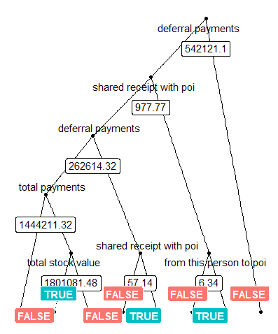
Random Forest using SMOTE
mtry = log(N)+1 = 5, ntree = 500
 | Reference
Prediction | False | True
False | 34 | 3
True | 3 | 2

Slide 24
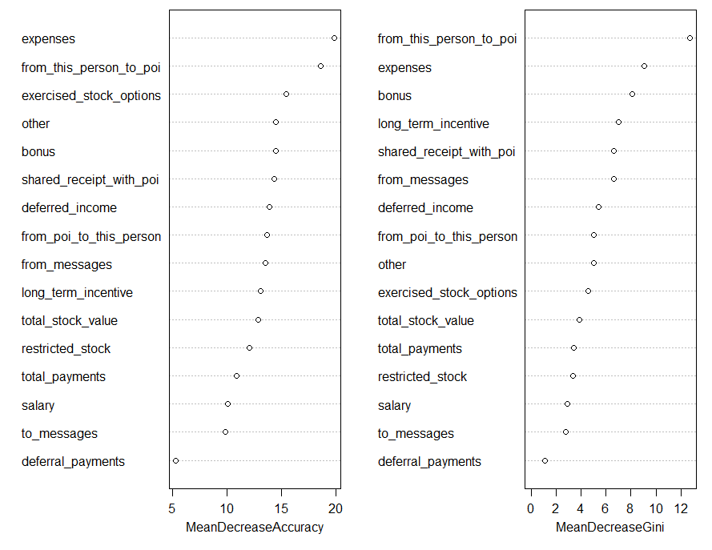
Random Forest using SMOTE
Variable Importance
Top 2
expenses
from_this_person_to_poi
Bottom 3
salary
to_messages
defferal_payments

Slide 25

Non-data analytics elements
Poor corporate governance and internal control
CFO exempted from a conflicts of interest policy
Off balance sheet debt (“Hidden liabilities”) ignored although the obligation remained
Contingent liabilities not disclosed
Internal audit function outsourced to Arthur Andersen (as Enron’s external auditor at the same time).
Notes:
· What are the other non-data analytic elements that should be considered (e.g. corporate governance and controls)?
Auditors assess the internal controls of a client to determine the extent to which they can rely on a client’s accounting system. Enron had too many internal control weaknesses to be given here. Two serious weaknesses were that the CFO was exempted from a conflicts of interest policy, and internal controls over SPEs were a sham, existing in form but not in substance. Many financial officials lacked the background for their jobs, and assets, notably foreign assets, were not physically secured. The tracking of daily cash was lax, debt maturities were not scheduled, off balance sheet debt was ignored although the obligation remained, and company-wide risk was disregarded. Internal controls were inadequate; contingent liabilities were not disclosed; and, Andersen ignored all of these weaknesses.
It is no wonder revenue grew that way they did, especially since incentive plans were based on the hypothetical total net present value of the deal, not the actual cash flow that would result from the deal.. (103)

Slide 26

Suggestions for Prevention
Strengthening board oversight
prohibit accounting practices and transactions that put the company at high risk of non-compliance with generally accepted accounting principles and result in misleading and inaccurate financial statements
prohibit off-the-books activity used to make the company's financial condition appear better than it is, and require full public disclosure of all assets, liabilities and activities that materially affect the company's financial condition
Strengthening directors and auditors Independence
strengthen requirements for director independence at publicly traded companies, including by requiring a majority of the outside directors to be free of material financial ties to the company other than through director compensation
strengthen requirements for auditor independence, including by prohibiting the company's outside auditor from simultaneously providing the company with internal auditing or consulting services and from auditing its own work for the company.
Avoiding perverse financial incentives for executives
Instilling ethical discipline throughout business organization
Set up internal audit and risk control to monitor and ensure integrity of corporate governance
Notes:
Do your team have any suggestions on how to prevent similar financial fraud in future?
https://www.govinfo.gov/content/pkg/CPRT-107SPRT80393/html/CPRT-107SPRT80393.htm
With respect to avoiding the perverse financial incentives that corrupted Enron, my book makes specific recommendations for designing executive pay in public companies, including the effective use of stock-based compensation and comparative performance measures, and the need to balance turbocharged incentives with turbocharged controls.

Slide 27
Thank you

