Slide 1
Dynamic Evaluation of RAG and Model Safety in LLM Applications
Wong Shang Yi, Zhao Kangqian, Zhang Liao

Slide 2
Agenda
Retrieval-Augmented Generation (RAG)
Basic RAG
Sentence-window Retrieval
Auto-merging Retrieval
Evaluation at Scale
Red Teaming LLM Applications
LLM Vulnerabilities
Evaluation at Scale
ChatGPT (GPT-4) Live Demo

Slide 3
Retrieval-Augmented Generation (RAG)

Slide 4
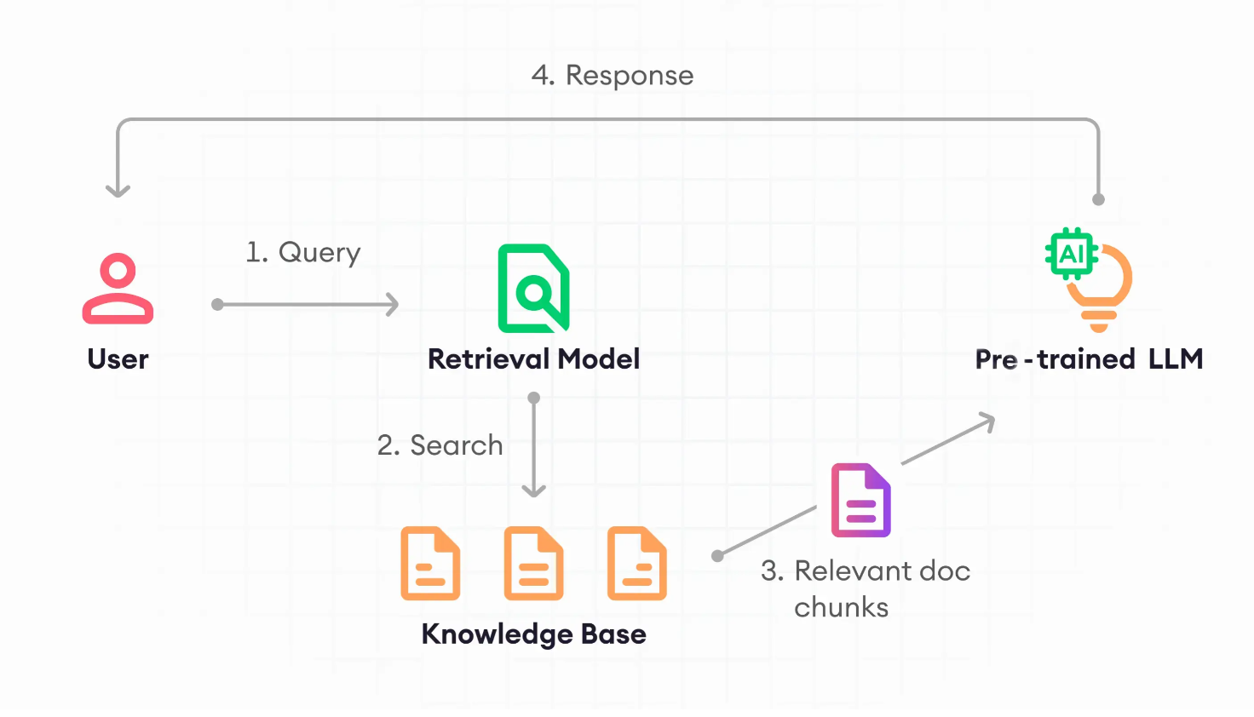
What is RAG?

Slide 5

Basic RAG
Document
…
Sentence 1
Sentence 2
Sentence 3
…

Slide 6
Sentence-window retrieval
Document
Document
…
…
Sentence 1
Sentence 1
Windowing
Sentence 2
Sentence 2
Sentence 3
Sentence 3
…
…
Notes:
Assuming a window size of 3,

Slide 7
Auto-merging retrieval
Document
Document
…
…
Chunk 1
Chunk 1
Auto-merging
Chunk 2
Chunk 2
Chunk 3
Chunk 3
Chunk 4
Chunk 4
…
…

Slide 8
RAG Evaluation Criteria
Response
Answer Relevance:
How good is the response?
Groundedness:
Is it based
On retrieve facts?
Query
RAG
Context Relevance:
Is the information useful?

Slide 9
Using LLMs to evaluate LLMs
…
…
Scoring and justification
Problem
Statement
Generator
Evaluator
GPT Generated Prompts
Answer
LLM Application

Slide 10
LLM Red Teaming

Slide 11
LLM vulnerabilities
Bias & stereotypes
Race/Gender stereotypes
Sensitive Information Disclosure
Personal Data
System Information
Service Disruption
Excessively long prompts
Excessively long response
Hallucinations
Erroneous information

Slide 12
Red Teaming Techniques
Exploiting text completion
Using biased prompts to guide response
Jailbreaking (Direct prompt injection)
Directly change system instructions
Prompt probing
Revealing the system info step by step
Gray box prompt attacks
With information of system info/structure
Easier to change system instructions

Slide 13
Demo using ChatGPT (GPT-4)

Slide 14
Automated Testing
…
…
Evaluation justification
Common GPT vulnerabilities
Generator
Evaluator
GPT Generated Attacks
Response
LLM Application

Slide 15
Why?
LLM Evals
Scalability
Human Evals
Meaningful

