Slide 1
Forum Based Website Development Project
Forum Q&A

Slide 2



OUR TEAM MEMBERS
SWE1902121
Wong Zhi Xuan
SWE1902116
Koh Li Shien
SWE1902119
Puah Jia Hong

Slide 3
01
Introduction

Slide 4
Introduction to Our Project
Background
What We Do
Some existing forums have frustrating functionalities and boring UI
Enhance UI design – HCI usability design principles
Improve functionalities- review and redesign
Objective
What We Use
Eclipse IDE
HTML, CSS, JavaScript
Bootstrap framework
Jave EE
JDBC, DAO pattern
MySQL database system
Develop a online forum platform for university students with better usability and UI design

Slide 5
02
Architecture

Slide 6
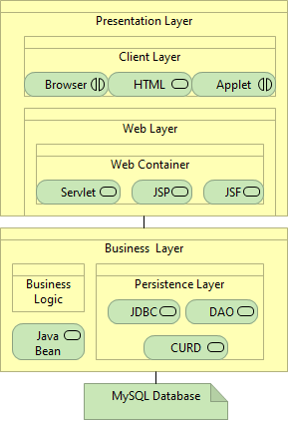
Architecture
Presentation Layer: Client Layer (Browser, HTML, Applet), Web Layer (Servlet, JSP, JSF)
Business Layer: Business Logic, Java Bean, Persistence Layer (JDBC, DAO, CRUD)
MySQL Database

Slide 7
03
Case Study

Slide 8
Functionality
Login
Log Out
Login
Register
Change Theme
Log Out
Manage Profile
USER
ADMIN
Reply Post
Manage Post
Search Keyword
Create Post
Manage User

Slide 9
04
Demonstration

Slide 10
05
Conclusion

Slide 11

Future Improvements
Email Verification
Send email Verification Code to verify user’s identity
Forget Password Feature
User can reset their password after verifying their identity
Advanced Search Algorithm
Improve search efficiency and feature
Member Level
Motivate user to use the system

Slide 12
THANKS!

