Slide 1




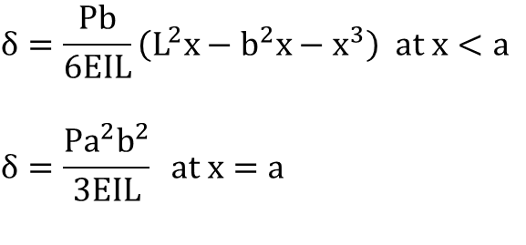



$$P$$
$$a$$
$$b$$
$$x$$
$$δ=\frac{Pb}{6EIL}\left(L^{2}x−b^{2}x−x^{3}\right) at x<a$$
$$δ=\frac{{Pa}^{2}b^{2}}{3EIL} at x=a$$
$$w$$
$$x$$
$$δ=\frac{w}{24EI}(L^{3}x−2Lx^{4}−x^{4})$$

Slide 2



















시계방향
시계방향
$$θ$$
2$θ$
$$σ_{x}$$
$$σ_{x}^{′}$$
$$θ$$
$$τ_{xy}$$
$$σ_{x}^{′}$$
$$σ_{x}$$
$$σ_{y}$$
$$σ_{y}$$
$$σ_{y}$$
$$σ_{1}$$
$$σ$$
$$σ_{2}$$
$$τ_{xy}$$
$$2θ$$
$$τ_{xy}$$
$$σ_{x}$$
+ 응력 방향
$$τ$$

Slide 3


$$d_{o}$$
$$d_{i}$$

