Slide 1
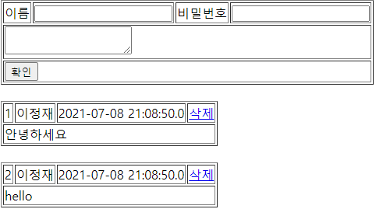
리스트
Handler Mapping
”/guestbook3/list” get post → guestbookController.list()
http://localhost:8088/guestbook3/list
Tomcat
guestbook3
web.xml
spring-servlet.xml
Rquest
[파라미터]
[어트리뷰트]
"guestList", guestList
Handler Mapping
2
/list
GuestbookController
3
GuestbookDao
사
용
자
1
Front Controller
DispatcherServlet
Controller
getguestList()
4
ModelAndView
Response
포워드
List<GuestbookVo>
list
6
5
View
View Resolver
7
DB
View
Return "list.jsp"

Slide 2
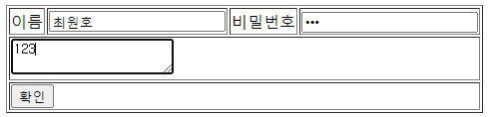
등록
Handler Mapping
”/guestbook3/add” get post → guestbookController.add()
Tomcat
guestbook3
http://localhost:8088/guestbook3/add
Name=최원호
Password=123
Content=123
web.xml
spring-servlet.xml
Rquest
[파라미터]
Name=최원호
Password=123
Content=123
[어트리뷰트]
Handler Mapping
2
/add
GuestbookController
3
GuestbookDao
사
용
자
1
Front Controller
DispatcherServlet
Controller
guestInsert
(guestVo)
4
ModelAndView
Response
리다이렉트
6
5
View
View Resolver
7
DB
View
Return "redirect:/list"

Slide 3
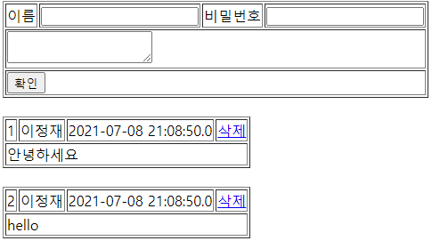
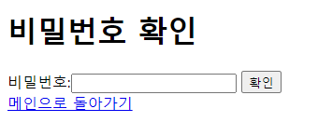
삭제폼
Handler Mapping
”/guestbook3/deleteForm” get post → guestbookController.deleteForm()
http://localhost:8088/guestbook3/deleteForm?no=값
Tomcat
guestbook3
web.xml
spring-servlet.xml
Rquest
[파라미터
No=값
[어트리뷰트]
Handler Mapping
2
/deleteForm
GuestbookController
사
용
자
1
Front Controller
DispatcherServlet
3
Controller
4
ModelAndView
Response
포워드
6
5
View
View Resolver
7
View
Return "deleteForm.jsp"

Slide 4
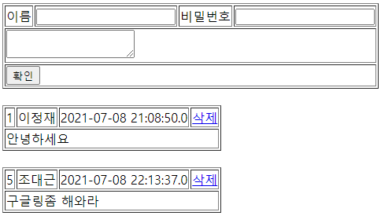
삭제
http://localhost:8088/guestbook3/delete
no=값
Password=값
Handler Mapping
”/guestbook3/delete” get post → guestbookController.delete()
Tomcat
guestbook3
web.xml
spring-servlet.xml
Rquest
[파라미터]
No=값
Password=값
[어트리뷰트]
Handler Mapping
2
빈화면
리다이렉트 list
/delete
GuestbookController
3
GuestbookDao
사
용
자
1
Front Controller
DispatcherServlet
Controller
guestDelete
(guestVo)
4
ModelAndView
Response
리다이렉트
6
5
View
View Resolver
7
DB
View
Return "redirect:/list"

