Slide 1
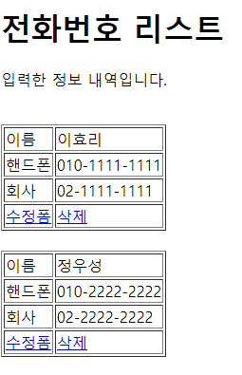
리스트
Handler Mapping
”/phonebook3/list” get post → phoneController.list()
http://localhost:8088/phonebook3/list
Tomcat
phonebook3
web.xml
spring-servlet.xml
Rquest
[파라미터]
[어트리뷰트]
"personList", personList
Handler Mapping
2
/list
PhoneController
3
PhoneDao
사
용
자
1
Front Controller
DispatcherServlet
Controller
getPersonList()
4
ModelAndView
Response
포워드
List<PersonVo>
list
6
5
View
View Resolver
7
DB
View
Return "list.jsp"

Slide 2
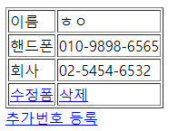
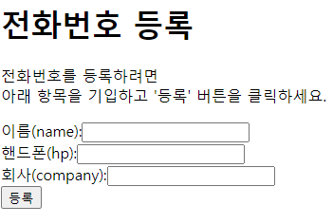
쓰기폼
http://localhost:8088/phonebook3/writeForm
Handler Mapping
”/guestbook3/writeForm” get post → PhoneController.writeForm()
Tomcat
guestbook3
web.xml
spring-servlet.xml
Rquest
[파라미터]
[어트리뷰트]
Handler Mapping
2
/writeForm
phoneController
사
용
자
1
Front Controller
DispatcherServlet
3
Controller
4
ModelAndView
Response
포워드
6
5
View
View Resolver
7
View
Return "writeForm"

Slide 3
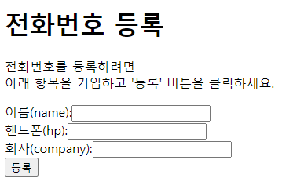
쓰기
Handler Mapping
”/phonebook3/write” get post → PhoneController.write()
http://localhost:8088/phonebook3/write
Name=최원호
hp=123
company=123
Tomcat
phonebook3
web.xml
spring-servlet.xml
Rquest
[파라미터]
Name=최원호
hp=123
company=123
[어트리뷰트]
Handler Mapping
2
/writeForm
PhoneController
3
PhoneDao
사
용
자
1
Front Controller
DispatcherServlet
Controller
personInsert
(PersonVo)
4
ModelAndView
Response
리다이렉트 list
6
5
View
View Resolver
7
DB
View
Return "redirect:/list"

Slide 4
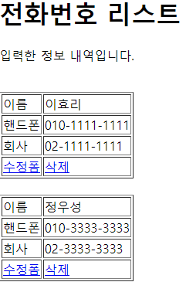
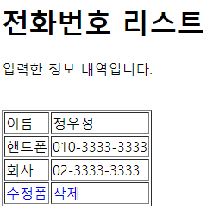
삭제
Handler Mapping
”/guestbook3/delete” get post → PhoneController.delete()
http://localhost:8088/phonebook3/delete
personId=1
Tomcat
guestbook3
web.xml
spring-servlet.xml
Rquest
[파라미터
personId=1
[어트리뷰트]
Handler Mapping
2
/update
PhoneController
3
PhoneDao
사
용
자
1
Front Controller
DispatcherServlet
Controller
personDelete
(personId)
4
ModelAndView
Response
리다이렉트
6
5
View
View Resolver
7
DB
View
Return "redirect:/list"

Slide 5
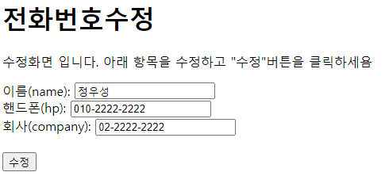
수정폼
Handler Mapping
”/guestbook3/updateForm” get post → PhoneController.updateForm()
http://localhost:8088/phonebook3/updateForm?
personId=2
Tomcat
guestbook3
web.xml
spring-servlet.xml
Rquest
[파라미터
personId=2
[어트리뷰트]
Handler Mapping
2
/updateForm
PhoneController
3
PhoneDao
사
용
자
1
Front Controller
DispatcherServlet
Controller
getPerson
(personId)
4
ModelAndView
Response
포워드
6
5
View
View Resolver
7
DB
View
Return "updateForm.jsp"

Slide 6
수정
Handler Mapping
”/guestbook3/update” get post → PhoneController.update()
http://localhost:8088/phonebook3/update
personId=2
name=정우성&
hp=010-2222-2222&
company=02-2222-2222
Tomcat
guestbook3
web.xml
spring-servlet.xml
Rquest
[파라미터
personId=2
name=정우성&
hp=010-2222-2222&
company=02-2222-2222
[어트리뷰트]
Handler Mapping
2
/update
PhoneController
3
PhoneDao
사
용
자
1
Front Controller
DispatcherServlet
Controller
personUpdate
(personVo)
4
ModelAndView
Response
리다이렉트
6
5
View
View Resolver
7
DB
View
Return "redirect:/list"

