Slide 1
NVIDIA (NVDA)
Quarterly Financial Report | FY2024 - FY2025
Income Statement / Revenue & Profit Analysis / Margins & EPS Trend
Data Source: stockanalysis.com | Generated by Python

Slide 2
Q4 FY2025 Key Metrics
Revenue
Net Income
EPS
$39,331M
$22,091M
$8.87
+12.1% QoQ
+14.4% QoQ
+14.3% QoQ
Gross Margin
Operating Margin
YoY Revenue Growth
77.9%
66.2%
+78%
vs 78.3% prev
vs 66.3% prev
vs Q4 FY2024

Slide 3
Income Statement (Quarterly)
Metric ($ millions) | Q1 2024 | Q2 2024 | Q3 2024 | Q4 2024 | Q1 2025 | Q2 2025 | Q3 2025 | Q4 2025
Revenue | $7,192 | $13,507 | $18,120 | $22,103 | $26,044 | $30,040 | $35,082 | $39,331
Cost of Revenue | $2,544 | $4,045 | $4,720 | $5,312 | $5,638 | $6,599 | $7,606 | $8,695
Gross Profit | $4,648 | $9,462 | $13,400 | $16,791 | $20,406 | $23,441 | $27,476 | $30,636
Operating Income | $2,662 | $6,800 | $10,417 | $13,615 | $16,909 | $19,521 | $23,276 | $26,033
Net Income | $2,043 | $6,188 | $9,243 | $12,285 | $14,881 | $16,599 | $19,309 | $22,091
EPS ($) | $0.82 | $2.48 | $3.71 | $4.93 | $5.98 | $6.67 | $7.76 | $8.87

Slide 4
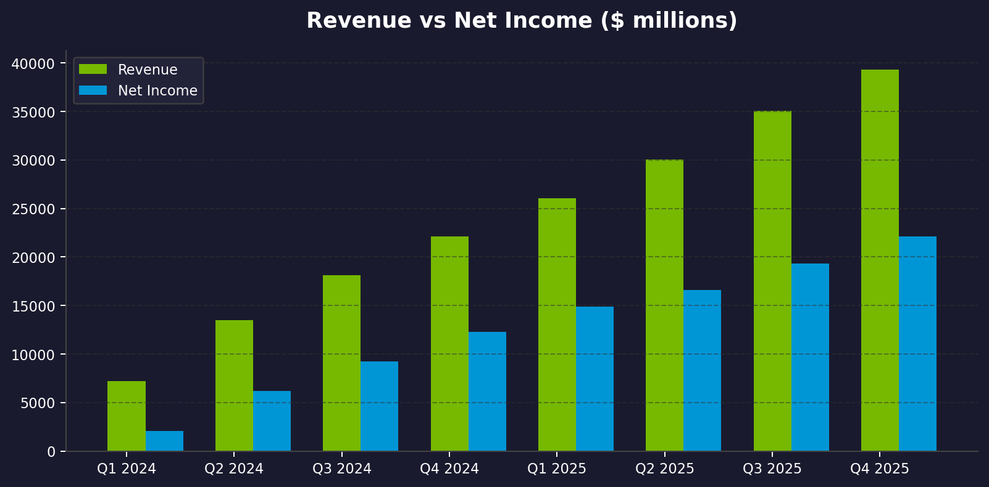
Revenue vs Net Income

Slide 5
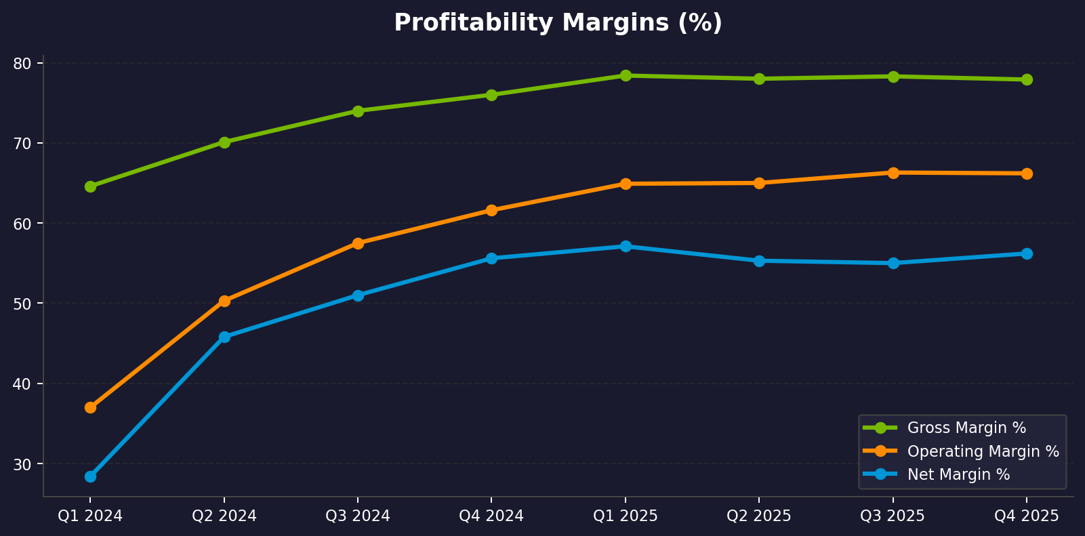
Profitability Margins Trend

Slide 6
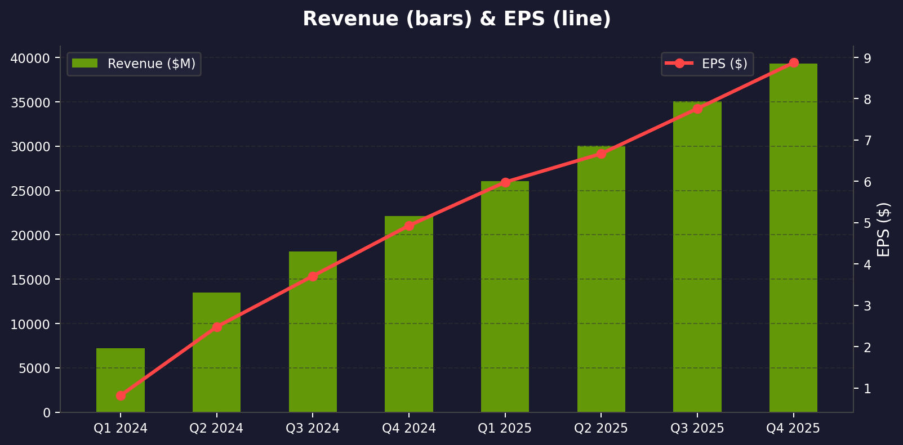
Revenue & EPS Growth

Slide 7
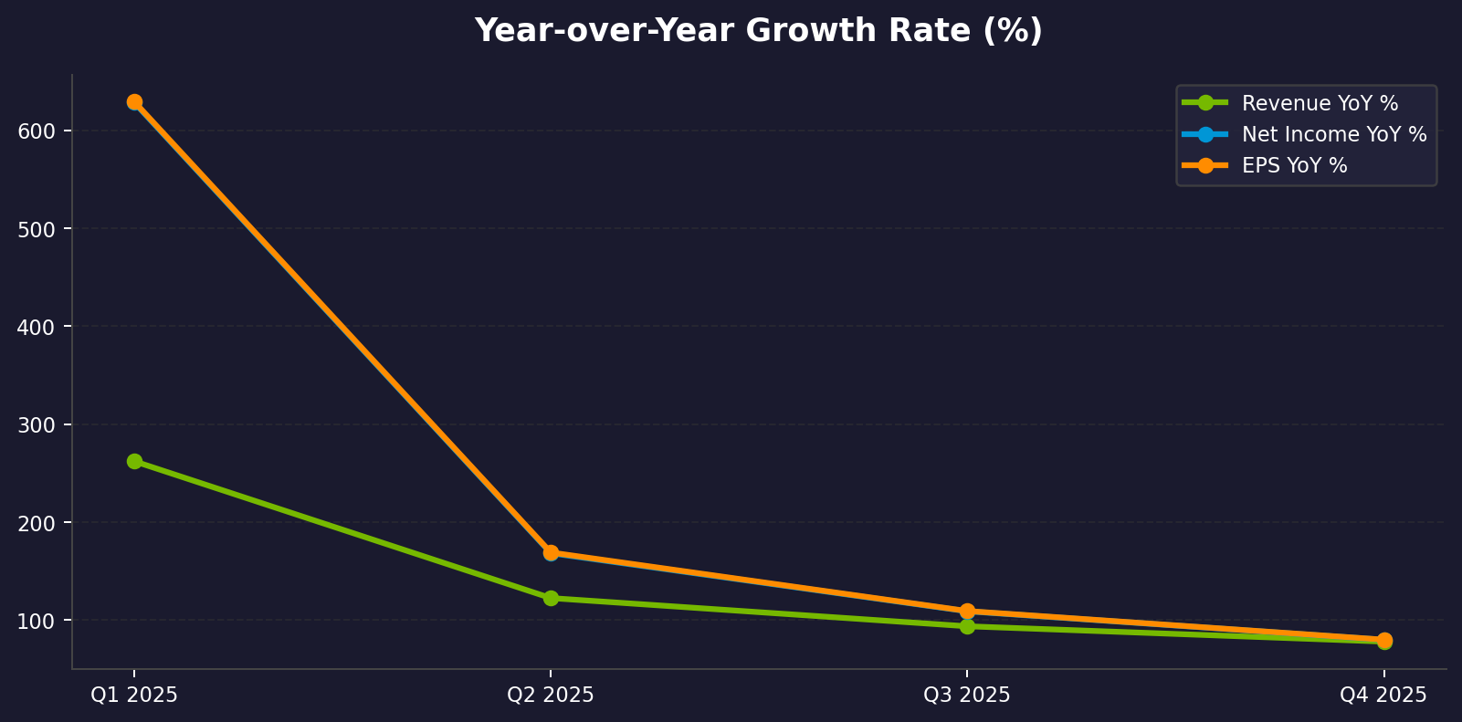
Year-over-Year Growth

Slide 8
NVIDIA Financial Summary
Q4 FY2025 Revenue: $39,331M | Net Income: $22,091M | EPS: $8.87 | YoY Revenue Growth: +78%
Source: stockanalysis.com | Generated with Python & python-pptx

