Slide 1
Procedure
Get MLEs for the nuisance parameters under H₀.
Calculate Score with MLE by 1) which can be formulated as follows,
Estimate variance of Score as follows,

Slide 2
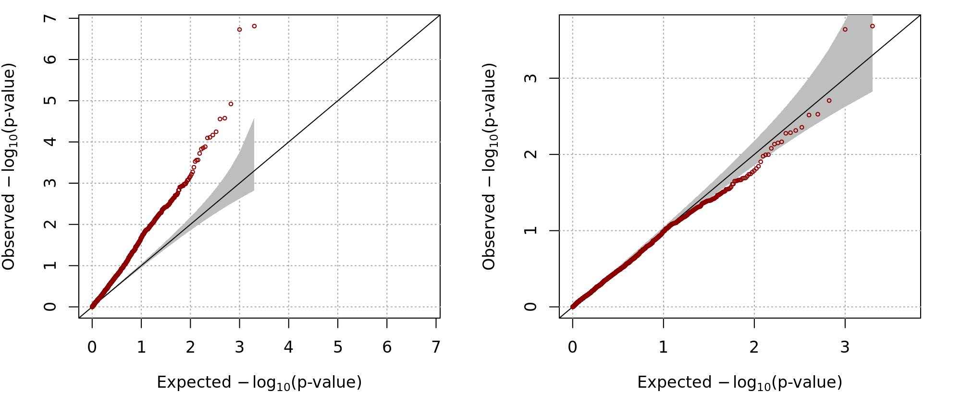
H₀:h²=0
Empirical Size (prev=0.1, h2=0), 2000 replicates
Prev | Alpha | Chisq*2 | Chisq
0.1 | 0.005 | 0.0385 | 0.0035
 | 0.01 | 0.0615 | 0.0065
 | 0.05 | 0.156 | 0.0425
 | 0.1 | 0.226 | 0.097

Slide 3
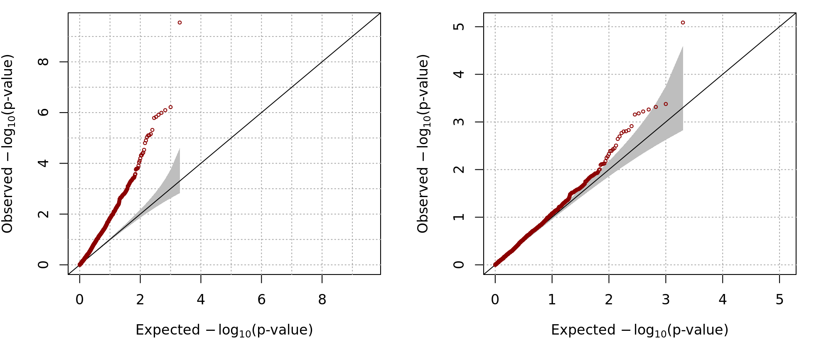
H₀:h²=0
Empirical Size (prev=0.2, h2=0), 2000 replicates
Prev | Alpha | Chisq*2 | Chisq
0.2 | 0.005 | 0.0585 | 0.01
 | 0.01 | 0.08 | 0.0145
 | 0.05 | 0.1815 | 0.0615
 | 0.1 | 0.274 | 0.1165

Slide 4
H₀:h²=0
Empirical power, 2000 replicates
Prevalence | h2 | Alpha | Chisq*2 | Chisq
0.1 | 0.2 | 0.005 | 0.5220 | 0.1405
 |  | 0.01 | 0.6025 | 0.2300
 |  | 0.05 | 0.7820 | 0.5340
 |  | 0.1 | 0.8555 | 0.6870
 | 0.4 | 0.005 | 0.981 | 0.831
 |  | 0.01 | 0.9875 | 0.902
 |  | 0.05 | 0.9945 | 0.9835
 |  | 0.1 | 0.9975 | 0.9915

Slide 5
H₀:h²=0
Empirical power, 2000 replicates
Prevalence | h2 | Alpha | Chisq*2 | Chisq
0.2 | 0.2 | 0.005 | 0.7835 | 0.4060
 |  | 0.01 | 0.8300 | 0.5245
 |  | 0.05 | 0.9285 | 0.7895
 |  | 0.1 | 0.9560 | 0.8780
 | 0.4 | 0.005 | 1.000 | 0.998
 |  | 0.01 | 1.000 | 1.000
 |  | 0.05 | 1.000 | 1.000
 |  | 0.1 | 1.000 | 1.000

