Slide 1
“Singleton Variants Dominate the Genetic Architecture of Human Gene Expression” and its application
Mar 7, 2019
Wonji Kim

Slide 2
Introduction
Recent explosive growth of human populations
Abundance of genetic variants with MAF < 1%
Role of rare variants
Mendelian diseases vs complex diseases
Improvement in imputation services
Imputation quality of rare variants
However, these studies excluded the rarest variants or included only well-imputed variants

Slide 3
Introduction
Goal
Development of an approach for inferring the relative phenotypic contributions of all variants, from singletons to high frequency
Application
Narrow-sense heritability of gene expression
Evaluation of robustness to
Genotyping errors
Read mapping errors
Population structure
Rare variant stratification
Wide range of possible genetic architecture

Slide 4
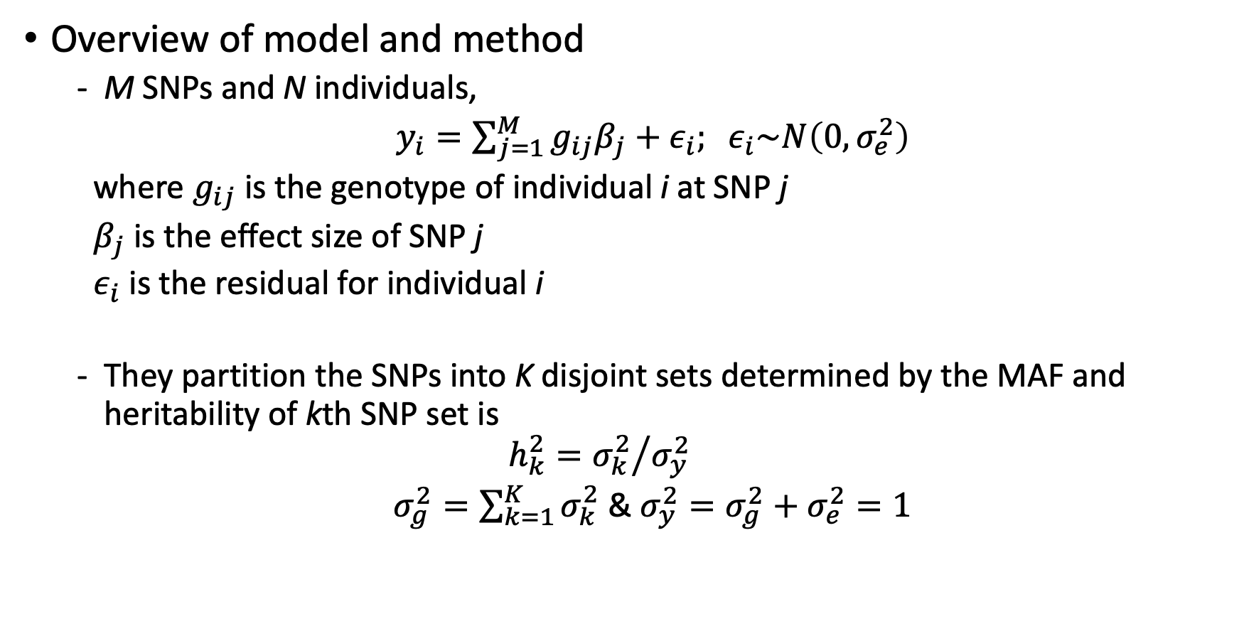
Partitioning heritability by MAF
Overview of model and method
M SNPs and N individuals,
$y_{i}=\sum_{j=1}^{M}{g_{ij}β_{j}}+ε_{i}; ε_{i}\sim N\left(0,σ_{e}^{2}\right)$
where $g_{ij}$ is the genotype of individual i at SNP j
$β_{j}$ is the effect size of SNP j
$ε_{i}$ is the residual for individual i
They partition the SNPs into K disjoint sets determined by the MAF and heritability of kth SNP set is
$$h_{k}^{2}={σ_{k}^{2}}/{σ_{y}^{2}}$$
$σ_{g}^{2}=\sum_{k=1}^{K}{σ_{k}^{2}}$ & $σ_{y}^{2}=σ_{g}^{2}+σ_{e}^{2}=1$

Slide 5
Partitioning heritability by MAF
Haseman-Elston (H-E) regression
The effect size for the kth
Notes:
HE regression is kind of a variance component analysis for quantitative traits, so it is usually used for estimating heritability. The premise of HE regression is that heritability can be estimated by the correlation between the phenotypic covariance across individuals and the genotypic covariance across individuals.
Quantile-normalized why?

